Slide 1

Wednesday 13 May 2026
Parallel Session I : Decarbonisation Update
International Working Group on Maritime Decarbonisation
Introduction to the work of the IWG and the present status of maritime decarbonisation,
Haris Zografakis, IWG Chair
Green Fuels: An international liability & compensation regime for alternative fuels – the IMO trajectory,
Jolien Kruit
Biofuels and the international liability conventions,
Neil Henderson
Liability & Compensation for Alternative Fuels : Identifying Legal Gaps and Lessons from Existing Regimes,
Hannah Mosmans
Greening Shipping Contracts: do we already have the kit?
Charles Debattista
Questions & Discussion

Slide 2
Maritime decarbonisation
Dead, alive or zombie?
CMI Rio
Wednesday 13 May 2026
Parallel Session I : Decarbonisation Update
Haris Zografakis
Chair of the IWG on Maritime Decarbonisation
Senior Consultant,
Stephenson Harwood LLP, London.

Slide 3
Introduction to the work of the iwg
Green Ships
  Comparative law perspectives of the contractual aspects of “readiness” and “dual fuel”.
Green Fuels
  Liability & compensation regime for non-hydrocarbon fuels
Green Contracts
  Comparative law perspectives as to contracts implementing or enabling decarbonisation

Slide 4
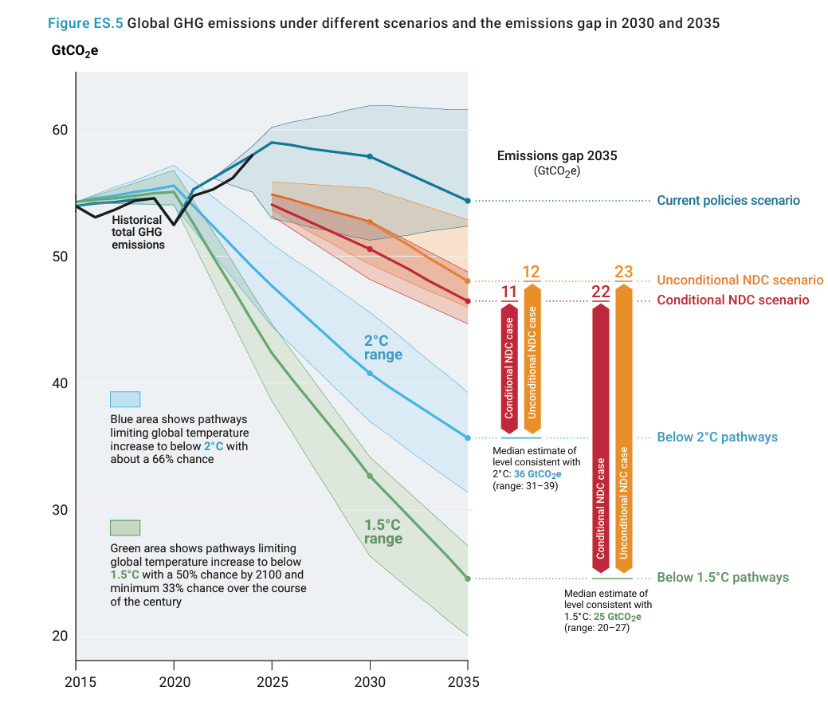

The CLIMATE

Slide 5
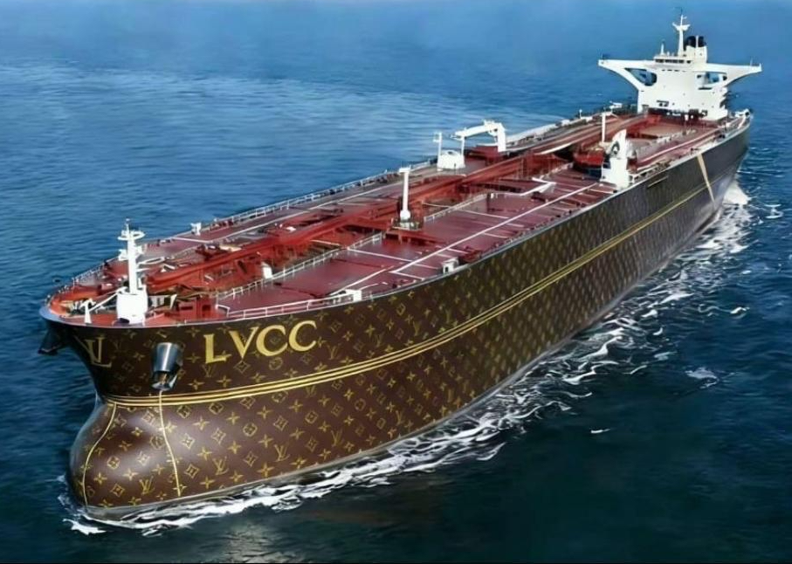
The decarbonisation paradox
Crude oil at US$100+ &
“Stranded Assets” making US$1m per day …

Slide 6
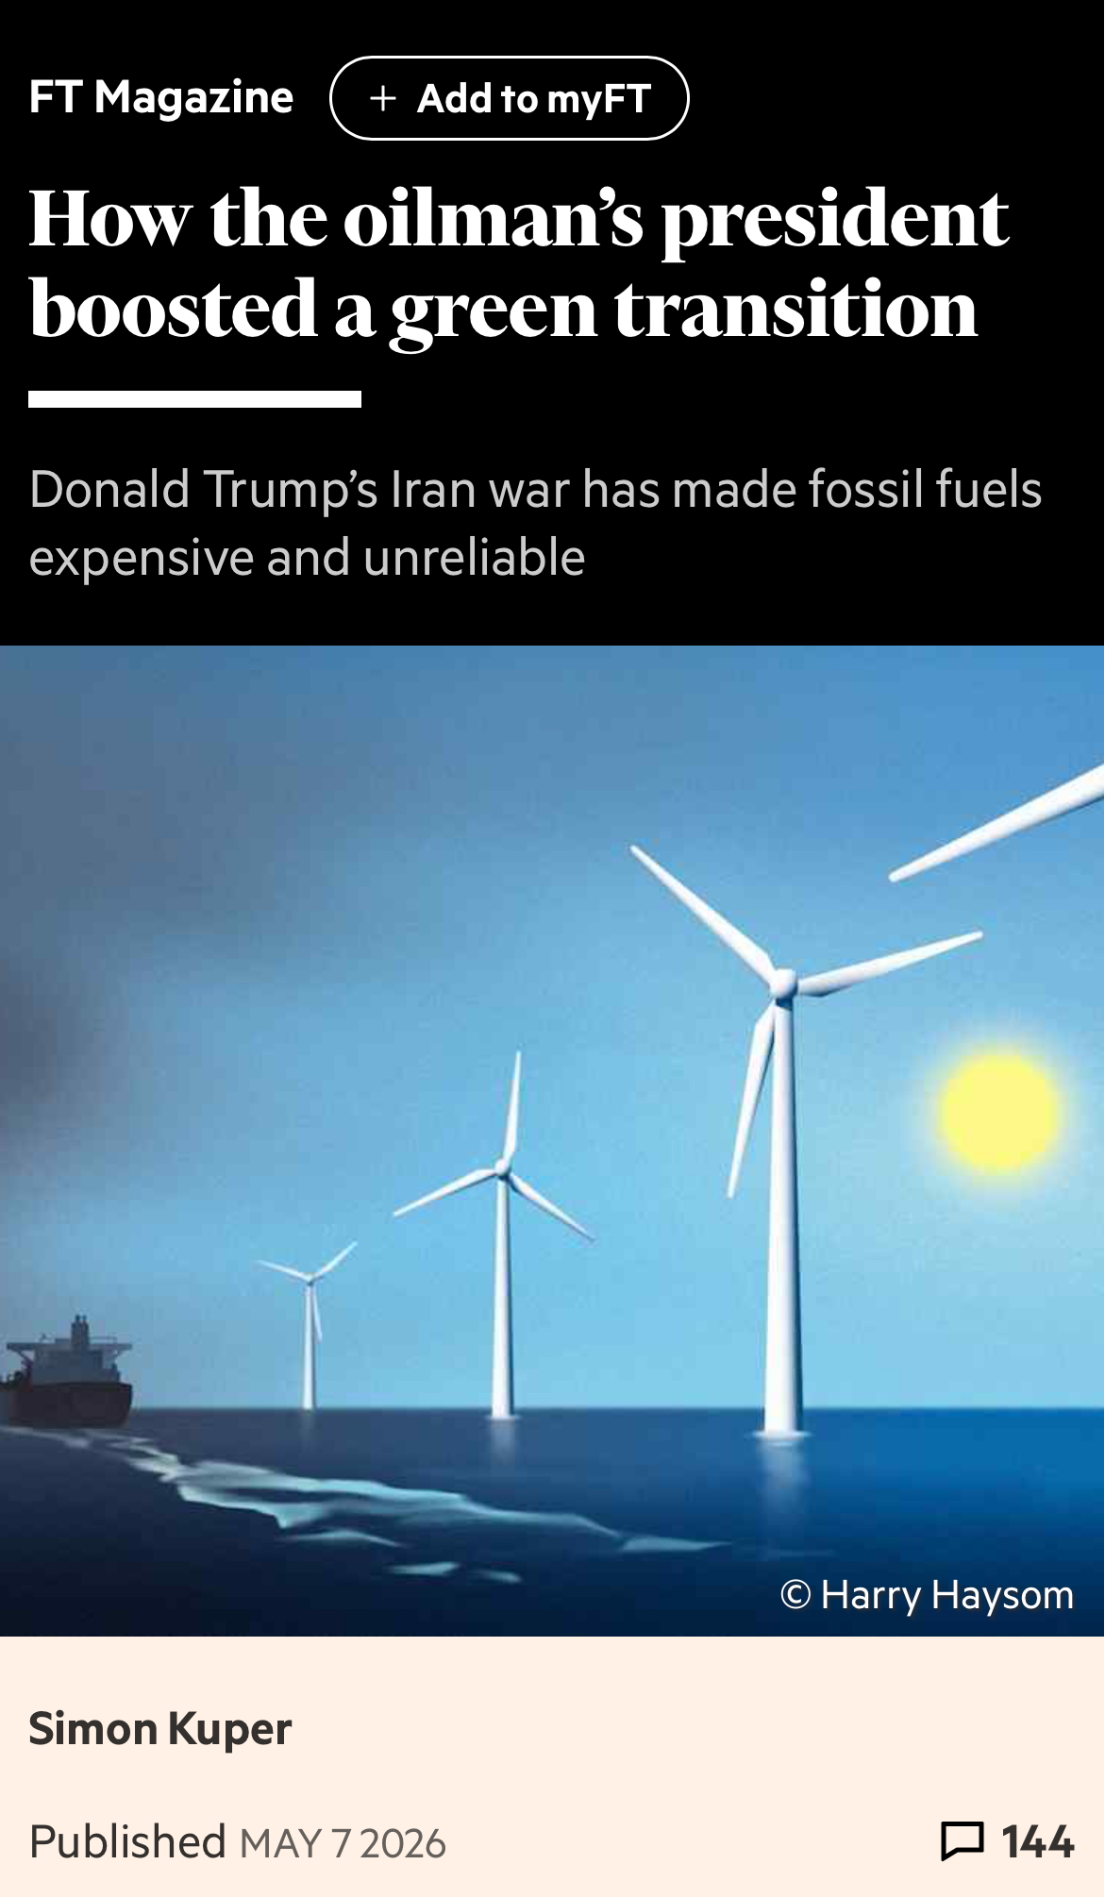
The decarbonisation paradox
Crude oil at US$100+ &
“Stranded Assets” making US$1m per day …
… but the world is waking up to the fragility
of our fossil-fuel-based economy

Slide 7
The decarbonisation paradox
Crude at US$100+ &
“Stranded Assets” making US$1m per day …
… but the world is waking up to the fragility of our fossil-fuel-based economy

Slide 8
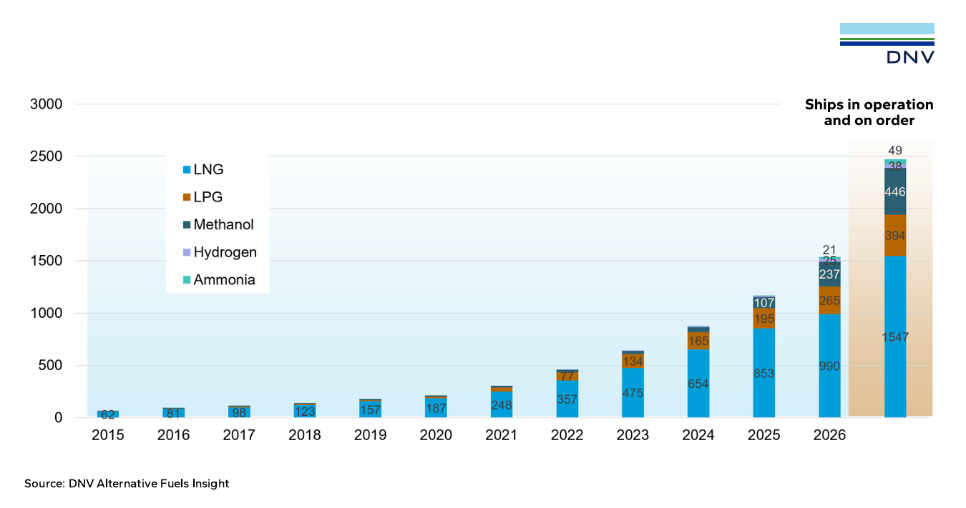
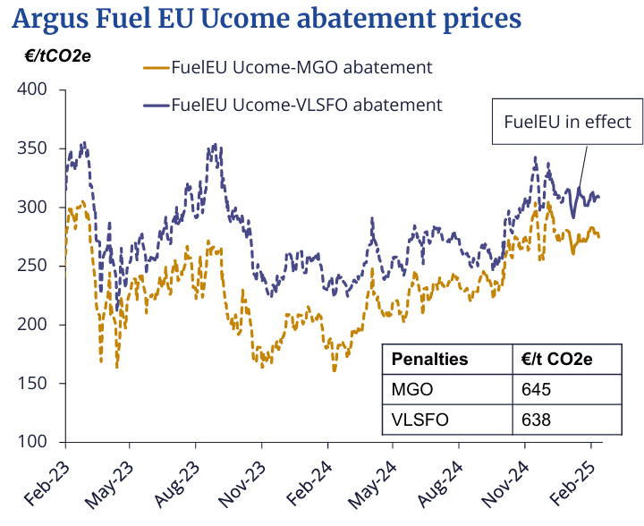
The maritime decarbonisation paradox
The obstacles to the wide-scale deployment of
non-hydrocarbon-fuelled ships
remain formidable …
while “ready” or “capable” doesn’t mean “consuming” …
… but the cost of carbon
is now irreversibly
part of the economics of shipping

Slide 9
If we change perspective, there is in fact no paradox
The world’s public opinion has proved unwilling
to sacrifice today for a better tomorrow…
… but prioritises energy efficiency & energy resilience, and …
… fossil fuels are being replaced by better alternatives,
only if and when they are…
  economically viable,
  operationally reliable,
  commercially feasible.

Slide 10



We will always have paris …
Decarbonisation 1.0 (2019-2025)
  global consensus,
  benevolent governments,
  omnipotent regulators,
  omniscient engineers

Slide 11

We will always have paris …
Decarbonisation 1.0 (2019-2025)
  global consensus,
  benevolent governments,
  omnipotent regulators,
  omniscient engineers
Decarbonisation 2.0 (2025)
  It’s tough, but shout louder

Slide 12
We will always have paris… BUT THERE’S A SEQUEL…
Decarbonisation 1.0 (2019-2025)
  global consensus,
  benevolent governments,
  omnipotent regulators,
  omniscient engineers
Decarbonisation 2.0 (2025)
  It’s tough, but shout louder
Decarbonisation 3.0 (2026 - )
  discard what does not work
  jettison what is unnecessary
  focus on what is realistic (economically, operationally & commercially)

Slide 13
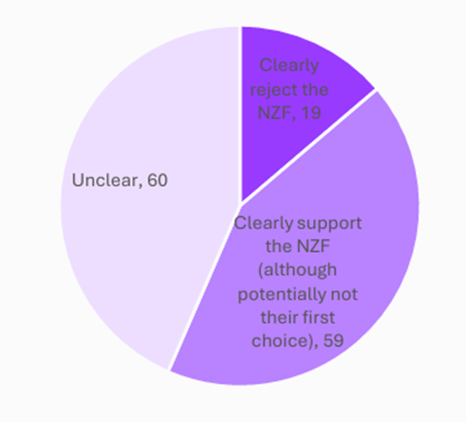
What’s dead
The end of the illusions is always messy.
Global consensus
“Ambition”
Global carbon tax
Redistribution
IMO as a fund
MEPC84 voting record on NZF, April 2026
Source: UCL Energy Institute

Slide 14
What’s dead what’s comatose
(or zombie)
The end of the illusions is always messy.
Global consensus
“Ambition”
Global carbon tax
Redistribution
IMO as a fund
Some type of MBM
Green Corridors
Green Loans
The S-curve of alternative fuels

Slide 15
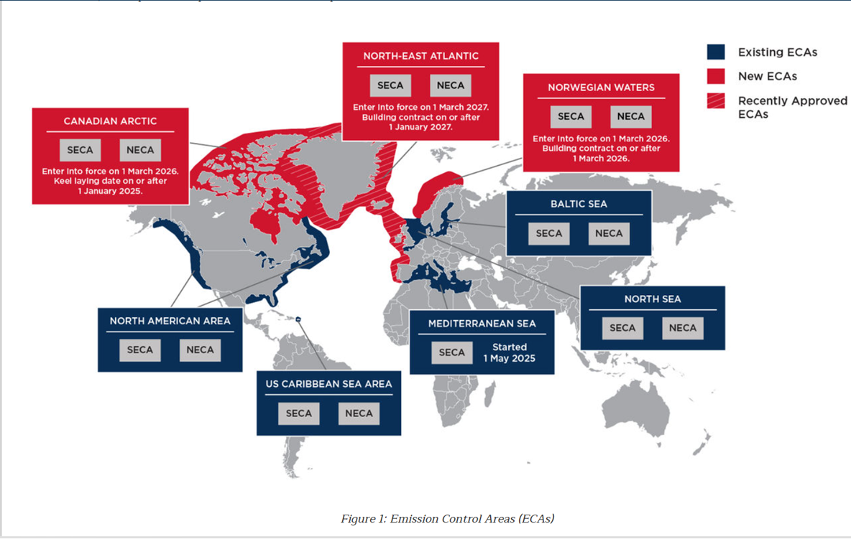
What’s dead what’s comatose and what lives on
(or zombie)
The end of the illusions is always messy.
Global consensus
“Ambition”
Global carbon tax
Redistribution
IMO as a fund
Some type of MBM
Green Corridors
Green Loans
The S-curve of alternative fuels

Slide 16
What’s dead what’s comatose and what lives on
(or zombie) (even if taking a nap)
The end of the illusions is always messy.
Global consensus
“Ambition”
Global carbon tax
Redistribution
IMO as a fund
Some type of MBM
Green Corridors
Green Loans
The S-curve of alternative fuels
EEDI, EEXI, CII
EU ETS
FuelEU Maritime
Pooling
RED & POS
Local ETSs
Local carbon taxes
Regulatory arbitrage
Scope 3
Biofuels, incl. ethanol
Shore power
LNG & biomethane
Methanol & ammonia
Energy saving retrofits
Charterparty adaptations
Green disputes

Slide 17
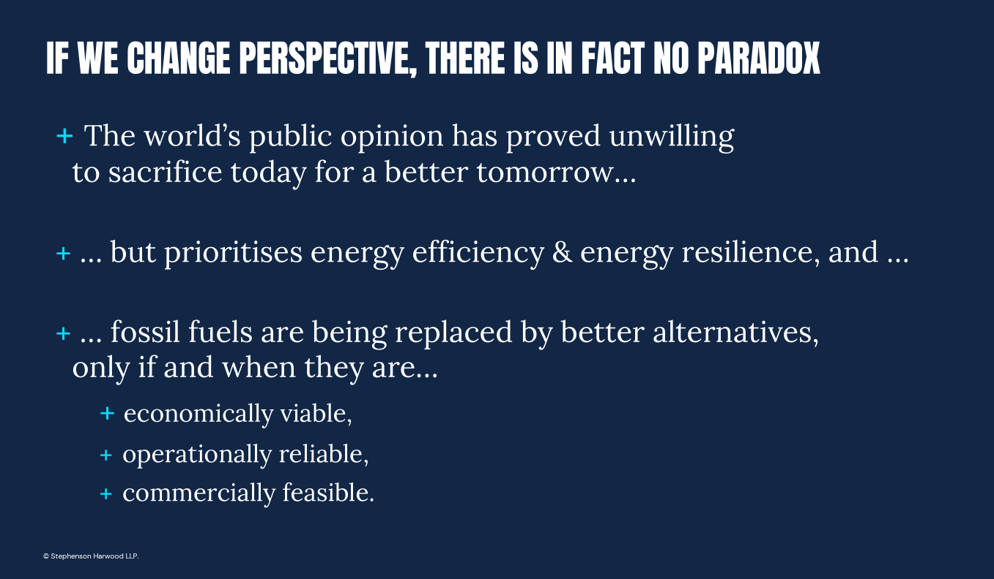
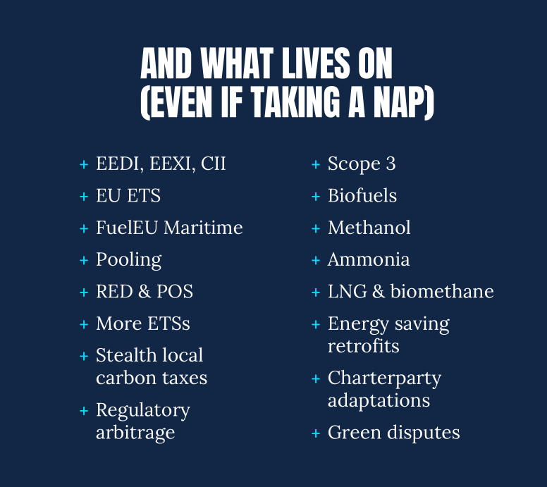
… SO, THAT’S THE CONTEXT OF THE IWG

Slide 18
Maritime decarbonisation
Dead, alive or zombie?
CMI Rio
Wednesday 13 May 2026
Parallel Session I : Decarbonisation Update
Haris Zografakis
Chair of the IWG on Maritime Decarbonisation
Senior Consultant,
Stephenson Harwood LLP, London.

Slide 19
Wednesday 13 May 2026
Parallel Session I : Decarbonisation Update
International Working Group on Maritime Decarbonisation
Introduction to the work of the IWG and the present status of maritime decarbonisation,
Haris Zografakis, IWG Chair
Green Fuels: An international liability & compensation regime for alternative fuels – the IMO trajectory,
Jolien Kruit
Biofuels and the international liability conventions,
Neil Henderson
Liability & Compensation for Alternative Fuels : Identifying Legal Gaps and Lessons from Existing Regimes,
Hannah Mosmans
Greening Shipping Contracts: do we already have the kit?
Charles Debattista
Questions & Discussion

Slide 20



Alternative fuels - liability and compensation regime:
The IMO trajectory
Prof. dr. Jolien Kruit

Slide 21

Emission reduction regimes
IMO and EU rules are technology neutral
BUT: operational efficiency in due course will be insufficient to meet targets
Therefore: there will most likely be an uptake of alternative fuels in the foreseeable future

Slide 22
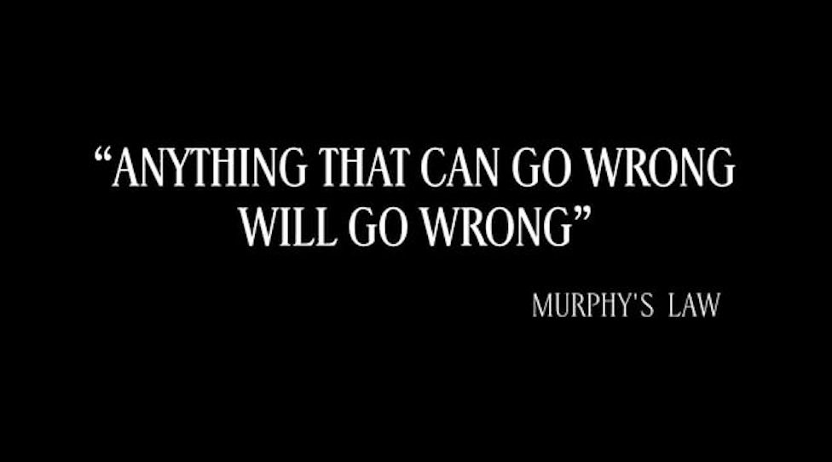

Slide 23
Gothenburg paper – June 2024
Shipping fuels | On board as cargo | On board in/as bunkers
Oil = (persistent) hydrocarbon mineral oil | CLC | CLC/Bunker Pollution Convention
Alternative fuels (LNG, biofuels, methanol, ammonia) | HNS Convention 2010 After entry into force (nov 2027?) In state parties

Slide 24

Alternative fuels = alternative risks
The legal gap: existing liability and compensation regimes were not designed for these hazards
Risk profile of alternative fuels
The existing legal gap
Toxicity — ammonia is highly toxic; acute exposure is lethal
The CLC/Fund, HNS Convention, Bunkers Convention and Nairobi WRC were each designed around specific, known substances and incident types. None adequately addresses:
Flammability — hydrogen poses novel explosion risks
Who bears liability for new fuel incidents?
Corrosivity — methanol damages conventional containment
What is the scope of damage that needs to be compensated?
Invisible damage — some fuels leave no visible pollution trail
Which convention applies to which fuel?
Blended fuels — biofuel blends interact unpredictably with existing materials
How are cross-border incidents handled?
New fuels demand new legal frameworks: proactively, before incidents occur.
Kruit · Van Traa Advocaten · CMI IWG on Maritime Decarbonisation · CMI Colloquium Rio de Janeiro 2026

Slide 25
Recommendation CMI IWG
Gothenburg-discussion-paper-Green-Fuels-1.pdf:
“There is a need for an international discussion on the necessity for a legal regime to deal with civil liability and compensation in case of an incident involving alternative fuels, either carried on board vessels as cargo or to be used as fuel.”

Slide 26
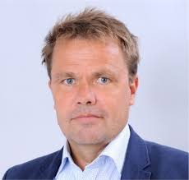
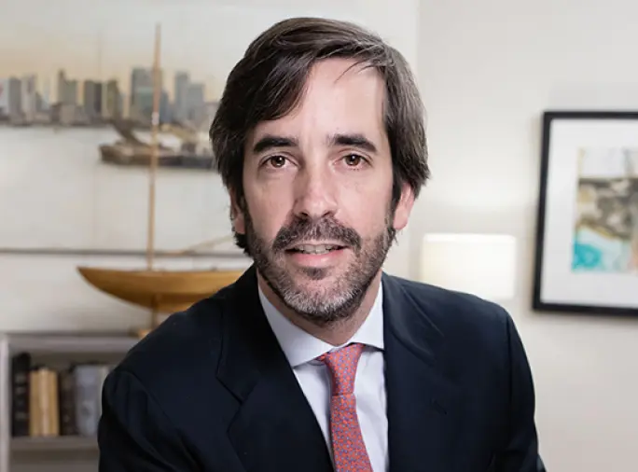
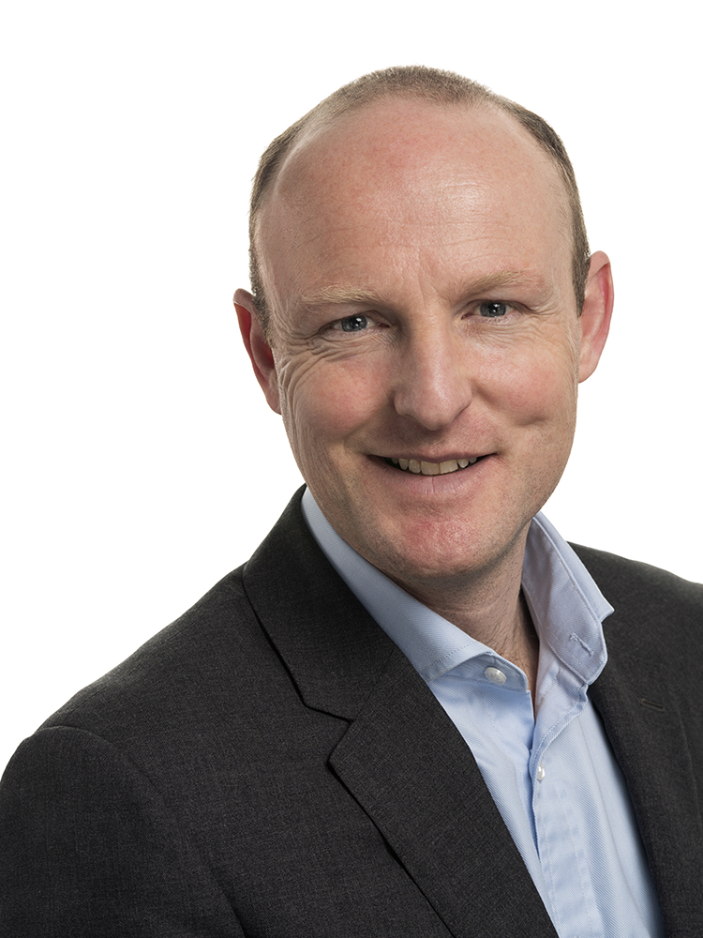
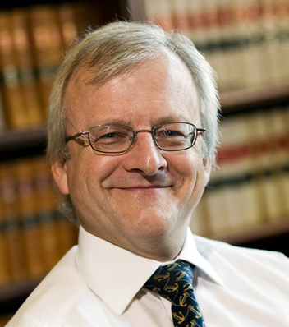

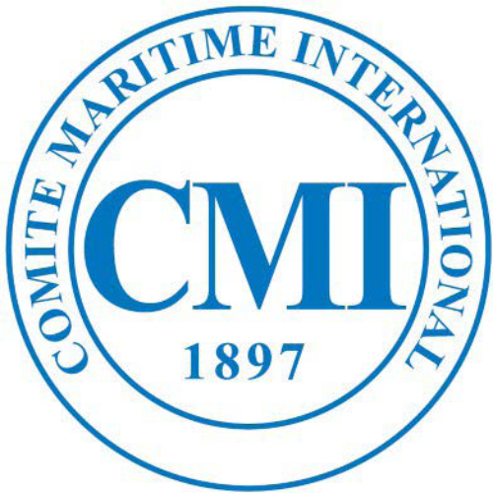

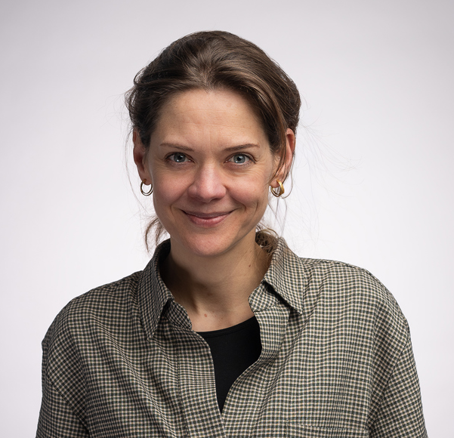

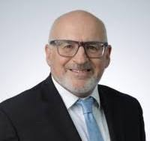
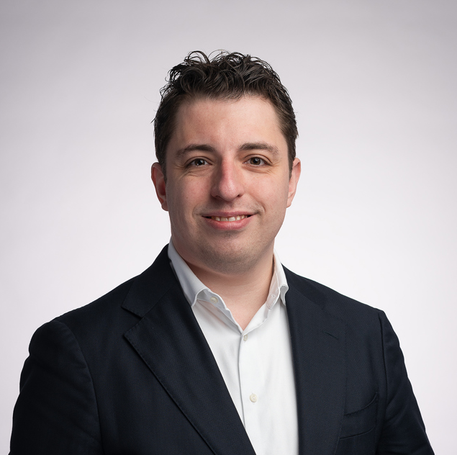
Henrik Ringbom
Nick Gaskell Jan-Erik Pötschke
Jaime Albors
Neil Henderson
Hannah Mosmans
Fred Kenney
Manami Sasaoka Jolien Kruit
Mark Broekhuisen

Slide 27

The IWG's journey to the IMO Legal Com 113
Four milestones across two years: each building on the last
Spring
Spring
Autumn
Spring
2024
2025
2025
2026
Gothenburg Discussion Papers
LEG 112 — IMO Work Programme
Nairobi WRC Discussion Paper
LEG 113 — ICG Report and Biofuel Blends paper
LEG 113/14/3 · LEG 113/14
The IWG published the Decarbonisation Discussion Papers at the annual CMI meeting in Sweden. Topics: liability regime for new fuels; contractual guidelines on new-fuel readiness; contractual architecture of maritime trade.
LEG 112/13/2 · LEG 112/13/5
Participation in informal correspondence group.
The IWG published a Discussion Paper on the 2007 Nairobi Wreck Removal Convention, examining its applicability to alternative-fuel incidents and wrecks.
Analysis included in the Tokyo document and in the correspondent’s group report.
Publication of the informal correspondence group’s comparative analysis submitted by Antigua & Barbuda and others to LEG.
The IWG published a Discussion paper on biofuel blends which was received with strong interest.
Our paper resulted in a submission by Antigua & Barbuda (Australia & Canada), supported by CMI.
The Legal Committee agreed to include alternative fuels liability on the IMO work programme.
Informal correspondence group set up.
Kruit · Van Traa Advocaten · CMI IWG on Maritime Decarbonisation · CMI Colloquium Rio de Janeiro 2026

Slide 28
The IMO trajectory
I. Informal correspondence group’s report:
  1. Analysis of the current liability regime under the CLC, Bunker Pollution Convention, HNS, LLMC and the Wreck Removal Convention
    Discussion Paper on the 2007 Nairobi Wreck Removal Convention - Comite Maritime International – CMI
      WRC can be applicable to alternative fuel spills, but does not respond to damage caused to third parties
    Tokyo paper (Gothenburg + Wreck Removal Analysis) IWG on Decarbonisation - Comite Maritime International - CMI

Slide 29
The IMO trajectory
Informal correspondence group’s report:
  Conclusion: None of the existing regimes would be suitable for alternative fuels and technology used for the propulsion and operation of a ship
    the potential for damage is wider than merely pollution damage
    the WRC does not respond to claims from third parties.

Slide 30
The IMO trajectory
Informal correspondence group report:
  2. Identification of the essential characteristics of a liability and compensation regime for alternative fuels:
    Purpose, definitions, scope of application, liability, liability limits, compulsory insurance, insurance certificates, right of direct action, who is liable, scope of liability, damage covered, time bars, ship and overlap provision
  3. Advantages and disadvantages of instrument options for alternative fuels
    Protocol to Bunker Pollution Convention or new instrument?

Slide 31
The IMO Trajectory
II. February 2026: Biofuel blends paper IWG on Decarbonisation - Comite Maritime International - CMI

Slide 32
The IMO trajectory
March 2026: LEG 113
  A regulatory gap exists regarding liability and compensation for incidents involving alternative fuels used for ship propulsion
  Intersessional correspondence group set up
  Title output amended to: “Develop or amend a liability regime for alternative fuels and technologies when used for the operation/propulsion of a ship”

Slide 33
Conclusions
These processes
take time
That is precisely
why we started early
The window
is now open
What CMI
can do next
International treaty-making at IMO is deliberate and multi-year. From work programme item to convention in force can take a decade or more. That is not a failure — it is the architecture of durable international law.
The IWG was founded in 2023 because alternative fuels were already at sea, and the legal vacuum was already growing. Early preparation gives the process the substance it needs when the political window opens.
Alternative fuels liability is on the IMO LEGCOM work programme. A correspondence group is active. The IWG's three years of preparation are precisely what is needed to make the most of this moment.
Continue providing expert input to the correspondence group;
aligning with industry;
expanding the coalition of supporting states;
driving the process forward.
Kruit · Van Traa Advocaten · CMI IWG on Maritime Decarbonisation · CMI Colloquium Rio de Janeiro 2026

Slide 34
Prof. Dr. Jolien Kruit
kruit@vantraa.nl
+31 10 224 55 11
+31 6 46 00 40 43

Slide 35
Wednesday 13 May 2026
Parallel Session I : Decarbonisation Update
International Working Group on Maritime Decarbonisation
Introduction to the work of the IWG and the present status of maritime decarbonisation,
Haris Zografakis, IWG Chair
Green Fuels: An international liability & compensation regime for alternative fuels – the IMO trajectory,
Jolien Kruit
Biofuels and the international liability conventions,
Neil Henderson
Liability & Compensation for Alternative Fuels : Identifying Legal Gaps and Lessons from Existing Regimes,
Hannah Mosmans
Greening Shipping Contracts: do we already have the kit?
Charles Debattista
Questions & Discussion

Slide 36
Biofuels and the International Liability Conventions
CMI, Rio 2026
Neil Henderson
Barrister

Slide 37
What are biofuels?
Generic term for energy sources made from organic material, as opposed to fossil sources
Biodiesel
  FAME
  HVO
Blends
Pollution

Slide 38
B5
B30
B95

Slide 39
What are biofuels?
Generic term for energy sources made from organic material, as opposed to fossil sources
Biodiesel
  FAME
  HVO
Blends
Pollution

Slide 40
"…biodiesel's relatively similar fate and behaviour in comparison to conventional fuels means that claims arising from a spill would be similar to those associated with conventional hydrocarbon oil spills."
ITOPF, 2024

Slide 41
The International Liability Conventions
CLC 1992¹
Bunkers Convention 2001²
Wreck Removal Convention 2007³
HNS Convention 2010⁴
International Convention on Civil Liability for Oil Pollution Damage 1969, replaced by the 1992 Protocol
International Convention on Civil Liability for Bunker Oil Pollution Damage, 2001
Nairobi International Convention on the Removal of Wrecks, 2007
International Convention on Liability and Compensation for Damage in Connection with the Carriage of Hazardous and Noxious Substances by Sea (HNS), 1996 (and its 2010 Protocol) – NB. not yet in force

Slide 42
“bunker fuel oil” ¹
“oils, carried in bulk”²
“dangerous liquid substances carried in bulk” ³
Wreck Removal Convention, arts.5(e) and 6(h)
HNS Convention, art.5(a)(i) – biofuel blends of 25% or less (MARPOL Annex I cargo)
HNS Convention, art.5(a)(iii) – biofuel blends of more than 25% (MARPOL Annex II cargo – ch.17 IBC Code)
Notes:
25% or less
Biofuel blends and MARPOL Annex I cargoes with 25% (by volume) or less biofuel are to be considered a MARPOL Annex I cargo and are required to comply with MARPOL Annex I.
More than 25%
Biofuel blends and MARPOL Annex I cargoes with more than 25% (by volume) biofuel are to be regarded as MARPOL Annex II products and must comply with the requirements set out in Chapter 17 of the IBC Code.

Slide 43
“(persistent) hydrocarbon mineral oil”

Slide 44
What can be done about it?
IMO LEG 113 – document LEG 113/14/3 (CMI)
IMO Legal Committee formal guidance?
IMO unified interpretation?
A protocol to the Bunkers Convention?
An Alternative Fuels Convention?

Slide 45
Neil Henderson, Barrister
4 Pump Court
Temple
London
nhenderson@4pumpcourt.com

Slide 46
Wednesday 13 May 2026
Parallel Session I : Decarbonisation Update
International Working Group on Maritime Decarbonisation
Introduction to the work of the IWG and the present status of maritime decarbonisation,
Haris Zografakis, IWG Chair
Green Fuels: An international liability & compensation regime for alternative fuels – the IMO trajectory,
Jolien Kruit
Biofuels and the international liability conventions,
Neil Henderson
Liability & Compensation for Alternative Fuels : Identifying Legal Gaps and Lessons from Existing Regimes,
Hannah Mosmans
Greening Shipping Contracts: do we already have the kit?
Charles Debattista
Questions & Discussion

Slide 47
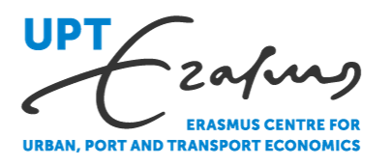

Liability and Compensation for
Alternative Fuels in Shipping
Lessons from the Historical Development of Existing Regimes
CMI Colloquium 2026 · Rio de Janeiro · Parallel Session on Decarbonisation
CMI IWG on Maritime Decarbonisation – Workstream on Green Fuels
Hannah Mosmans MSc. LLM
External PhD Researcher, Erasmus School of Law | Researcher, Erasmus UPT
Co-authored with Jolien Kruit · Frank Smeele · Albert Veenstra - published in Climate Law (2026)

Slide 48
Agenda
01
Context and method
Why history matters - and how we studied it
02
The legal architecture
Origins in nuclear law · four key elements · what they mean for alternative fuels
03
Process lessons
What made regimes succeed – or fail – and what that teaches us about the path ahead
04
Conclusion
Way forward
Mosmans et al. (2026) · Climate Law · CMI Colloquium Rio de Janeiro 2026

Slide 49
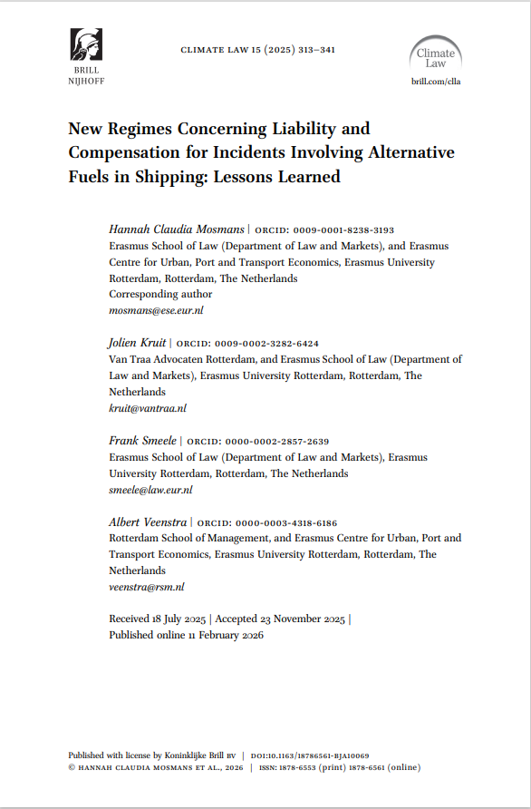
Context and method
We do not need to start from scratch: 60 years of regime development offer a proven foundation
Literature analysis
Systematic and snowball sampling across to trace evolution from Torrey Canyon to regime developments:
IMCO/IMO meeting records,
convention texts,
CMI questionnaires and reports,
diplomatic conference preparatory documents, and
academic publications
16 in-depth interviews
Key persons who involved in development of CLC/Fund, HNS, Bunkers and other regimes - including IOPC Fund directors, IMO Legal Committee delegates, diplomatic conference chairs, P&I Club representatives, and national advisors.
Conducted October–December 2024 · online and in person.
Hybrid thematic analysis (Braun & Clarke; Fereday & Muir-Cochrane) · 7 themes · analysed in NVivo.
Mosmans et al. (2026) · Climate Law · CMI Colloquium Rio de Janeiro 2026
Notes:
7 themes:
1) meeting composition and power structures; 2) pre-negotiation agenda-setting and triggering events; 3) dynamics during negotiations; 4) external and internal factors shaping agreement; 5) post-adoption challenges and implementation efforts; 6) elements in conventions; and 7) specific considerations for alternative fuels.

Slide 50
01
THE LEGAL ARCHITECTURE
From nuclear law
to maritime law
How the four key elements of today's liability regimes were first developed in the nuclear liability conventions of the early 1960s

Slide 51
The nuclear law origins of maritime liability
The key elements did not emerge in the CLC— they were deliberately transferred from the nuclear liability conventions of the early 1960s
Paris/Vienna Conventions 1960/1963
Brussels Convention 1962
CLC 1969 / Fund 1971
Bunkers 2001 / HNS 2010
First international nuclear liability treaties (OEEC/IAEA).
Introduced strict liability for nuclear operators and compulsory insurance. Channelled liability exclusively to the operator of the nuclear installation.
Convention on the Liability of Operators of Nuclear Ships. Developed through collaboration between IAEA and CMI (see Rijeka [1959] documents).
Applied the nuclear liability model directly to ships: strict liability, limitation of liability, legal channelling to the operator, compulsory insurance, and direct action against the insurer. Never entered into force but provided the exact template for CLC.
Mirrored the Brussels Convention architecture directly.
All four elements transplanted into oil pollution law. CMI preparatory work was instrumental (see Torrey Canyon reports by CMI [1967/1968]).
Fifth element added: the Fund financed by cargo interests.
Both built on the CLC model. HNS reinstated full channelling and two-tier fund. Bunkers departed on channelling and used LLMC for limitation. Core elements unchanged for over 60 years.
→
→
→
Mosmans et al. (2026) · Climate Law · CMI Colloquium Rio de Janeiro 2026

Slide 52
The four key elements
Proven in nuclear law · adopted in CLC 1969 · confirmed in HNS 2010 · all recyclable for a future alternative fuels regime
① Strict Liability
② Legal Channelling
③ Limitation of Liability
④ Compulsory Insurance
+ Direct Action
Liability attaches automatically: no proof of fault required. Fundamental departure from pre-Torrey Canyon maritime law.
Liability directed exclusively to one identifiable party. Simplifies claims and reduces litigation.
Capped liability (ship tonnage-based) as quid pro quo for strict liability.
Mandatory insurance plus right to claim directly against insurer: critical where owner is insolvent or based abroad.
+ Compensation Fund(s) (CLC/HNS): Second-tier fund financed by cargo interests, providing additional compensation beyond shipowner limits - the element that completed the architecture and secured political legitimacy.
Open design questions for alternative fuels: Appropriate limits · LLMC linkage or separate regime · scope of channelling · damage categories beyond pollution (personal injury, property damage, loss of life) · …
Mosmans et al. (2026) · Climate Law · CMI Colloquium Rio de Janeiro 2026

Slide 53
02
PROCESS LESSONS
What made regimes
succeed – or fail
Nine lessons from 60 years of maritime liability regime development, organised across four themes

Slide 54
Nine lessons — four themes
From 16 in-depth interviews with key persons who created CLC/Fund and HNS
The convention itself
Drafting process
Stakeholders involved
External impetus
① Core legal architecture: four key elements
④ Pragmatism and flexibility as success factors
⑦ Broad support, political will, and the role of non-governmental stakeholders
⑨ Incident preferably not as a catalyst
② Binding international regime preferred
⑤ Preparation is key
⑧ Shared financial responsibility for legitimacy
③ Complexity complicates implementation
⑥ Careful considerations for reopening conventions
The paper contains a full elaboration of each lesson with supporting interview evidence and documentary sources. The following slides present each lesson with its implications for a future alternative fuels regime.
Mosmans et al. (2026) · Climate Law · CMI Colloquium Rio de Janeiro 2026

Slide 55
The legal architecture of any future regime
Lessons on the convention itself
The convention itself
① Core legal architecture: four key elements for any future regime
① Strict liability
② Legal channelling
③ Limitation of liability
④ Compulsory insurance
+ direct action
Broadly accepted as uncontroversial for any future regime.
Most debated element: Bunkers does not channel. Scope of channelling will be a critical design choice.
LLMC linkage or separate limits? Current LLMC ceilings may be inadequate given the risk profiles of alternative fuels.
Broadly uncontroversial.
The convention itself
The convention itself
② Binding international regime preferred
③ Complexity complicates implementation
TOVALOP and CRISTAL showed voluntary schemes are useful stopgaps but not durable.
Large preference for binding international regime to prevent national and regional patchworks.
The HNS Convention has not entered into force since 1996* in large part due to complexities such as defining receiver and fund contributions (as well as the administrative burdens on ratifiying states). Simplicity is a design virtue.
*earliest entry into force November 2027
Mosmans et al. (2026) · Climate Law · CMI Colloquium Rio de Janeiro 2026
Notes:
For alternative fuels: the diversity of fuel types, damage categories, and responsible parties risks producing a convention too complex to ratify. Simplicity is a design virtue, not a compromise.

Slide 56
How to draft and what not to do
Lessons on the drafting process
Drafting process
Drafting process
Drafting process
④ Pragmatism and flexibility as success factors
⑤ Preparation is key
⑥ Careful considerations for reopening conventions
Diplomatic conferences were strategically managed: issues bundled, compromises prioritized over perfection. The CLC/Fund regime’s adaptability (through 1992 Protocols and tacit acceptance procedures) explains much of its longevity.
"A pragmatic, compromise-driven outcome was always preferable." (Interviewee 2)
The Brussels Convention on Nuclear Ships (1962) never entered into force, yet was the direct template for CLC 1969. Legal groundwork before political momentum arrives is invaluable.
CMI's preparatory role for CLC, HNS and Bunkers is the analogy for the IWG's current work on alternative fuels. The Gothenburg and Tokyo papers are exactly this kind of groundwork.
Near-universal agreement among interviewees: once reopened, a convention's full scope is subject to renegotiation, risking unintended consequences, gridlock, or loss of political support built up over decades.
"Re-opening conventions is a complex matter and should normally be avoided because we cannot predetermine the scope of amendments." (Interviewee 6)
For alternative fuels: extending existing conventions vs. a new standalone instrument requires very careful consideration.
Mosmans et al. (2026) · Climate Law · CMI Colloquium Rio de Janeiro 2026

Slide 57
Who needs to be at the table
Lessons on stakeholders involved
Stakeholders involved
Stakeholders involved
⑦ Broad support, political will, and the role of non-governmental stakeholders
⑧ Shared financial responsibility for legitimacy
Even the best-designed legal regimes fail without sustained political will and broad support. The HNS Convention illustrates how adoption is not ratification. "It should not just be one country raising the issue: it requires broad support." (Interviewee 11)
P&I Clubs, IOPC Funds, ITOPF, ICS, OCIMF, and INTERTANKO all played decisive roles in CLC/Fund and HNS, not only as lobbyists but as technical experts who shaped provisions.
The CLC/Fund two-tier model was politically achievable because it distributed the burden fairly.
"They successfully pushed for the principle that liability should be shared between shipowner interests and cargo interests." (Interviewee 2)
For alternative fuels (in case of fund): who contributes to a fund? Fuel producers? Receivers? Flag states?
CMI's historic role: the precise analogy for today
CMI was cited by multiple interviewees as central to the creation of CLC. Over a century of advisory expertise to IM(C)O, bringing together national maritime law associations across jurisdictions to produce technically grounded, politically viable instruments.
Mosmans et al. (2026) · Climate Law · CMI Colloquium Rio de Janeiro 2026

Slide 58
Do not wait for a disaster
Lesson on external impetus — and the broader call to action
External impetus
⑨ Incident preferably not as a catalyst
Every major regime was catalysed by a disaster:
• Torrey Canyon (1967) → CLC 1969
• Amoco Cadiz (1978) → Fund expansion
• Erika (1999) + Prestige (2002) → Supplementary Fund 2003
Historically, political momentum has required an incident. Yet most interviewees stressed that for alternative fuels, proactive preparation is far preferable.
"Why wait? We are at a unique point where we have the chance to establish preventive measures before a massive incident occurs." (Interviewee 9)
Alternative fuels are already at sea. The order book is growing. There is no guarantee that an incident will not occur before a regime is in place.
Mosmans et al. (2026) · Climate Law · CMI Colloquium Rio de Janeiro 2026

Slide 59
03
WHAT’S NEXT?
Conclusions

Slide 60
Conclusions
⚖
⚙
⏱
⚓
The legal architecture is there
The process matters as much as the substance
The window is now
CMI and the IWG are uniquely placed
The four key elements have proven effectiveness. Open design choices (channelling model, LLMC linkage, damage scope) are resolvable with the right groundwork.
Proactive preparation, shared financial responsibility, broad stakeholder engagement, and managing complexity are the proven ingredients of a durable international regime.
Alternative fuels are already at sea and growing. The legal framework must anticipate, not react to, incidents.
CMI has over a century of advisory expertise to IMO and was central to the creation of existing regimes. The Gothenburg and Tokyo papers, and CMI's participation in the IMO LEGCOM correspondence group, show the IWG is already doing exactly the preparatory work that history shows is decisive.
Mosmans et al. (2026) · Climate Law · CMI Colloquium Rio de Janeiro 2026

Slide 61
Wednesday 13 May 2026
Parallel Session I : Decarbonisation Update
International Working Group on Maritime Decarbonisation
Introduction to the work of the IWG and the present status of maritime decarbonisation,
Haris Zografakis, IWG Chair
Green Fuels: An international liability & compensation regime for alternative fuels – the IMO trajectory,
Jolien Kruit
Biofuels and the international liability conventions,
Neil Henderson
Liability & Compensation for Alternative Fuels : Identifying Legal Gaps and Lessons from Existing Regimes,
Hannah Mosmans
Greening Shipping Contracts: do we already have the kit?
Charles Debattista
Questions & Discussion

Slide 62
Wednesday 13 May 2026
Parallel Session I : Decarbonisation Update
International Working Group on Maritime Decarbonisation
Introduction to the work of the IWG and the present status of maritime decarbonisation,
Haris Zografakis, IWG Chair
Green Fuels: An international liability & compensation regime for alternative fuels – the IMO trajectory,
Jolien Kruit
Biofuels and the international liability conventions,
Neil Henderson
Liability & Compensation for Alternative Fuels : Identifying Legal Gaps and Lessons from Existing Regimes,
Hannah Mosmans
Greening Shipping Contracts: do we already have the kit?
Charles Debattista
Questions & Discussion

Slide 63

Wednesday 13 May 2026
Parallel Session I : Decarbonisation Update
International Working Group on Maritime Decarbonisation
Introduction to the work of the IWG and the present status of maritime decarbonisation,
Haris Zografakis, IWG Chair
Green Fuels: An international liability & compensation regime for alternative fuels – the IMO trajectory,
Jolien Kruit
Biofuels and the international liability conventions,
Neil Henderson
Liability & Compensation for Alternative Fuels : Identifying Legal Gaps and Lessons from Existing Regimes,
Hannah Mosmans
Greening Shipping Contracts: do we already have the kit?
Charles Debattista
Questions & Discussion

