Slide 1
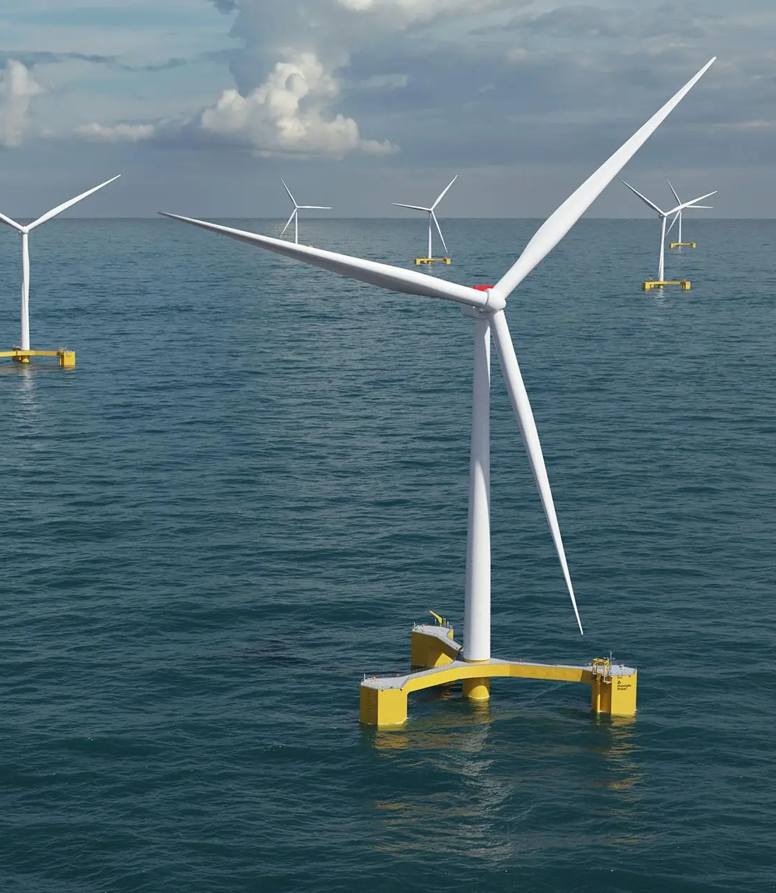
The MORU Registration Framework
Isle of Man Ship Registry

Slide 2









The Isle of Man Ship Registry
Respected & Quality
Flag
Paris / Tokyo MoU
Whitelisted
USCG Qualship
Member of Red
Ensign Group
Fees only regime
No tonnage tax
Building lasting relationships
Putting the client first
Cluster of Maritime Excellence
Fully
Digital

Slide 3
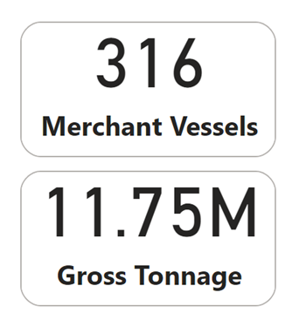
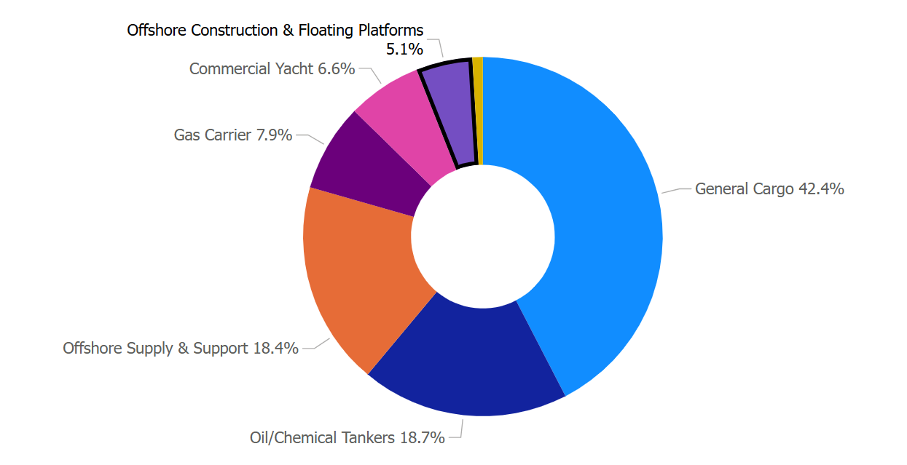

Slide 4





A Future-focused Shipping Register
Incentivising Green Technology
Green Fee Discounts
for Novel Technologies
Sustainability Partners
-Getting to Zero Coalition
- Eyesea
Partnering with clients for a greener future
Enabling world-first client deployments of maritime green technologies

Slide 5







Working in partnership with 7 x Classification Societies
Full delegation to class for all statutory surveys & audits
Several of these classification societies already established in the renewables sector for project certification work

Slide 6
UK
Territories
EU/EEA
countries
Ship ownership structures accepted from
Panama, Liberia,
Marshall Islands
British Commonwealth countries
Scheduled
Countries*
*Australia, Bahamas, Canada, China, Hong Kong, India, Japan, Monaco, New Zealand, Pakistan, Singapore, South Africa, South Korea, Switzerland, United Arab Emirates, USA
& more

Slide 7



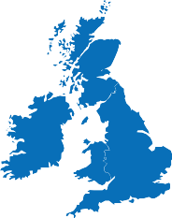


Secure and
Stable
Government
Financially secure
Preferred Flag by banks and insurers
Located in Europe but not an EU member
0%
Tax friendly
OECD whitelisted
0% corporate tax
Part of the British Isles but not in the UK
-VAT linked with UK
-Independent of UK for other tax matters
Maritime cluster built on maritime tradition

Slide 8




The IOM MORU Framework – Important Concepts
MORU are floating, movable assets
A ship in certain areas of Maritime law
Clarifies a MORU’s status
Complements Coastal State Regulation
IOM Shipping Register is an International Register
Targeted at global market

Slide 9

The IOM MORU Framework – Legislative Process
Regulatory Review
Legislative package
MORU Framework
Comprehensive Review
Specialist Consultant
Industry Support (NDA)
Three stage
Application Order
MORU Order
Bespoke Regulation
MORU Registration permitted under Part I of the Merchant Shipping Register

Slide 10
The IOM MORU Framework – Key Facts
Permits Registration of
Floating Offshore Wind Turbines
Floating Tidal Generators
Floating Offshore Substations
Prohibits Registration of
Manned MORU
Hybrid MORU
Other MORU Types (e.g. Chemical)
Prerequisites
Qualified Owner
Classification or Project Certification
IOM Representative
Provides
MORU documentation
Capacity based fees model
Guidance documentation

Slide 11
Maritime Facilities
Certainty
Potential
Registration with the IOM Ship Registry
(Regular & Demise Registration)
Respected
Repeatable
Considered

Slide 12
How can CMI help the IOM Ship Registry?
Push for swift adoption of a MORU finance convention which:
  Provides for state parties’ mutual recognition of:
    Public registration (flagging) of MORUs by other state parties
    Public registration of mortgages on MORUs by the flag state
  Limits maritime liens with priority over mortgages on MORUs
  Ensures recognition of LLMC 1976/1996’s application to MORUs
  Ensure UNCLOS based freedom of navigation / innocent passage for foreign flagged MORUs

Slide 13
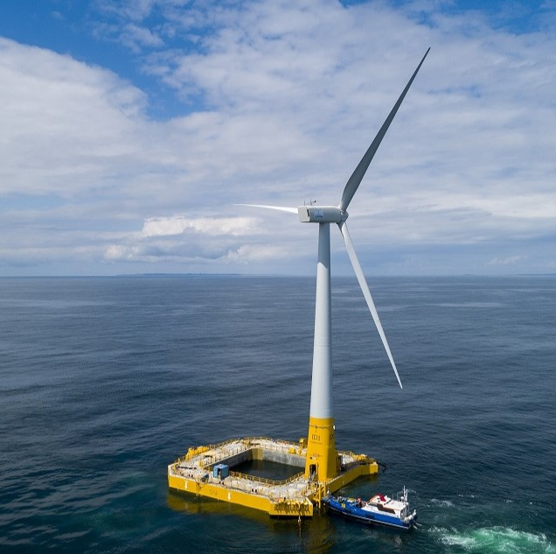
Cameron Mitchell
Director
St. George's Court
Upper Church Street Douglas
Isle of Man
IM1 1EX
BRITISH ISLES
Tel: +44 (0)1624 688500
Mob: +44 (0)7365805422
www.iomshipregistry.com

