Slide 1
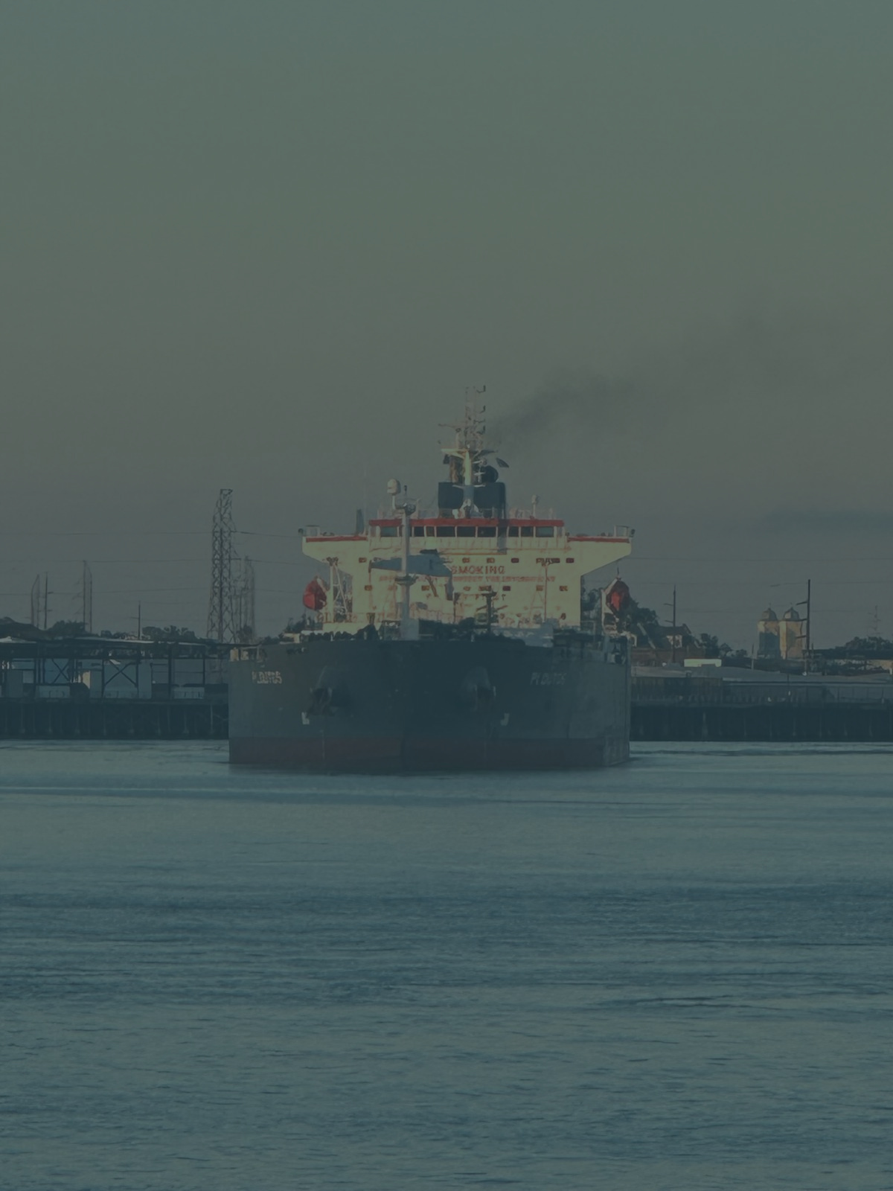

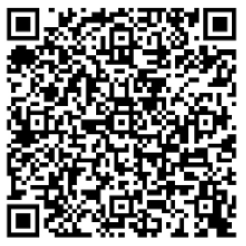
Sanctions and legal issues in shipping:
A perspective from the evolving situation in
Colombia and Venezuela
Javier franco
socio
Franco & abogados asociados s.a.s.
www.francoabogados.com.co

Slide 2

Sanctions
Different countries (U.S./U.K.) and organizations (ie. E.U.)
Many (and different) subjects involved/targeted (natural or legal persons, institutions, governmental institutions, vessels)
Regarding Venezuela - NOT really a new topic
US sanctions – Office of Foreign Assets Control (OFAC) – US Department of Tresasury.
The main implication – commercial/financial

Slide 3
Sanctions
Countries in which the sanctions have focused:
Russia
Venezuela
Iran
North Korea
US Sanctions regarding Venezuela:
Executive Orders – U.S. President
OFAC – administering and enforcing the sanctions

Slide 4
Sanctions
Countries in which the sanctions have focused in practice:
Russia
Venezuela
Iran
North Korea
US Sanctions regarding Venezuela:
Executive Orders – U.S. President (in particular EO 13692, EO 13850, EO 13884, EO 14373, EO 13857)
OFAC – administering and enforcing the sanctions
Venezuela Sanctions Regulations (31 CFR Part 591)
Licences (general or specific)

Slide 5
Sanctions
Executive Orders – U.S. President (Pre-Maduro’s arrest era)
EO 13692
Venezuela’s “National Emergency” - “unusual and extraordinary threat”
EO 13850
Certain natural or legal persons supporting the regime (not just governmental employees)
EO 13884
Property or interest of the Government of Venezuela (agencies and/or controlled entities)

Slide 6
LICENSES
Executive Orders – U.S. President (Pre-Maduro’s arrest era)
General License 30A
Very specific scope
“Ordinarily incident and necessary to operation and use of ports (…) in Venezuela”
Trading, export, movement of Venezuelan oil by ship required specific license and thus was quite restricted.

Slide 7
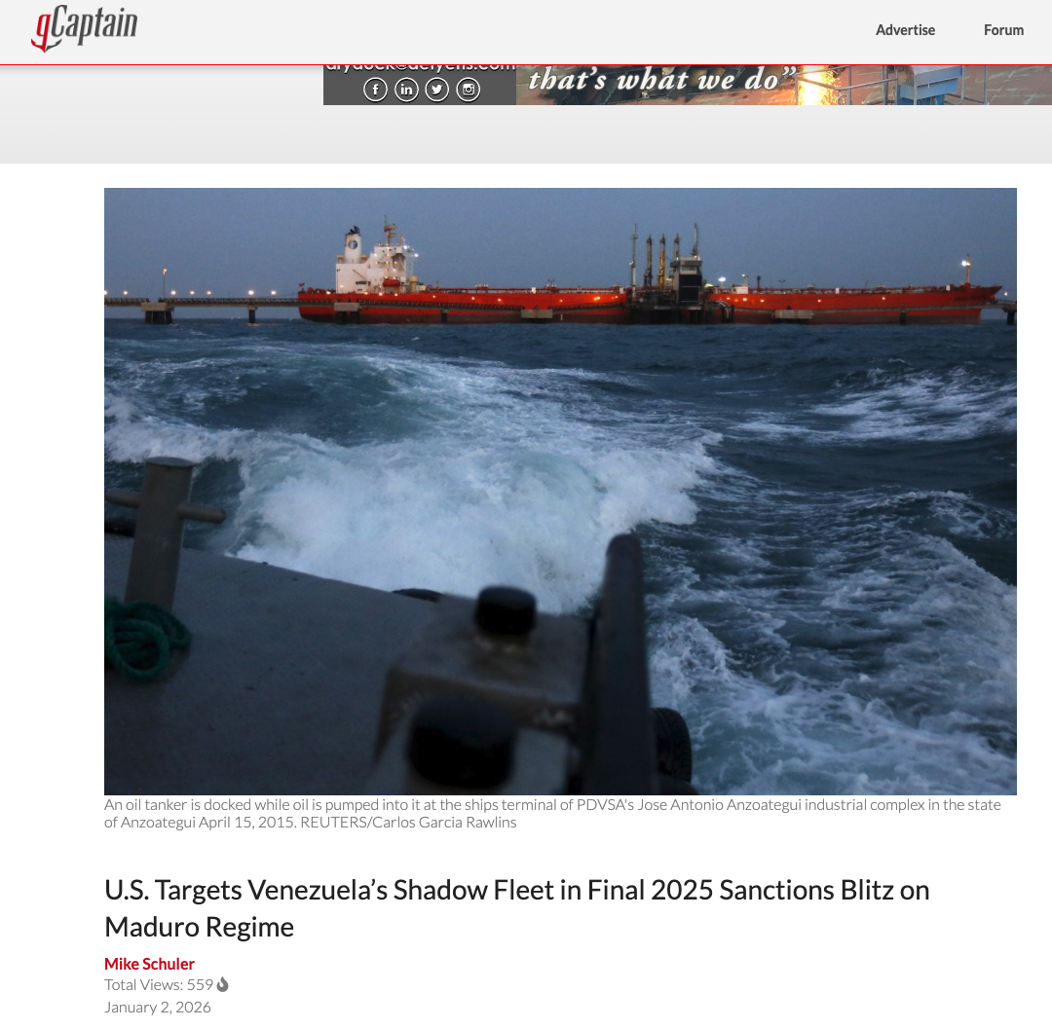
2nd January 2026…
“President Trump has been clear: We will not allow the illegitimate Maduro regime to profit from exporting oil while it floods the United States with deadly drugs,” said Secretary of the Treasury Scott Bessent. “The Treasury Department will continue to implement President Trump’s campaign of pressure on Maduro’s regime.”
On December 31, 2025, the Treasury’s Office of Foreign Assets Control (OFAC) designated the companies for operating in Venezuela’s oil sector, targeting vessels that form part of the shadow fleet serving the South American nation.
https://gcaptain.com/u-s-targets-venezuelas-shadow-fleet-in-final-2025-sanctions-blitz-on-maduro-regime/

Slide 8
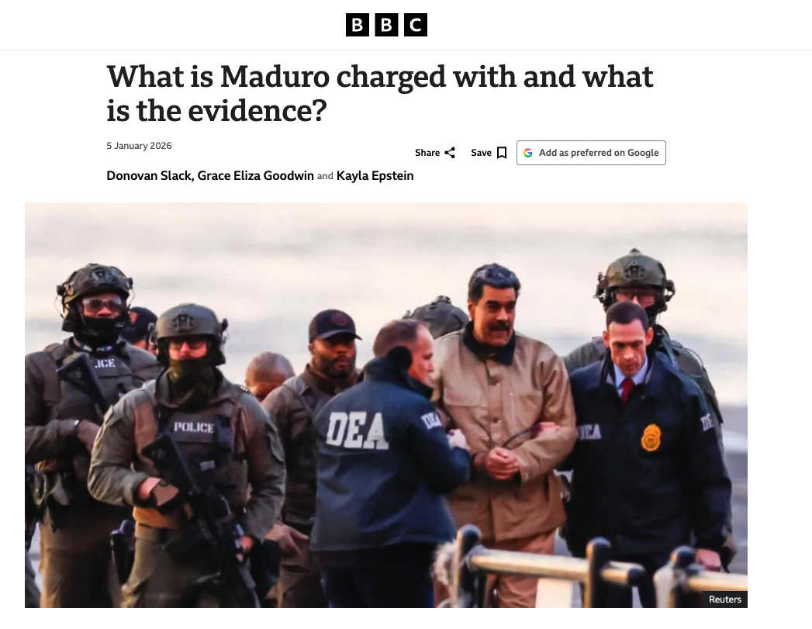
BUT Then, the world change…
https://www.bbc.com/news/articles/cwyndnqqey5o

Slide 9
Sanctions
Situation AFTER 3 jan/2026
EO 14373 (Jan. 9/2026)
Changes after the Maduro extraction and re-designing new licensing scheme - Foreign Government Deposit Funds (protection of funds)
Focal point for new licences in oil, petrochemicals, logistics, chartering, P&I, port and terminal services

Slide 10
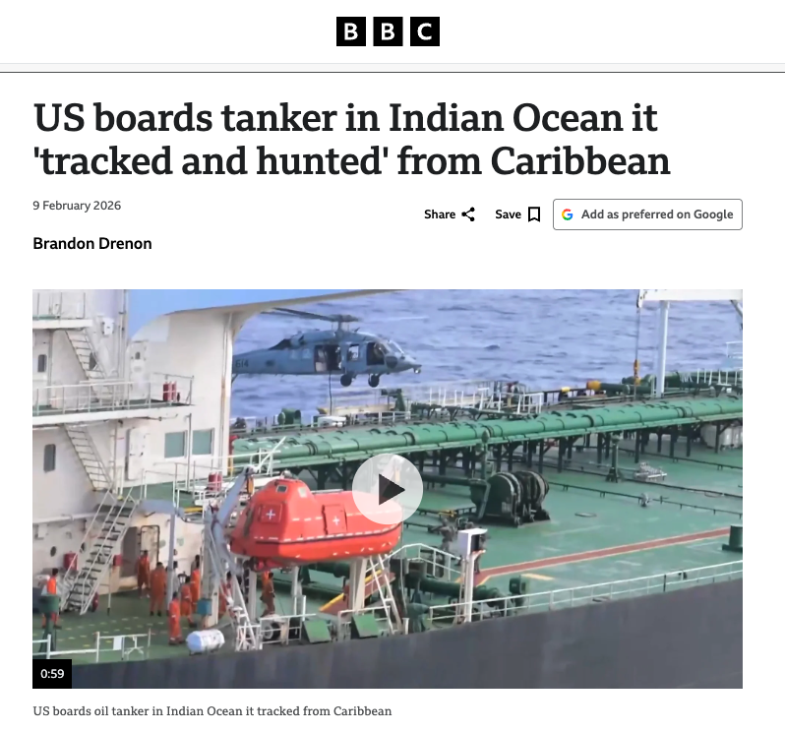
The quarantine PERIOD…
“US officials said the ship - named Aquila II - was operating in defiance of a US "quarantine of sanctioned vessels in the Caribbean".”
“The US blockade has sharply curtailed Venezuelan oil exports, with only ships associated with Chevron and bound for the US operating as usual”.
At least seven oil tankers have been seized by the US since last year, as the Trump administration moves to control the supply of Venezuelan oil, the country's main economic resource.
https://www.bbc.com/news/articles/c5y4dyp0765o

Slide 11
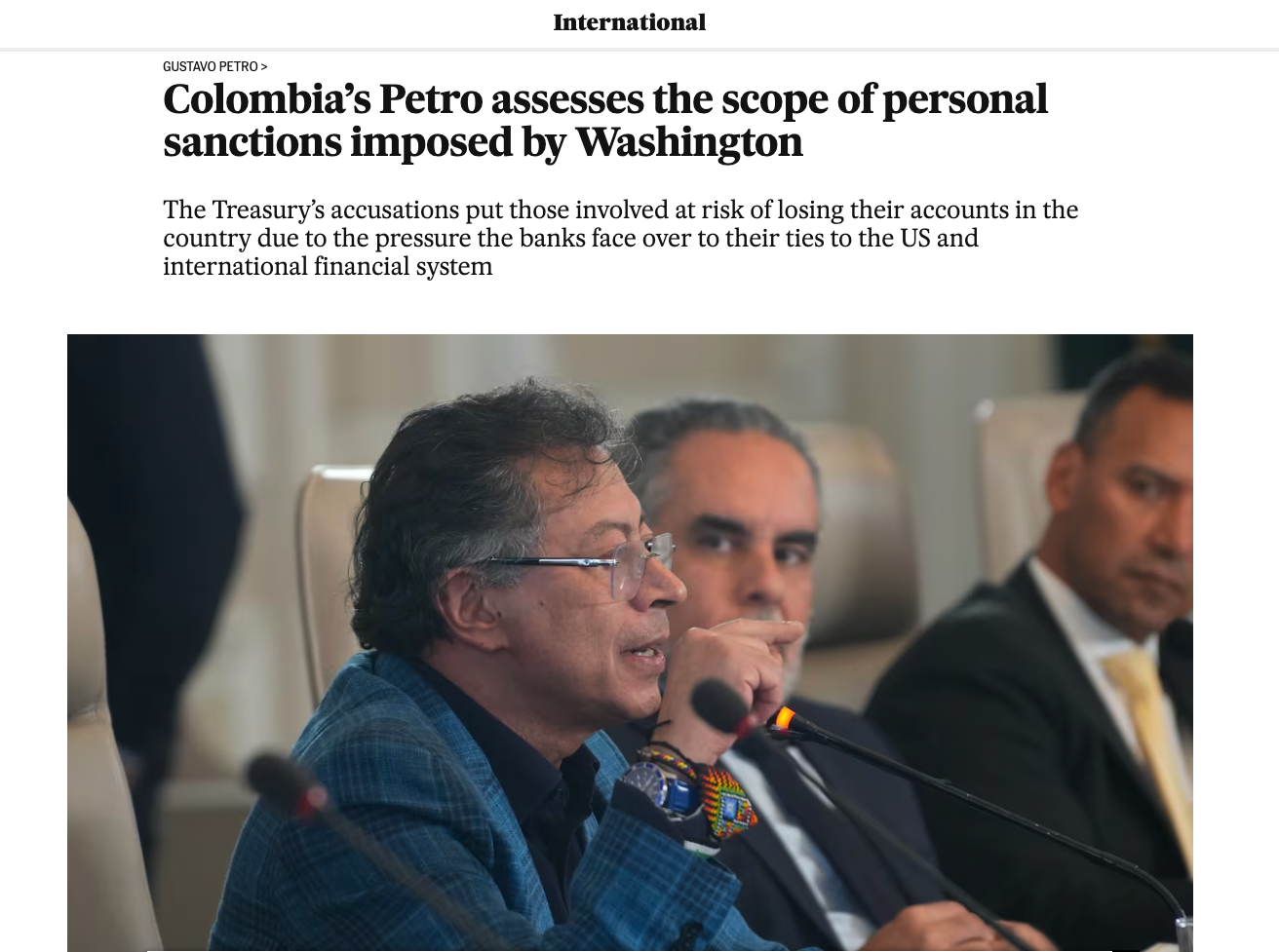
The situation for Colombia…
https://english.elpais.com/international/2025-10-28/colombias-petro-assesses-the-scope-of-personal-sanctions-imposed-by-washington.html

Slide 12

WE need a lawyer…
For an operation with a vessel that does not has class.
To carry oil from Venezuela but do not worry… we’re not going to Cuba.
https://screenrant.com/batman-batphone-gadget-explode-commissioner-gordon-joker/

Slide 13
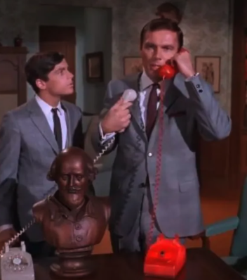
WE need a lawyer…
No,
Thanks!
I’m not BATMAN…
mmmm… but in reality
https://www.themarysue.com/bruce-wayne-batman-phone/

Slide 14
The new normal…
Main new or amended licenses in 2026 were GL 30B, 46B, 47, 48A, 49A, 50A and 52, all mainly related to oil and gas.
License 30B – Authorizing Certain Transactions Necessary to Port and Airport Operations, issued on February 10, 2026.
Permitted or authorized certain transactions and/or activities regarding exportation of diluents to Venezuela and clarified that license covers port fees and customs duties.

Slide 15
The new normal…
46B regarding certain activities related to “lifting, exportation, reexportation, sale, resale, supply, storage, marketing, purchase, delivery, or transportation de Venezuelan-origin oil”.
It includes “arranging shipping and logistics services, chartering vessels, obtaining marine insurance and P&I coverage, arranging port and terminal services, engaging with relevant port or maritime authorities” (FAQ 1227).

Slide 16
The new normal…
47B: Certain transactions “incidental and necessary” “related to exportation, reexportation, sale, resale, supply, storage, marketing, delivery, or transportation de U.S.-origin diluents to Venezuela”.
48A: provision of goods, technology, software, or services for the exploration, development, or production of oil, gas, or petrochemical products in Venezuela.
50A: BP PLC, Chevron Corporation, Eni S.p.A., Établissements Maurel & Prom SA, Repsol S.A. y Shell PLC.
52: Certain transactions with PdVSA and to which PdVSA has directly or indirectly 50% or more whenever those are carried out by an established U.S. entity

Slide 17
IN A NUTSHELL…
Governing law: U.S. law + dispute resolution in the United States.
Payments to be made to specific accounts - Foreign Government Deposit Funds - Executive Order 14373.
Compliance report

Slide 18
What about non-us persons…
No risk if certain conditions are met. Good opportunity for third countries shipowners, P&Is, etc.
Transactions with PDVSA and “certain transactions that are ordinarily incident and necessary to, among other activities, the exportation, sale, supply, storage, purchase, delivery, or transportation of Venezuelan-origin oil, petrochemical products, or minerals (including gold)”.
Conditions such as:
  Payment to be made into the Foreign Government Deposit Funds
  Commercially reasonable operation;
  The transaction does not involve a person located in or organized under the laws of sanctioned countries
  No blocked vessel involved
Third party is exposed to be “designated”. ¿Is this good at the end?

Slide 19
What about Colombia?
More business opportunities but also … risk!
Generally speaking… Regime NOT addressed to a non- US person but…
US financial services are critical to international operations
In practice, everyone – including Colombian nationals – would respect the regime.

Slide 20
