Slide 1

Vassilis Vernicos
Scope of application and applicable law : linking the threads of a new international collision regime.
CMI Colloquium
Rio de Janeiro
15 May 2026
E: vev@kvlex.gr
W: www.kvlex.gr

Slide 2
Interconnectivity between scope of application and jurisdiction

Slide 3
TABLE A
Convention | Scope of application | Jurisdiction
1989 Salvage | This Convention shall apply whenever arbitral or Court proceedings are brought in a State Party (art. 2) | State Party (art. 2)
1976 LLMC | This Convention shall apply whenever any person referred to in Article 1 seeks to limit his liability before the Court of a State Party or seeks to procure the release of a ship or other property or the discharge of any security given within the jurisdiction of any such State (art. 15) | Any person alleged to be liable may constitute a fund with the Court or other competent authority in any State Party in which legal proceedings are instituted in respect of claims subject to limitation (art. 11)
1969/1992 CLC | This Convention shall apply exclusively : (a) to pollution damage caused (i) in the territory, including territorial sea, of a Contracting State, and (ii) in the exclusive economic zone of a Contracting State (Art. II) | Where an incident has caused pollution damage in the territory, including the territorial sea … of one or more Contracting States, or preventive measures have been taken to prevent or minimize pollution damage in such territory including the territorial sea … actions for compensation may only be brought in the Courts of any such Contracting State or States (Art. IX.1) After the fund has been constituted … the Courts of the State in which the fund is constituted shall be exclusively competent to determine all matters relating to the apportionment and distribution of the fund (Art. IX.3)
1992/2000 Fund | This Convention shall apply exclusively : (a) to pollution damage caused (i) in the territory, including territorial sea, of a Contracting State, and (ii) in the exclusive economic zone of a Contracting State (Art. 3) | Subject to the subsequent provisions of this Article, any action against the Fund for compensation under article 4 of this Convention, shall be brought only before a Court competent under Article IX of the 1992 Liability Convention (Art. 7.1) Each Contracting State shall ensure that its Court possess the necessary jurisdiction to entertain such actions against the Fund as are referred to in paragraph 1 (Art. 7.2)

Slide 4
2001 Bunker | This Convention shall apply exclusively : (a) to pollution damage caused (i) in the territory, including territorial sea, of a State Party, and (ii) in the exclusive economic zone of a State Party (Art. 2) | Where an incident has caused pollution damage in the territory, including the territorial sea, or in an area referred to in article 2(a)(ii) of one or more States Parties, or preventive measures have been taken to prevent pollution damage in such territory, including the territorial sea… actions for compensation against the shipowner, insurer or other person providing security … may be brought only in the Courts of any such States Parties (Art. 9.1) Each State Party shall ensure that its Courts have jurisdiction to entertain actions for compensation under this Convention (Art. 9.3)
1952 Arrest | The provisions of this Convention shall apply to any vessel flying the flag of a Contracting State in the jurisdiction of any Contracting State (Art. 8.1) | A ship may only be arrested under the authority of a Court or of the appropriate judicial authority of the Contracting State in which the arrest is made (Art. 4)
2001 Wreck removal | Except as otherwise provided in this Convention, this Convention shall apply in the Convention Area (Art. 3.1) “Convention Area” means the exclusive economic zone of a State Party (Art. 1.1) A State Party may extend the application of this Convention to wrecks located within its territory, including the territorial sea … (Art. 3.2)
2022 Judicial sale of ships | This Convention applies only to a judicial sale of a ship if : (a) the judicial sale is conducted in a State Party and (b) the ship is physically within the territory of the State of judicial state at the time of that sale (Art. 3) | The Courts of the State of judicial sale shall have exclusive jurisdiction to hear any claim or application to avoid a judicial sale of a ship conducted in that State that confers clean title to the ship or to suspend its effects (Art. 9.1)
1924/1968 Hague Visby Rules | The provisions of these Rules shall apply to every bill of lading relating to the carriage of goods between ports in two different States if (a) the bill of lading is issued in a Contracting State or (b) the carriage is from a port in a Contracting State, or … (Art. X).

Slide 5
TABLE B
Convention | Scope of application
1989 Salvage | This Convention shall apply whenever arbitral or Court proceedings are brought in a State Party (art. 2)
1976 LLMC | This Convention shall apply whenever any person referred to in Article 1 seeks to limit his liability before the Court of a State Party or seeks to procure the release of a ship or other property or the discharge of any security given within the jurisdiction of any such State (art. 15)
1969/1992 CLC | This Convention shall apply exclusively : (a) to pollution damage caused (i) in the territory, including territorial sea, of a Contracting State, and (ii) in the exclusive economic zone of a Contracting State (Art. II)
1992/2000 Fund | This Convention shall apply exclusively : (a) to pollution damage caused (i) in the territory, including territorial sea, of a Contracting State, and (ii) in the exclusive economic zone of a Contracting State (Art. 3)
2001 Bunker | This Convention shall apply exclusively : (a) to pollution damage caused (i) in the territory, including territorial sea, of a State Party, and (ii) in the exclusive economic zone of a State Party (Art. 2)
1952 Arrest | The provisions of this Convention shall apply to any vessel flying the flag of a Contracting State in the jurisdiction of any Contracting State (Art. 8.1)
2001 Wreck removal | Except as otherwise provided in this Convention, this Convention shall apply in the Convention Area (Art. 3.1) “Convention Area” means the exclusive economic zone of a State Party (Art. 1.1) A State Party may extend the application of this Convention to wrecks located within its territory, including the territorial sea … (Art. 3.2)
2022 Judicial sale of ships | This Convention applies only to a judicial sale of a ship if : (a) the judicial sale is conducted in a State Party and (b) the ship is physically within the territory of the State of judicial state at the time of that sale (Art. 3)
1924/1968 Hague Visby Rules | The provisions of these Rules shall apply to every bill of lading relating to the carriage of goods between ports in two different States if (a) the bill of lading is issued in a Contracting State or (b) the carriage is from a port in a Contracting State, or … (Art. X).

Slide 6
The two-fold collision exception

Slide 7
1910 Collision Convention
Scope of application provisions only
Article 1
Where a collision occurs between sea-going vessels or between sea-going vessels and vessels of inland navigation, the compensation due for damages caused to the vessels, or to any things or persons on board thereof, shall be settled in accordance with the following provisions, in whatever waters the collision takes place.
Article 12
The provisions of this Convention shall be applied as regards all persons interested when all the vessels concerned in any action belong to States of the High Contracting Parties, and in any other cases for which the national laws provide.
Provided always that:
1. As regards persons interested who belong to a non-Contracting State, the application of the above provisions may be made by each of the contracting States conditional upon reciprocity.
2. Where all persons interested belong to the same State as the court trying the case, the provisions of the national law and not of the Convention are applicable.

Slide 8
Two failed attempts
A. 1952 International Convention on certain rules concerning civil jurisdiction in matters of collision.
Article 1
(1) An action for collision occurring between seagoing vessels or between seagoing vessels and inland navigation craft, can only be introduced :
(a) either before the Court where the defendant has his habitual residence or a place of business ;
(b) or before the Court of the place where arrest has been effected of the defendant ship or of any other ship belonging to the defendant which can be lawfully arrested , or where could have been effected and bail or other security has been furnished ;
(c) or before the Court of the place of collision when the collision has occurred within the limits of a port or in inland waters.
(2) It shall be for the Plaintiff to decide in which of the Courts referred to in para. 1 of this article the action shall be instituted.

Slide 9
Continue…
B. 1977 Draft International Convention for the unification of certain rules concerning civil jurisdiction, choice of law, and recognition and enforcement of judgments in matters of collision.
Article 2 (Jurisdiction)
(1) Unless the parties otherwise agree, the plaintiff may prosecute such an action only in a Court of a State Party to this Convention :
a) where the defendant has his habitual residence or domicile, or principal place of business ; or
b) in the internal waters or territorial sea of which the collision has occurred ; or
c) where a vessel involved in the collision (other than the plaintiff’s own vessel) or a vessel under the same ownership lawfully subject to arrest, has been arrested or security has been provided to avoid arrest on account of the collision ; or
d) where the defendant has property subject to attachment under the law of that State and such property has been attached or security has been provided to avoid attachment on account of the collision ; or
e) where a limitation fund has been properly constituted by the defendant in accordance with the law of that State on account of the collision.

Slide 10
Continue…
Article 4 (Choice of law)
Unless the parties otherwise agree, when a collision occurs in the internal waters or territorial sea of a State the law of that State shall apply, and when a collision occurs in waters beyond the territorial sea, the law of the Court seized of the case shall apply, except that when all the vessels involved are registered or otherwise documented or, if not registered or otherwise documented, owned in the same State, the law of that State shall apply, wherever the collision occurs.

Slide 11
Complications in relation to the application of the 1910 Convention
When:
Proceedings are commenced in Non Contracting States, where
- a defendant has his residence/principal place of business,
- or collision has occurred in internal waters,
- or vessel has been arrested/security has been provided,
- or limitation fund has been established.
1910 Convention applies only if, pursuant to the Conflict of Laws rules of the Non Contracting State, the law applicable is the law of a Contracting State.
Reasons :
- Commencement of proceedings in Non Contracting State
- Absence of choice of law provisions in CC 1910 / JCC 1952
- No ratification of CC 1910 by flags of convenience

Slide 12
The proposed extended scope of application regime

Slide 13
Article 1.2 – Scope of Application
(1) This Convention shall govern the jurisdiction, choice of law, allocation of liabilities, and the evaluation of damages in collision actions, including recourse actions, for loss or damage arising from collisions between vessels taking place:
(i) in any waters where all colliding vessels were [registered] [flagged] in member states, (reflects existing article 12 para. 1)
(ii) in the inland waters, territorial sea [, contiguous zone or exclusive economic zone] of a member state, or (new provision)
(iii) in any waters where so provided by the national laws of a member state (reflects existing article 12 para 1)
(2) This Convention shall not apply to collisions:
(i) to which the 1960 Convention relating to the unification of certain rules concerning collisions in inland navigation applies, if the state where proceedings are brought is also a contracting state of the 1960 Convention; (new provision)
(ii) between inland waterway vessels if the member state where the collision occurs has opted to exclude inland waterway vessel collisions from the application of this convention, or (new provision)
(iii) involving ships of war or to Government ships appropriated exclusively to a public service, subject always to the national laws of the state of origin of such ships (reflects existing article 11 with amendment)

Slide 14
Abandoning the flag criterion ?
- 1989 Salvage Convention
Article 1.
The Convention shall apply whenever judicial or arbitral proceedings relating to a collision are initiated in a contracting state.
For:
(i) expanding the scope of application well beyond the 1910 regime and the current draft text.
(ii) flag often not sufficiently representative of a connection with a Contracting State
(iii) useful in avoiding complications encountered with regard to applicable law in collisions occurring on the high seas
Against:
(i) Overlap between scope of application and jurisdiction, which make the latter provisions surplus to requirements
(ii) favours forum shopping
(ii) need to refer to national legislation to establish jurisdiction (iv) uncertainty of application until commencement of proceedings
(v) collision distinguished from salvage

Slide 15
Applicable law and “the kingdom of the Contracting State”

Slide 16
The new provision
Article 9.2 (Applicable law)
Unless the parties agree or have otherwise agreed, where a collision occurs in the internal waters or territorial sea [or exclusive economic zone] of a State party, the law of that State shall apply to issues not otherwise regulated by this Convention, and where a collision occurs elsewhere, the law of the court seized of the incident shall apply, except that where all of the vessels involved are flagged in the same State, the law of that State shall apply, wherever the collision may occur. The application of such law shall mean the application of the substantive rules of such law to the exclusion of any rule of private international law.

Slide 17
Historical evolution
A. 1910 CC Brussels regime:
- 1897 Brussels CMI conference, Louis Franck :
« … Pour les abordages en mer, les solutions les plus diverses sont proposees. … les conflits des lois en matière d’ abordage maritime paraissent juridiquement insolubles : la collision devrait etre regie par la lex loci et pareille loi n’ existe pas en pleine mer. … Il reste donc a appliquer la loi du tribunal saisi, et, c’est a quoi se decident la plupart des pays. Telle est la tendance generale de la jurisprudence en Allemagne et en France, et telle est la loi en Angleterre ».
B. The 1977 Rio draft
- Article 4 (Choice of law)
Unless the parties otherwise agree, when a collision occurs in the internal waters or territorial sea of a State the law of that State shall apply, and when a collision occurs in waters beyond the territorial sea, the law of the Court seized of the case shall apply, except that when all the vessels involved are registered or otherwise documented or, if not registered or otherwise documented, owned in the same State, the law of that State shall apply, wherever the collision occurs.

Slide 18
Continue …….
- Article 4 applies to:
basis of liability,
exemption/division of liability
kinds of recoverable damage
quantum of damages
entitlement to sue
vicarious liability
assignment/inheritance of rights
burden of proof & presumptions of law
prescription/time bar

Slide 19
C. Currently prevailing applicable laws in national legislations:
- Collision in territorial or inland waters : Lex loci delicti
- Collision on the high seas : Lex fori
- Setting aside lex loci in favour of lex loci by jurisprudence / Article 4(3) “escape clause” under Rome II.
D. Regulation (EC) 864/2007 on the law applicable to non-contractual obligations (Rome II).
Article 4
(1) Unless otherwise provided for in this Regulation, the law applicable to a non-contractual obligation arising out of a tort/delict shall be the law of the country in which the damage occurs irrespective of the country in which the event giving rise to the damage occurred and irrespective of the country or countries in which the indirect consequences of that event occur.
…
(3) Where it is clear from all the circumstances of the case that the tort/delict is manifestly more closely connected with a country other than indicated in paragraphs 1 or 2, the law of that other country shall apply. A manifestly closer connection with another country might be based in particular on a pre-existing relationship between the parties, such as a contract, that is closely connected with the tort/delict in question (“escape clause”)

Slide 20
Why lex fori instead of lex loci delicti ?
Policy considerations
Reflection of the structural scheme of the Protocol : “the kingdom of Contracting State”
No contradiction to Rome II regime
regulating disputes between contracting parties occurring in non-contracting states as opposed to disputes between contracting/non contracting parties occurring in non contracting states)
potential incompatibility of applicable lex loci delicti of non-contracting state with CC 1910 (see article 4 (3) of Rio draft : “Provided, further, that to the extent that it is established that the law of all of such States is in accordance with the principles of a convention, the Court seized of the case shall, to that extent apply such law”
- Article 7 (3) of CC 1910 : “The grounds upon which the said periods of limitation may be suspended or interrupted are determined by the law of the court where the case is tried”.

Slide 21
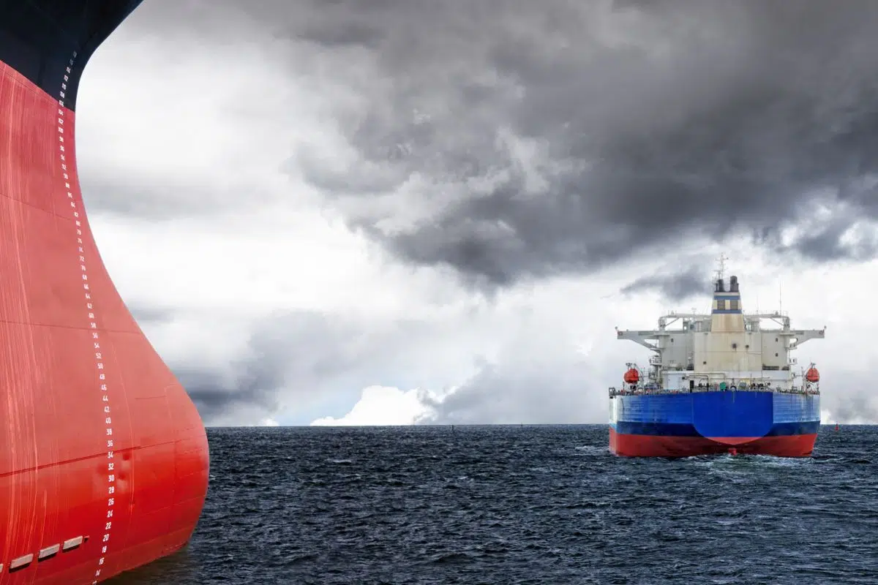
THANK YOU FOR YOUR ATTENTION!

