Slide 1

“Ratification of International Conventions and Operation of Regional Navigation Agreements by Latin American Countries”
Presenter: Dr. Diego Esteban Chami
President, Argentine Maritime Law Association (MLA)

Slide 2
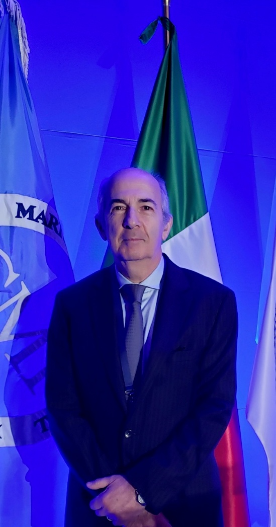
The Hidrovía Paraguay - Paraná

Slide 3
The Hidrovía: 9 Key Questions
1
Is the Hidrovía a river?
2
Is the Hidrovía a waterway?
3
Is it important?
4
Is it a treaty?
5
Which countries are members of the treaty of the Hidrovía?
6
How is the treaty structured?
7
Is it a corporation?
8
Is it a legal system?
9 ?

Slide 4
1. Is the Hidrovía a River?
Not exactly,
it is not just one river
The Hidrovía is made up of several rivers

Slide 5
2. Is the Hidrovía a Waterway?
Yes
it is an international sailing corridor
It is composed of these major rivers:
The Paraguay River
The Paraná River
and other smaller ones
It runs from the Brazilian interior
to the Atlantic Ocean

Slide 6
CONTEXT
3. Is it important?
The total length is
3,334 km
Brazil
Brazil
The route runs
● from Puerto Cáceres, Brazil (north)
● to Nueva Palmira, Uruguay (south)
14 / 30

Slide 7
CONTEXT
3. Is it important?: The 9th longest in the world
1
Amazon
7,062 km
Peru · Colombia · Brazil
2
Nile
6,650 km
Tanzania to Egypt
3
Yangtze
6,300 km
China
4
Mississippi–Missouri
6,375 km
USA
5
Yellow River
5,464 km
China
7
Congo
4,770 km
Zambia · Congo · Angola
8
Mississippi
3,734 km
USA
9
Hidrovía Paraguay-Paraná
3,334 km
Brazil to Uruguay
23 / 30

Slide 8
ECONOMIC IMPORTANCE
3. Is it important? Economic Importance
71%
80×
Saving diesel consumption
Waterway
3.74 L/ton
1 barge = 80 trucks
Hidrovía accounts for
71% Argentina's cereal
& oilseed exports
Train
8.26 L/ton
Truck
32.25 L/ton
Cost savings: 40% vs railway · 220% vs truck
Key countries & roles:
Argentina: cereals & soy · Brazil: grains & minerals · Uruguay: soy, rice, pulp, timber · Bolivia & Paraguay: landlocked access to global markets

Slide 9
3. Convoys: Tug + Barges Types of convoy

Slide 10
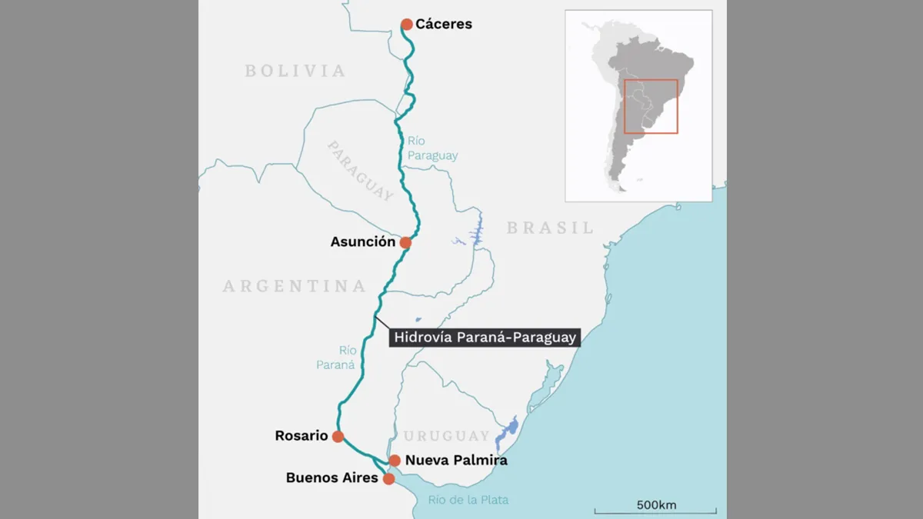
3. Hidrovía Map

Slide 11
ECONOMIC IMPORTANCE
3. Is it important? main ports on the Waterway
Puerto Cáceres
Brazil
Northern terminus of the waterway
Corumbá
Brazil
Key iron ore & mineral export hub
Asunción
Paraguay
Capital; major river transport center
Rosario
Argentina
World's largest grain export complex
Santa Fe
Argentina
Industrial and agricultural gateway
Nueva Palmira
Uruguay
Southern terminus; free port zone
14 / 30

Slide 12
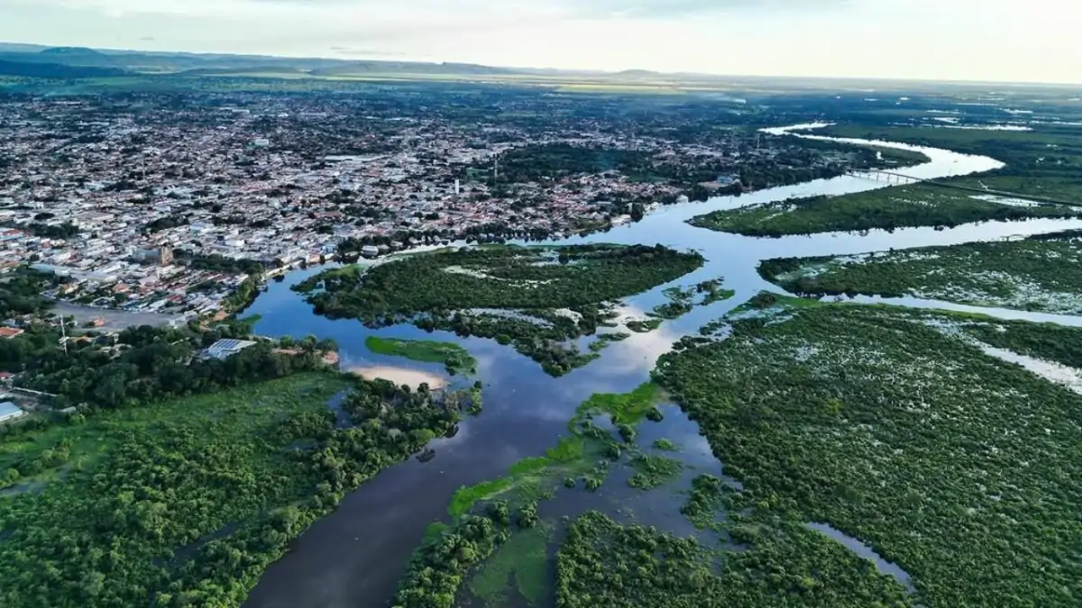
Puerto Cáceres, Brazil · Northern terminus

Slide 13
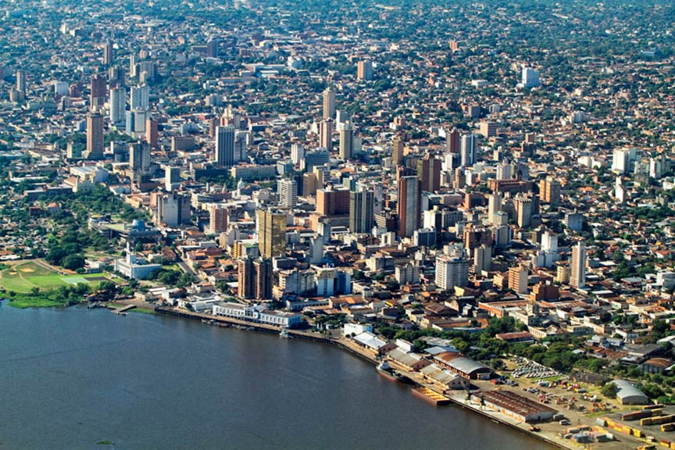
Asunción, Paraguay · Capital & major river transport center

Slide 14
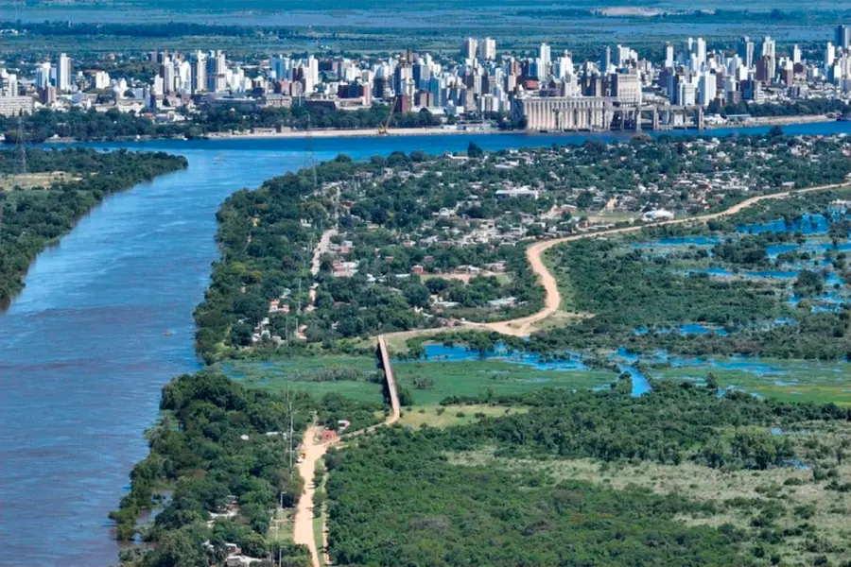
Santa Fe, Argentina · Industrial & agricultural gateway

Slide 15
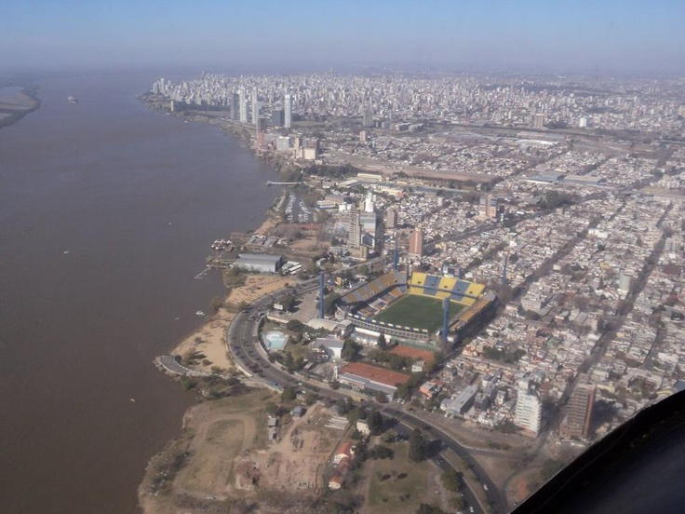
Rosario, Argentina · World’s largest grain export complex

Slide 16
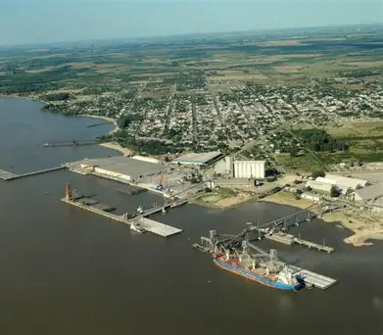
Nueva Palmira, Uruguay · Southern terminus

Slide 17
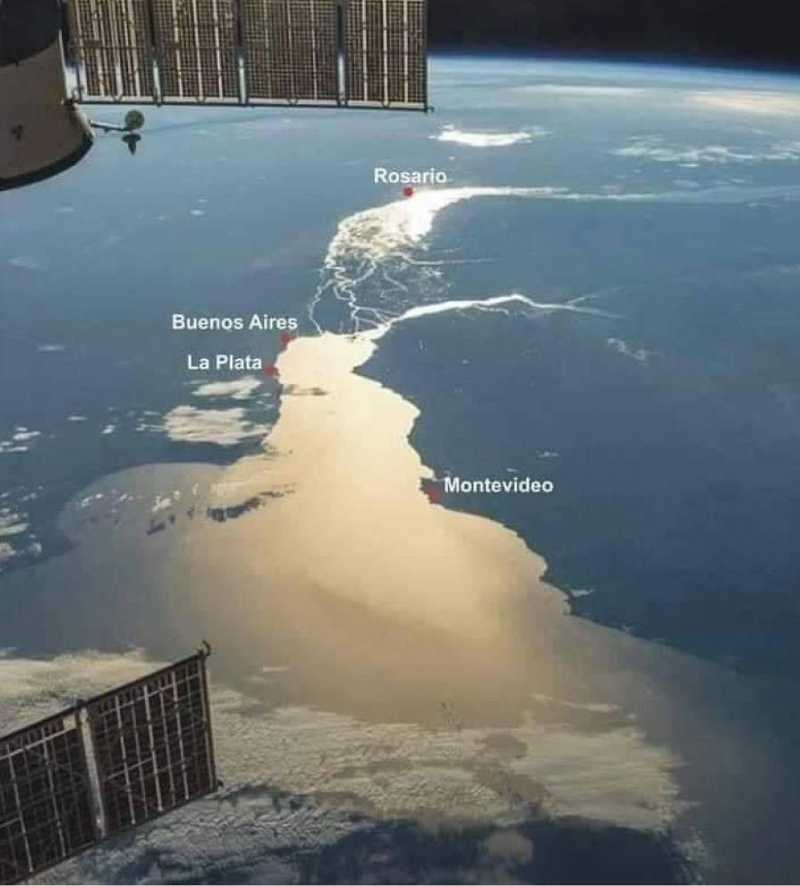
Río de la Plata · Southern gateway to the Atlantic

Slide 18
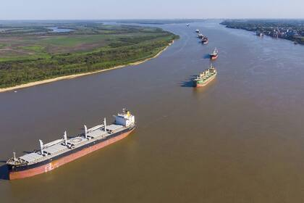
Commercial convoy in transit

Slide 19
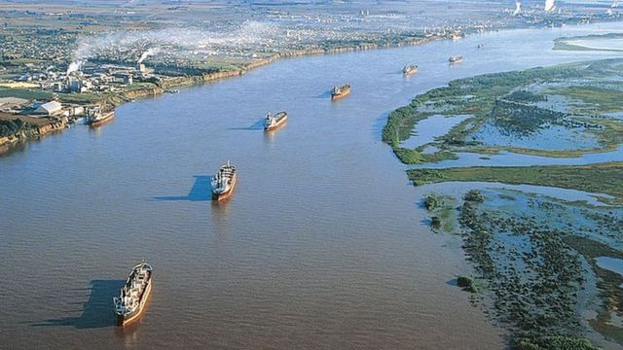
River navigation corridor

Slide 20
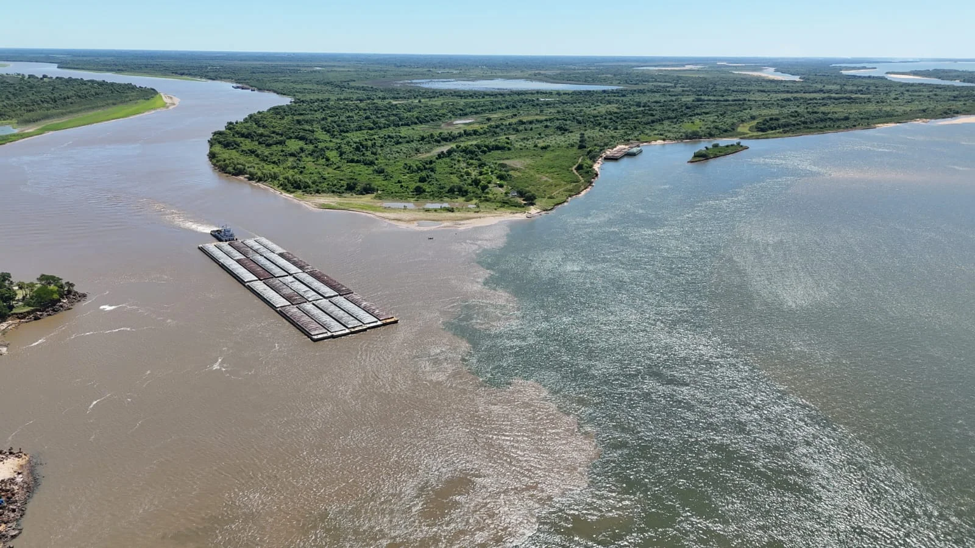
A convoy of a tug with 20 barges

Slide 21
4. Is the Hidrovía a Treaty?
Yes
it is a treaty
The Hidrovía is governed by a formal multilateral agreement:
“Agreement on River Transport for the Paraguay-Paraná Waterway (Puerto Cáceres – Nueva Palmira)”
a formal multilateral treaty
Signed on June 26, 1992
Entered into force: March 13, 1995

Slide 22
5. Which countries are members of the Treaty?

Slide 23
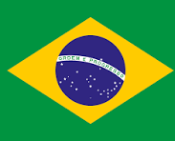
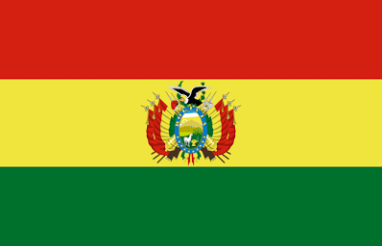
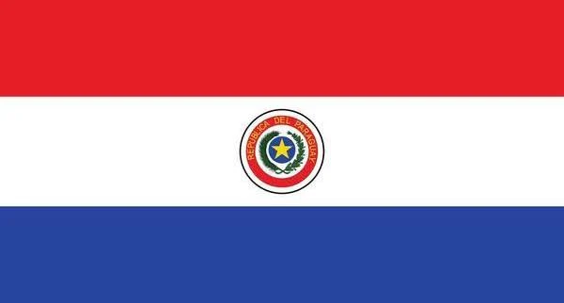
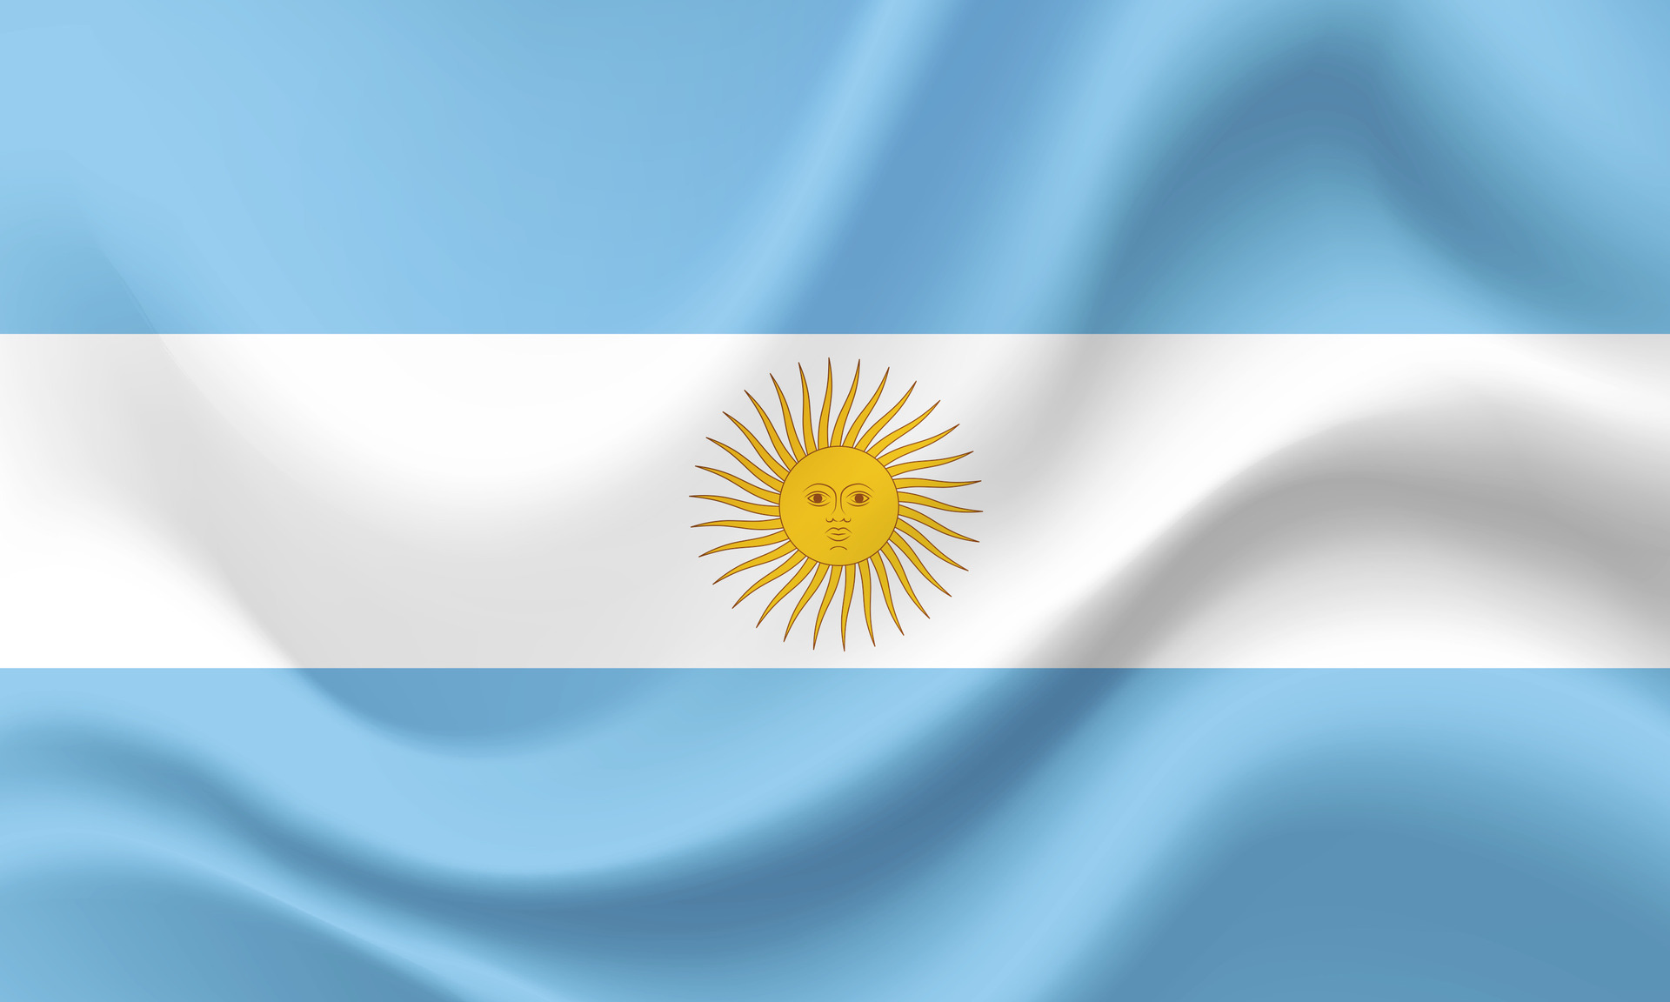
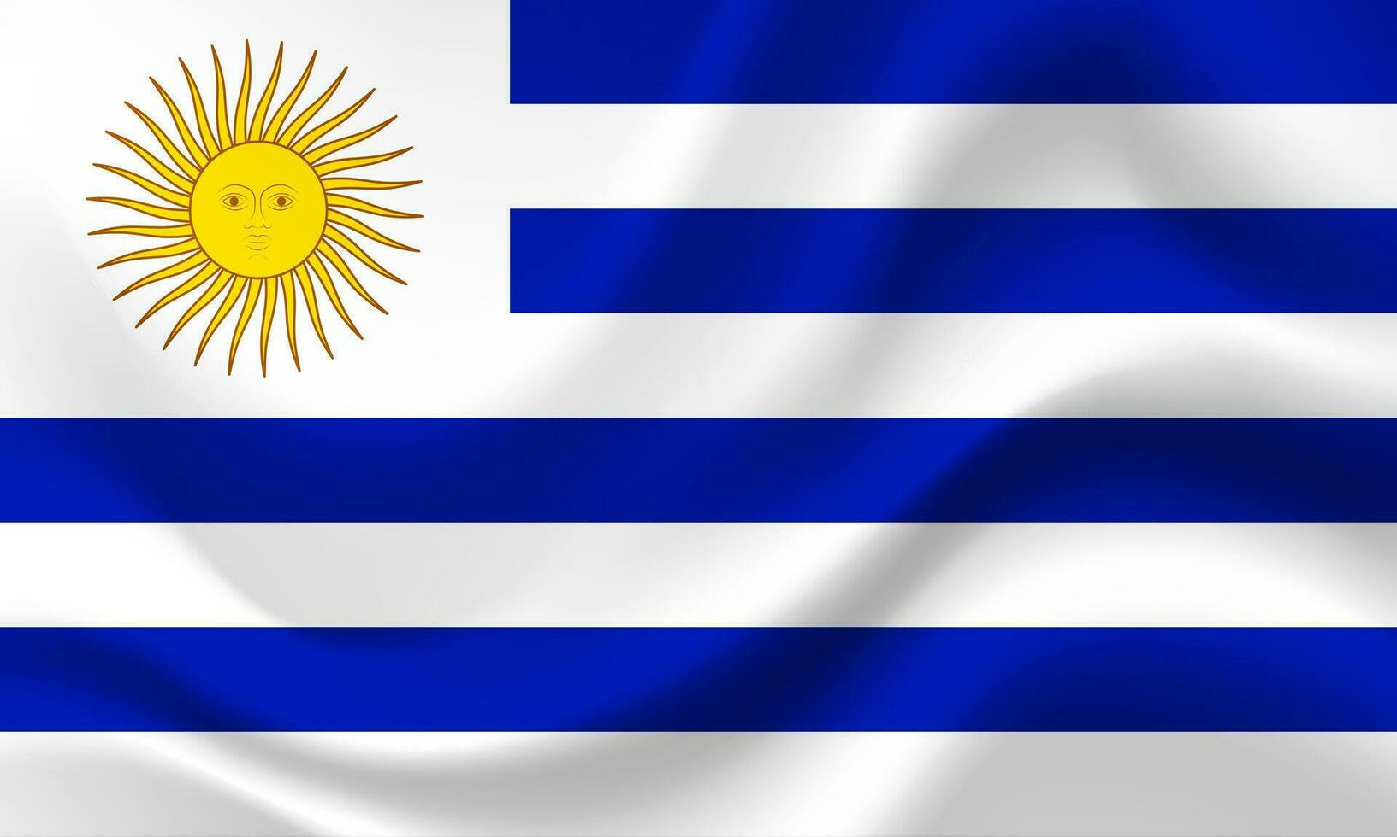
5. Which countries are members of the Treaty?
Brazil
Bolivia
Paraguay
Argentina
Uruguay
890 km
48 km
375 k
1,240 km
Nueva Palmira

Slide 24
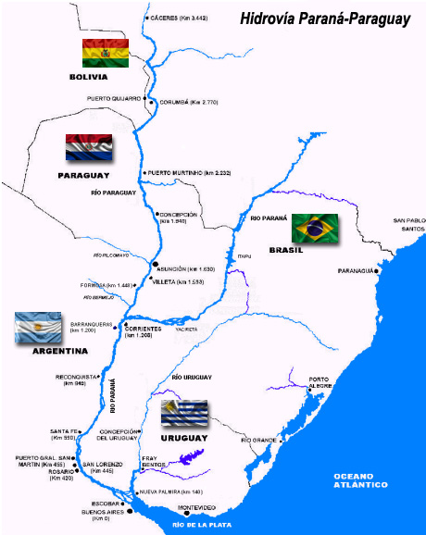

Slide 25
6. How is the Treaty structured?
A) Main Transport Agreement
B) Additional Protocols (×6)
C) Regulations (×14)
Core framework
Important protocols
Technical standards: buoyage, tonnage, convoy dimensions, pilot rules, pollution prevention and more.

Slide 26
6. Principles of the Main Transport Agreement
Freedom of navigation for vessels of all flags (art. 4)
Reservation of NATIONAL transport for vessels of the member country (art. 11)
Reservation of REGIONAL transport for shipowners of the 5 states (art. 10)

Slide 27
PROTOCOLS & REGULATIONS
6. Additional Protocols
Protocol 1
Protocol 4
Customs matters
Equal opportunity & competitiveness
Protocol 2
Protocol 5
Navigation and safety
Dispute resolution
Protocol 3
Protocol 6
Insurance
Temporary cessation of flag
11 / 30

Slide 28
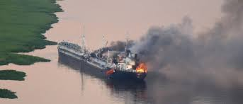
6. Navigation & Safety Protocol — arts. 46 & 61

Slide 29
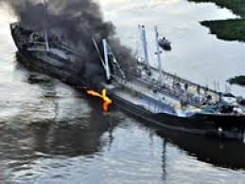
6. Navigation & Safety Protocol — arts. 46 & 61

Slide 30
6. Navigation & Safety Protocol — arts. 46 & 61
The member countries adopted
the COLREG 1972 and
the 1910 Collisions Convention
Key point:
● Provides legal certainty for vessels through multiple national jurisdictions

Slide 31
6. 14 Technical Regulations
1. Transport of Goods on Deck
2. Buoyage
3. Uniform Glossary of Port Services
4. Prevention of Collisions
5. Determining Vessel Tonnage
6. Communications Plan for Navigation Safety
7. Maximum Dimensions of Convoys
8. Freeboard and Stability
9. Common Requirements for Vessel Registration
10. Inspections & Safety Certificates
11. Single System of Infractions and Sanctions
12. Pilot Regulations
13. Personnel Training and Certification
14. Prevention of Pollution (RIOCON)

Slide 32
7. Is the Hidrovía a Corporation?
Yes,
including the 5 states
Not supranational
● Decisions require unanimity (veto power)
● Rules must be incorporated into national law
● No direct enforcement mechanism

Slide 33
7. Hidrovía: Governance Structure
CIH — Intergovernmental Committee
Political body.
Agreement Commission
Technical & regulatory body.
Executive Secretariat
Administrative body.

Slide 34
8. Is it a legal system?
Yes — composed of:
1
The Main Agreement
2
6 Protocols
3
14 Regulations

Slide 35
Summary
1
The Hidrovía is a waterway, a treaty, a corporation, and a legal system
2
Freedom of navigation (Art. 4) applies to all flags together with NATIONAL and REGIONAL CARGO RESERVATION
3
The 1910 Brussels Convention on collisions and the COLREG applies to the Hidrovía
4
5

Slide 36
“Ratification of International Conventions and Operation of Regional Navigation Agreements by Latin American Countries”
Focus on the
Hidrovía Paraguay - Paraná

