Slide 1
Green corridors
CMI Rio Colloqium
Wednesday 13 May 2026
Panel on
Decarbonisation affecting Ports & Terminals
Haris Zografakis
Senior Consultant,
Stephenson Harwood LLP, London.

Slide 2
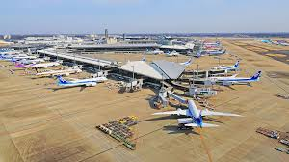
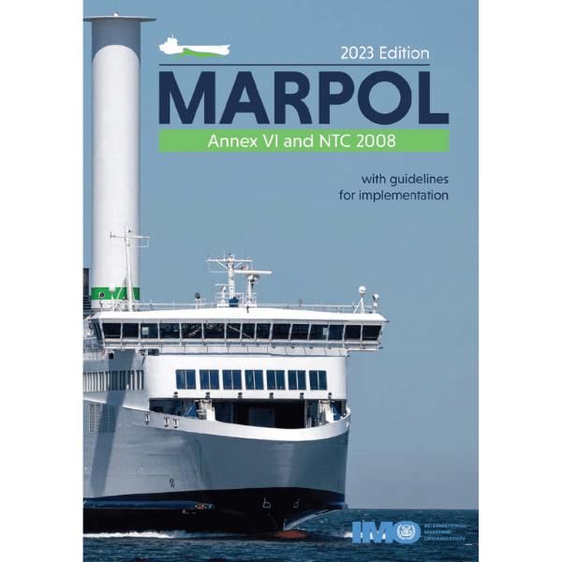
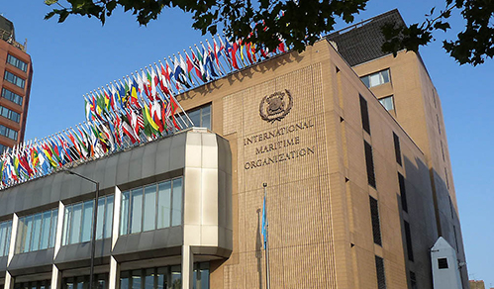
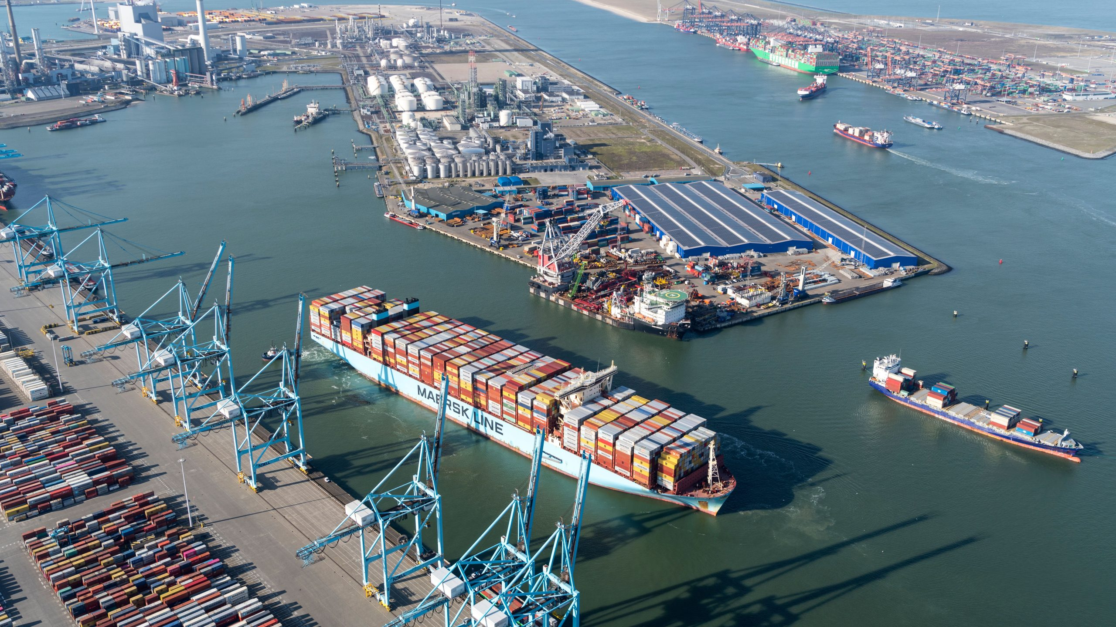

Slide 3
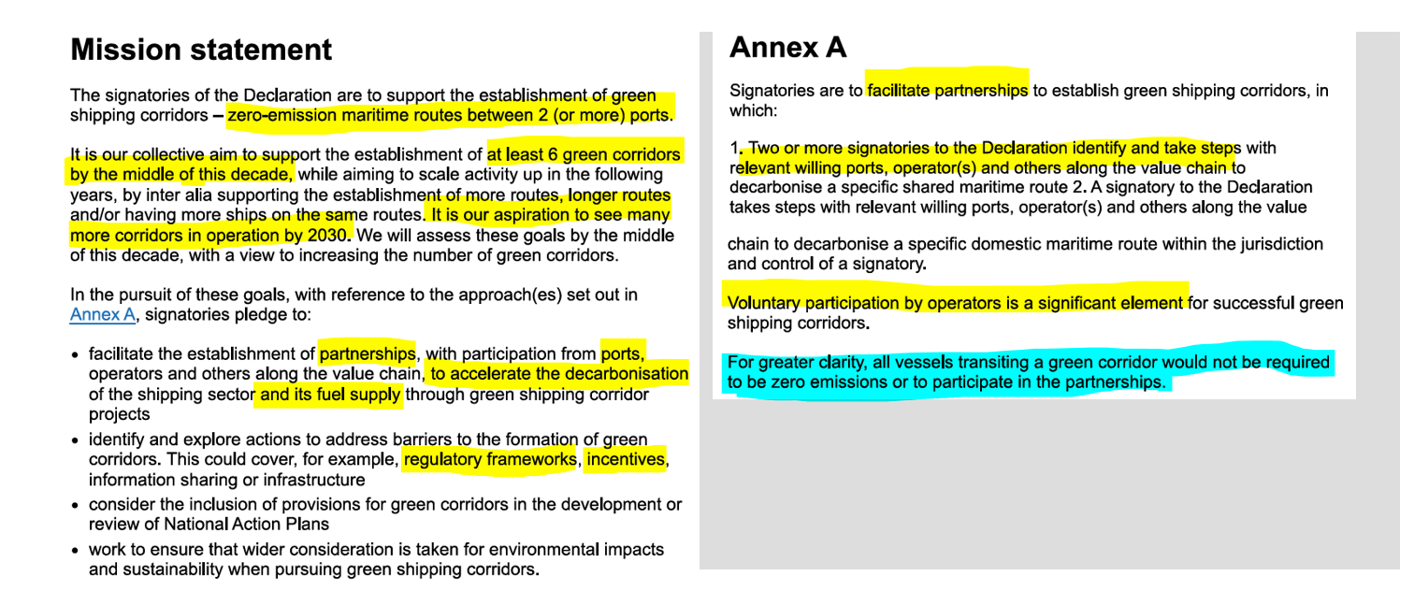
The policy foundation
Of green corridors
Clydebank
Declaration,
COP26,
Glasgow

Slide 4
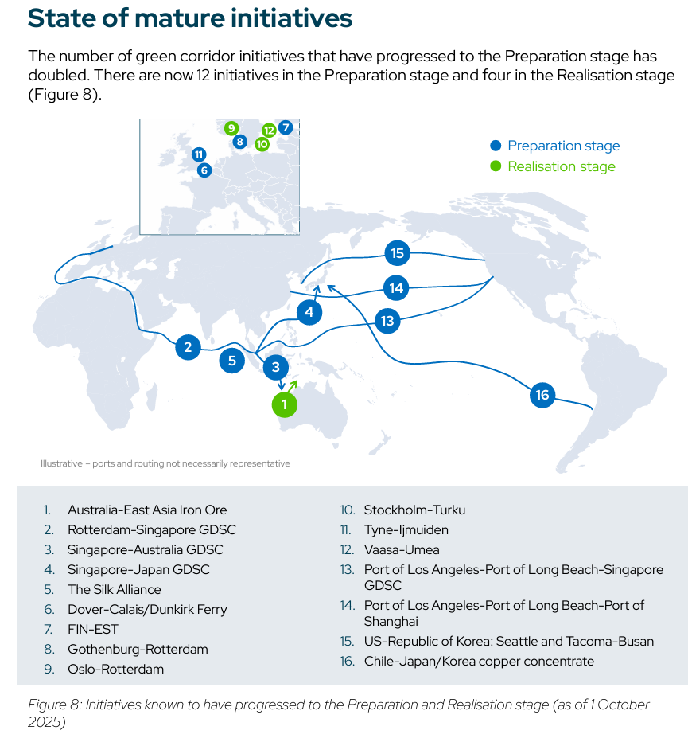
A GEOGRAPHY OF GREEN CORRIDORS
Source: UCL Energy Institute

Slide 5
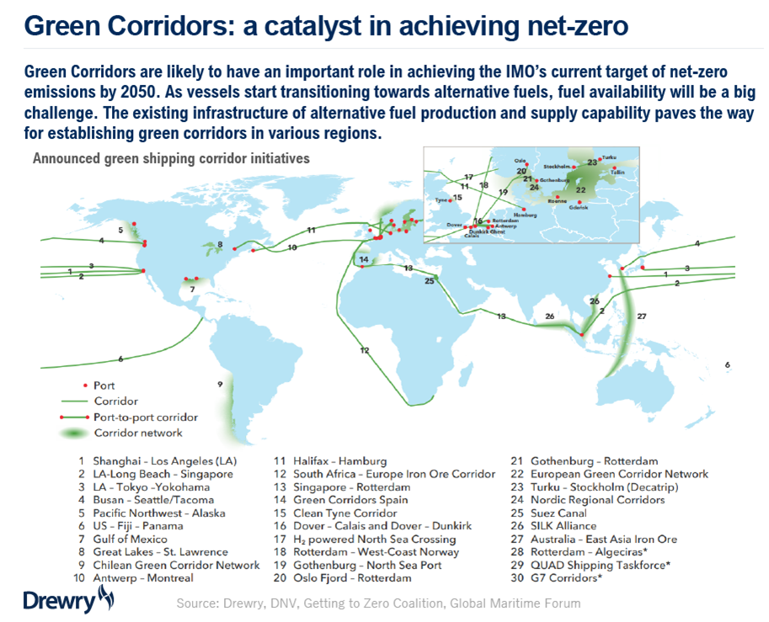
A GEOGRAPHY OF GREEN CORRIDORS
Source: UCL Energy Institute

Slide 6
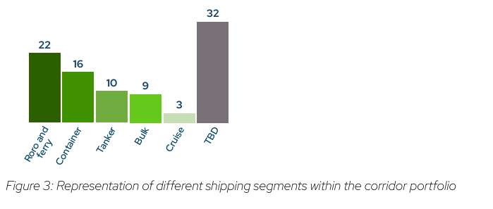
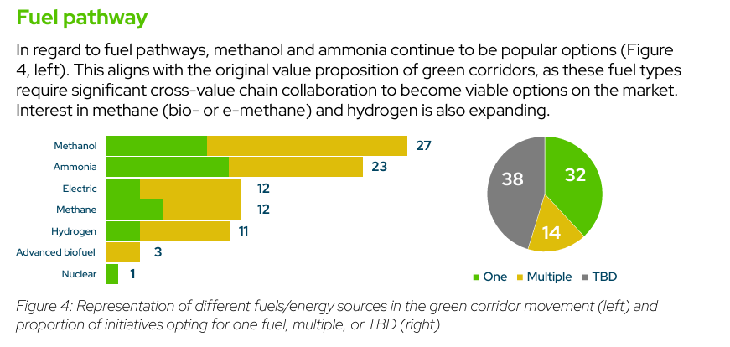
A typology OF GREEN CORRIDORS
Source: Global Maritime Forum

Slide 7
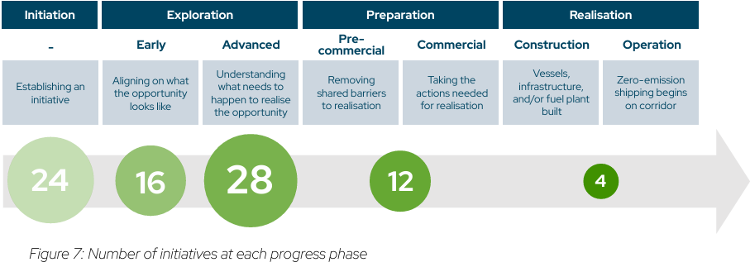
THE MATURITY STATUS OF GREEN CORRIDORS
Source: Global Maritime Forum

Slide 8
Concepts
Single Point (Silk Alliance v1)
Point-to-Point (C5)
Network (Silk Alliance v2)
Segments
Domestic pax/ro-pax/ro-ro
International ro-ro/ro-pax
International container line
International bulk trade
Elements
Green electricity
Green fuel production
Port logistics & bunkering
Green vessels
Cargo demand
(incl. virtual)

Slide 9
Legal issues
Structure
  JV?
  vertically integrated?
Finance
  Project?
  Asset?
Spot trading & access
  Open or closed?
  Dedicated vessels or worldwide trading?
Contractual framework
  Charterparties or something else?
Anti-trust & state-aid
Insurance
  Risk allocation?
Applicable law
  Local?
  International uniformity?

Slide 10
Green corridors
CMI Rio Colloqium
Wednesday 13 May 2026
Panel on
Decarbonisation affecting Ports & Terminals
Haris Zografakis
Senior Consultant,
Stephenson Harwood LLP, London.

