Slide 1
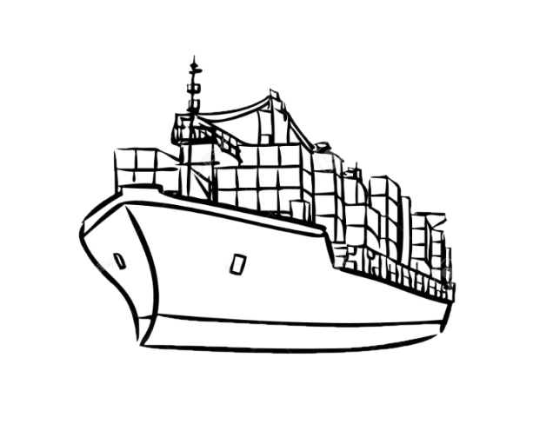
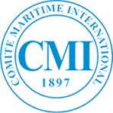
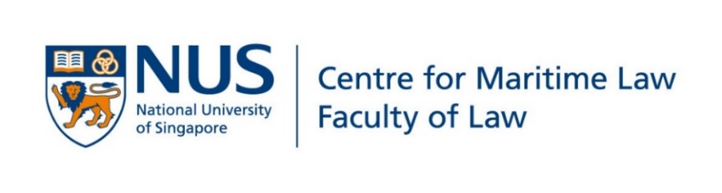
The CML CMI Database 2017-
Professor Stephen Girvin FRSA AFNI
Director, Centre for Maritime Law

Slide 2
Montreal Declaration on Free Access to Law
Public legal information from all countries and international institutions is part of the common heritage of humanity
Maximising access to this information promotes justice and the rule of law
Public legal information is digital common property and should be accessible to all on a non-profit basis and free of charge
Organisations such as legal information institutes have the right to publish public legal information and the government bodies that create or control that information should provide access to it so that it can be published by other parties

Slide 3
Beginnings: 2014
mooted by John Hare … Agreement signed between CML and CMI on 2 January 2017 (for five years), renewed on 2 January 2022 (for five years)
technical development by Websparks Pte Ltd
modelled on the Pace Law Albert H Kritzer CISG Database and Professor Bonell’s UNILEX database on the CISG and the UNIDROIT Principles
First case: El Greco (Australia) Pty Ltd v Mediterranean Shipping Co SA [2004] FCAFC 202 (Luci Carey (now Aberdeen))

Slide 4
Now We are All Grown Up
currently 2,808 decisions and counting
decisions from 88 jurisdictions, from Antigua and Barbuda to Vanuatu, with everything in between
covers all international maritime law Conventions and other instruments in which CMI played a role: 39 instruments
the Database currently receives 35k hits per month, ie, around 420k hits per year
since 2018, 320,253 visits; 416,147 page views

Slide 5
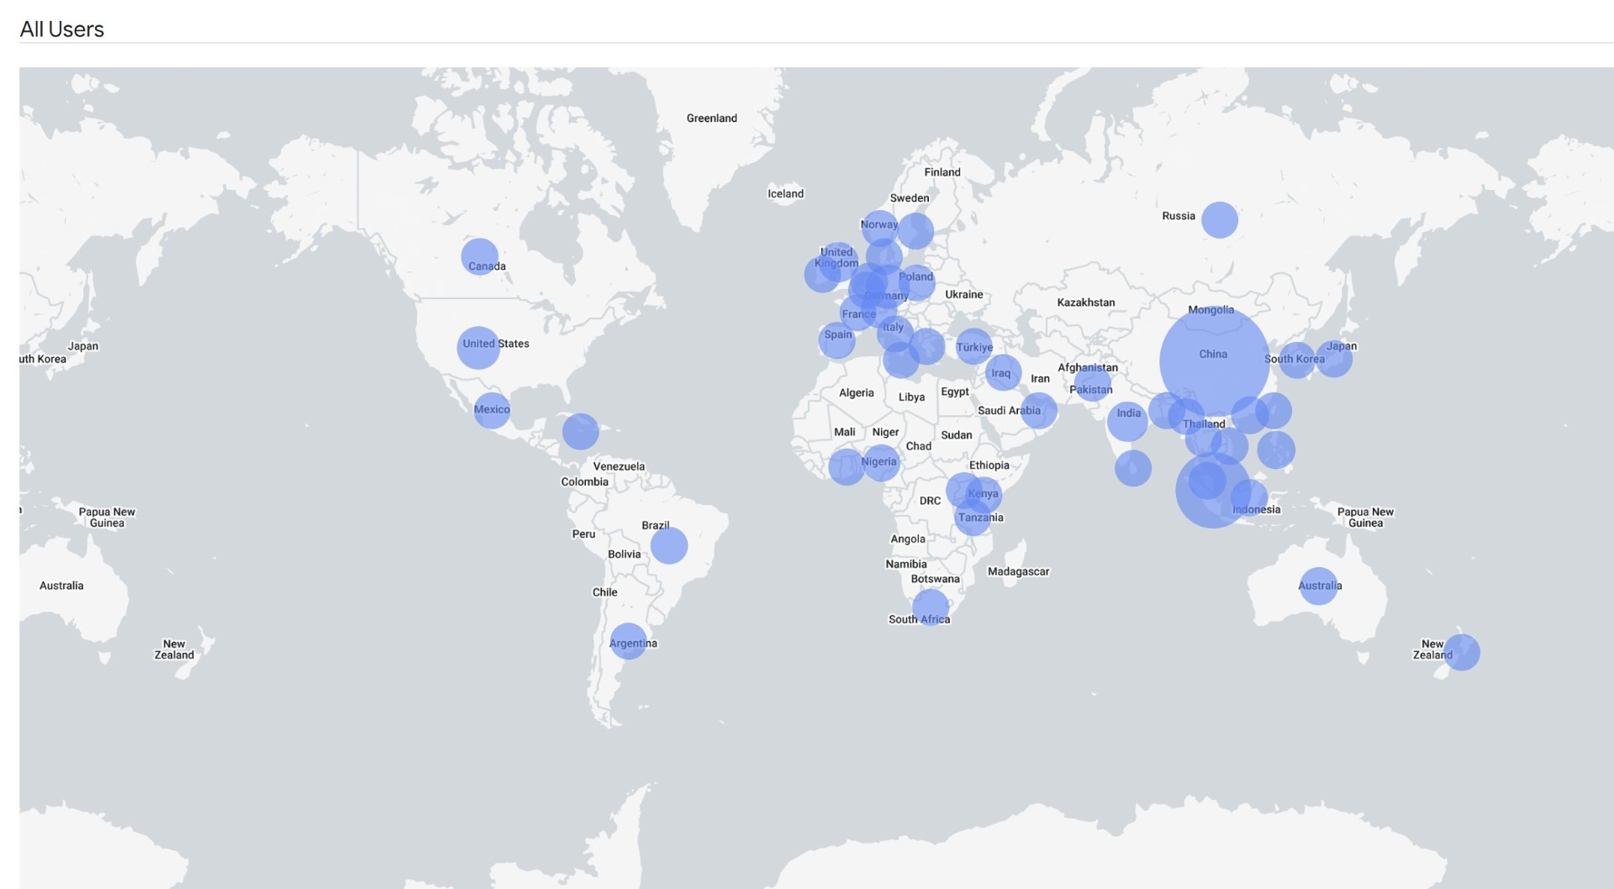
What is Our Reach?

Slide 6
Who is our Audience? Top Countries
S
1 PRC
2 Singapore
3 India
4 Philippines
5 USA
6 UK
7 Germany
8 Nigeria
9 Australia
10 Malaysia
11 Hong Kong SAR
12 Netherlands
13 Canada
14 Japan
15 Ghana
16 Vietnam
17 France
18 Greece
19 South Africa
20 Kenya
21 Indonesia
22 Brazil
23 Italy
24 Spain
25 New Zealand

Slide 7
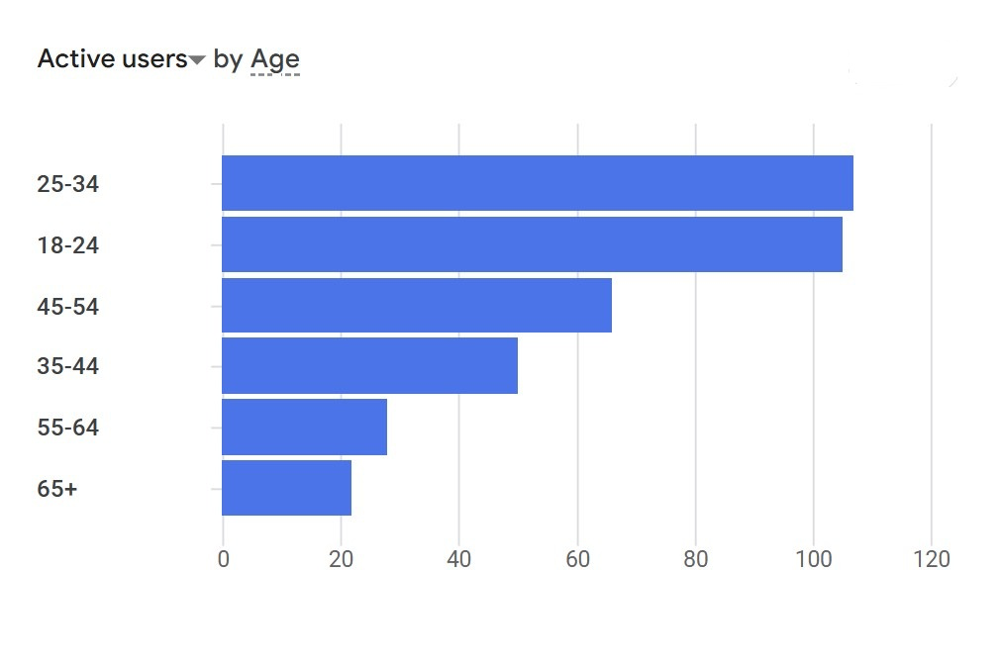
Who is our Audience? Age

Slide 8
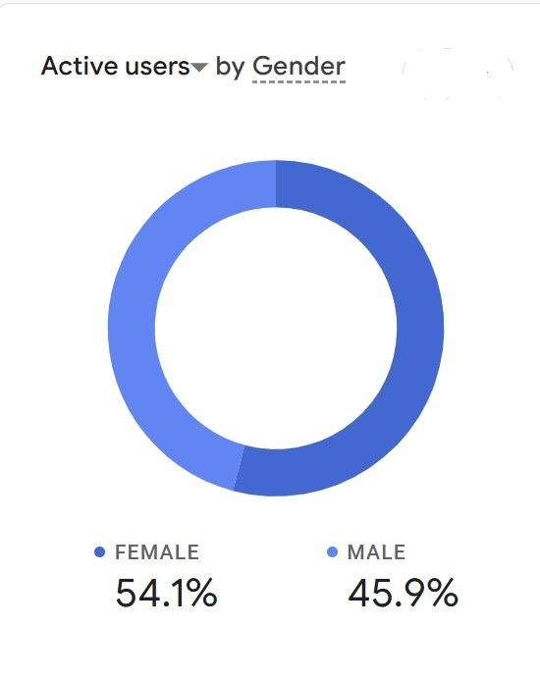
Who is our Audience? Gender

Slide 9
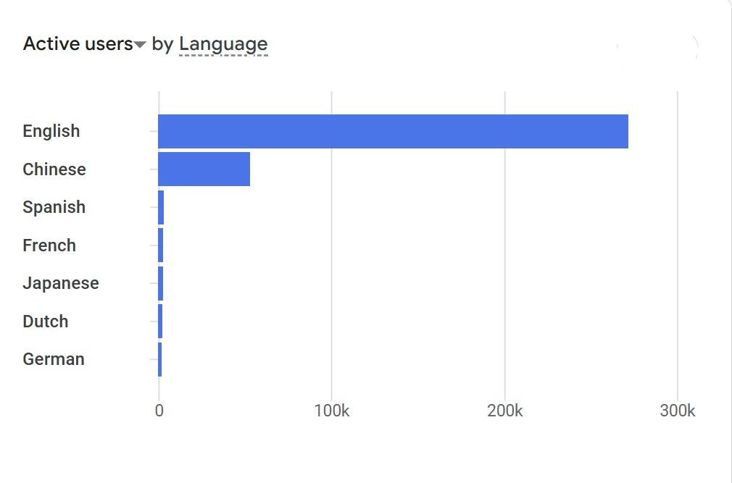
Who is our Audience? Language

Slide 10
Random database facts
Oldest case: The HMS Archer [1919] P 1 (Collision Convention 1910)
Most recent case: Dayan v Norwegian Cruise Line, Quebec C, 29 January 2026 (Athens)
Most accessed cases: (i) Magallona v Ermita (2011) Sup Ct Manila (UNCLOS); (ii) MV Elisabeth v Harwan Investment & Trading Pvt Ltd (1992) Sup Ct India (Ship arrest);

Slide 11
Random database facts
Most accessed cases: (iii) Pyrene Co Ltd v Scindia Navigation Co Ltd (1954) QBD (Hague Rules)
Least accessed case: Angsley Investments Ltd v Jupiter Denizcilik Tasimacilik Mumessillik San Ve Ticaret Ltd Sirketi (2023) (Arrest Convention 1999)

Slide 12
Random database facts (contd.)
Jurisdictions: USA (365), UK (353), France (182), Spain (172), Netherlands (106), Australia (101), India (98), Turkïye (82), Singapore (69) ...

Slide 13
Many hands make light work ...
MPA (Maritime & Port Authority), SMI (Singapore Maritime Institute), Ms Tan Beng Tee (now with Singapore Maritime Foundation (SMF))
Websparks Pte Ltd
General Editor, Professor Paul Myburgh, CML research staff (past and present)
Lawrence Teh (CMI Administrator), and Taco van der Valk
Rowena Goh and Jothi Bhavani (CML admin)
To the Next 3,000+ Cases! Cheers!

Slide 14
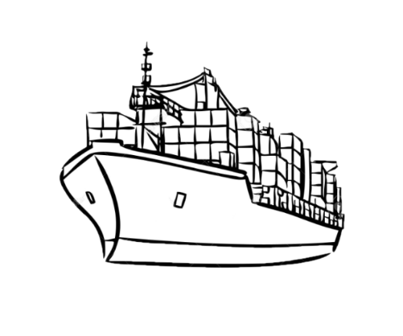
CML CMI Database 2017-
Thank you for your attention
15 May 2026, 9.00-10.30am (Louvre Room II)
Comité Maritime International Rio 2026

