Slide 1

MARINE ENVIRONMENTAL DAMAGE DURING WARS: COMPENSATION MECHANISMS AND UKRAINE’S PERSPECTIVE
Prepared by
Diana Lіashenko
Attorney at law, Associate at Black Sea Law Company

Slide 2
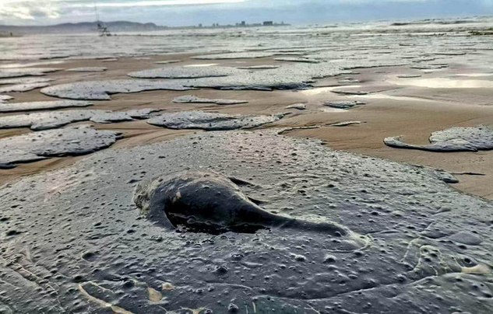
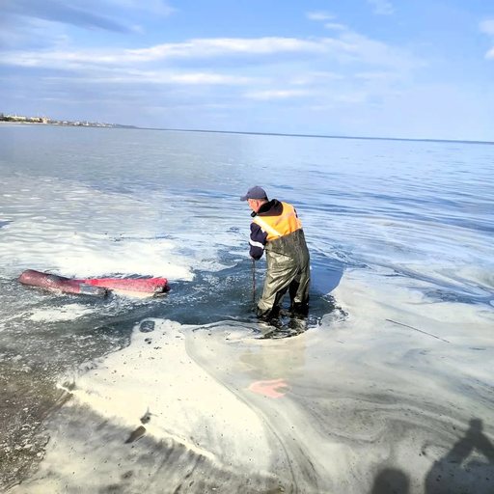
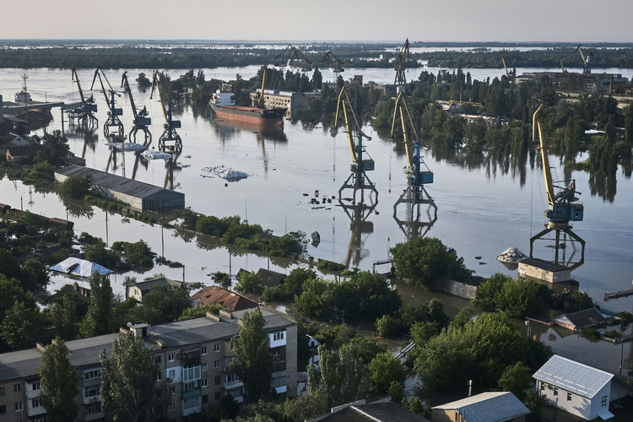
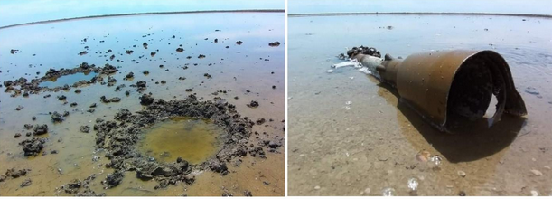
Impact of War on Marine Environment
  Oil spills from damaged vessels and infrastructure
  Pollution from chemicals, fuel, and untreated waste
  Shipwrecks releasing hazardous substances over time
  Sea mines and explosions disrupting marine life
  Destruction of habitats and biodiversity loss
  Long-term ecosystem imbalance (food chains, fisheries)

Slide 3
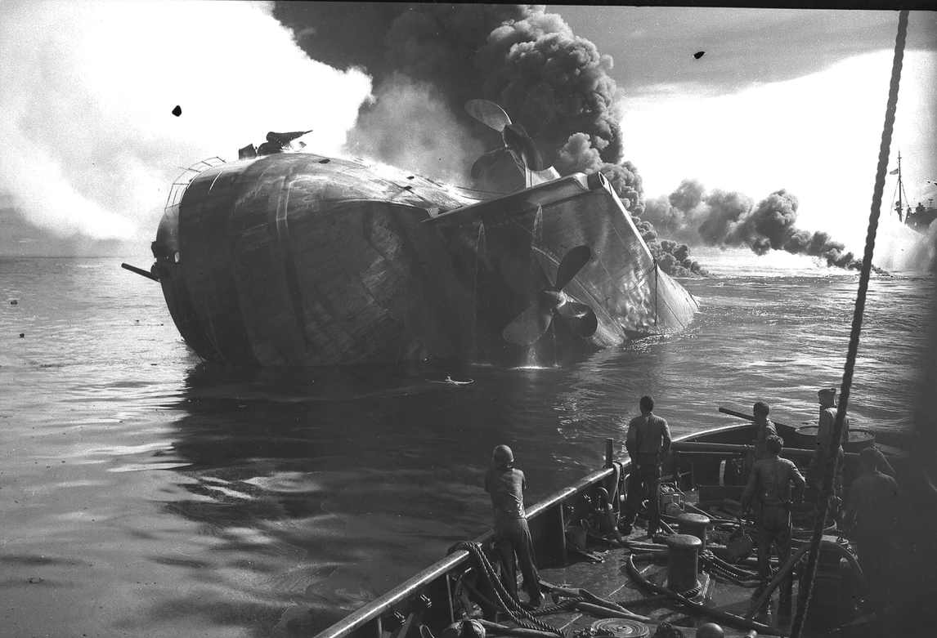
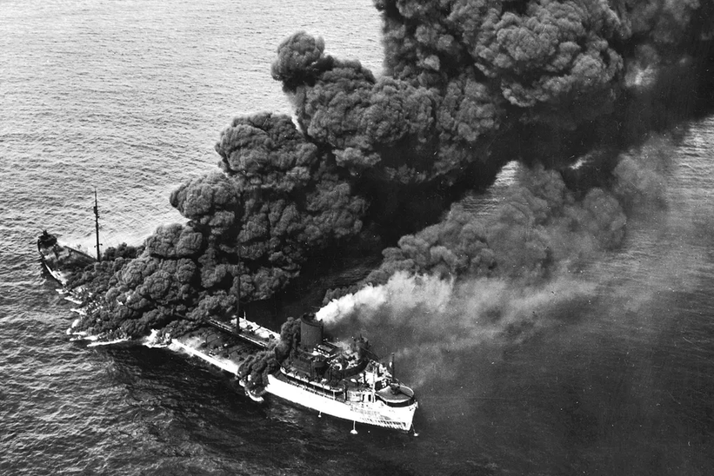
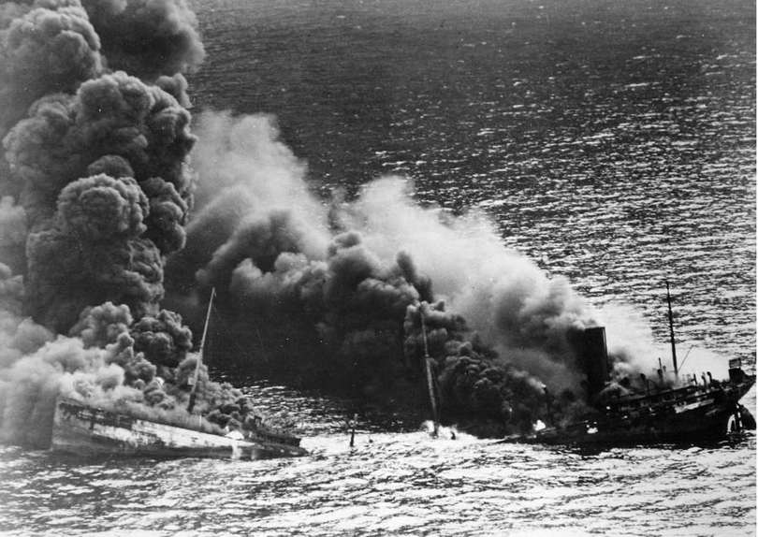
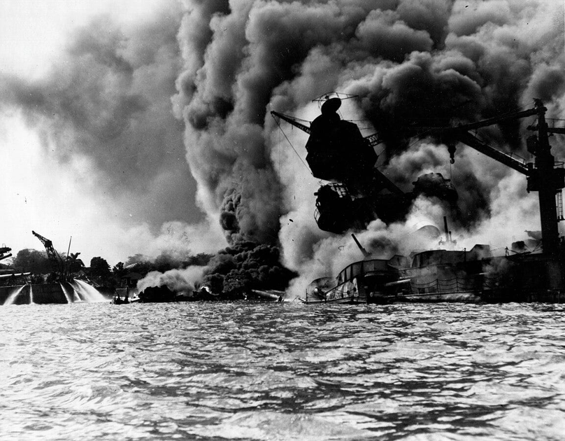

MARINE POLLUTION DURING WORLD WAR II
Over 300,000 tonnes of chemical munitions were dumped at sea, including mustard gas and nerve agents.

Slide 4
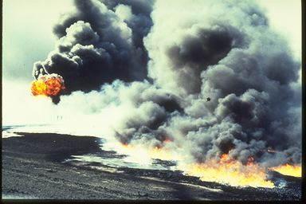
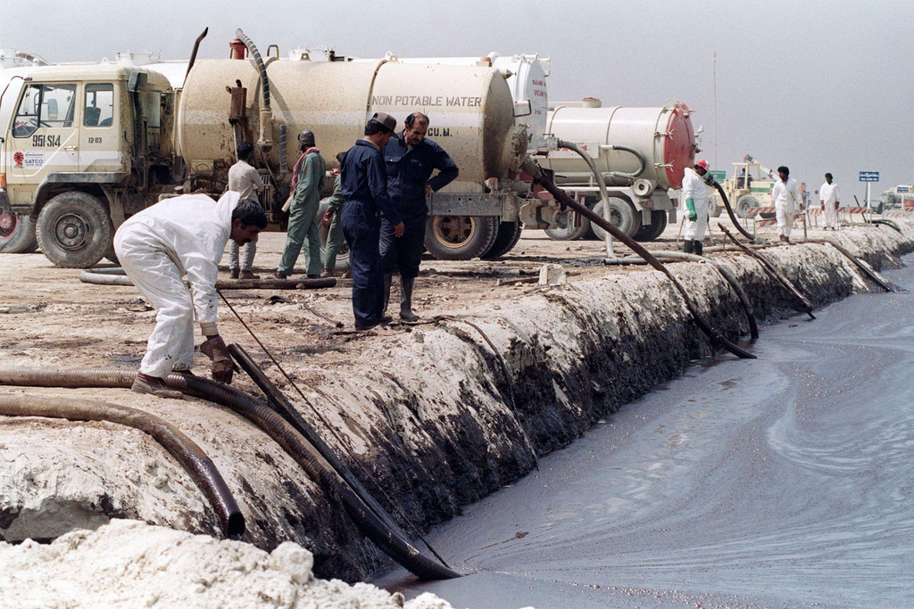
ENVIRONMENTAL CONSEQUENCES OF THE GULF WAR
UNCC Environmental Claims
$85 billion claimed (35% of total)
$5.3 billion awarded (109 of 168 claims)

Slide 5
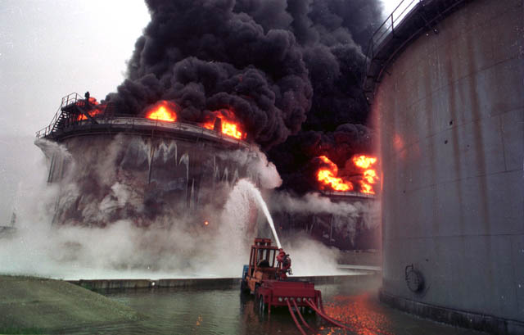
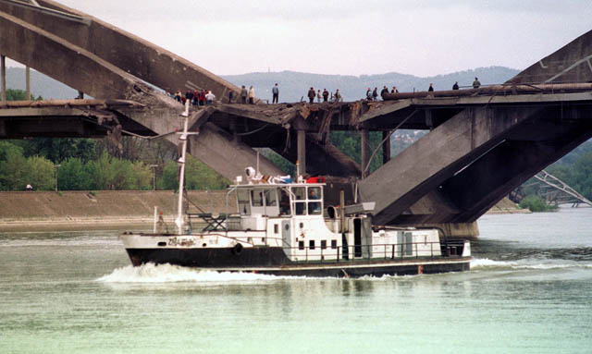
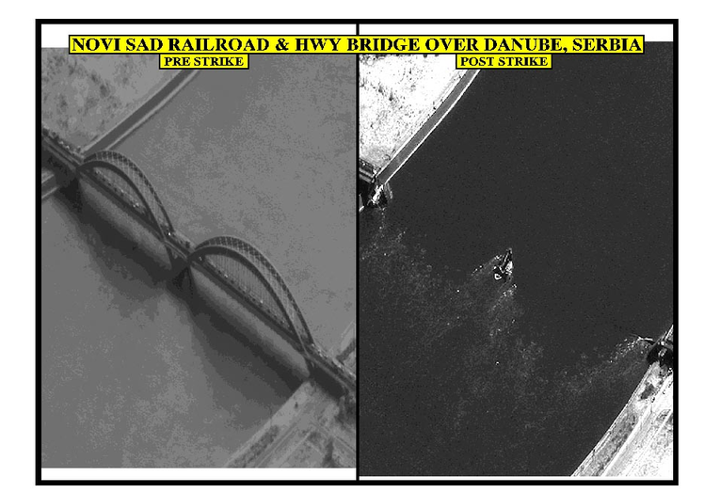
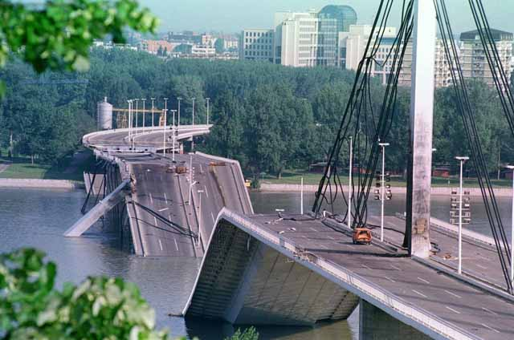
IMPACT OF THE BALKAN WARS ON MARINE ECOSYSTEMS

Slide 6
Liability for Marine Environmental Damage: Peacetime vs Wartime

Slide 7
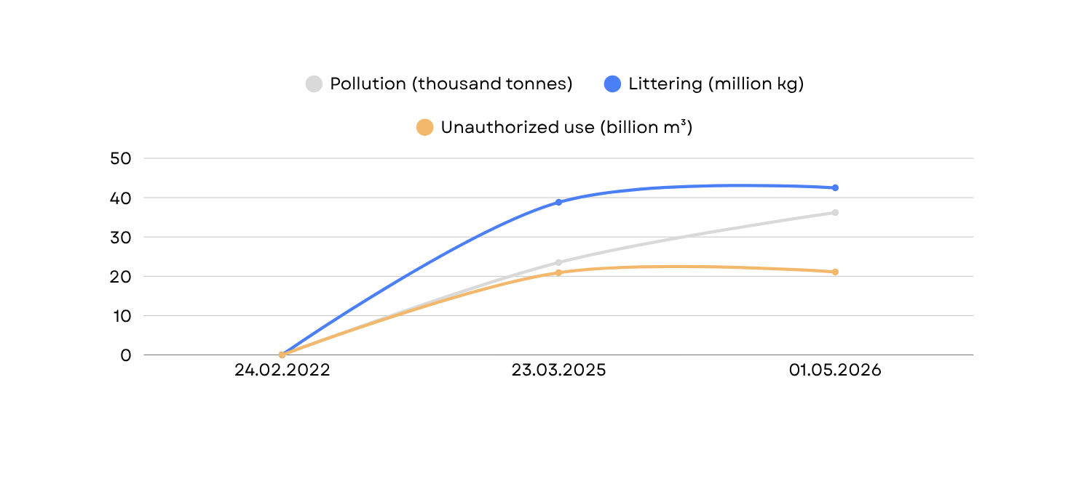
Assessment of Environmental Damage
by the State Environmental Inspectorate of Ukraine
Total environmental damage increased from UAH 3.82 trillion to UAH 6.82 trillion
Water-related damage rose to UAH 78.3 bn from UAH 68.2 bn

Slide 8
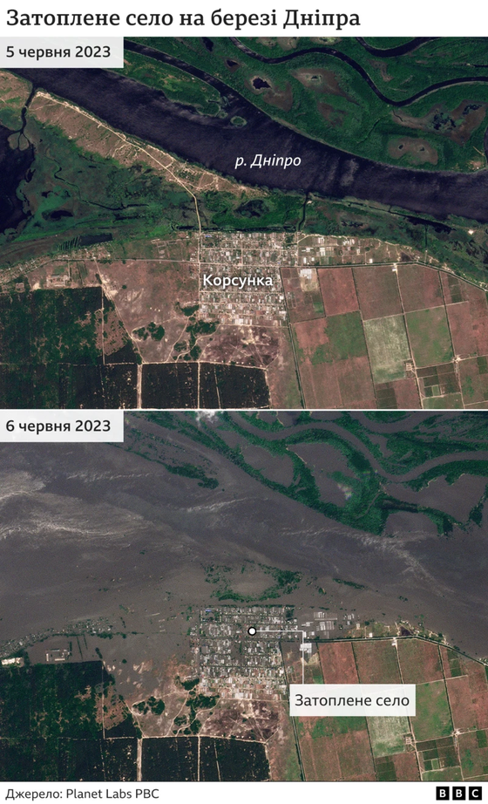
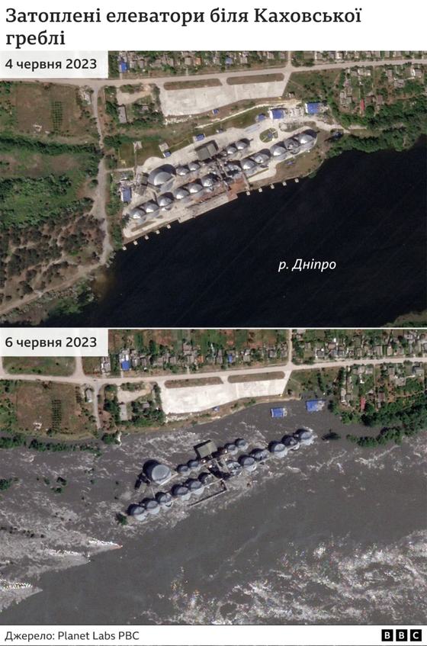
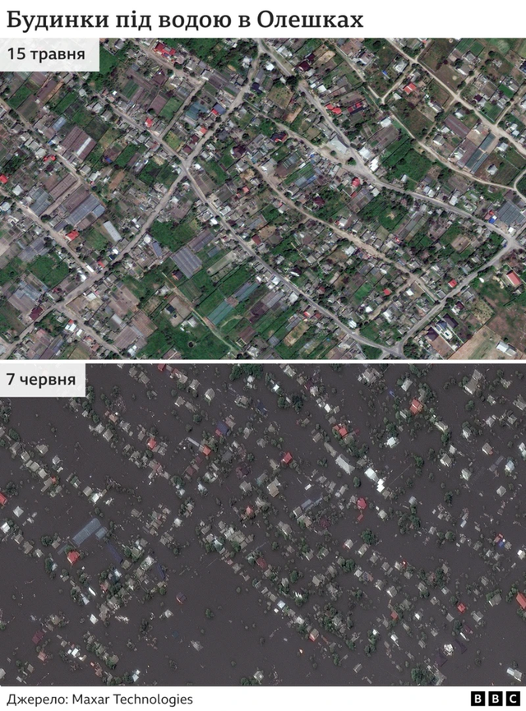
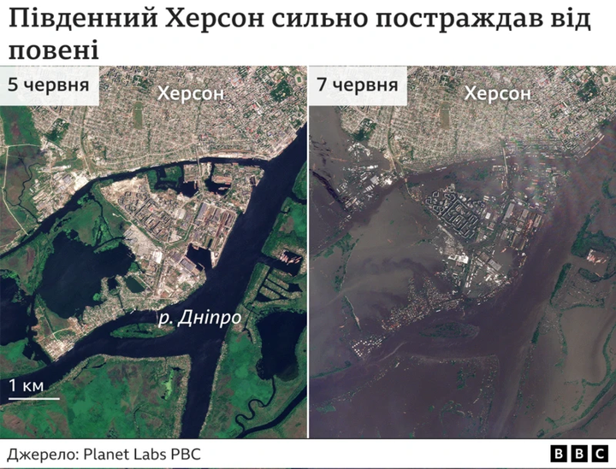
Kakhovka Dam Destruction: Before vs After

Slide 9
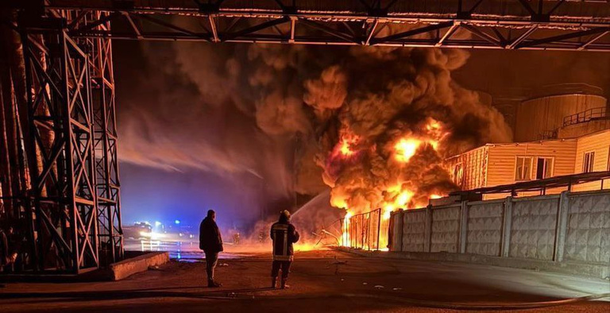
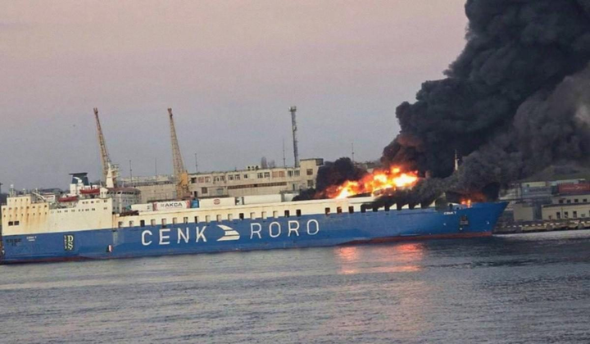
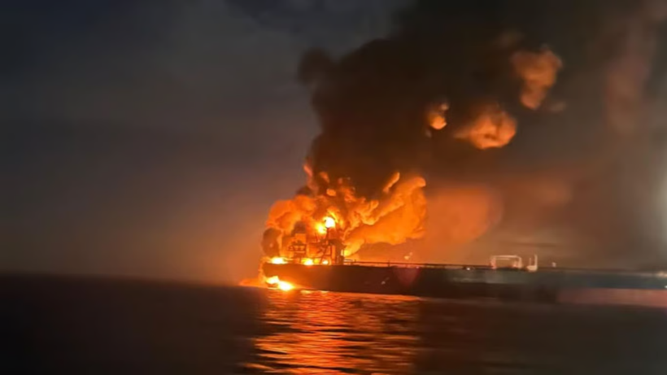
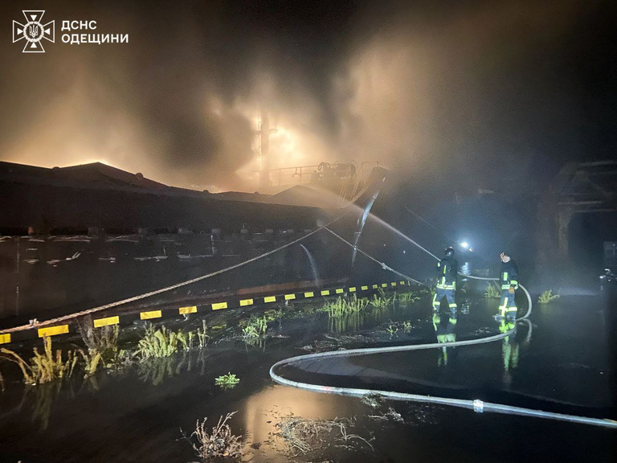
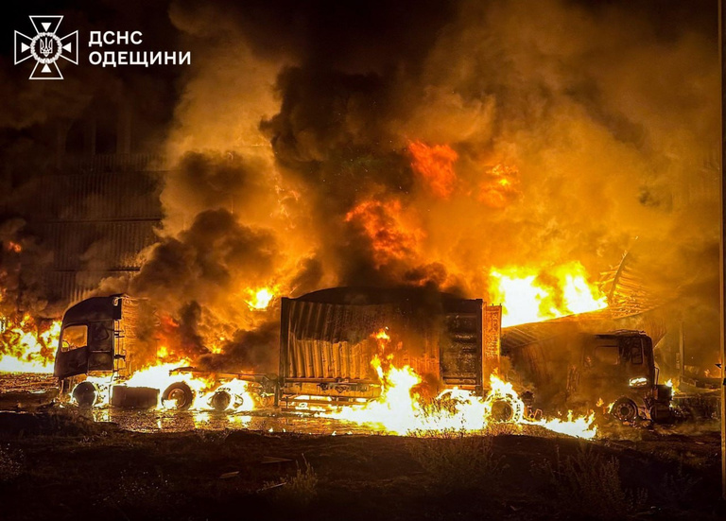
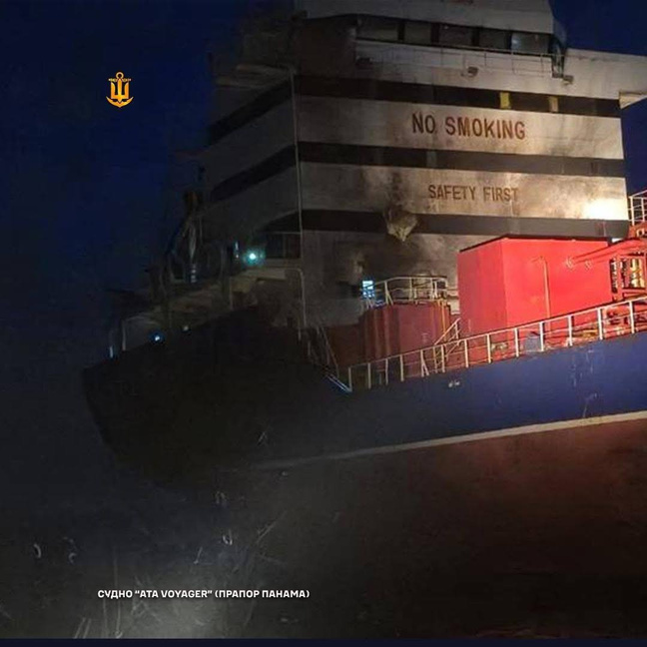
Attacks by the russian federation on Ukraine’s maritime infrastructure since February 2022
900+ damaged port facilities
177 civilian vessels

Slide 10
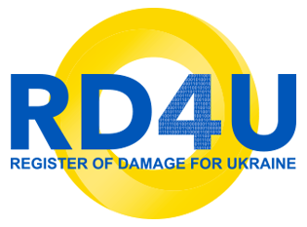
Compensation Mechanisms in Ukraine
  Criminal proceedings (national prosecution)
  National compensation mechanisms (eRecovery programme, litigation in Ukraine)
  International judicial bodies (International Court of Justice, European Court of Human Rights, arbitral tribunals)
  Register of Damage (RD4U)
  Compensation fund (confiscation of frozen Russian assets)

Slide 11
Thank you for your attention!
Diana Lіashenko
Attorney at law, Associate at Black Sea Law Company
d.liashenko@blacksealawcompany.com
+380686215368

