Slide 1

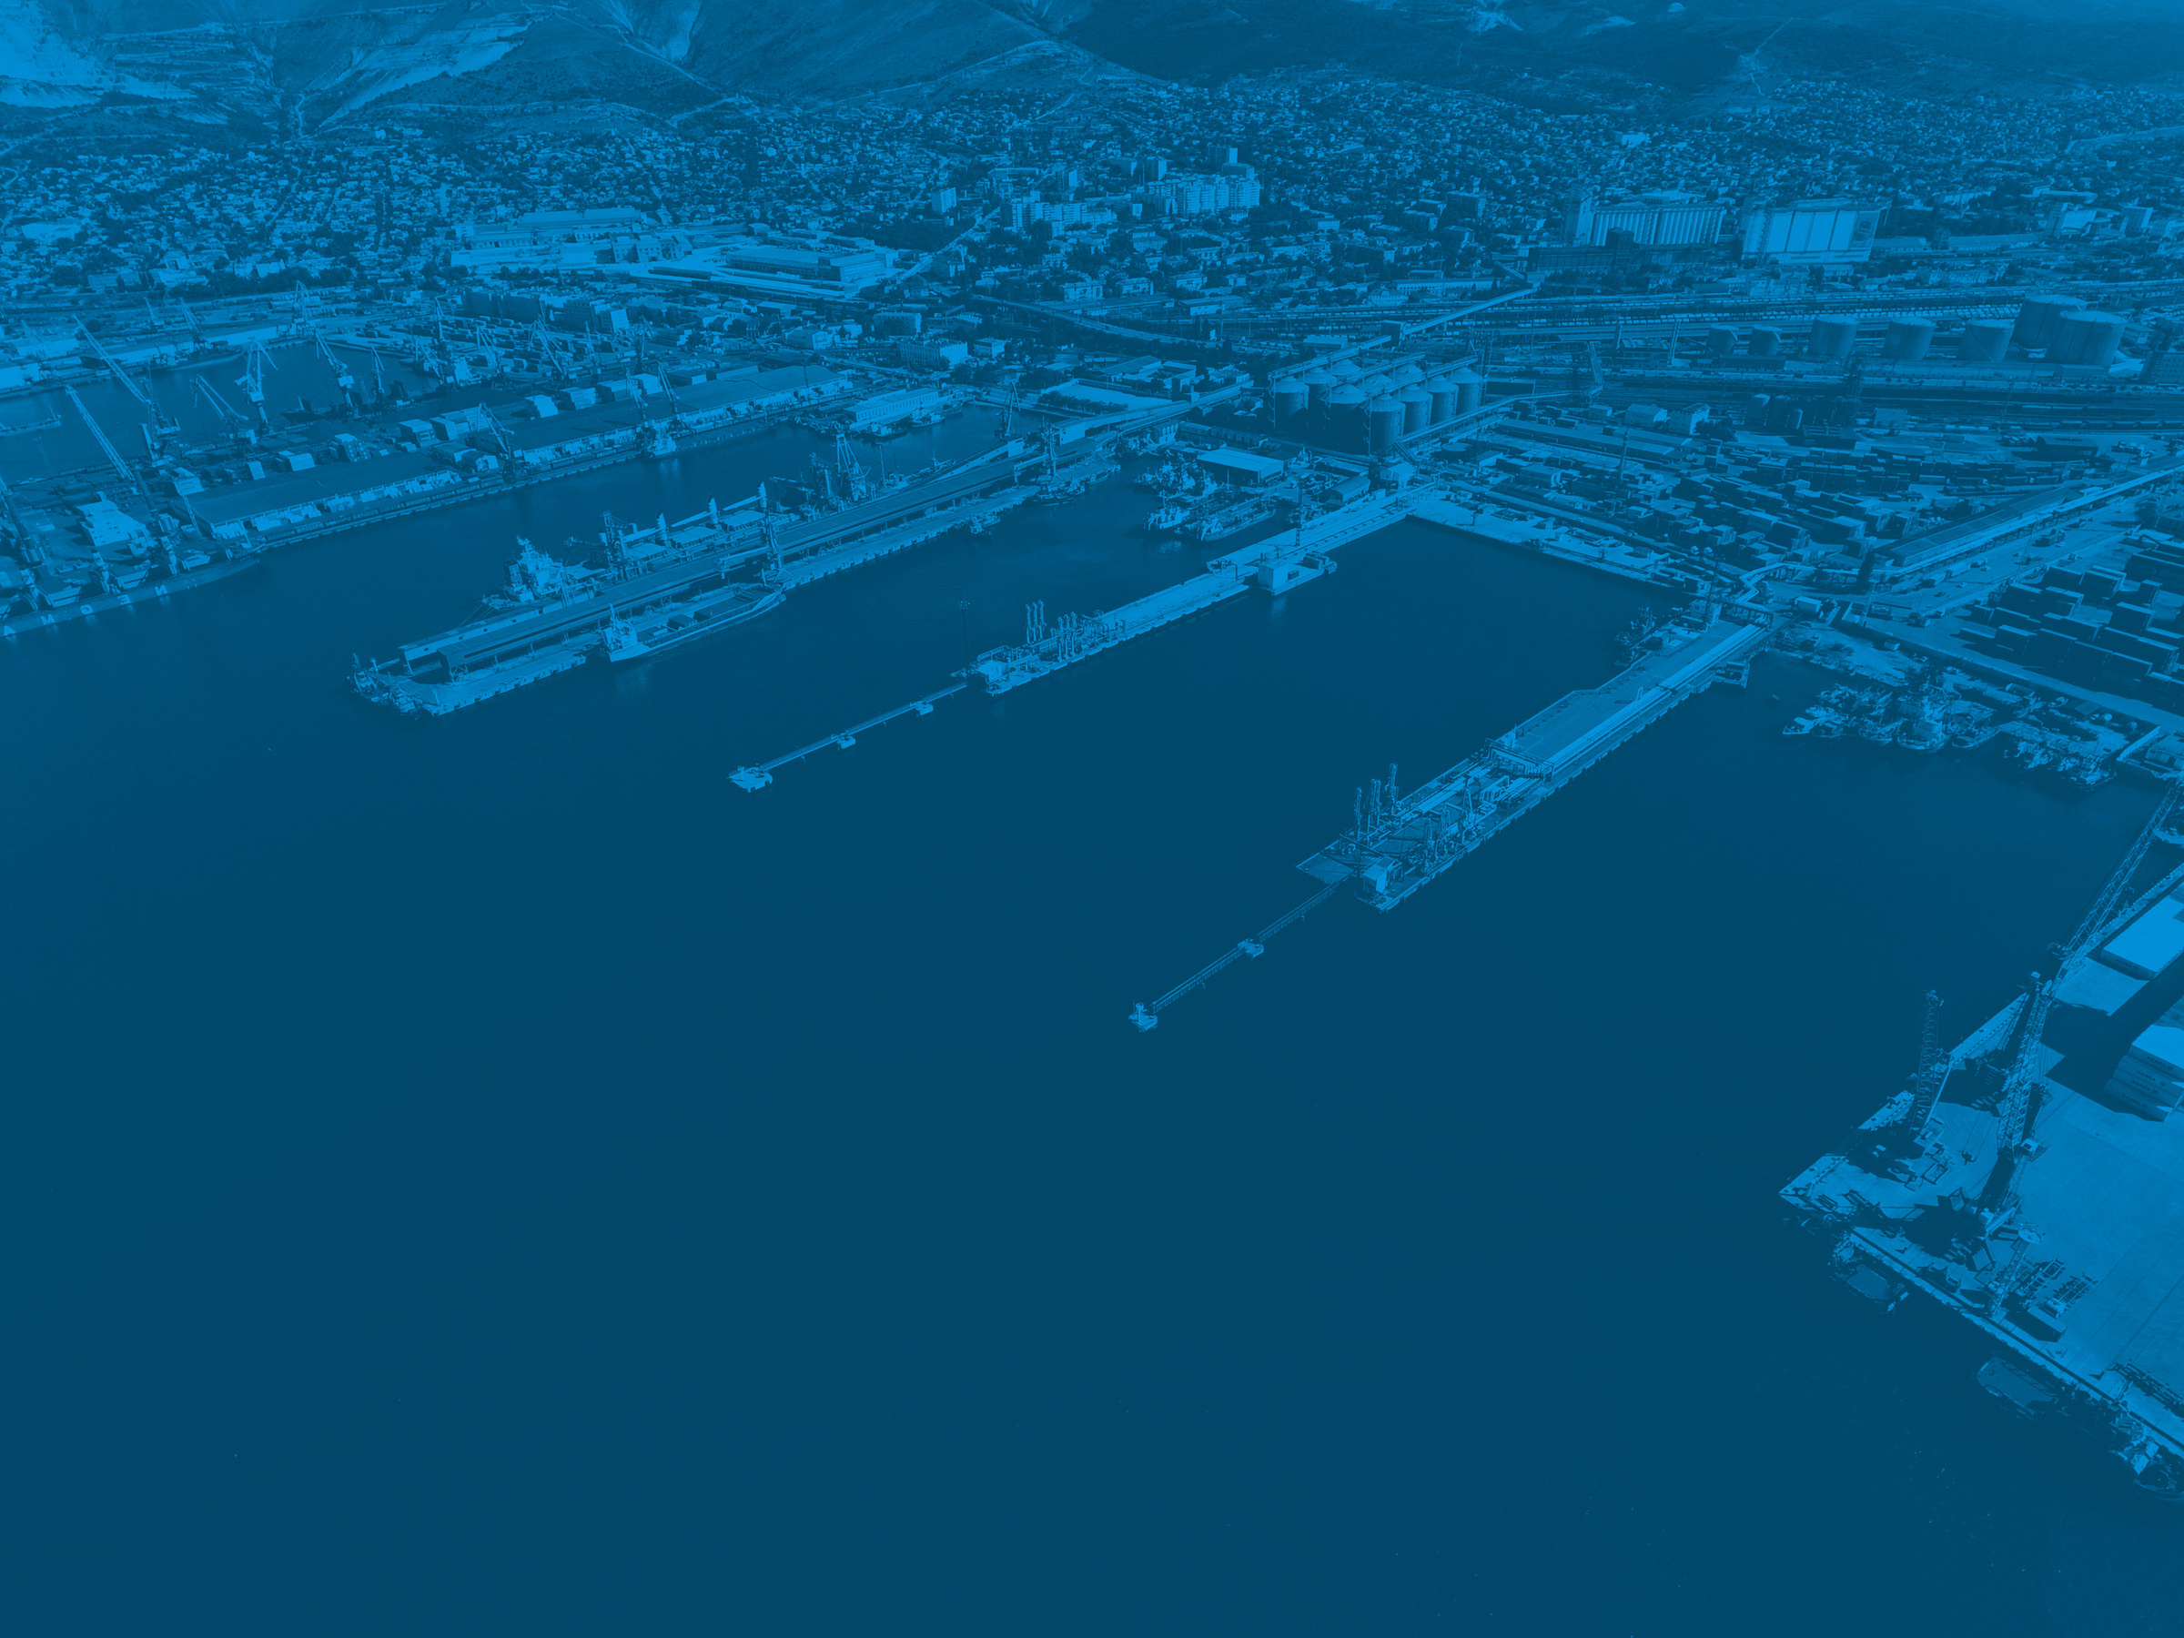



Next steps:
The Parliamentary Front of Ports and Airports (FPPA) and the Brazilian Infrastructure Institute (IBI) are already addressing a second package of IMO conventions to further promote their respective ratifications:
    Beijing Convention (Step 3)
    Fund 1992 and 2003 (Step 2)
    HNS Convention 1996 and Protocol 2010 (Step 2)
    Bunker Convention 2001(Step 2)

