Slide 1
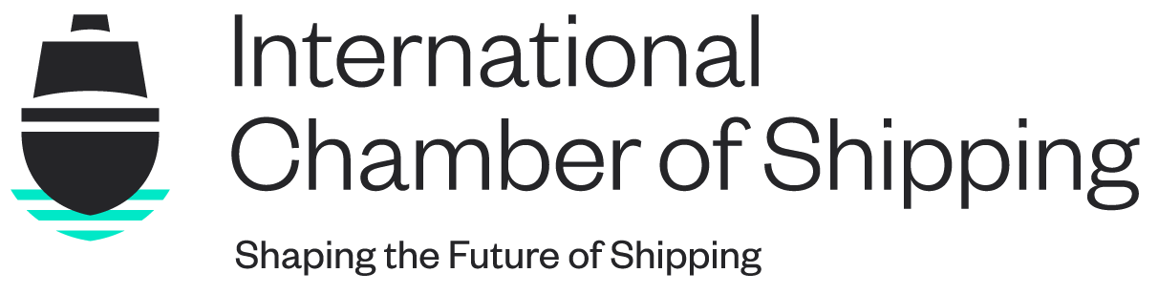
Shared Seas, Divided Powers – Navigating the EEZ
Leyla Pearson, Senior Manager (Legal) – International Chamber of Shipping

Slide 2
About ICS
Established in 1921
Principal international trade association for shipowners and operators
Represents interests of shipowners and operators engaged in all sectors and trades
40 national shipowners’ associations from Asia, Europe, Africa and the Americas
80% of the world merchant tonnage

Slide 3
Scope of Application
1910 Collision Convention – Article 12
The provisions of this Convention shall be applied as regards all persons interested when all the vessels concerned in any action belong to States of the High Contracting Parties, and in any other cases for which the national laws provide.

Slide 4
Draft Protocol - Article 1.2
(1) This Convention shall govern the jurisdiction, choice of law, allocation of liabilities, and the evaluation of damages in collision actions, including recourse actions, for loss or damage arising from collisions between vessels taking place:
in any waters where all colliding vessels were [registered] [flagged] in member states,
in the inland waters, territorial sea, [contiguous zone or exclusive economic zone] of a member state, or
(iii) in any waters where so provided by the national laws of a member state.

Slide 5
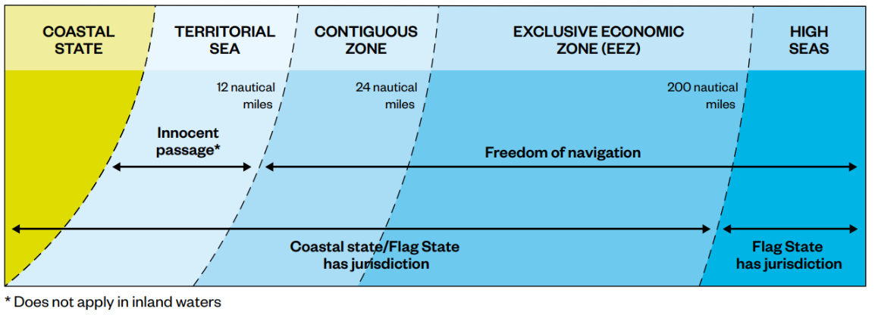
Maritime Zones as provided for in UNCLOS
Extracted from the ICS/IFSMA The Master’s Practical Guide to Maritime Law, First Edition, 2023

Slide 6
Extending the Scope of Application to the EEZ
An extension of the scope of application to the EEZ is only possible if permitted by the legal regime established by UNCLOS. A ship navigating on the high seas is subject to the exclusive jurisdiction of the flag state and protected by the principle of freedom of navigation
There is no bar to the proposed extension of scope. The freedom of navigation principle does not cover all possible aspects relating to the operation of the ship, but only to the flag state’s authority over the ship in respect of its operation.

Slide 7
The IMO Liability and Compensation Regime
1992
Convention on Civil Liability for Oil Pollution Damage 1992 (as amended) – first enacted in 1969 after the Torrey Canyon incident.
2001
International Convention on Civil Liability for Bunker Oil Pollution Damage
2007
Nairobi International Convention on the Removal of Wrecks
2010
International Convention on Liability and Compensation for Damage in connection with the Carriage of Hazardous and Noxious Substances by Sea, 2010 (not yet in force)

Slide 8
Specific legal regime of the exclusive economic zone
UNCLOS Article 55
The exclusive economic zone is an area beyond and adjacent to the territorial sea, subject to the specific legal regime established in this Part, under which the rights and jurisdiction of the coastal State and the rights and freedoms of other States are governed by the relevant provisions of this Convention

Slide 9
UNCLOS Article 56
Rights, jurisdiction and duties of the coastal State in the exclusive economic zone:
Sovereign rights over natural resources; and
Limited jurisdiction with regard to:
i. The establishment and use of artificial islands, installations and structures;
ii. Marine scientific research; and
iii. The protection and preservation of the marine environment
The EEZ in not an extension of the territory of the coastal State.

Slide 10
UNCLOS Article 58
In the exclusive economic zone, all States, whether coastal or land-locked, enjoy, subject to the relevant provisions of this Convention, the freedoms referred to in article 87 of navigation and overflight…..
(2) Articles 88 to 115 and other pertinent rules of international law apply to the exclusive economic zone in so far as they are not incompatible with this Part.
(3) In exercising their rights and performing their duties under this Convention in the exclusive economic zone, States shall have due regard to the rights and duties of the coastal State and shall comply with the laws and regulations adopted by the coastal State in accordance with the provisions of this Convention and other rules of international law in so far as they are not .incompatible with this Part

Slide 11
UNCLOS ARTICLE 92
(1) Ships shall sail under the flag of one State only and, save in exceptional cases expressly provided for in international treaties or in this Convention, shall be subject to its exclusive jurisdiction on the high seas. A ship may not change its flag during a voyage or while in a port of call, save in the case of a real transfer of ownership or change of registry.

Slide 12
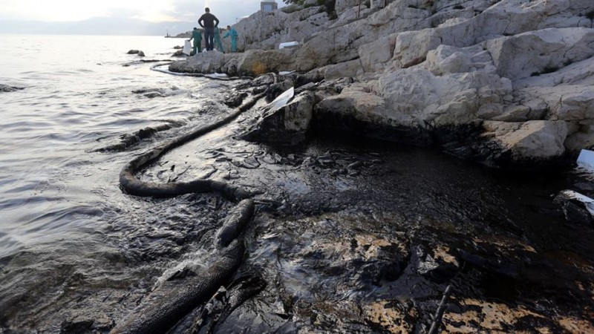
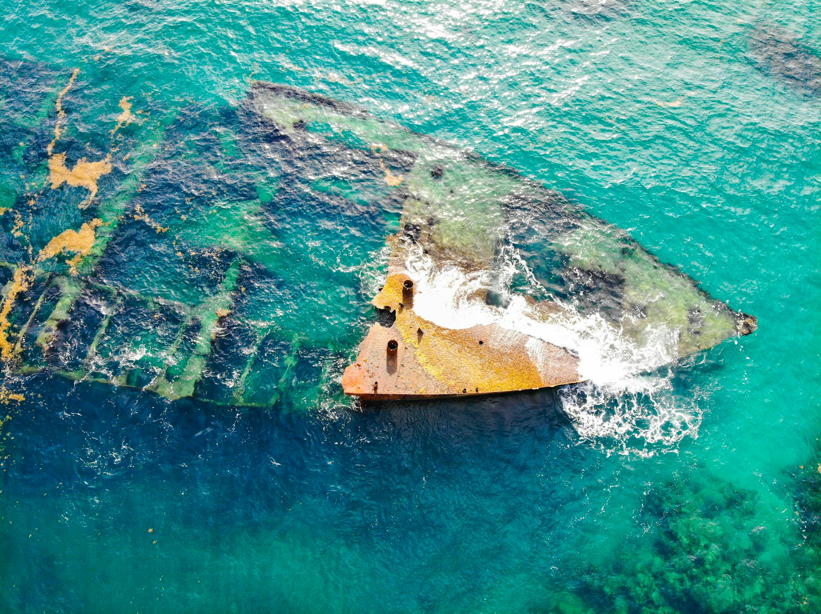
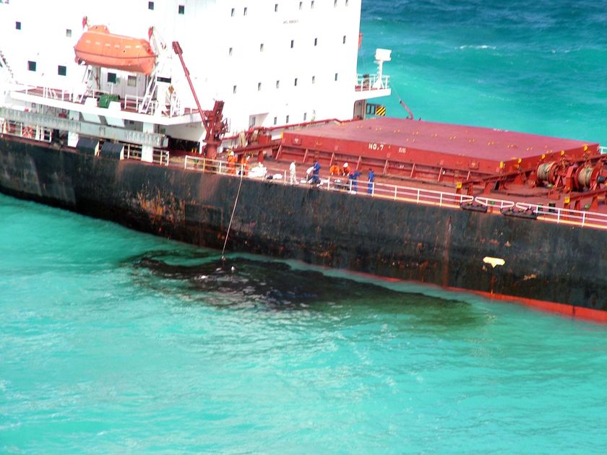
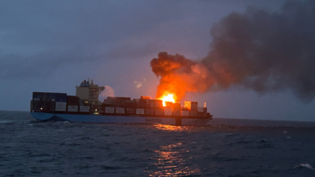
The IMO Liability and Compensation Regime
These Photos by Unknown Author are licensed under CC BY-NC-ND
1992
Convention on Civil Liability for Oil Pollution Damage 1992 (as amended)
2001
International Convention on Civil Liability for Bunker Oil Pollution Damage
2007
Nairobi International Convention on the Removal of Wrecks
2010
International Convention on Liability and Compensation for Damage in connection with the Carriage of Hazardous and Noxious Substances by Sea, 2010 (not yet in force)

Slide 13
Norstar Judgment (paragraph 225)
“the principle of exclusive flag State jurisdiction is an inherent component of the freedom of navigation under article 87 of the Convention. This principle prohibits not only the exercise of enforcement jurisdiction on the high seas by States other than the flag State but also the extension of their prescriptive jurisdiction to lawful activities conducted by foreign ships on the high seas”

Slide 14
Norstar Judgment (paragraph 224)
“In the view of the Tribunal, it does not matter whether or not a chilling effect is produced. Regardless of such effect, any act which subjects activities of a foreign ship on the high seas to the jurisdiction of States other than the flag State constitutes a breach of the freedom of navigation, save in exceptional cases expressly provided for in the Convention or in other international treaties”

Slide 16

Thank you for listening
Questions?
www.ics-shipping.org

