Slide 1

SECURITY ON CONTAINERS
VIEWS FROM THE BOX SHIPPING INDUSTRY
PETER LAURIJSSEN

Slide 2
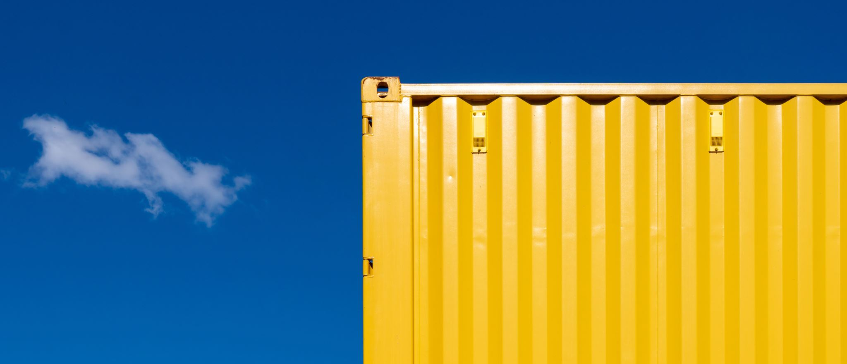
VIEWS FROM THE BOX SHIPPING INDUSTRY
Introduction
Container Facts
Common Shipping Contracts
Possession & Custodians
Challenges
Conclusion

Slide 3
INTRODUCTION

Slide 4
International Convention / Cape Town Protocol
  enforceability of security rights over shipping containers
  unique international container register vs national registers of countries which would ratify such convention
  what? shipping containers = moveable property in global trades across jurisdictions
  which security rights? property, retention of title, pledge, lien, possessory lien, purchase/call option, …
  whose rights? lessors, sellers, investors/financiers, pledgees, lessees with purchase option and terminal and depot operators

Slide 5
CONTAINER FACTS

Slide 6
Containers & Shipping
  Worldwide: around 65 MIO (in TEU) containers whereof 25 – 27 MIO in active circulation
  Worldwide fleet capacity: 7,533 vessels with 54,050,654 TEU container capacity (nominal at 14t homogeneous intake)
  1 vessel = 2,5 suits of containers
  Container: average number of round voyages p.a.: 3 to 6 full cycles per year for deep-sea routes (trade lane distance, port dwell time, idle time/empty return time, exceptional trade disruptions such as Ever Given, blocking & trapping in AG, …)
  Compare: a ship might travel over 179,000 miles per year (roughly 7x around the world)

Slide 7
Acquisition & Leasing of Containers
Acquisition:
  Purchase from manufacturer
Leasing:
  Lessors: Triton (28% market share), Textainer, Florens (COSCO), GE Seaco, CAI, …
  Leasing: on-hire & off-hire
  Leasing with purchase option

Slide 8
Types of Container Leasing
Master Lease Agreement:
  “full-service” lease: management of container fleet incl. M&R
Long-Term Lease Agreement:
  “dry” lease: fixed number of containers for a set period of time (5-7 for new and 1-5 for used containers)
Short-Term Lease Agreement:
  Limited duration (e.g. 6 months) to meet sudden surge in demand
One-Way Lease Agreement:
  single trip with easy pick-up and drop-off

Slide 9
Container Fleet
Fleet growth projection: 2 to 5% growth per annum
Origin:
  Roughly 90% of all containers are manufactured in China (CIMC, Shenzen)
  MCI, Tinglev, Denmark: (fully robotised and focused on high-tech reefer containers): closed down. Maersk sold MCI entirely to CIMC in 2021
99,98% bears unique BIC number
  4-letter prefix, aka ISO 6346), serial number (6 digits), check digit: MAEU8354157

Slide 10
COMMON SHIPPING CONTRACTS

Slide 11
Containers & Carriage of Goods
Bills of Lading
  NVOCC B/L
  Ocean carrier’s B/L
  Pro-forma B/L
Cooperation between carriers:
  Vessel Sharing Agreements (VSA)
  Feeder Contract / Connecting Carrier Agreement (CCA)
  Equipment / Container pooling agreement
Charter Parties
  Time charters
  Bareboat charters
  Slothire

Slide 12
Containers & Bills of Lading
SOC vs COC
Definition Container: “Includes any container, trailer, transportable tank, flat or pallet, or any similar article used to consolidate goods and any connected or accessory equipment”
Definition Goods: “includes the whole or any part of the cargo carried under this Bill of Lading, including any packing or packaging materials and Merchant owned or leased Containers”

Slide 13
Containers & Bills of Lading
Merchant’s responsibility
Merchant’s responsibility: “If Containers supplied by or on behalf of the Carrier are unpacked by or for the Merchant, the Merchant is responsible for returning the empty Containers, with interiors clean, odour free and in the same condition as received, to the point or place designated by the Carrier, within the time prescribed. Should a Container not be returned in the condition required and/or within the time prescribed in the Tariff, ”
“Containers released into the care of the Merchant for packing, unpacking or any other purpose whatsoever are at the sole risk of the Merchant until redelivered to the Carrier.”
Carrier’s Tariff: “The terms and conditions of the Carrier’s applicable Tariff are incorporated herein. Attention is drawn to the terms therein relating to free storage time and to container and vehicle demurrage or detention”

Slide 14
Containers & Bills of Lading
Carrier’s Subcontractors / Himalaya Clause
Definition Subcontractor: “includes owners, charterers and operators of vessels (other than the Carrier), stevedores, terminal and groupage operators, road and rail transport operators, warehousemen, and any independent contractors employed by the Carrier performing the Carriage or whose services or equipment have been used for the Carriage and any direct or indirect subcontractors, servants and agents thereof whether in direct contractual privity or not”
Subcontracting Clause: “The Carrier shall be entitled to subcontract on any terms whatsoever the whole or any part of the Carriage”
No liability + indemnity if held liable + Himalaya Clause

Slide 15
Containers & Bills of Lading
Container Freight Stations & Container Terminals
CFS: “Where US COGSA applies then the provisions stated in the said Act shall govern during Carriage to or from a container yard or container freight station at the Port of Loading before loading on the vessel or at the Port of Discharge before delivery to an inland carrier”
“if the loss or damage is known to have occurred during Carriage by sea, for shipments to or from the United States of America, or waterborne Carriage in the United States of America or Carriage to or from a container yard or container freight station at Port of Loading before loading on the carrying vessel or at the Port of Discharge before delivery to the inland carrier, by the provisions of U.S. COGSA;

Slide 16
Containers & Bills of Lading
Lien Clause
Lien Clause: “The Carrier, its servants or agents shall have a lien on the Goods and any document relating thereto for freight and for general average contributions to whomsoever due. The Carrier, its servants or agents shall also have a lien against the Merchant on the Goods and any document relating thereto for all sums due from the Merchant to the Carrier under any other contract. The Carrier may exercise its lien at any time and any place in its sole discretion, through the action of any servant, agent, Subcontractor, whether the contractual carriage is completed or not. The Carrier’s lien shall also extend to cover the cost and legal expense of recovering any sums due. The Carrier shall have the right to sell any Goods liened by public auction or private treaty, without notice to the Merchant. Nothing herein shall prevent the Carrier from recovering from the Merchant the difference between the amount due to the Carrier and the net amount realised by such sale.
Lien (conflict with rights of container lessor, stevedore, …)

Slide 17
Containers & Bills of Lading - CCA / Feedering
Feeder vessel is mentioned in Bill of Lading (Port-to-Port):
  PoL: Gothenburg
  PoD: Santos
  Feeder leg Gothenburg – Rotterdam: m/v “Feedership”
  Ocean leg Rotterdam – Santos: m/v “Oceanship”
Ocean vessel is mentioned in Bill of Lading (Combined Transport)
  PoR: Gothenburg
  PoL: Rotterdam
  PoD: Santos
  Feeder leg Gothenburg – Rotterdam: m/v “Feedership”
  Ocean leg Rotterdam – Santos: m/v “Oceanship”
Importance: L/C and “shipped on board”-requirements

Slide 18
Containers & Vessel Sharing Agreements
BIMCO Slot Hire
  Owners’ responsibilities and liabilities: “In respect of loss of or damage to Containers owned or hired by the Charterers, the quantum of liability of the Owners shall not in any event exceed the lesser of the reasonable cost of repair or market value of the Container, however, the Charterers shall make no claim for damage to any Container of less than USD 500 on any one voyage.”
  Lien: “The Owners shall have a lien, including after discharge, upon the Charterers’ Goods and Containers for all sums due to the Owners from the Charterers, their servants, agents, Sub-contractors or principals in respect of services provided by the Owners to the Charterers under the terms of this Slot Charter Party”
  General Average: “[…] The Charterers shall guarantee the contributions properly due to the Owners in respect of (a)[…]; and (b) Containers shipped by the Charterers under this Slot Charter Party”

Slide 19
Containers & Time Charters
  VSA wording (BIMCO Slothire): “In respect of loss of or damage to Containers owned or hired by the Charterers, the quantum of liability of the Owners shall not in any event exceed the lesser of the reasonable cost of repair or market value of the Container, however, the Charterers shall make no claim for damage to any Container of less than USD 500 on any one voyage.”

Slide 20
POSSESSION & CUSTODIANS

Slide 21
Custodians of a container
Possession
    Lessor
    Merchant
    Carrier
    CFS
    PTI station (reefer containers)
    Haulier (rail/road/inland navigation)
    Customs
    CY – Container terminal
    Container depot
    Stevedore
    Feeder vessel
    Ocean vessel
    VSA partner
    GA adjuster
    Equipment insurers

Slide 22
CHALLENGES

Slide 23
Challenges
Possession
Retention
Ranking
Opposability
Conflicting legal obligations: duty to carry to destination
Jurisdiction re conflicting security interests
Registrable types of security interests
Publicity: universal accessibility of security register

Slide 24



Peter Laurijssen
Legal Director, CMB NV
T: +32 3 247 59 11
M: +32 477 79 09 04 peter.laurijssen@cmb.tech
CMB nv
De Gerlachekaai 20
2000 Antwerpen
Belgium
T: +32 3 247 5911

