Slide 1


Two Conventions, One Problem
The Challenge of Coexistence
Juan Pablo Rodríguez
Professor of Commercial Law at Carlos III University
Of Counsel Albors Galiano Portales

Slide 2
Academic Exercise
Neither Convention is currently in force (they need 10 and 15 Contracting States respectively)

Slide 3
Documentary provissions
Issuance
Transfer of documents
Evidenciary aspects
Rights and libiality of the holder
HVR
HamR
Art. 1.3
The extension to issuing NCD in connection with contract of carriage (w/p) by sea rise a question of COEXISTECE: what happens when NCDC and RR apply simultaneously to the same transport?
The thesis of my intervention is that the relationship between the two Conventions is one of asymmetric complementarity: RR can operate fully without the NCDC, as they already contain a comprehensive regime for negotiable transport documents; but the NCDC, by contrast, is structurally accessory to and dependent upon a principal regime governing the contract of carriage.
Preeliminary observation: An NCD issued in connection with a contract of carriage by sea would qualify as a “transport document” (1.14 RR); and due to the NCD is transferable, it would qualify as a “negotiable transport document” (1.15 RR).
RR
NCDC
CMR
CIM
MC
Documentary provissions
Contractual Obligations
Rights of the Holder
Liability Regime
Jurisdiction

Slide 4
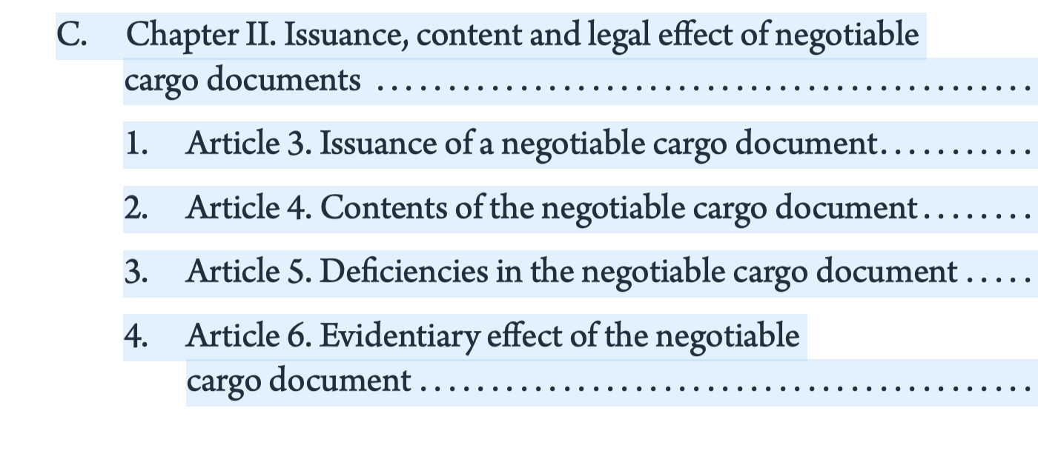
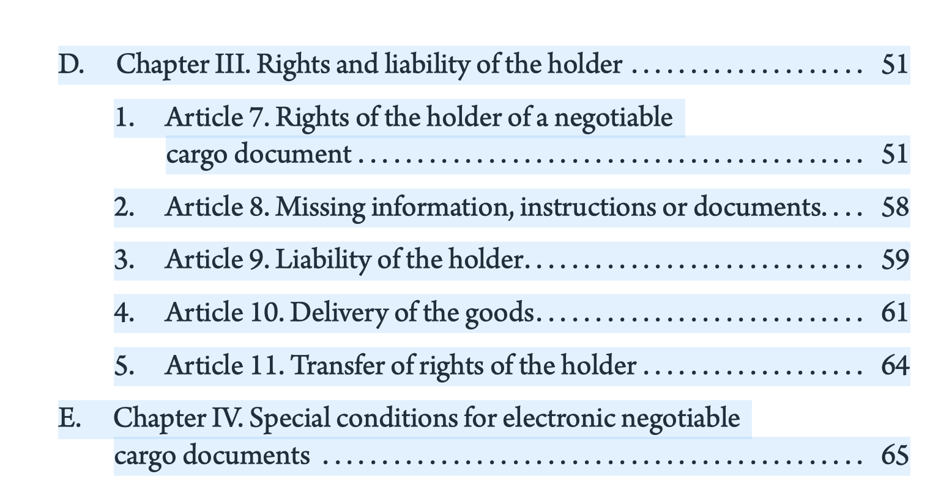
  Issuance of a NCD requires an agreement between TO and shipper (3.1) - consensual basis ensures that the NCDC application is never imposed.
Types of documents admitted:
  - RR: Order and bearer documents
  - NCDC: Only Order documents (permit blank endorsements)

Slide 5
Both Conventions follow the same pattern regarding the information that must be stated in the negotiable document (4.1 NCDC/36 RR).
The evidentiary regime of both Conventions follow same structure (6 NCDC and 40–41 RR):
  the carrier may (NCDC)/shall (RR) qualify information provided by the shipper;
  absent qualification, the document constitutes prima facie evidence of the receipt of the goods as stated;
  against a third-party holder acting in good faith, no proof to the contrary is admissible.
Where both Conventions apply simultaneously the minor differences operates as complementarity, not as irreconcilable conflict (or consequences).

Slide 6
  Art. 10 NCDC is functionally equivalent to RR (Article 47(1)(a): establishes the basic presentation rule (RR a more detailed provisions)
  One point of potential tension: Article 47.2 RR permits the carrier, in certain circumstances, to deliver the goods without requiring presentation of the NTD. Art. 10 NCDC require always the surrendering of the NCD.
  When both Conventions are in force, the “presentation rule” on NCDC should prevail, displacing exceptions found in the RR, thereby strengthening the holder’s protection (art. 1.3 NCDC).
  -------------
  Art. 11 refers to the method whereby rights are transferred to the holder: endorsement and delivery (similar wording to art. 57 RR).

Slide 7
1. Upon the issuance of a NCD, the rights provided for in the NCD can be exercised only by the holder, which shall include the right to demand delivery of the goods at destination.
2. A person other than the consignor that becomes a holder of the NCD shall, by virtue of becoming the holder, have acquired the right to bring a claim against the transport operator and, where applicable, the right of disposal under the transport contract, as well as those rights provided for in the law applicable to the transport contract, as if it were a party to that contract.
Both Conventions establish the fundamental principle that only the holder may exercise the rights provided for [incorporated] in the document.
NCDC goes further than the RR in expressly enumerating additional rights of the holder (who is not the shipper)
Although they provide for the same legal outcome, the RR contain no comparable explicit provision regarding the holder’s right of sue.
Art. 7.2 NCDC provides that the holder acquires rights “as if it were party to the contract”. Reason: to acquire additional rights provided for in the law applicable to the contract of carriage (even if they are not provided for in the document)

Slide 8
1. A holder of the NCD that is not the consignor and that does not exercise any right in accordance with article 7 does not assume any liability under the transport contract solely by reason of being a holder of the negotiable cargo document.
2. A holder of the NCD that is not the consignor and that exercises a right in accordance with article 7 assumes any liability:
(a) Attributable to the person exercising such a right under the law applicable to the transport contract; or
(b) That arises from the exercise of that right under the transport contract to the extent that such liability is ascertainable from the NCD;
as if it were a party to the transport contract.
  Both Conventions agree that possession does not create liability (9.1 & 58)
  RR: The active-holder assumes only those liabilities imposed under the contract and “incorporated in or ascertainable from” the document (58)
  NCDC: introduces a dual-source of liability:
  (a) the liability attributed to a person exercising such right under the law applicable to the contract of carriage (ej. art. 52 RR), and
  (b) the liability ascertainable from the NCD.
  This wording have the effect of enabling TO to raise the defences provided in the contract should the holder bring a claim under the contract.
  The reference in (a) to “applicable law” may, in some jurisdictions, extend the holder's liability beyond what would be ascertainable from the document alone (& on which the 3º party bases its commercial decisions).
Notes:
RR protect the holder through evidentiary effect: the information in the document is conclusive evidence against the carrier vis-à-vis a holder in good faith. The NCDC operates through non-opposability: the transport operator may not invoke against a holder (other than the consignor) any condition of the contract inconsistent with the express terms of the NCD. The two mechanisms are complementary and would operate cumulatively in jurisdictions ratifying both instruments — the NCDC articulates as a free-standing rule what in the RR is arguably implicit.

Slide 9
My thesis: asymmetric complementarity
Dual-track system is workable for land/air transportation, but for maritime carriage it introduces additional complexity (but not irresolvable conflicts)
The relation between both Conventions is asymmetric
  - Although the NCDC introduces elements omitted in the RR, RR can function without the NCDC
  - RR are self-sufficient: they start from the contract and build outward to the document.
  - NCDC needs the RR (or other susbstantive regime) to achieve the full effectiveness of its core provisions.
When both Conventions apply simultaneously, they reinforce each other and the concurrent applicaton is possible: The issuance of NCD for a maritime(plus) carriage would not contradict the RR documentary regime (excepts some exceptions) but would engage it.
Notes:
- Only practice will tell whether the two documents, BL and NCD, will be alternatively used in maritime transport, or whether the BL will retain its current dominance in contractual practice, with NCDs remaining unused.

Slide 10
Thank you
Juan Pablo Rodríguez
Universidad Carlos III de Madrid
Of Counsel Albors Galiano Portales

