Slide 1
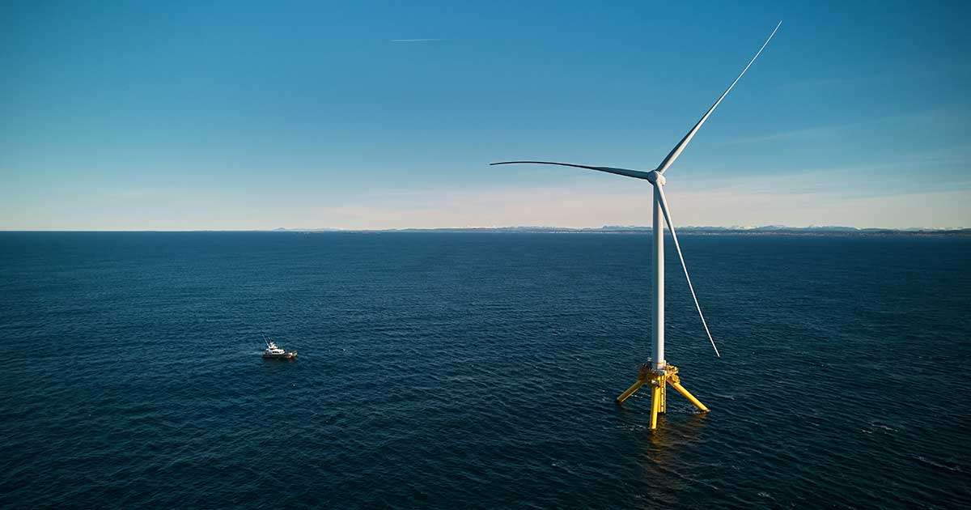
GWEC & FLOATING WIND
Advancing the Next Phase of the History of the Wind Power Industry

Slide 2
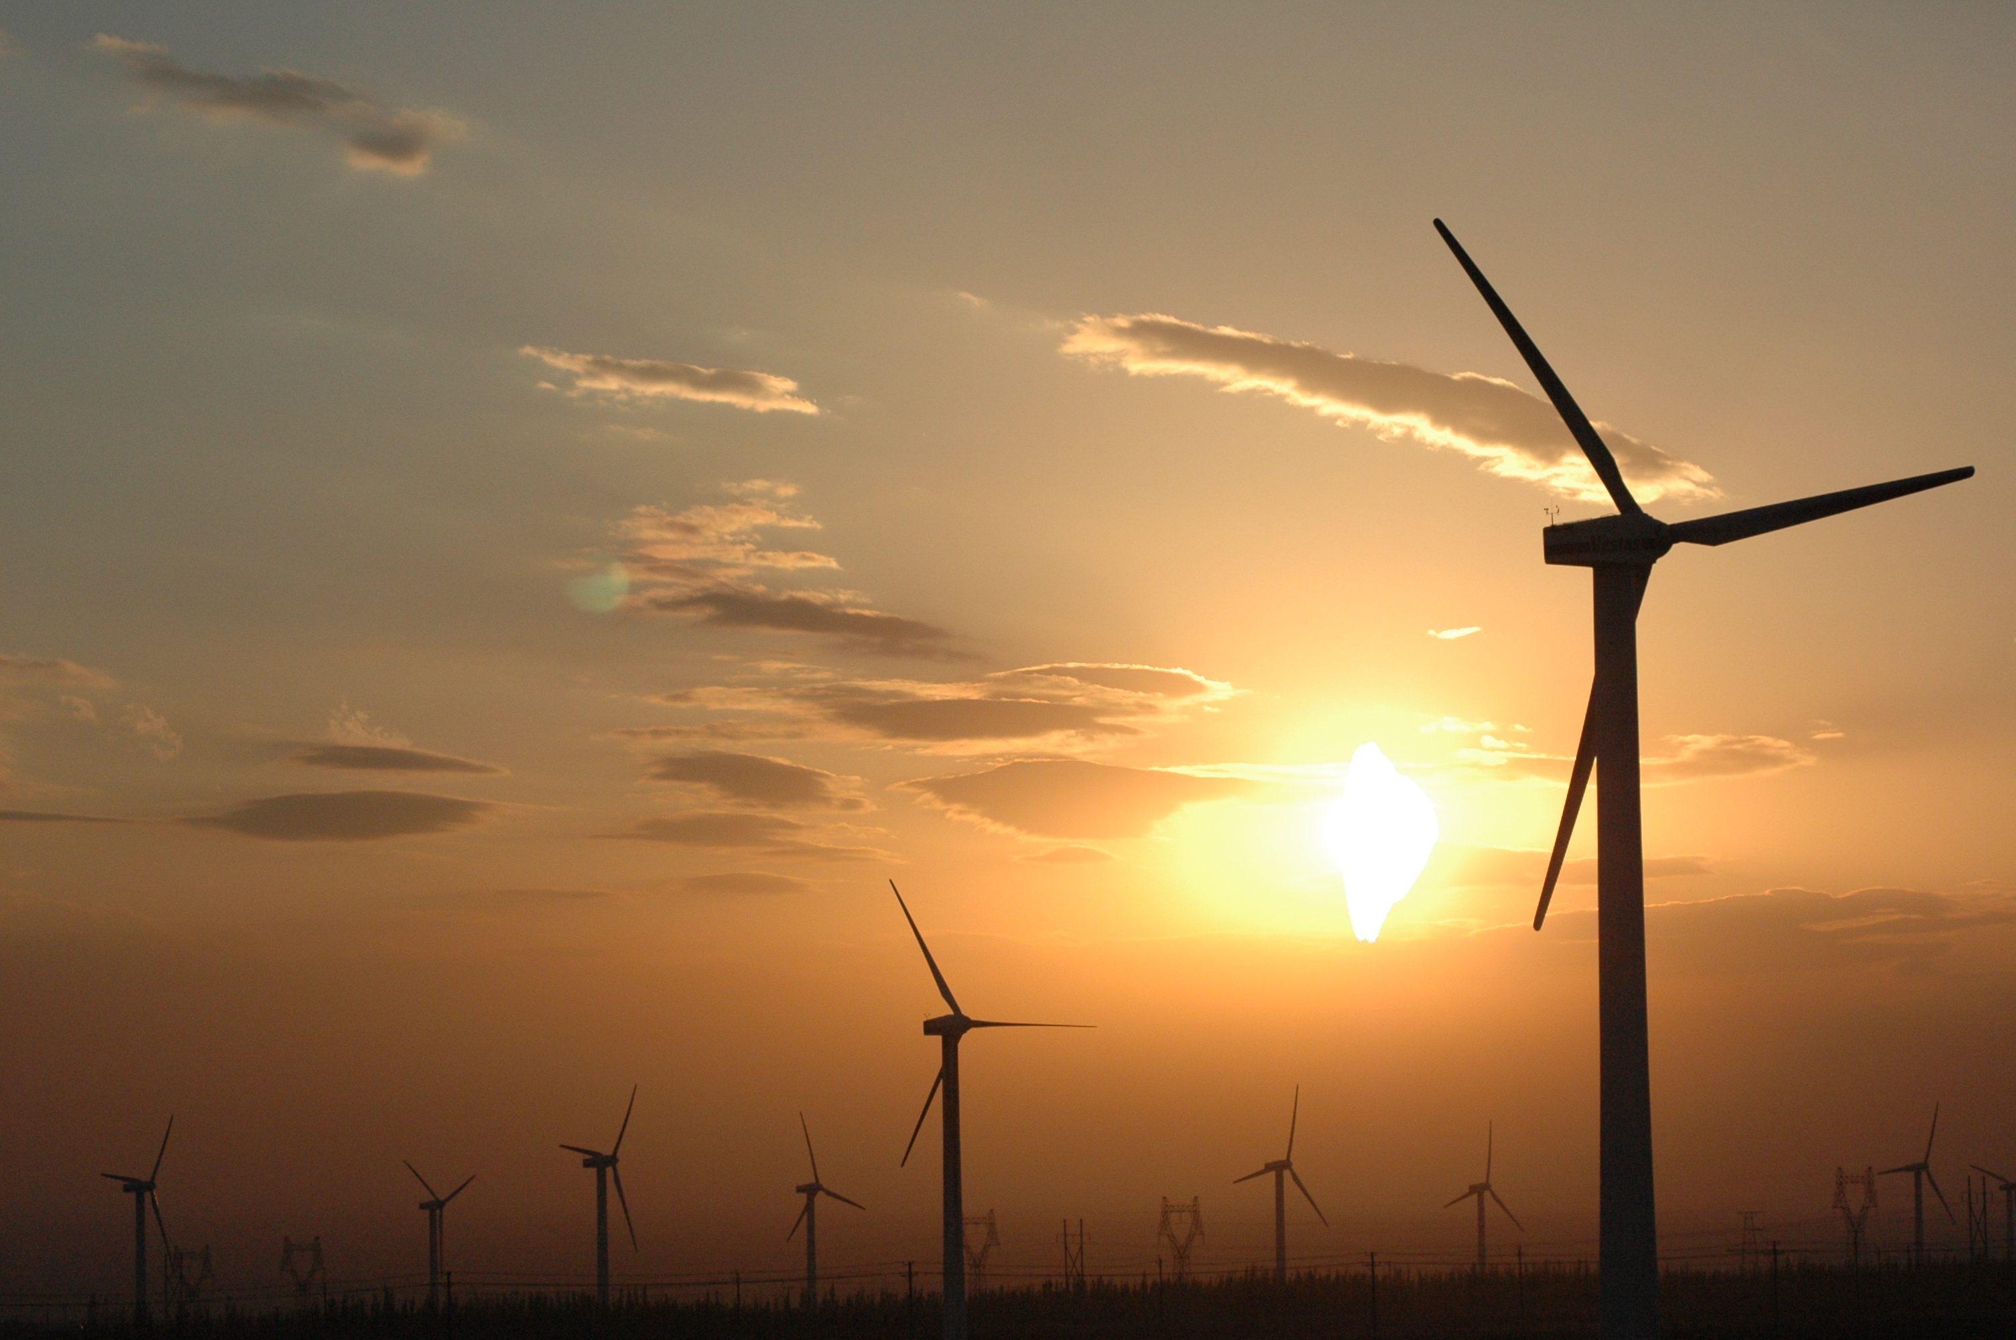
GWEC FUNDAMENTALS

Slide 3
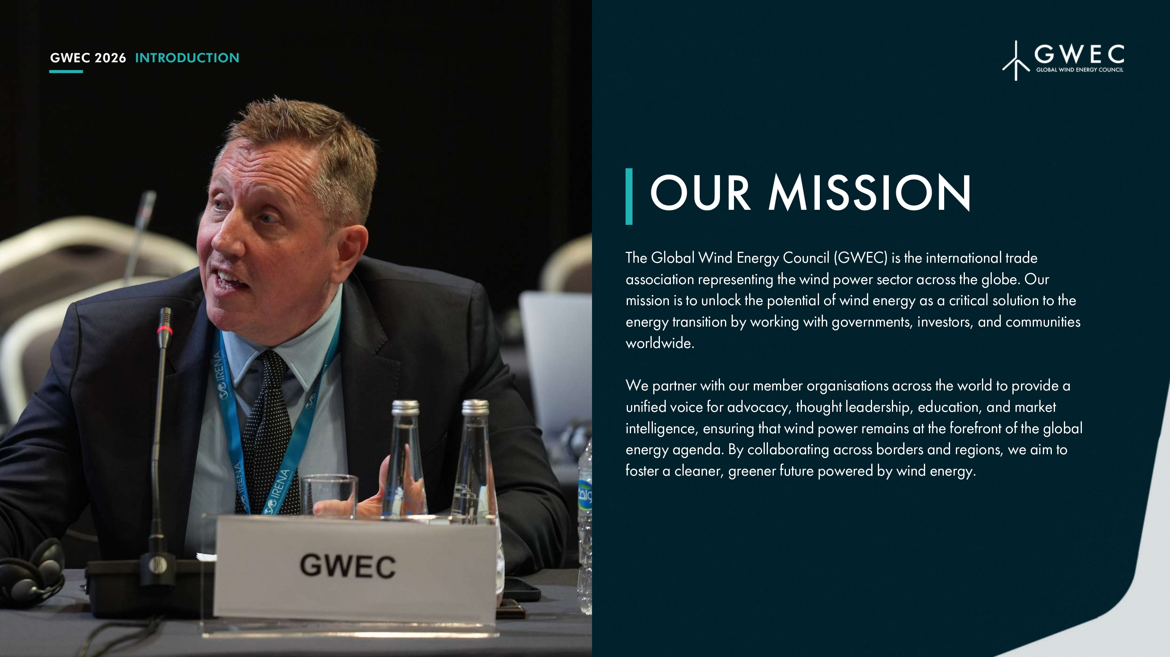
GWEC's Mission and Purpose
GWEC’s Objective
The Global Wind Energy Council (GWEC) is the international trade association representing the wind power sector across the globe. Our mission is to unlock the potential of wind energy as a critical solution to the energy transition by working with governments, investors, and communities Worldwide. We partner with our member organisations across the world to provide a unified voice for advocacy, thought leadership, education, and market intelligence, ensuring that wind power remains at the forefront of the global energy agenda. By collaborating across borders and regions, we aim to foster a cleaner, greener future powered by wind energy.
To achieve this, the Association shall carry out the following activities:
Policy development: To participate in policy and regulatory forums that can assist the creation of frameworks for wind power;
Business leadership: To provide the strategic and business leadership needed to engage external stakeholders;
Global outreach: To work with emerging markets to transfer know-how and strengthen the development of wind energy world-wide;
Information and education: To serve as a platform for providing quality information, expertise, analysis and data about wind energy.

Slide 4
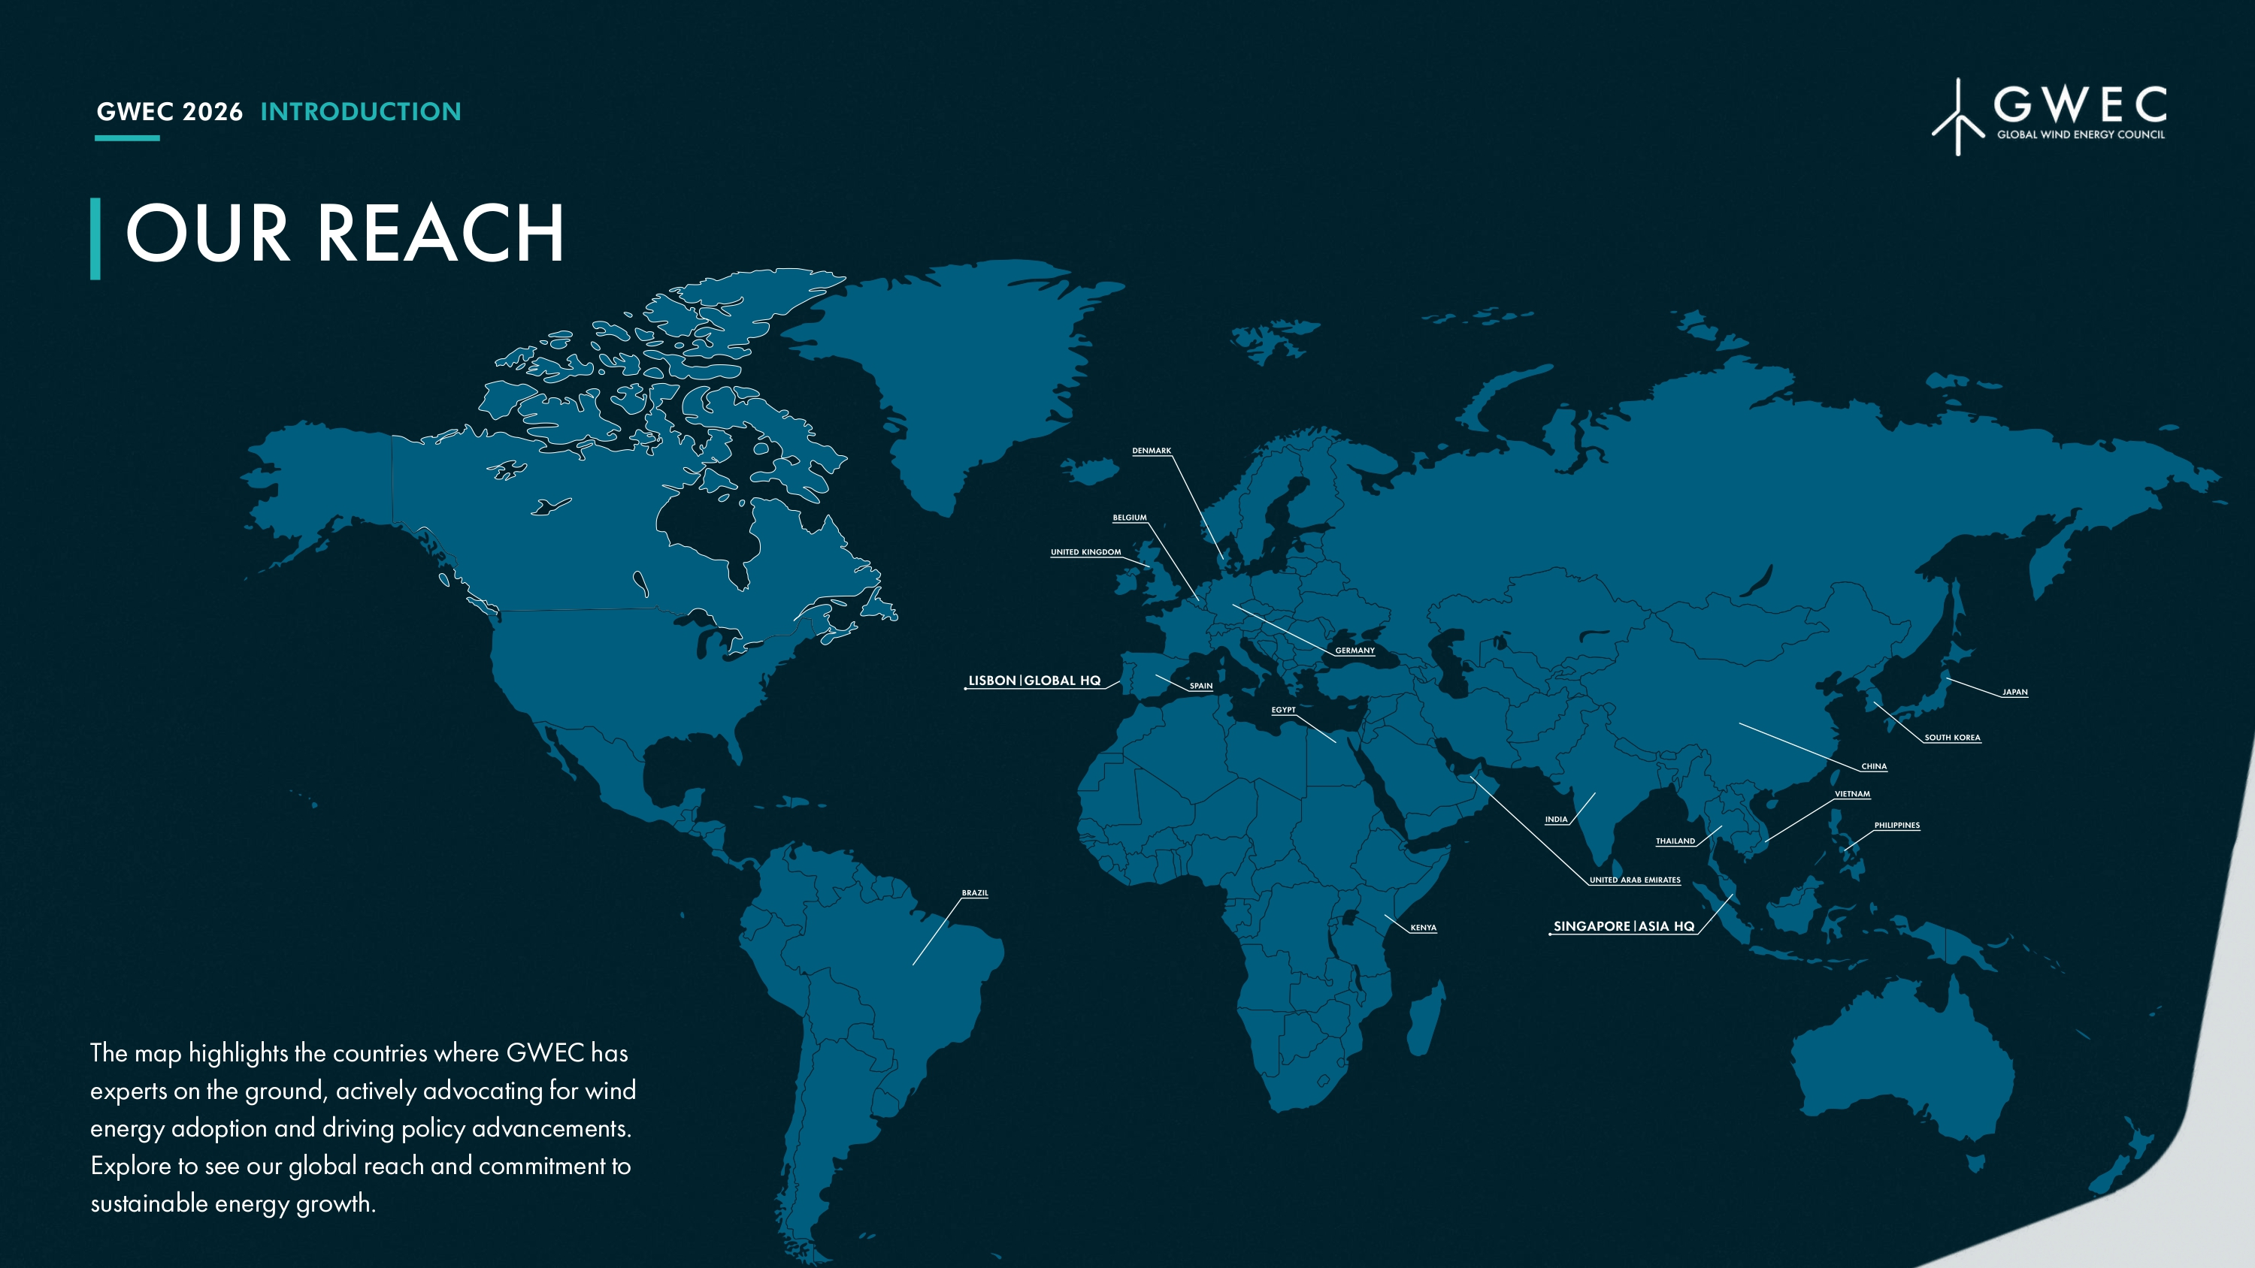

Slide 5
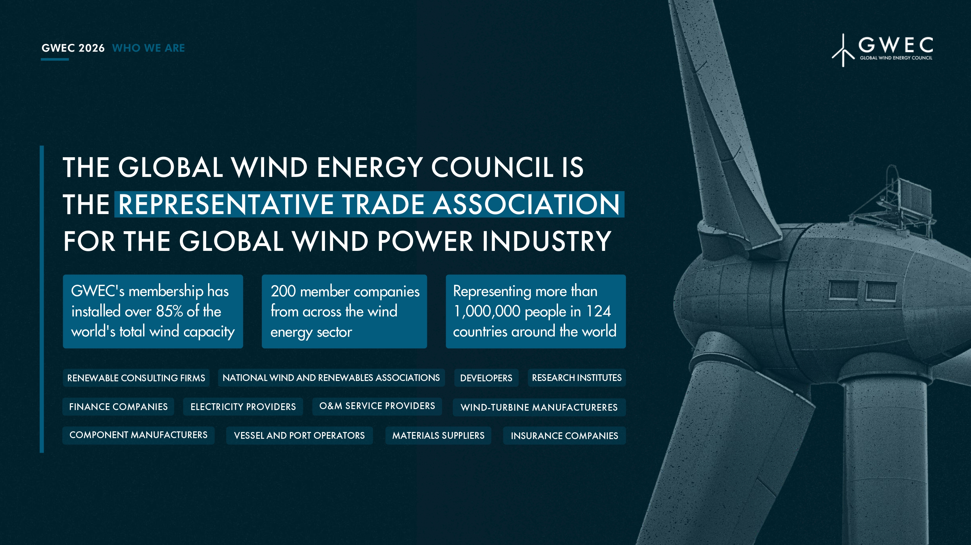

Slide 6
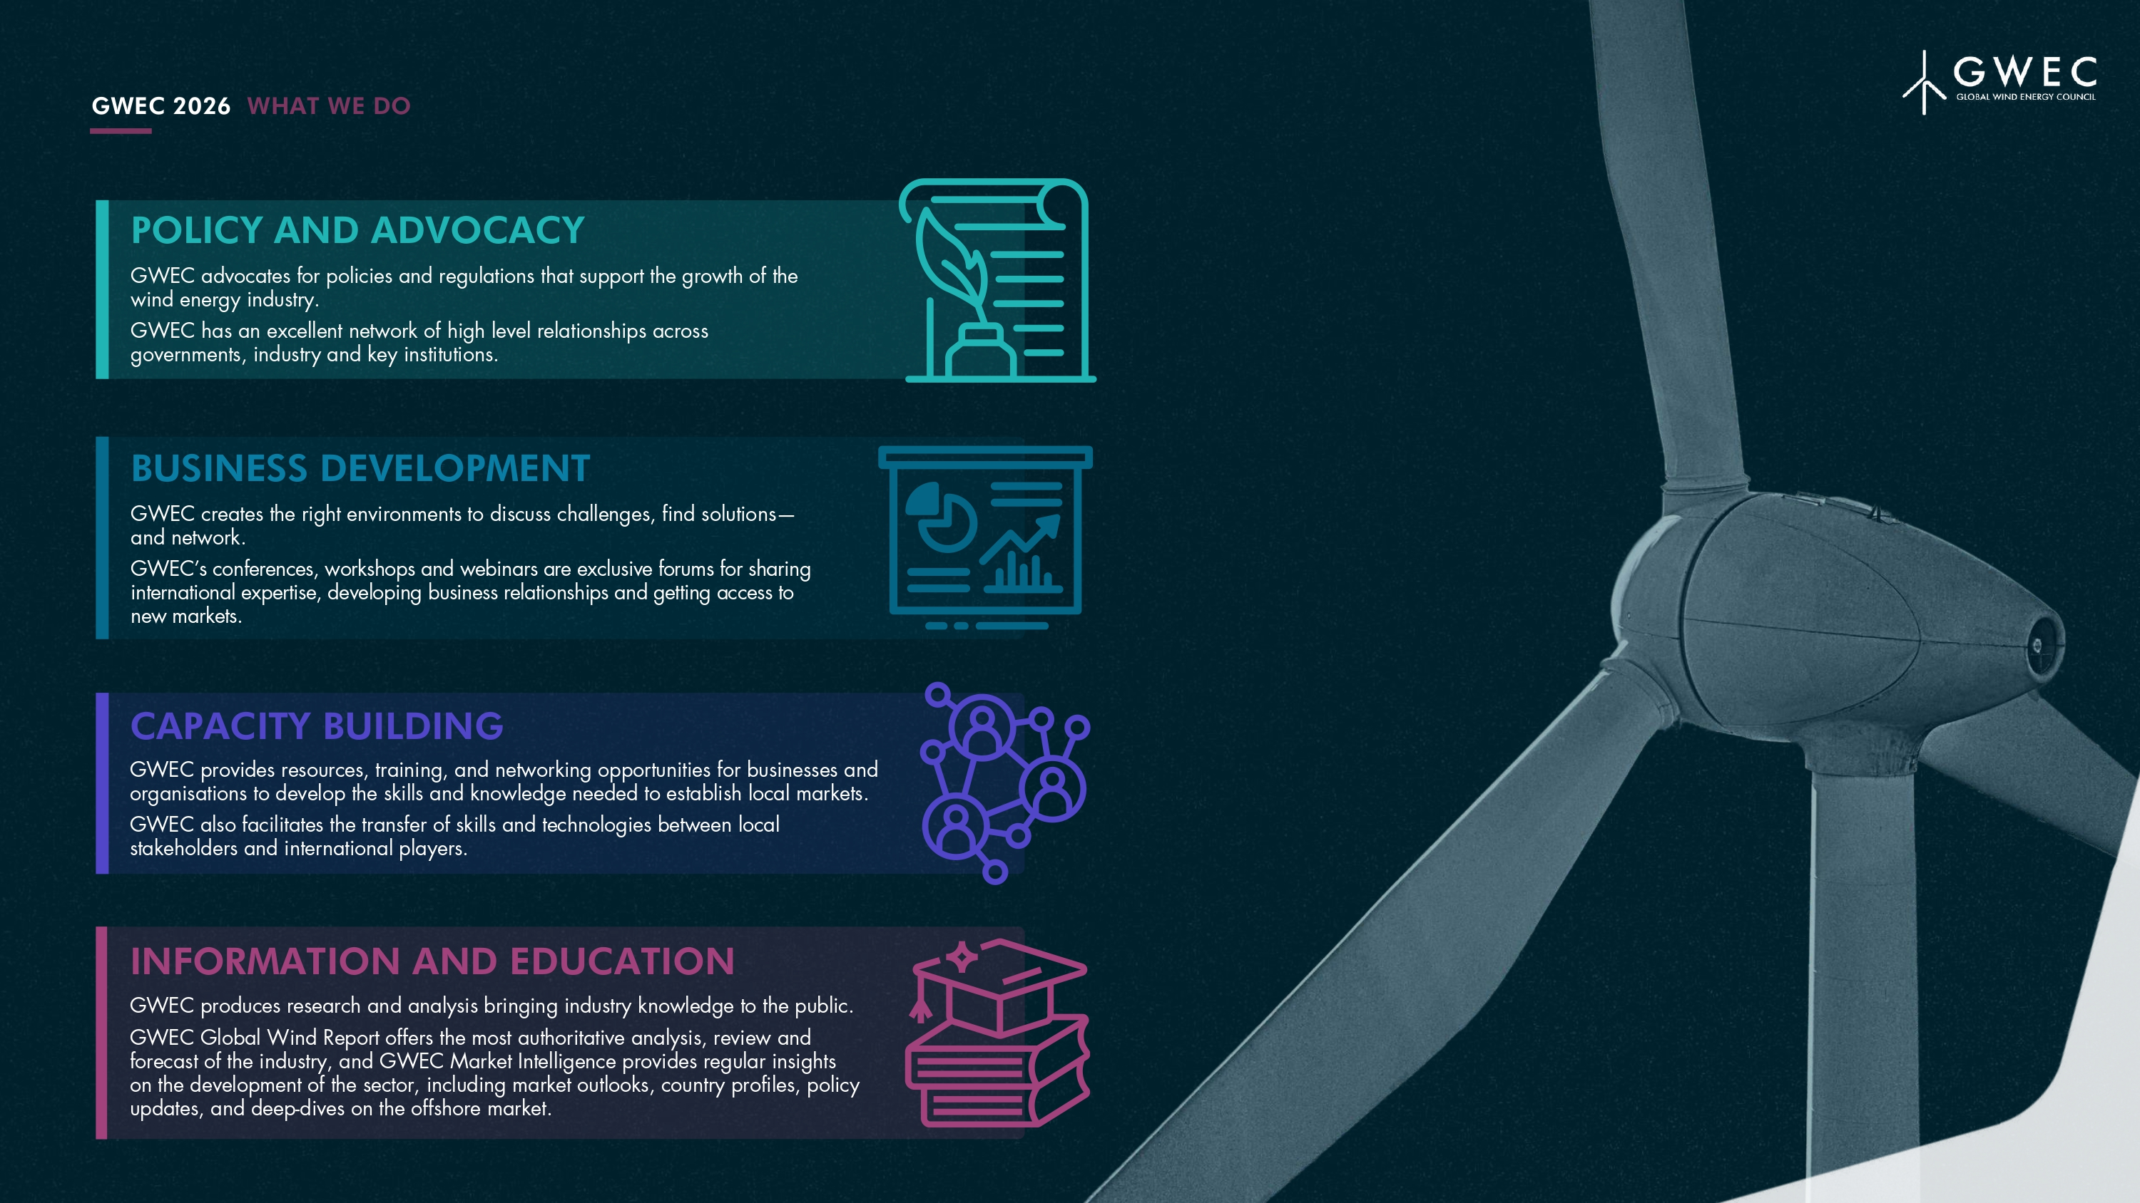

Slide 7
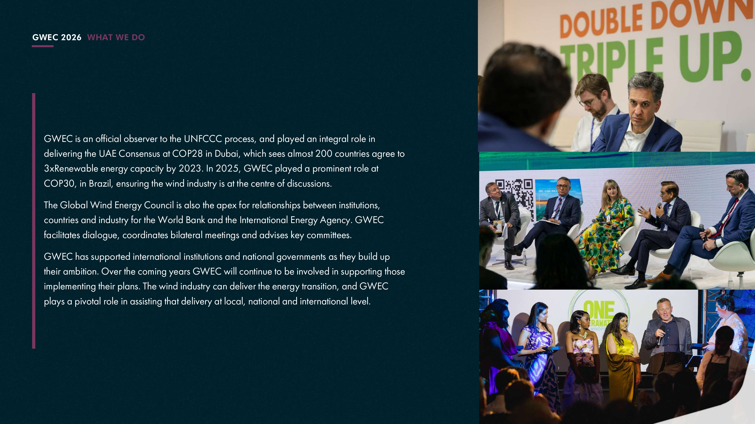

Slide 8
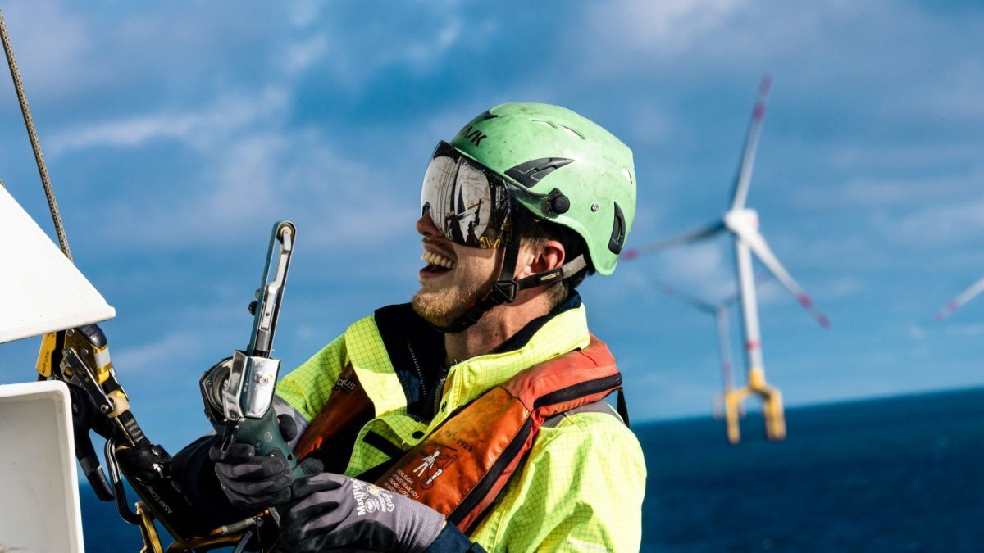
FLOATING WIND MARKET UPDATE

Slide 9

Floating Wind – Untapping the Power of the High Seas for the Wind Power Industry
Fixed installations are constrained to continental shelf regions with suitable seabed conditions, whereas floating systems can be deployed farther offshore, unlocking stronger and more consistent wind.
Floating technologies will allow the industry to tap into over 80% of offshore wind resources in deeper waters and achieving higher, more stable capacity factors that often exceed 60%.
Challenges ahead:
Floating wind is still emerging, with higher capital expenditures and limited standardization.
Floating projects, being farther offshore, may face higher transmission costs and more complex maintenance logistics.
Opportunities ahead:
Costs are expected to decline as deployment scales.
Floating turbines can be assembled and pre-commissioned onshore and then towed to site, reducing offshore installation risks and costs.
Floating can also reduce visual and environmental impacts near coastlines.

Slide 10
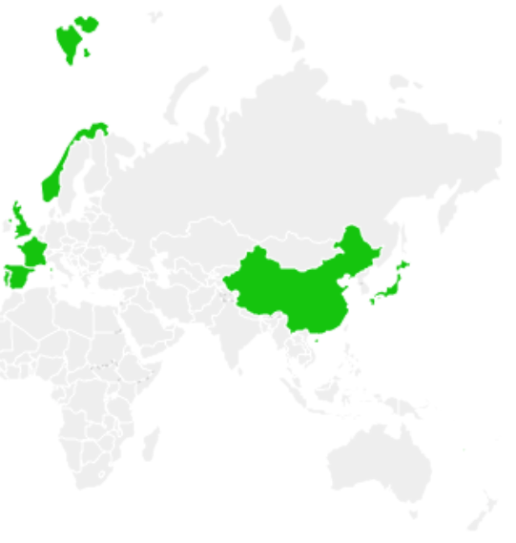




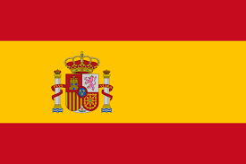
Global floating wind capacity by country: 379 MW operating or under construction
Note: 278 MW in operation and 101 MW under construction
Source: GWEC Market Intelligence, 2026

Slide 11
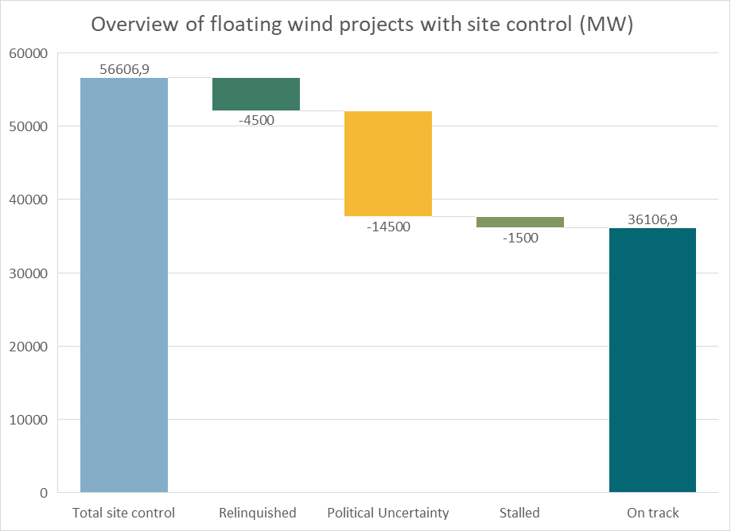
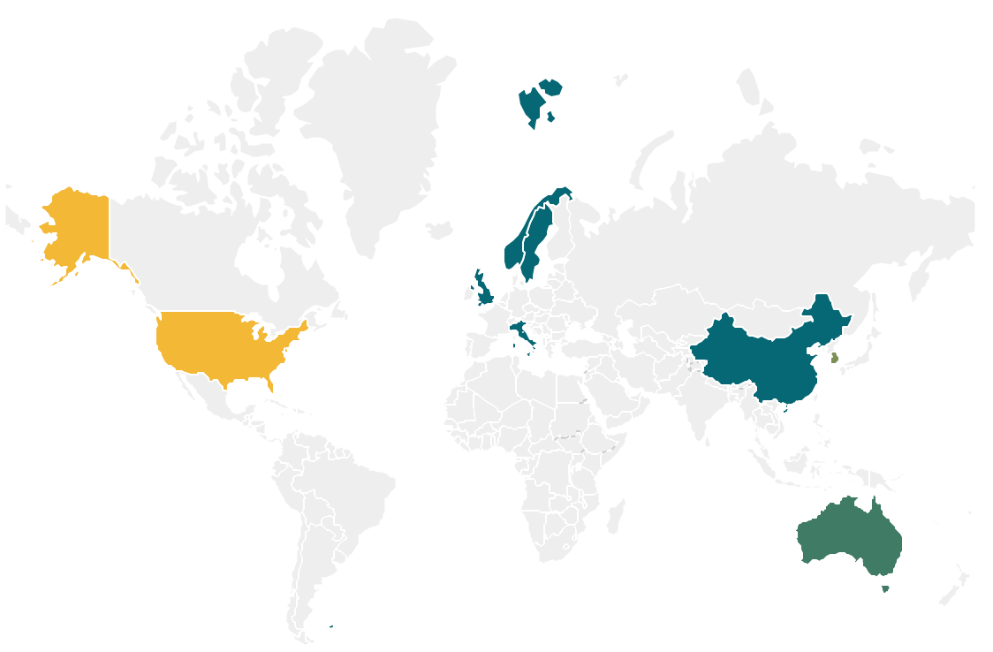
There is not a shortage of sites: 56 GW have secured site control and 36 GW have conditions to advance development pending grid and offtake.
*
*Note: CampionWind (UK), Arven South (UK) and Novocastrian (AU), totalling 4500 MW, have been relinquished, and the 1500 MW Bada Energy project in South Korea is stalled.
Definition:
Relinquished: Lease voluntarily returned to authorities before development progressed.
Political uncertainty: Project progress is at risk due to changes in adminstration policy.
Stalled: Development paused due to consortium restructuring and partner exit.
Source: GWEC Market Intelligence, 2026

Slide 12
~2,500 MW floating wind projects awarded offtake contracts, with total government targets of ~90 GW
Floating projects with active offtake contracts as of February 2026
*Note: projects that won offtake auctions/grants but no longer hold these contacts include TwinHub (UK), Goliat Vind (NO), and Bandibuli (KR). The Wanning Floating Phase 1 (CN) appears to be stalled with missed COD date and no recent updates.
Announced auction that could award offtake to FOW before 2027
Market | Auction/Round | Expected Capacity | Expected Timeline
South Korea | Offshore Wind Auction | 400 MW | 2026
France | AO9 Extension & AO10 | 5 GW | 2026–2027
Norway | Enova Utsira FOW Aid | 0.5 | 2027
United Kingdom | AR8 & AR9 | TBD | 2026–2027
Note: Other countries such as Spain, Italy, Taiwan (China) are considering scheduling floating wind offtake auctions before 2027 but have not yet confirmed
Source: GWEC Market Intelligence, 2026

Slide 13
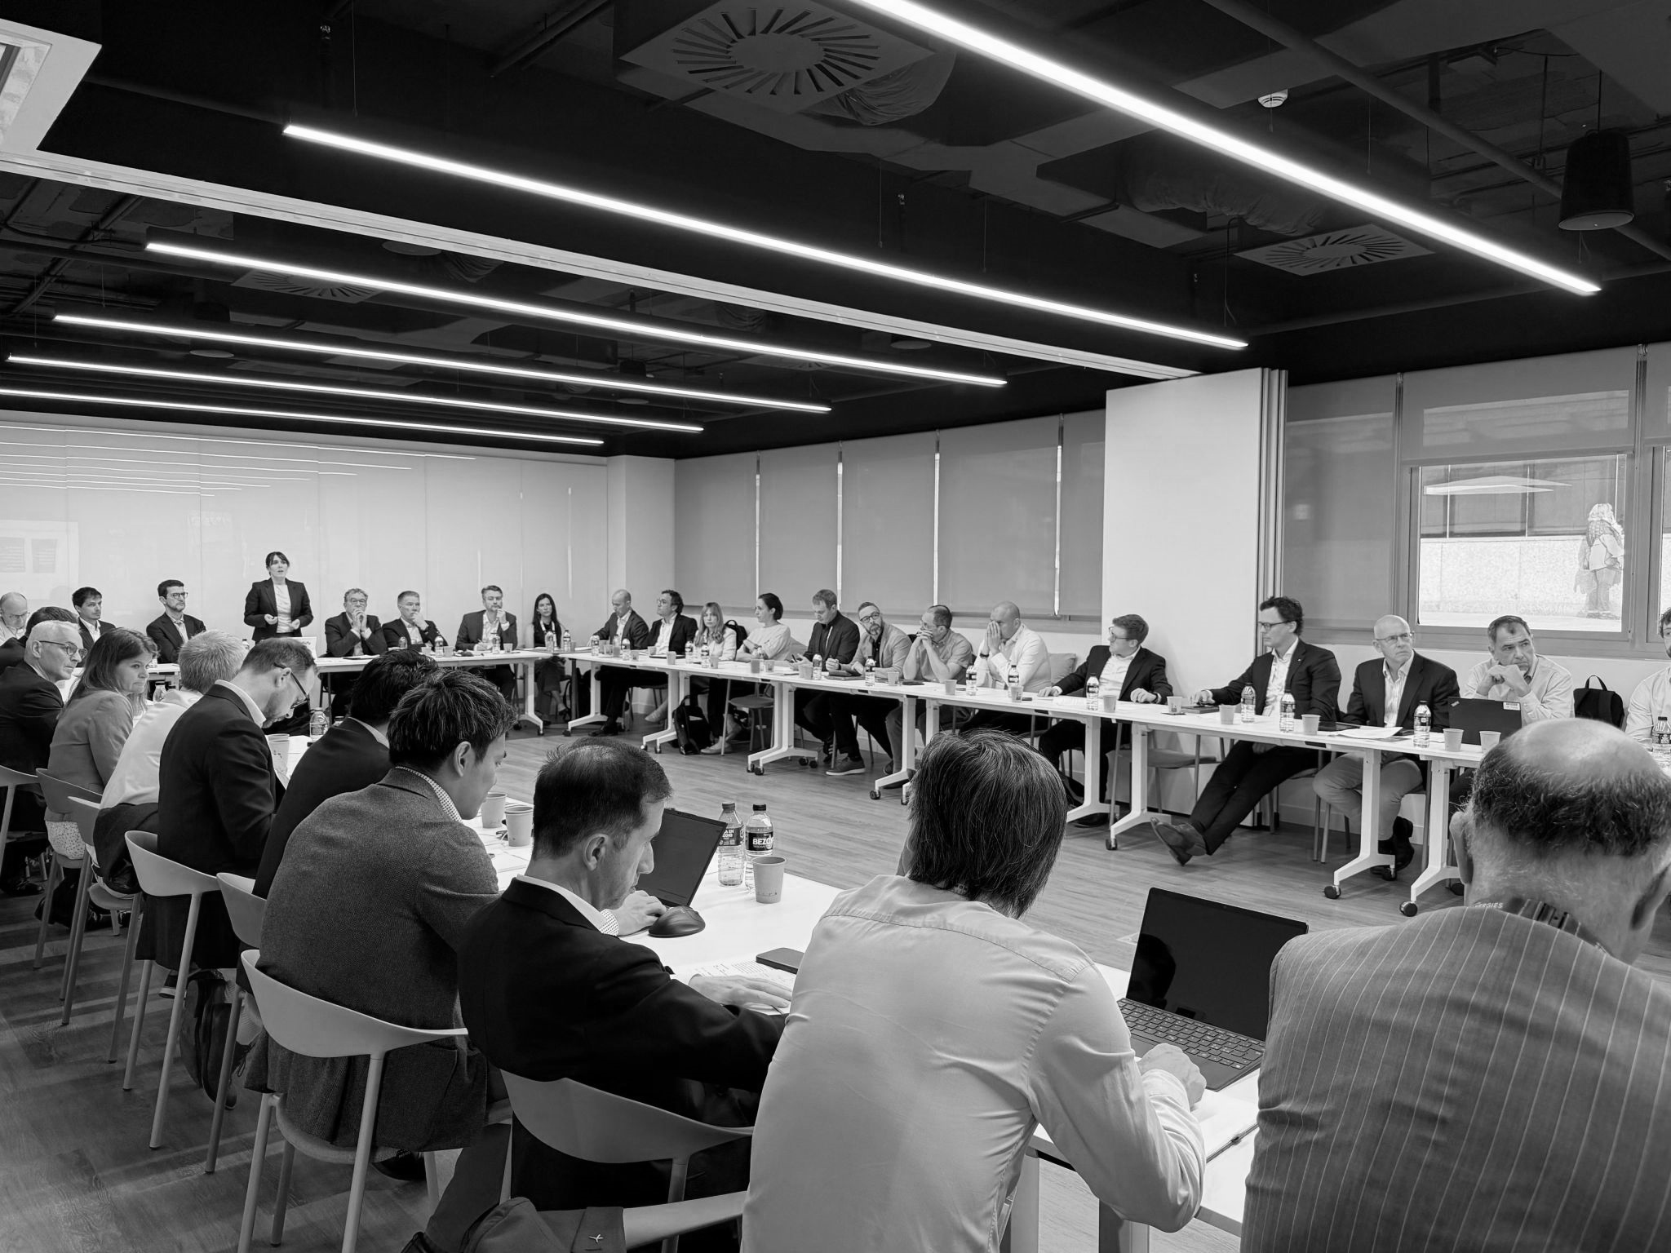
FLOATING WIND INDUSTRY ACCELERATOR

Slide 14
FLOATING WIND INDUSTRY ACCELERATOR
Mission
To agree and advance a clear, tangible and action-orientated industry roadmap for commercial scale floating offshore wind that will enhance political support by (a) demonstrating industry alignment on shared goals, (b) support near-term projects in creating conditions for investment decisions, and (c) prepare for scale up of regional and global supply chains.
The 3-year industry roadmap should consolidate and stabilize the industry in the late 2020s, preparing for successful scaling in the 2030s and beyond
14

Slide 15

A Three Pillared Approach to industry action on floating wind
01
02
03
01
02
03
01
Improving financial conditions for competitive projects (WACC, insurance, contracting)
Pathways for global supply chain development, standardisation & readiness
Global alignment on cost reduction trajectories and targets
02
03
Global alignment on cost reduction trajectory
Tackling barriers to
lower WACC and improve investor perceptions
Pathways for global supply chain development and readiness
Global alignment on cost reduction trajectory
Tackling barriers to
Pathways for global supply chain development and readiness
Industry-led Action Plan – status, levers, specific actions
*note: each task can be established with a lead and team comprising Floating Task Force Members. Task Plans should be developed with PMO and approved by SteerCo

Slide 16
A COMPREHENSIVE GOVERNMENT AND INDUSTRY PLAN TO ACCELERATE FLOATING WIND
GOVERNMENT AND DIPLOMACY
GOWA floating charter and accompanying government engagement
GWEC AND INDUSTRY
FWIA action plan proves industry is doing its part to address barriers (e.g., cost, finance)

Slide 17

Look Ahead: Hanoi APAC Summit
Next FWIA in-person meeting will take place at the APAC Summit June 10-11 in Hanoi
Agenda
  Insights from Developer Interviews
  Subcommittee Progress Updates
  Expanding participation in APAC region
  Action Statement Draft

Slide 18
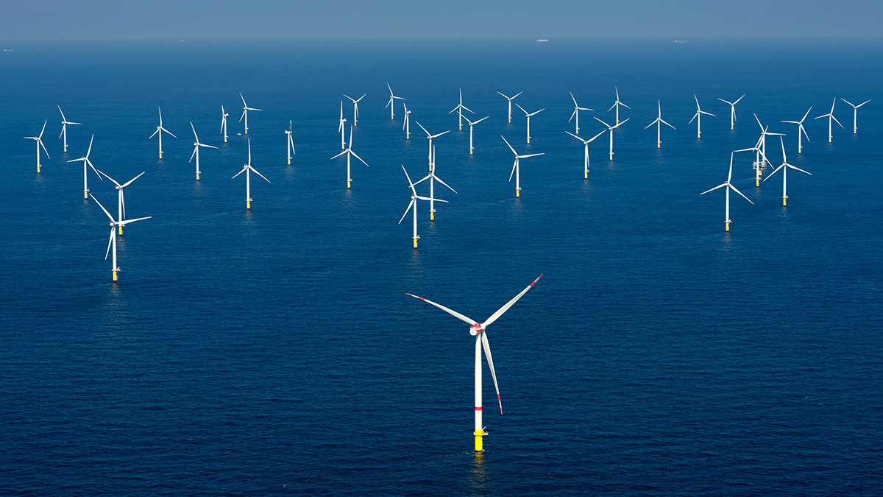
PARTNERSHIPS WITH OTHER ORGANIZATIONS

Slide 19
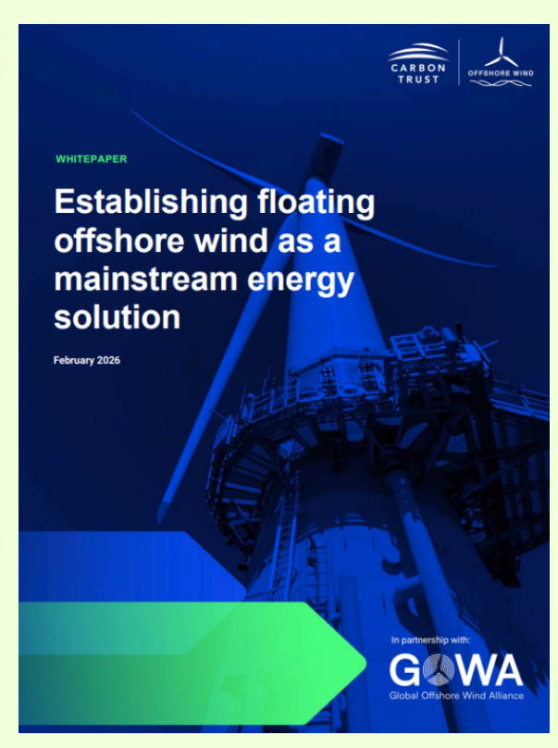
GOWA Floating Activities Update
High-level Ministerial Roundtable on Floating offshore win
Collaboration to unlock a global energy opportunity
Main Objectives
In collaboration with GWEC, build coordinated political and industrial support
Support governments in understanding the policy frameworks required to enable commercial scale deployment
Conduct a series of international dialogues convening governments, private sector, technical experts and financial institutions
Hosted on the side of London Climate Action Week (23 or 24 June), GOWA is convening a high-level roundtable to align perspectives between government and leading offshore wind stakeholders on the priority actions required to accelerate Floating Offshore Wind.
The roundtable seeks to bring together leading global FLOW initiatives, including FLOWRA, GWEC's FWIA, FLOWEX and the Carbon Trust JIP, alongside first mover governments.
Engagement has started with GOWA members UK, Norway, Netherlands, Japan.

