Slide 1

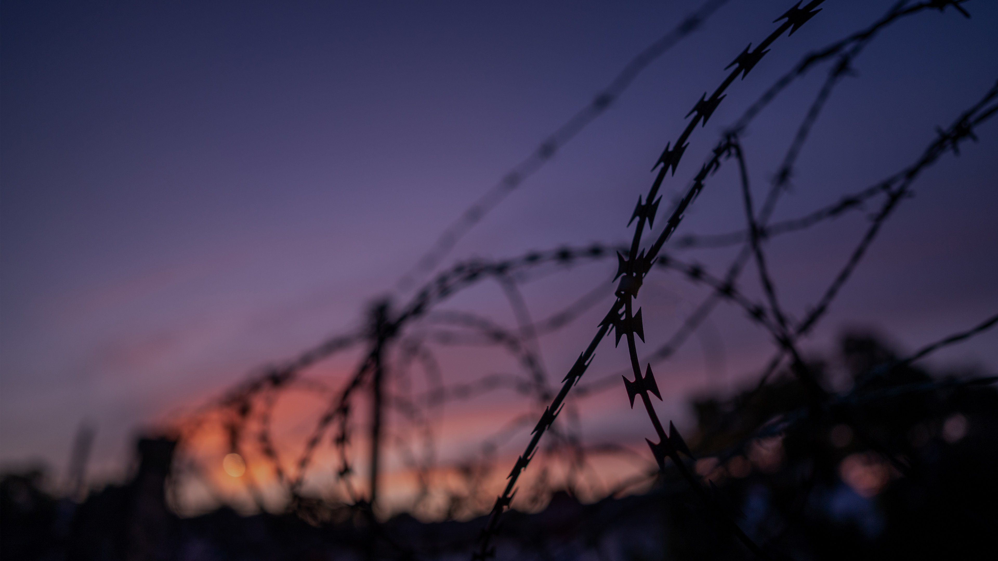
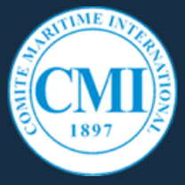
CMI Colloquium and General Assembly 2026,
Rio de Janeiro
International Working Group on Piracy Seizure, Maritime Violence and Fraudulent Activity
The Weaponisation of Sea Routes: Is Shipping in the Firing Line?
Friday, 15 May 2026

Slide 2

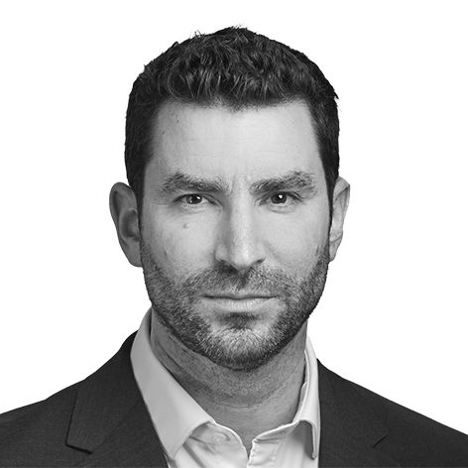

Richard Neylon
HFW
Partner, Head of Complex Environments
E: richard.neylon@hfw.com
M: +44 (0)7786 266 919

Slide 3
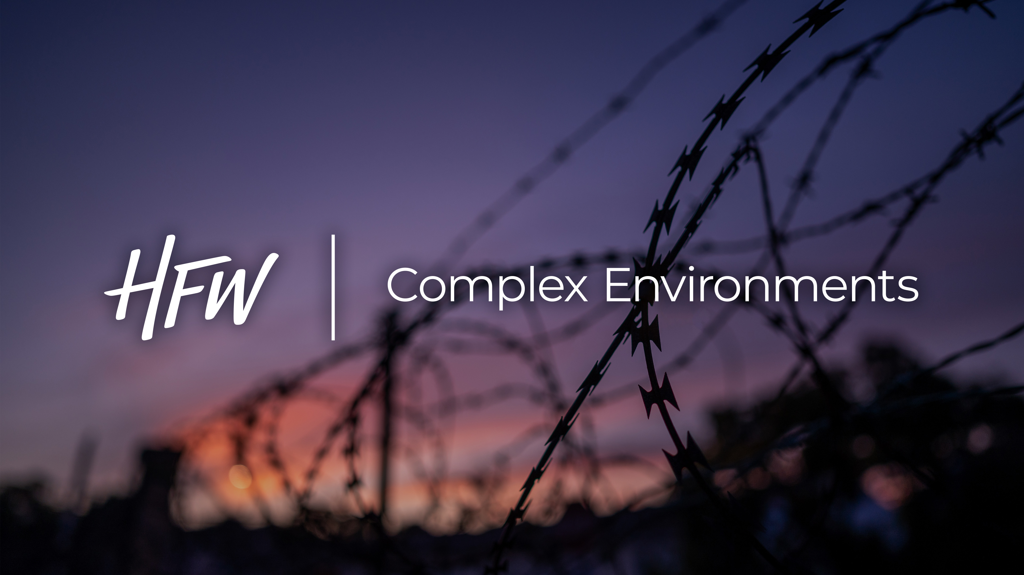

Slide 4
panellists
Moderator: Richard Neylon
Panellists: Rafael Zelesco Barretto
Assistant Professor in International Law, Brazilian Naval War College, Rio de Janeiro
Rita Feodrippe
Dry Bulk Shipping Manager, Vale Base Metals, Rio de Janeiro
Nick Shaw
CEO of the International Group of P&I Clubs, London
Pietro Palandri
Senior Partner, Studio Legale Mordiglia, Genoa

Slide 5
Members
International Working Group on Piracy, Seizure, Maritime Violence and Fraudulent Activity
Richard NEYLON (Chair) [UK]
Emeka AKABOGU [Nigeria]
Robin BOWLEY [Australia & New Zealand]
Charles BUSS [UK]
Patrick GRIGGS [UK]
Simone HÄDERLE INGEBERG [Norway]
Wan HILWANIE ARIFF [Malaysia]
John KIMBALL [USA]
Lene-Camilla NORDLIE [Norway]
Pietro PALANDRI [Italy]
Ian RALBY [USA]
Michelle WIESE BOCKMANN [UK]

Slide 6
topics
The Weaponisation of Sea Routes: Is Shipping in the Firing Line?
Crew
Lessons learned from recent conflict zones:
        Russia / Ukraine
        Houthis, Red Sea
    Seizure of vessels / hostile boardings
Strait of Hormuz
A changing world order?

Slide 7
Q&A

Slide 8
Thank you
Richard Neylon
HFW
Partner, Head of Complex Environments
E: richard.neylon@hfw.com
M: +44 (0)7786 266 919

