Slide 1


Maritime Insolvency in an Era of Geopolitical Fragmentation
Unique Maritime Risks and International Judicial Cooperation
yCMI Panel – CMI Colloquium Rio 2026
Thursday, 14 May 2026
Dr Warren de Waegh
Senior Lecturer
Shipping Law Unit
Commercial Law Department

Slide 2

Outline
Maritime insolvency in current times
Unique maritime risks
Territoriality as starting point
Judicial cooperation for a coordinated response
Way forward

Slide 3
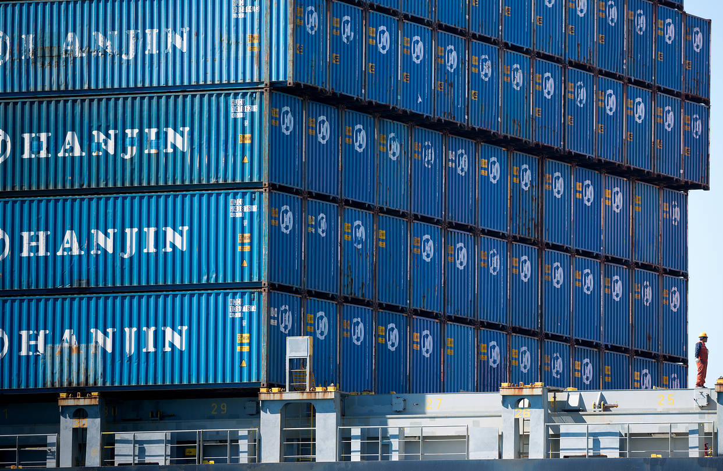
1. Maritime insolvency in current times
Risk of insolvency of shipping companies
2016 crisis: challenging administration of maritime insolvencies
State of the art research on maritime insolvencies
(see notably Athanassiou; Davies; diss. Göretzlehner; diss. Xu)
To date no legislative action taken

Slide 4
2. Unique maritime risks: basics
Territoriality in maritime enforcement procedures
Ship arrests following the location of the ship
vs.
Universalism in cross-border insolvency law
Insolvency proceedings following the centre of main interests of the debtor
Particularly problematic for maritime liens and ship mortgages
  Cost of credit to the ship
  Operation of the ship and maritime trade
  Effective and efficient administration of the maritime insolvency

Slide 5
2. Unique maritime risks: diverging protection
Netherlands: no protection for maritime liens
Rb Arnhem 03-12-2008, ECLI:NL:RBARN:2008:BG6986 (X Reederei GmbH v FLB SPRL)
cf. Rb Rotterdam (vzr) 29-04-2009, ECLI:NL:RBROT:2009:BL9093 (S&S 2009, 122; Hannes C)
See also US: in re Hanjin Shipping co, ltd (2016) case no. 16-27041 (JKS) (US Bankruptcy Court District of New Jersey)
France: maritime liens and ship mortgages protected
CA Aix-en-Provence 29-06-2011 DMF 2012, 131 (navire Ital Roro I)
cf. CA Aix-en-Provence 7-12-2012 DMF 2014.236 obs Cachard (navire Michele Iuliano)
See also Singapore: Natixis, Singapore Branch v Seshadri Rajagopalan [2025] SGCA 29
Belgium: protection extends to mere maritime claims
CA Antwerp 4-03-2009, European Transport Law 2009, 256 (The Normed Istanbul (ex-Hannes C)) CA Ghent, 7-07-2009, RHA 2010, 359 (The Pretty Flourish)
See also Australia: Yu v STX Pan Ocean Co Ltd (South Korea), in the matter of STX Pan Ocean Co Ltd (receivers appointed in South Korea) [2013] FCA 680

Slide 6
3. Territoriality as starting point
Territorial protection for rights in rem widely accepted
  Art. 8 European Insolvency Regulation (recast 2015)
  UNCITRAL Model Law CBI, Guide to Enactment, para 38
  Default in countries without international CBI regime
Maritime liens and mortgages are rights in rem
&
Territorial protection adequate: continuation of ship arrests
←→
Current state of law maladapted to mobile nature of ship
Include maritime liens and mortgages
under existing in rem protection grounds

Slide 7
3. Territoriality as starting point
Territorial protection for maritime liens and mortgages
Reduce impact on operation of ship and maritime trade
Most feasible solution across CBI regimes
Allow intervention of insurers
Beijing Convention and international recognition of effects of insolvency
Territorial administration of maritime security interests
also benefits general body of creditors & debtor

Slide 8
4. Judicial cooperation for a coordinated response
Risk of strict territoriality = uncoordinated administration
  Territoriality as “grab rule” (see Westbrook 2005)
Hedged by international cooperation between courts and insolvency practitioners:
  Art. 41- 44 European Insolvency Regulation (recast 2015)
  UNCITRAL Model Law CBI, Preamble (a): “promote cooperation”
Judicial cooperation championed by
2025 Judicial Insolvency Network (JIN)
Admiralty Guidelines
JIN Guidelines include territorial safeguards for security interests

Slide 9
5. Way forward
Advancing cooperative territoriality (see LoPucki 2000)
Multidimensional approach needed
JIN Admiralty Guidelines useful vehicle
Maritime input (CMI/NMLAs) on JIN Admiralty Guidelines advised
Monitoring of pending developments in cross-border insolvency law:
  2027 revision of European Insolvency Regulation
  “28^{th”} EU insolvency regime
  Draft UNCITRAL Model Law on Applicable Law in Insolvency

Slide 10
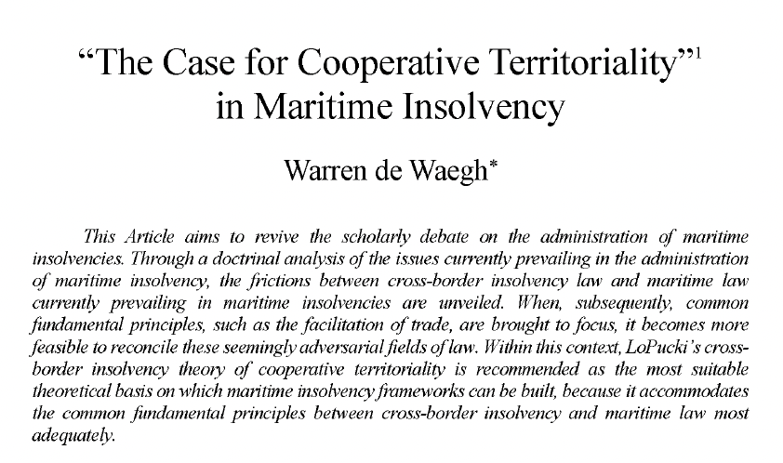
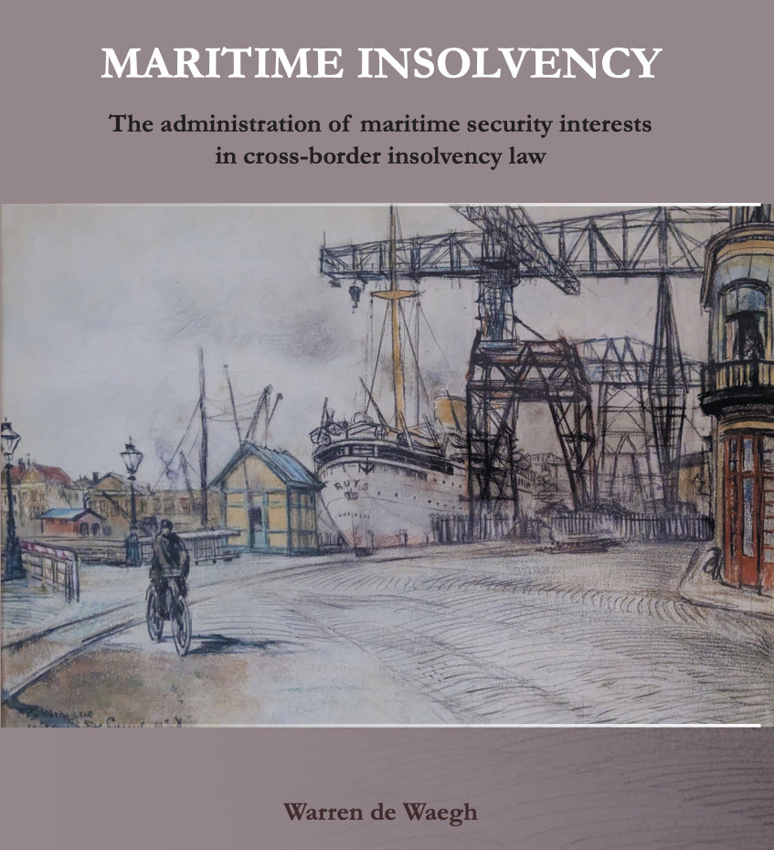
Warren de Waegh, '"The Case for Cooperative Territoriality" in Maritime Insolvency’
(2026) 50 Tul Mar LJ 77
Open access:
https://pure.eur.nl/en/publications/maritime-insolvency-the-administration-of-maritime-security-inter/

Slide 11
Thank you for your attention!
warren.dewaegh@uct.ac.za

