Slide 1
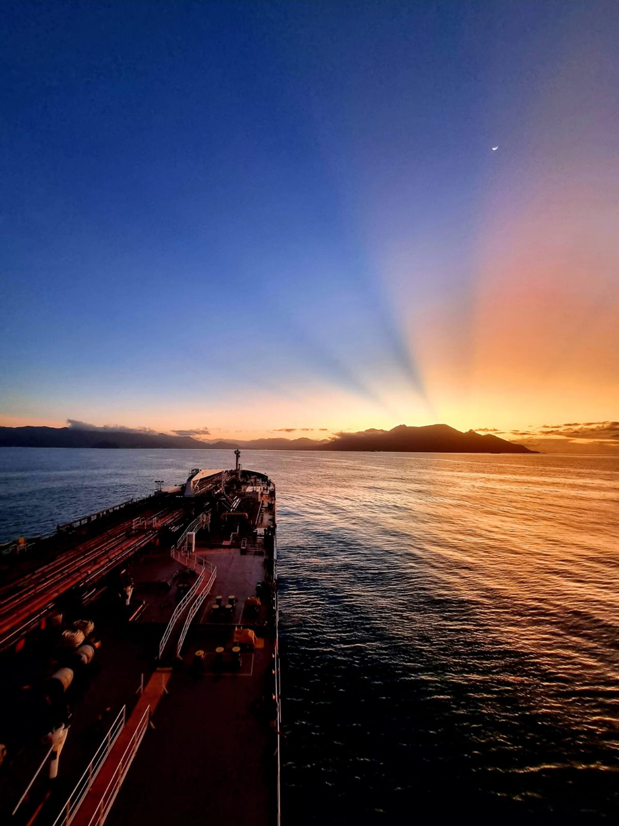


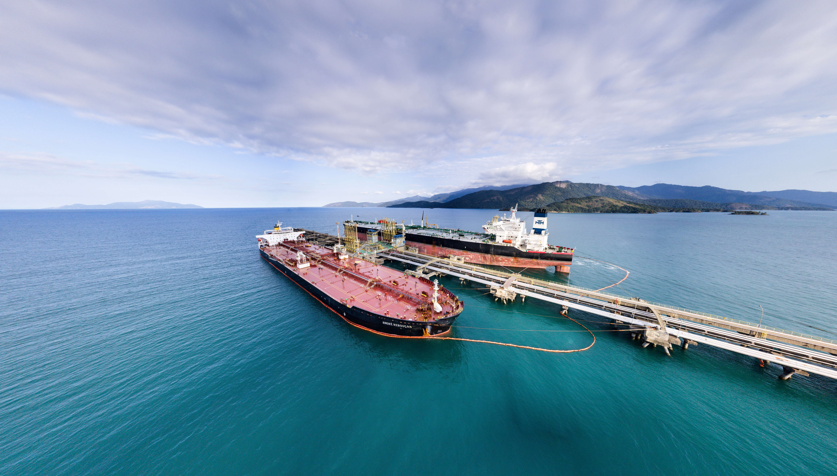
The new world order and legal aspects:
The importance of international
conventions for Brazil
Capt. Jones A. B. Soares
M.Sc AFNI MIFSMA MNAMEPA MCCMM MABDM
Director of Maritime Transport at Transpetro
CMI RIO 2026
Plenary Session
Rio de Janeiro, 13/may/2026.
P

Slide 2
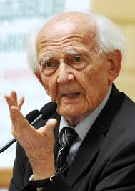

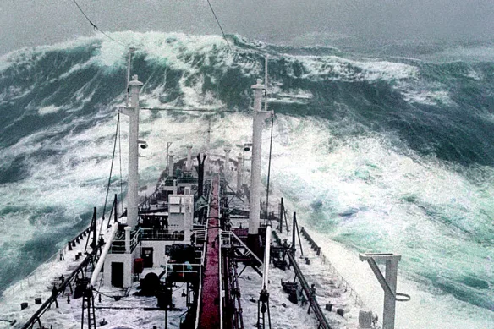
INTRODUCTION - WORLD OF INTERREGNUM
IN PROGRESS AN IMPORTANT
CHANGE OF AN ERA
“We are living in the interregnum between what is no longer and what is not yet”.
Bauman and Mauro, 2016.
For many centuries, maritime transport has protected itself from the environment.
Today, it must also protect enviroment too, when go to the the sea.
P
Notes:
Zygmunt Bauman (1925–2017) was a renowned Polish-British sociologist and philosopher who famously used the concept of the "interregnum" to describe the current global social and political condition. Definition: Drawing on Antonio Gramsci, Bauman defined the interregnum as a period where "the old is dying and the new cannot be born". It is a time-lag separating the collapse of old social structures (solid modernity) from the establishment of new, yet-to-be-defined ones.
"Liquid Modernity": The interregnum is the defining state of "liquid modernity," a phrase coined by Bauman to describe a world where social forms—bonds, careers, institutions—melt faster than new ones can be forged, leading to uncertainty and instability.

Slide 3
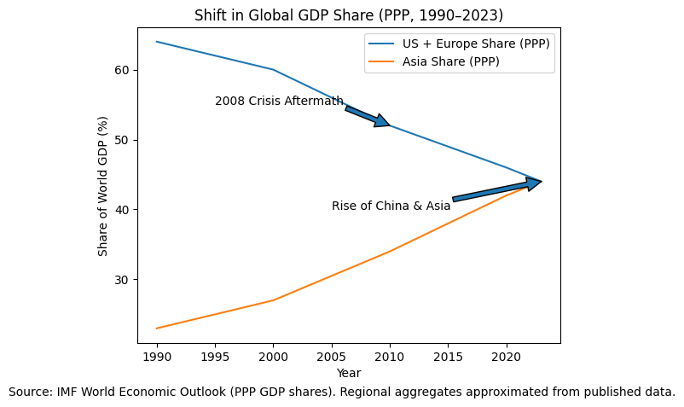
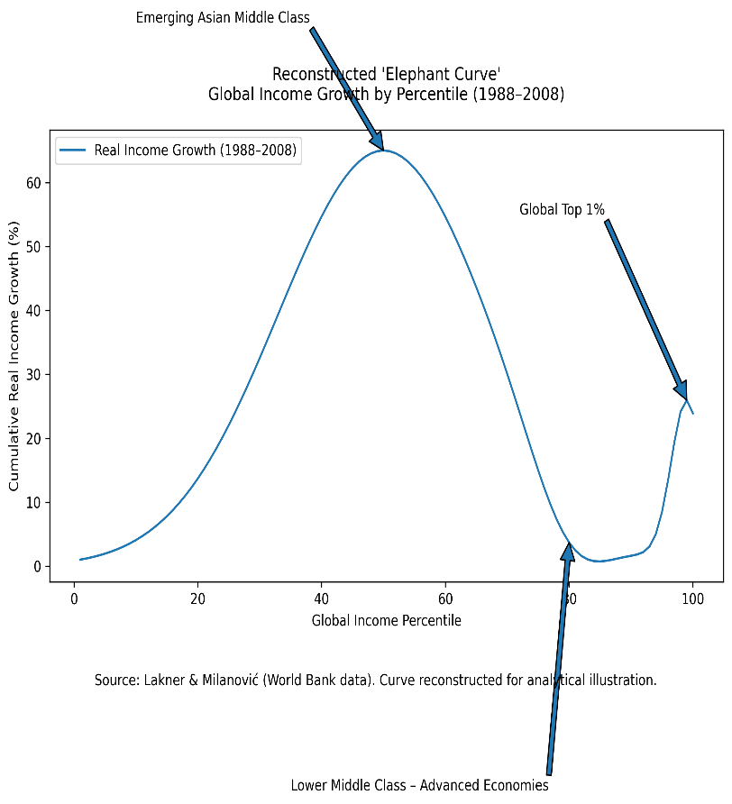
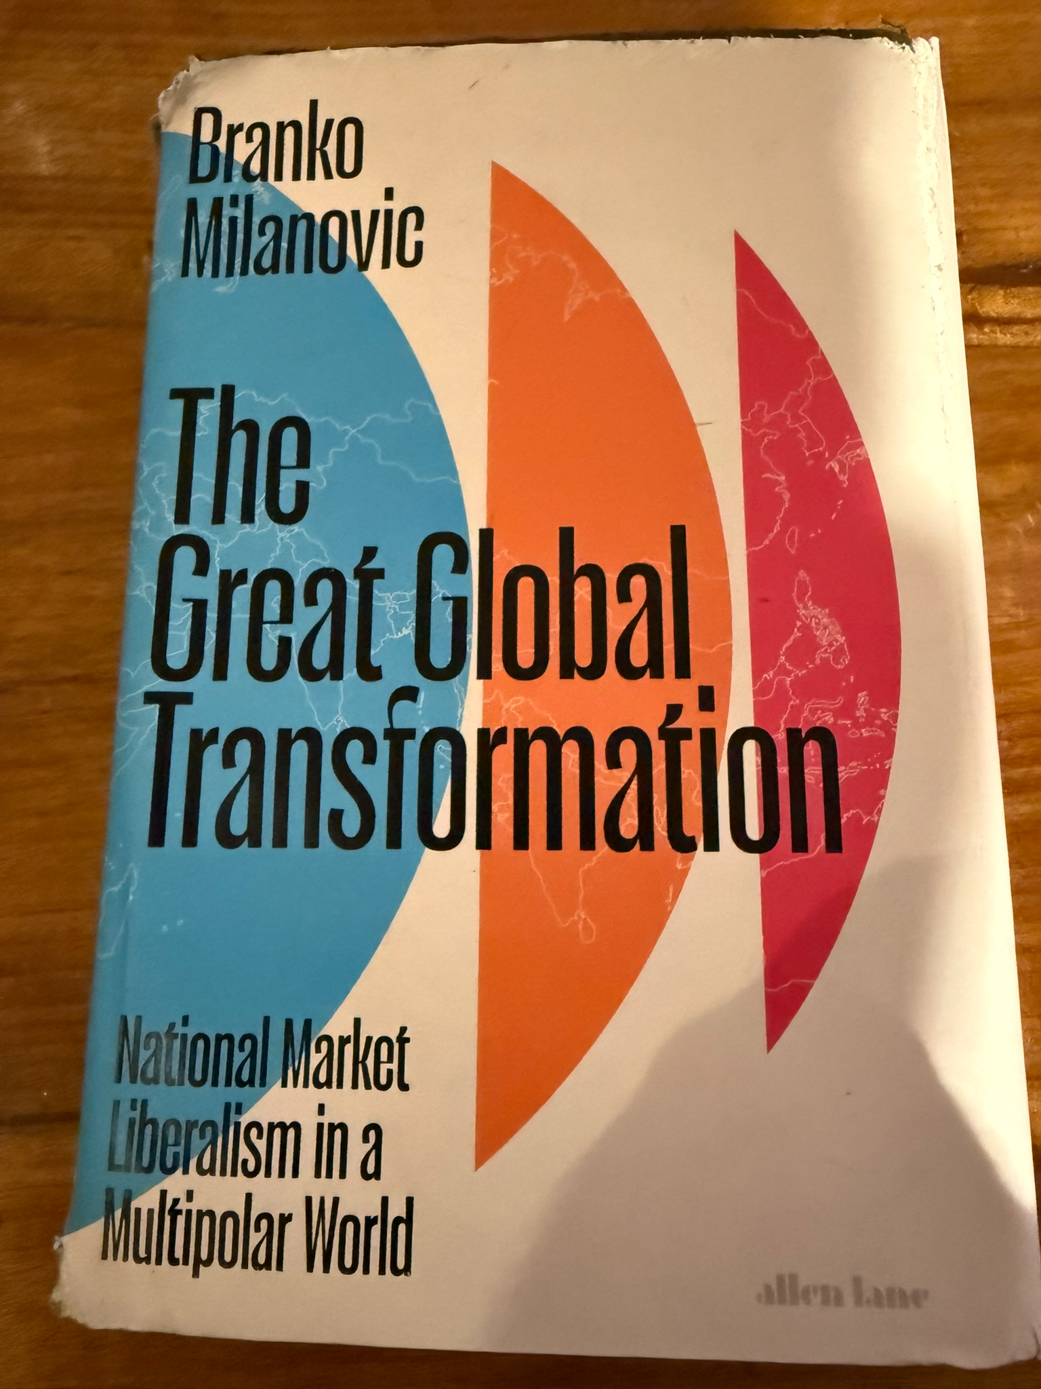
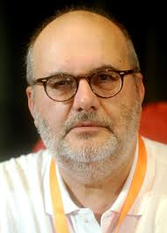
INTRODUCTION – WORLD OF INTERREGNUM - AND IT'S GETTING HARDER
“The Great Global Transformation argues that the neoliberal model of globalization that has dominated since 1989 is coming to an end, supplanted by a new system (national market liberalism) that mixes open domestic markets with protectionist foreign policies and intensified geopolitical competition.
It is not the end of the market—it is the market subordinated to geopolitics.
Markets remain central, but now embedded in a logic of power.”
Milanovic, B. (2025). The Great Global Transformation: The United States, China, and the Rise of a New World Order. University of Chicago Press.
Global income inequality trends from 1988 to 2008. It shows that during this period of high globalization, the emerging middle class in Asia saw massive income gains (the "back"), while the lower-middle class in developed nations stagnated (the "trough"), and the top 1% gained significantly (the "trunk").
P
Notes:
A resentful and violent reaction to the rise of Asia and developing countries. Why?
Global income inequality trends from 1988 to 2008. It shows that during this period of high globalization, the emerging middle class in Asia saw massive income gains (the "back"), while the lower-middle class in developed nations stagnated (the "trough"), and the top 1% gained significantly (the "trunk").
We also deserve to be developed and rich.

Slide 4


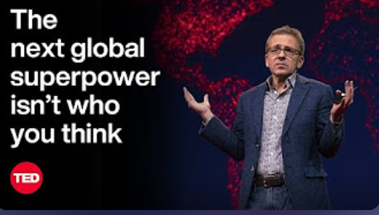

Three coexisting global orders:
INTRODUCTION – INTERREGNUM - AND IT'S GETTING HARDER
A WORLD WITHOUT A SINGLE LEADER
Unipolar Military Order - The global military order is dominated by the United States, with a significant military presence worldwide.
Multipolar Economic Order - Economic power is shared between countries such as China, Brazil, the EU, and India, shaping global trade and finance.
Digital Order - Technology companies influence behaviors, opinions, and identities through digital platforms and algorithms.
The legal system is directly influenced by the new coexisting global orders.
WHAT IS THE BEST COURSE ?
P

Slide 5
TRANSPETRO - STRATEGIC DRIVERS
VALORES
VISION
PURPOSE
  » Be careful with people.
  » Integrity
  » Sustainability
  » Innovation
  » Commitment to Transpetro, Petrobras, and Brazil
  To be the best logistics company for the oil, gas, and low-carbon products segments in Latin America, integrated with Petrobras, generating value with sustainability, safety, respect for the environment, and total attention to people.
To provide logistical solutions for the oil, gas, and low-carbon products segment, contributing to human and social development in an ethical, fair, safe, and competitive manner.
P

Slide 6
TRANSPETRO - WHO WE ARE
We are the largest logistics company for the oil, gas, and biofuels sectors in Latin America, with 27 years in the market.
As a wholly owned subsidiary of Petrobras, we guarantee excellence and safety in every operation.
8,5
mil km
Of pipelines
32
ships
48
Terminals
170
Private clientes
5.685
Effective
Own
Fonte: Relatório Anual Integrado 2024
P

Slide 7
WHAT IS THE COURSE ?
DECARBONIZATION PLAN FOR TRANSPETRO FLEET
Study and Implementation Plan
Higher Technical Maturity
Phase 3: 2028 to 2030
Better Cost Effectiveness
Alternative Fuels
Dual Fuel Engine Retrofit
CCS – Carbon Capture and Storage
Hybrid Propulsion and Power Generation
Phase 2: 2026 to 2028
Phase 1: 2021 to 2025
Emissions avoided (technology implemented): 21,038 t CO2
Period: 2022 to 2025
Wind Assisted Propulsion System (WAPS)
Hull Air Lubrication System
Power Take-Off (PTO)
Waste Heat Recovery System (WHRS)
Shore Power Connection
VOC Recovery System
High Performance AFS
ROV Hull Cleaning
Energy Saving Devices (ESD)
Route and Trim Optimization
Main Engine Upgrades
Course and Speed Control Systems
Mass Flowmeter (“Coriolis” type)
Biodiesel Testing
P

Slide 8
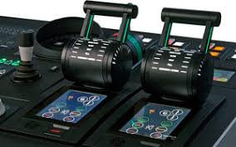
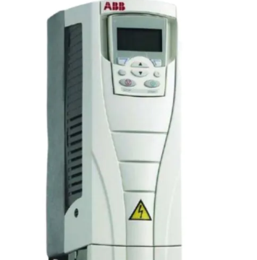
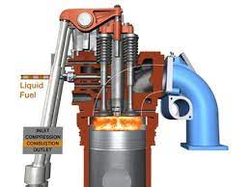
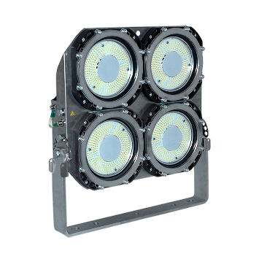
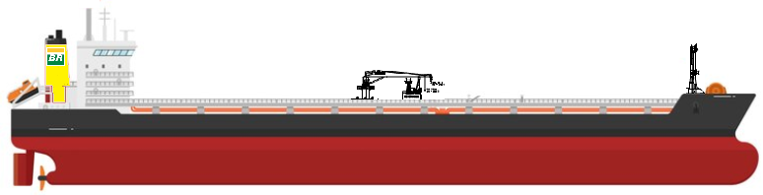
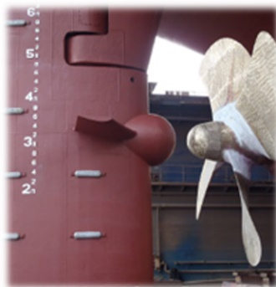
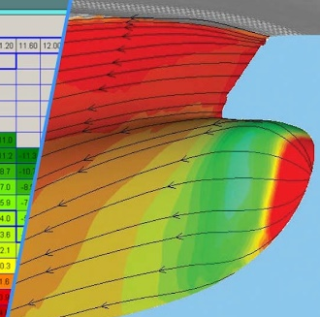
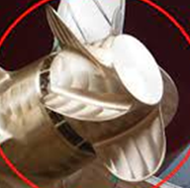
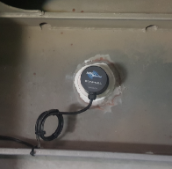
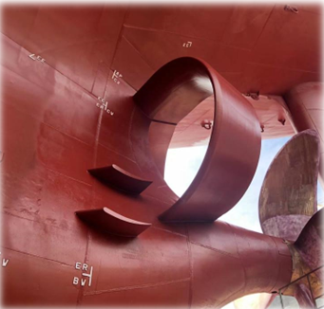
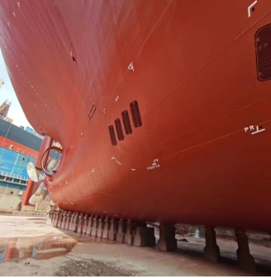
TRANSPETRO - EXISTING FLEET
Engine Optimization
Propulsion Control
VFD
Coriolis flowmeters
LED Lighting
Trim Optimization
Rudder Bulb
High Performance AF Coating
Anti-foulling system
PBCF
PSD
P
Shaft Power Meter
P

Slide 9
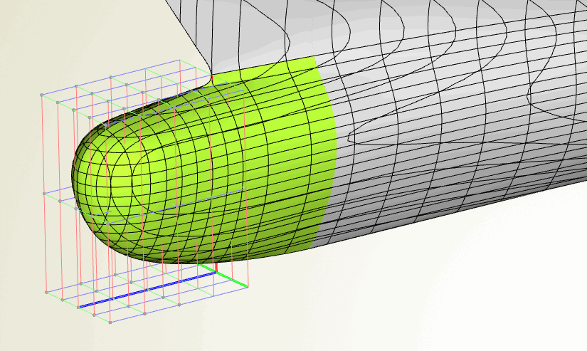
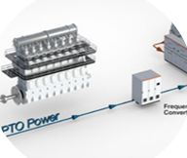
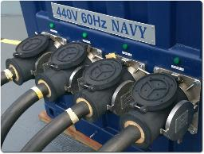
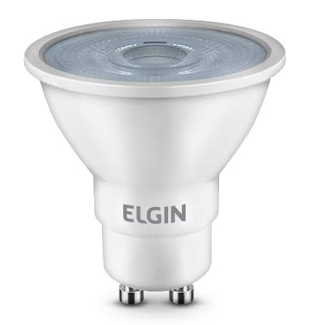
TRANSPETRO - NEWBUILDINGS
TP 25 SHIPBUILDING PROGRAM
New Ships with dual fuel Main Engine.
Additional specification includes the following projects:
Optimized Hull and Propeller
Ships built from 2025 onwards must be up to 30% more efficient than those in Phase 0 (Existing Fleet)
Shaft Generator
Eliminates the use of AE when traveling
Gain: 2 to 5%
Shore Power
Use of shore power during port operations
Gain: 5 to 7%
LED
Reduction of electrical consumption
Gain: 0.5 to 0.7%
P

Slide 10

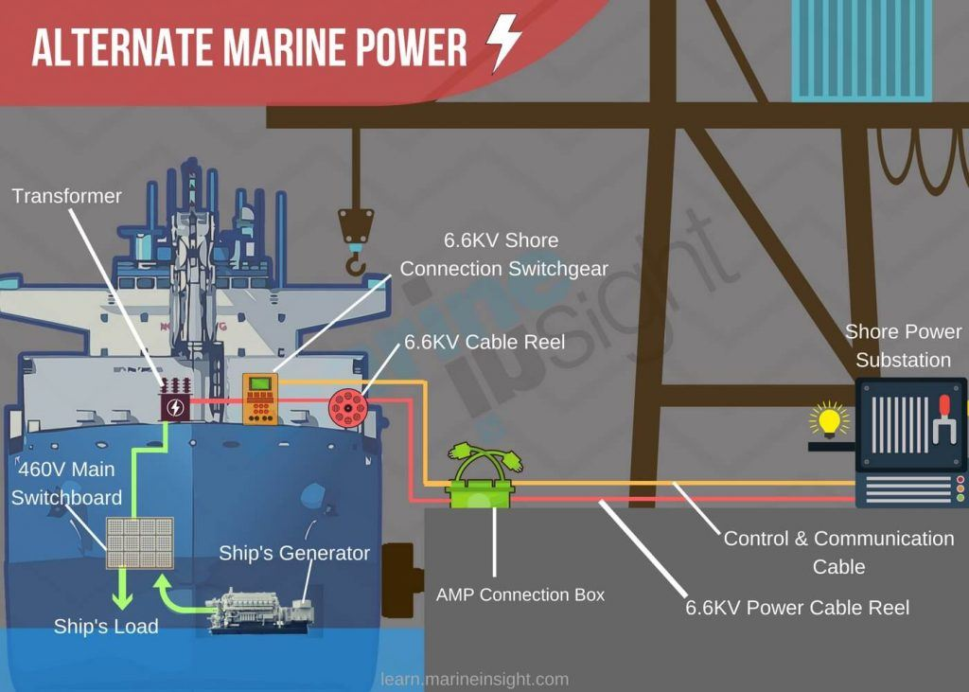
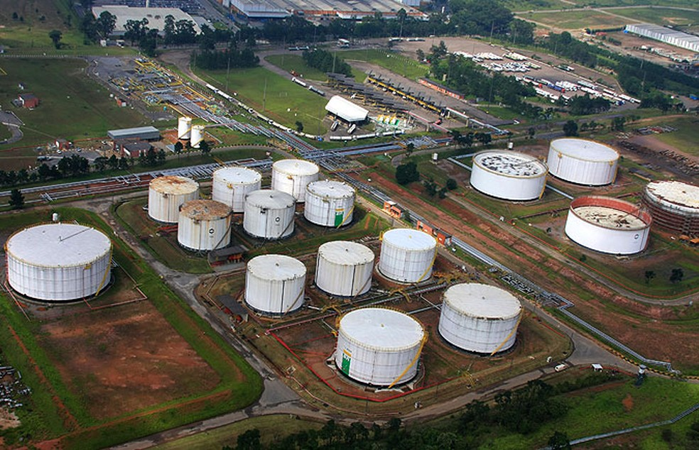
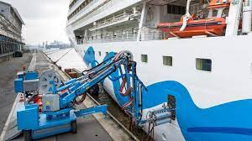
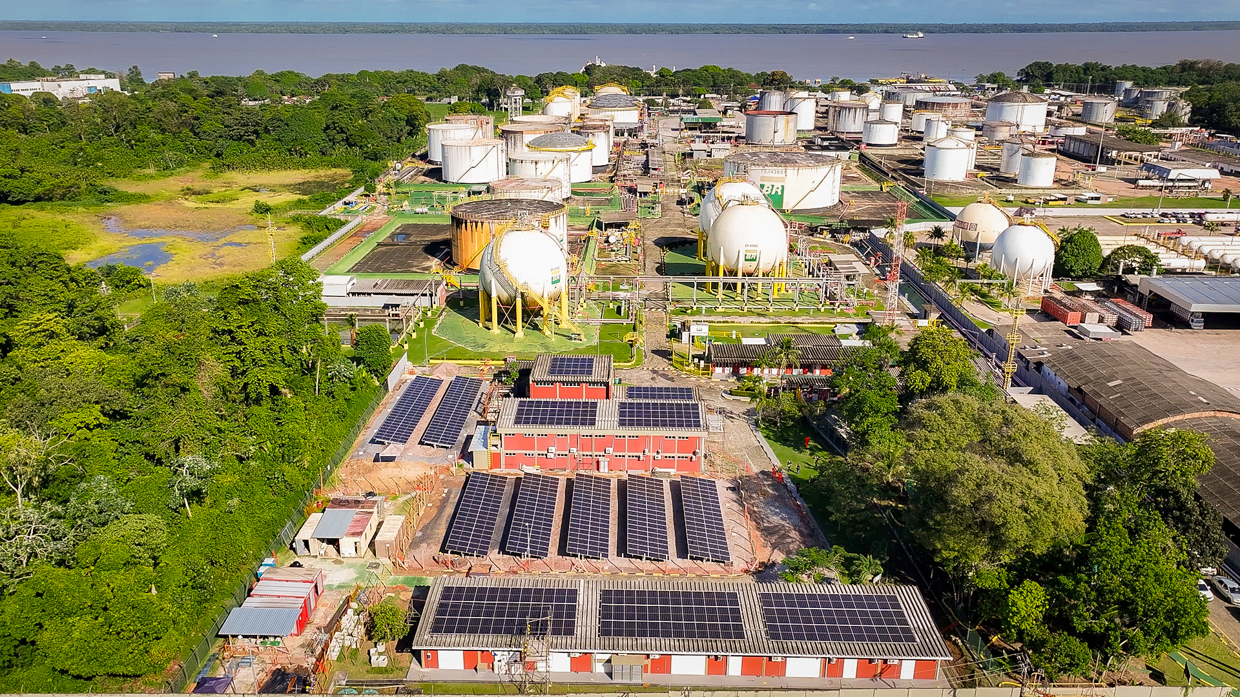


DECARBONIZATION PROJECTS FOR TRANSPETRO TERMINALS
STUDY AND IMPLEMENTATION PLAN
—
- Transpetro already implemented a plant of solar energy in order to ensure 100% power supply for the Guarulhos Terminal (SP) and Belem (PA). This project will allow the generation of 4.1 million megawatt hours. The plan involved the installation of more than 5 thousand solar panels in an area of 26,000 m².
- Transpetro also started to study instalation of Alternate Maritime Power or AMP which helps reducing air pollution generated from ship’s diesel generators by using shore electric power as a substitute.

Slide 11
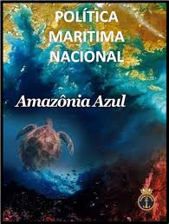
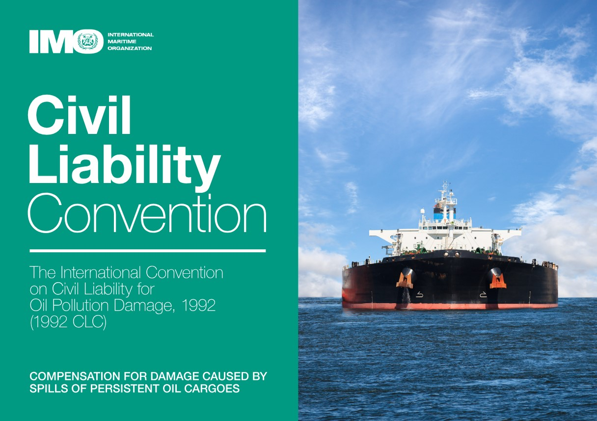
CONCLUSIONS – WHY SHOLD WE SIGN CLC 92
Despite Brazil's prominent position in the South American and global maritime context and its participation in the IMO Council, Group B, it is necessary to improve adherence to and internalization of international treaties in the maritime field, such as the Athens Convention and the LLMC, the HNS Protocol 2010, the Hong Kong Convention, the CLC 92 and its Supplementary Fund;
The recent enactment of Decree 12481/2025, establishing the National Maritime Policy (PMN), stands out, reinforcing Brazil's commitment to strengthening its role as a relevant maritime actor on the international stage, especially in the South Atlantic. Article 5, paragraph II, subparagraphs b and c, establishes among its objectives "proactive national action in international organizations and forums related to maritime, marine, and river-lacustrine issues," as well as "strengthening cooperation for the benefit of maritime security, especially with the states bordering the South Atlantic."
P

Slide 12
CONCLUSIONS – WHY SHOLD WE SIGN CLC 92
- International Convergence and Reputation
Convention 92 is a global standard. Non-adherence keeps Brazil outside a consolidated regime, increasing the perception of risk.
- Compensation Effectiveness
Mandatory insurance + direct action guarantee swift payment to victims.
Access to IOPC Funds expands the "deep pocket" for large claims.
- Regulatory Efficiency
Channeling + limitation reduces litigation and judicial costs.
Improves incident governance and decision predictability.
- Competitiveness and Cost of Capital
Lower regulatory risk → lower insurance costs and better access to financing.
Incentivizes fleet and operations under national flag/control.
P

Slide 13
CONCLUSIONS – WHY SHOLD WE SIGN CLC 92
- Public Policy and National Interest
Strengthens environmental security with robust financial instruments.
Consistent with a strategy to strengthen cabotage and coastal logistics.
- Relationship with Brazilian legal system
It coexists with:
Law No. 9,537/1997 (LESTA) and regulations of the Maritime Authority (navigation safety);
Law No. 9,966/2000 (oil pollution in waters under national jurisdiction);
ANTAQ regulations (operations and inspection).
The CLC does not replace internal environmental protection, but organizes the regime of civil liability and financial guarantee, bringing systemic coherence.
P

Slide 14

THANK YOU
The new world order and legal aspects:
The importance of international conventions for Brazil
CMI RIO 2026
Plenary Session
Rio de Janeiro, 13/may/2026.
Capt. Jones A. B. Soares
M.Sc AFNI MIFSMA MNAMEPA MCCMM MABDM
Director of Maritime Transport at Transpetro
cmt.jones@transpetro.com.br
P

