Slide 1

The CMI Lex Maritima 2025
The Tokyo Principles of Maritime Law
Prof Dr Eric Van Hooydonk (Maritime Institute, University of Ghent)
Chairman of the CMI Standing Committee on the Lex Maritima
CMI Colloquium 2026
Rio de Janeiro, 14 May 2026

Slide 2
The CMI Lex Maritima 2025
The Tokyo Principles of Maritime Law
Its object, purpose and status

Slide 3
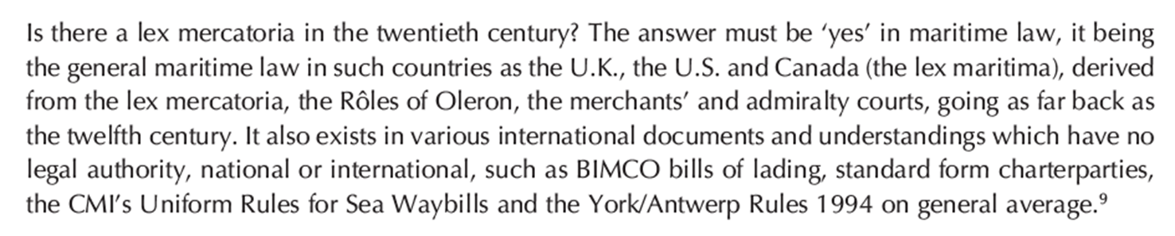
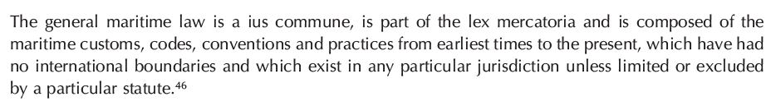
The CMI Lex Maritima:
Turning belief in the Lex Maritima into facts
What is this mythical Lex Maritima?
Prof Bill Tetley from Montreal, one of the great champions of the Lex Maritima idea
Chief Justice Allsop (CMI NYC 2016): ‘the common international heritage of values, rules and principles governing maritime matters’

Slide 4
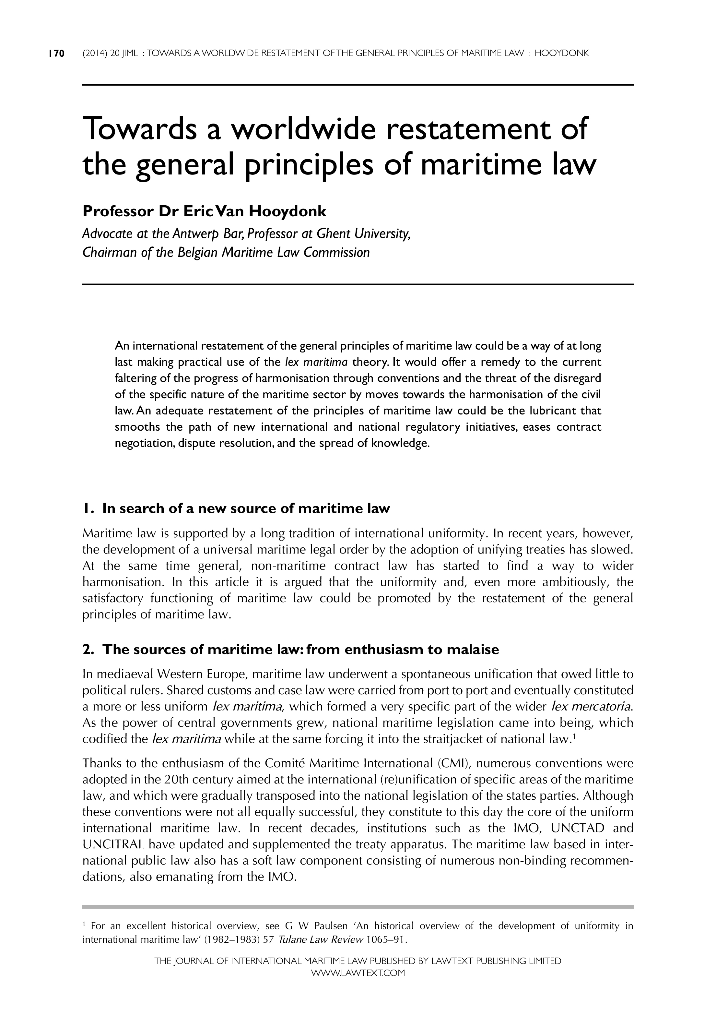
The CMI Lex Maritima:
Its Belgian and Antwerp origin
Belgian Shipping Code, 2007-2019
CMI Lex Maritima, 2014-2025

Slide 5
The CMI Lex Maritima:
What it is, and what it is not
It is a compilation of universally applicable principles of maritime law
It takes stock of what already unites us today, not of what divides us and still has to be harmonised
It is not a convention
It is not a model law
It is not guidelines about an existing instrument
It is a sui generis document
It has never been done before

Slide 6
The CMI Lex Maritima:
Its objectives
Identify, compile and spell out the universally accepted principles of maritime law
Clarify the specificities of maritime law (also to non-specialists)
Contribute to unification

Slide 7
The CMI Lex Maritima:
Its potential uses
Information
Education
Inspiration for legislators
A supplementary source of the law (but only if the positive maritime law so permits)
  e.g. Belgian Shipping Code
  Art. 1.1.2.4. Gebruiken en algemene scheepvaartrechtelijke beginselen
  § 1. De gebruiken en de algemene scheepvaartrechtelijke beginselen zijn bijzondere bronnen van scheepvaartrecht.
  Art. 1.1.2.4. Usages et principes généraux du droit de la navigation
  § 1er. Les usages et principes généraux du droit de la navigation sont des sources particulières du droit de la navigation.
Interpretation

Slide 8
The CMI Lex Maritima:
Its legal status (1)
A CMI Assembly Resolution
A soft law ‘instrument’ adopted by an NGO
The CMI can do this itself, without the governments, the IMO etc.

Slide 9
The CMI Lex Maritima:
Its legal status (2)
No legal authority, except if the positive maritime law decides otherwise
Non-supremacy: the CMI Lex Maritima is always subordinate to positive maritime law
Non-exclusivity: other Principles and other sources of Lex Maritima etc may be acknowledged and put into use
The CMI Lex Maritima is modest and flexible
The LM compilation is made available to end users for whatever role or status they might want to assign to it (or not)
Future updates are advisable (no Principles ‘once and for all’)

Slide 10
The CMI Lex Maritima:
The methodology
Extracting rules from ‘positive maritime law’ about which there is international unity
  Based on analysis and comparison of all conventions and 68 national legal systems (codes, statutes, case law, doctrine, contracts)
  It is an objective, mechanical, ‘scientific’ exercise based on ‘evidence’
  National divergences, policy preferences and sectoral interests were eliminated
3 categories of LM Principles
  The ‘instrument as such’ Principles (COLREG, YAR) (type 1)
  The full ‘substantive’ Principles (type 2)
  The ‘common occurrence’ Principles (type 3)

Slide 11
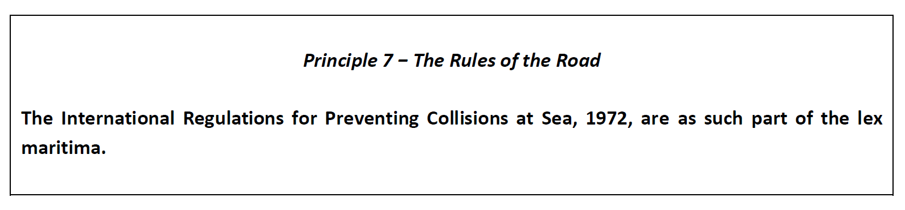
An example of type 1: COLREG

Slide 12
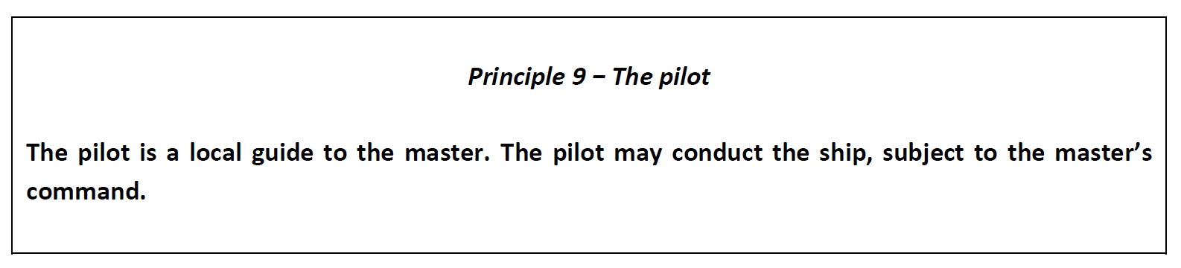
An example of type 2: the pilot (1)

Slide 13
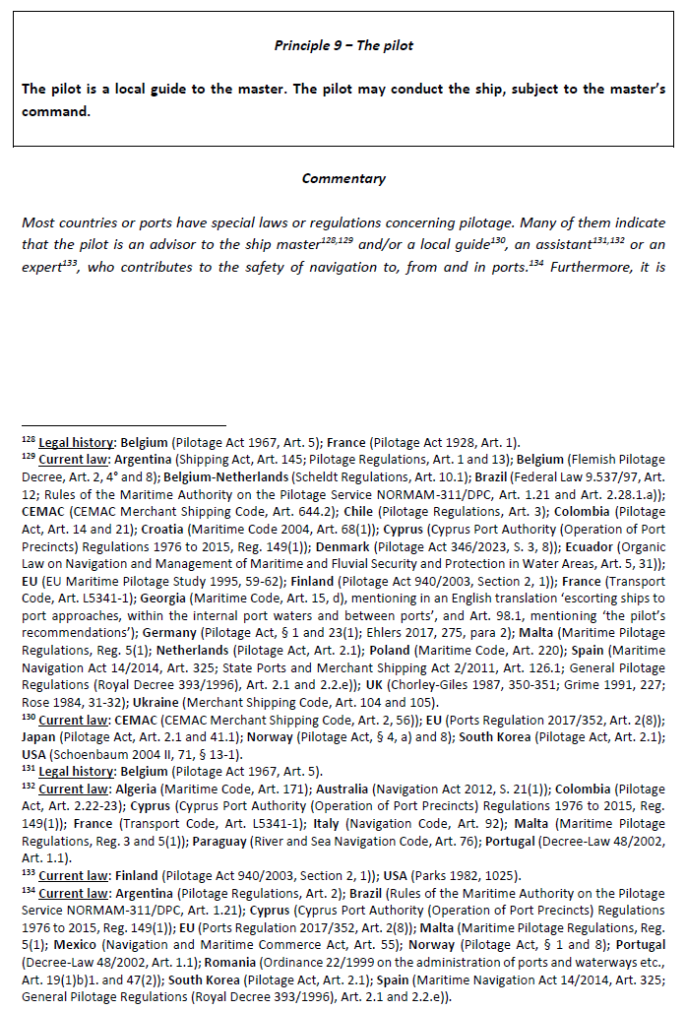
An example of type 2: the pilot (2)

Slide 14
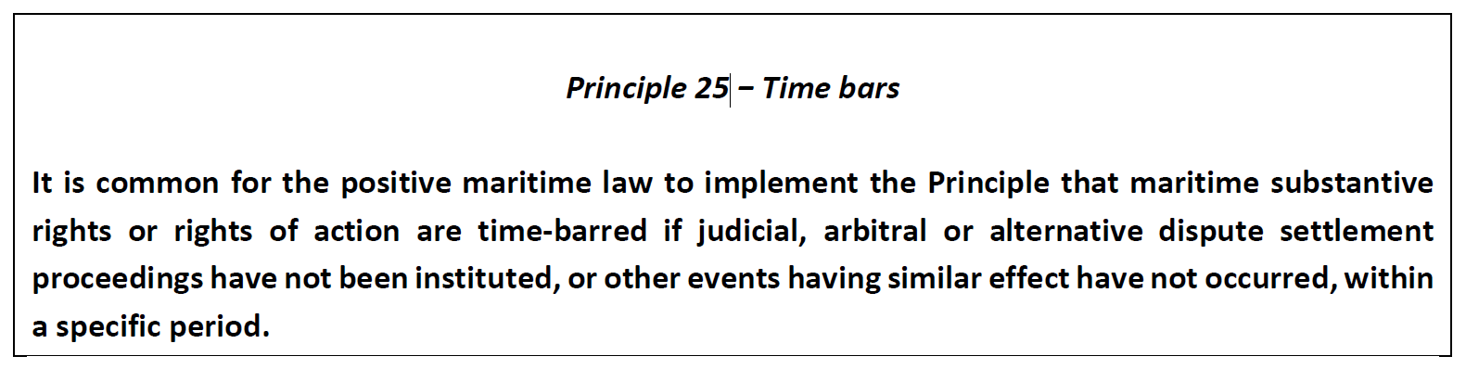
An example of type 3: Time bars

Slide 15
The CMI Lex Maritima 2025
The Tokyo Principles of Maritime Law
How it was made

Slide 16
Members of the IWG
Eric Van Hooydonk (Belgium), Chairman
Jesús Casas (Spain), Rapporteur
Lijun Zhao (Ms) (China)
Michael Sturley (USA)
Tomotaka Fujita (Japan)
Andreas Maurer (Germany)
Mišo Mudrić (Croatia)
Werner Braun Rizk (Brazil)
Massimiliano Rimaboschi (Italy)
Bernardo Melo Graf (Mexico)
Eduardo Adragna (Argentina)
Javier Franco (Colombia)
Kerim Atamer (Turkey)
Aybek Ahmedov (Russia)
Andrea La Mattina (Italy)
Frank Smeele (The Netherlands)
Luiz Roberto Leven Siano (Brazil)
Filippo Lorenzon (UK/Italy)
Gustavo Omaña (Venezuela)

Slide 17
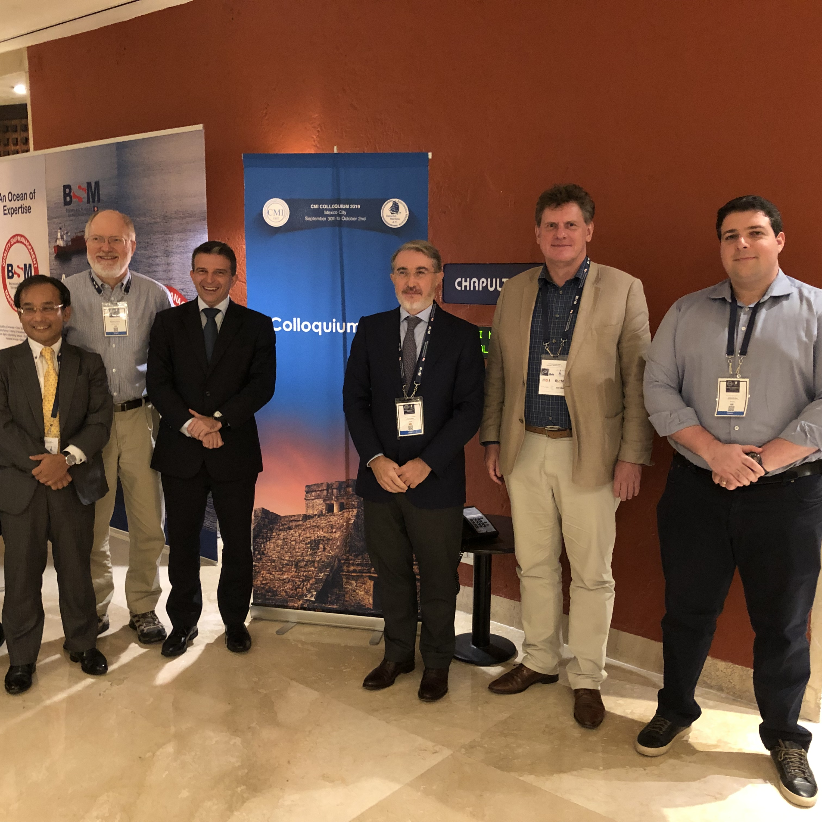
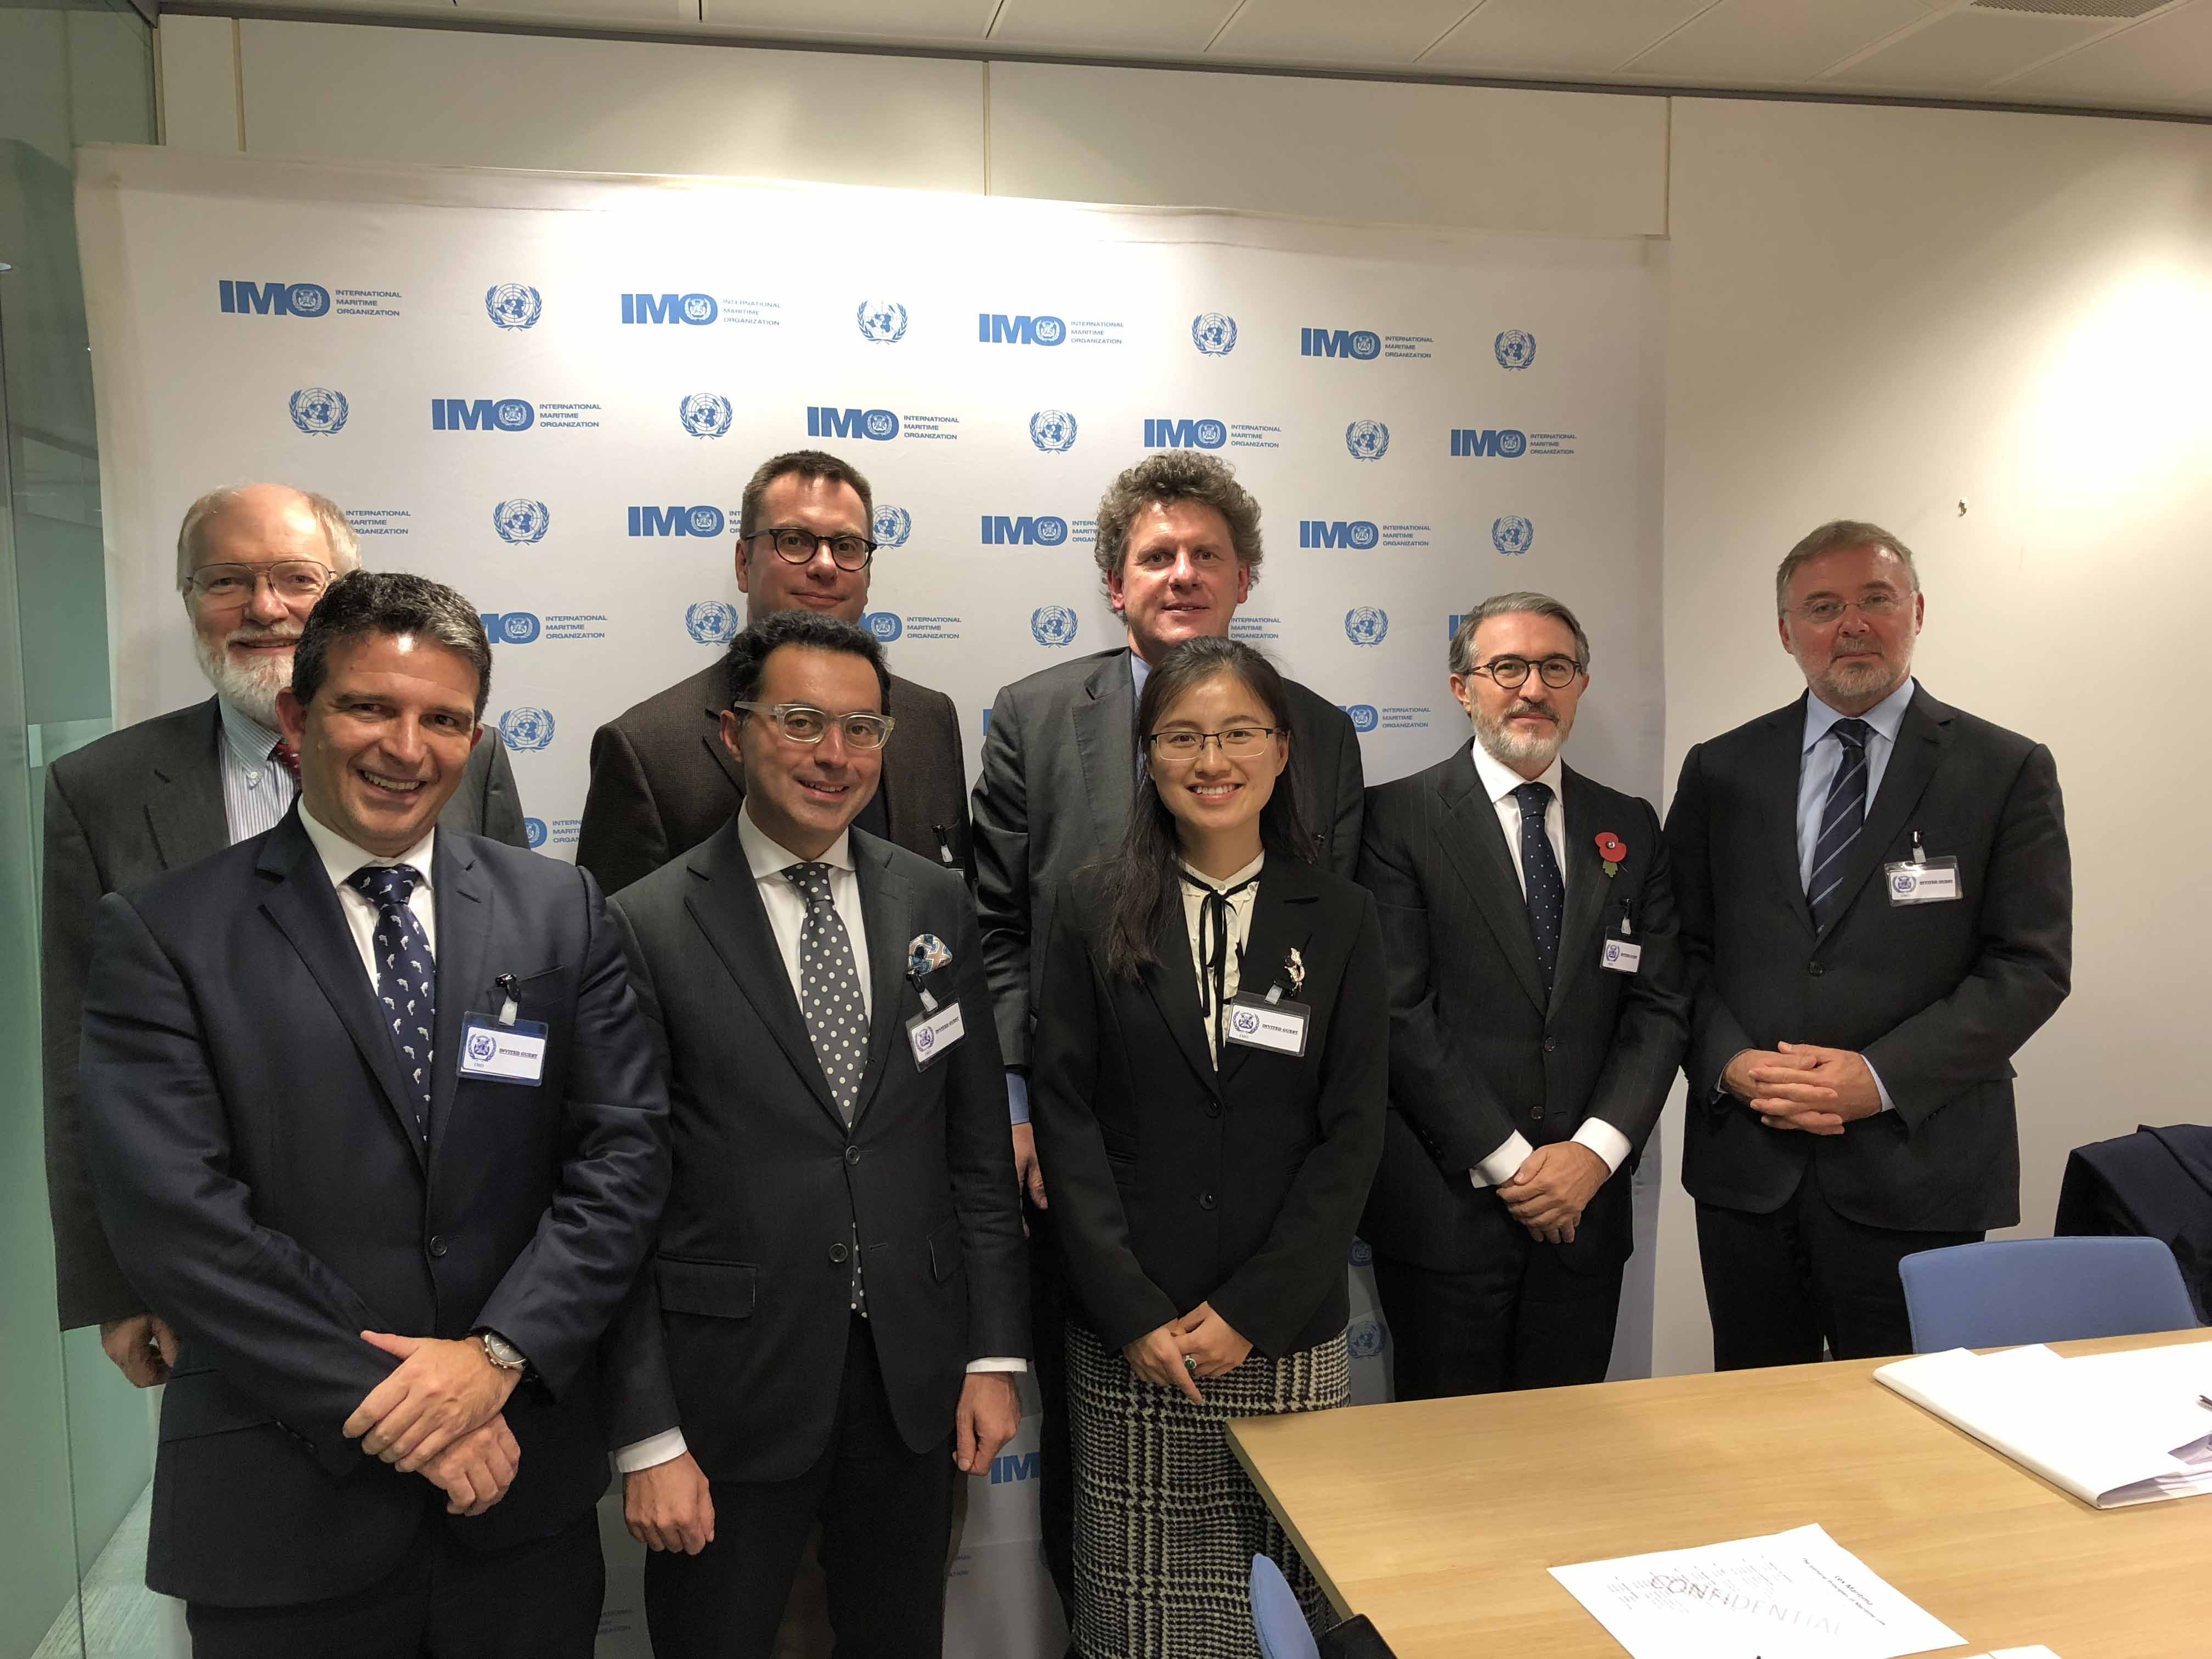
Time-line
The IWG was established by the ExCo in 2014 in Istanbul
The IWG reported on its work in New York 2016, London 2018, Mexico City 2019, Antwerp 2022, Montreal 2023, Gothenburg 2024 and Tokyo 2025

Slide 18
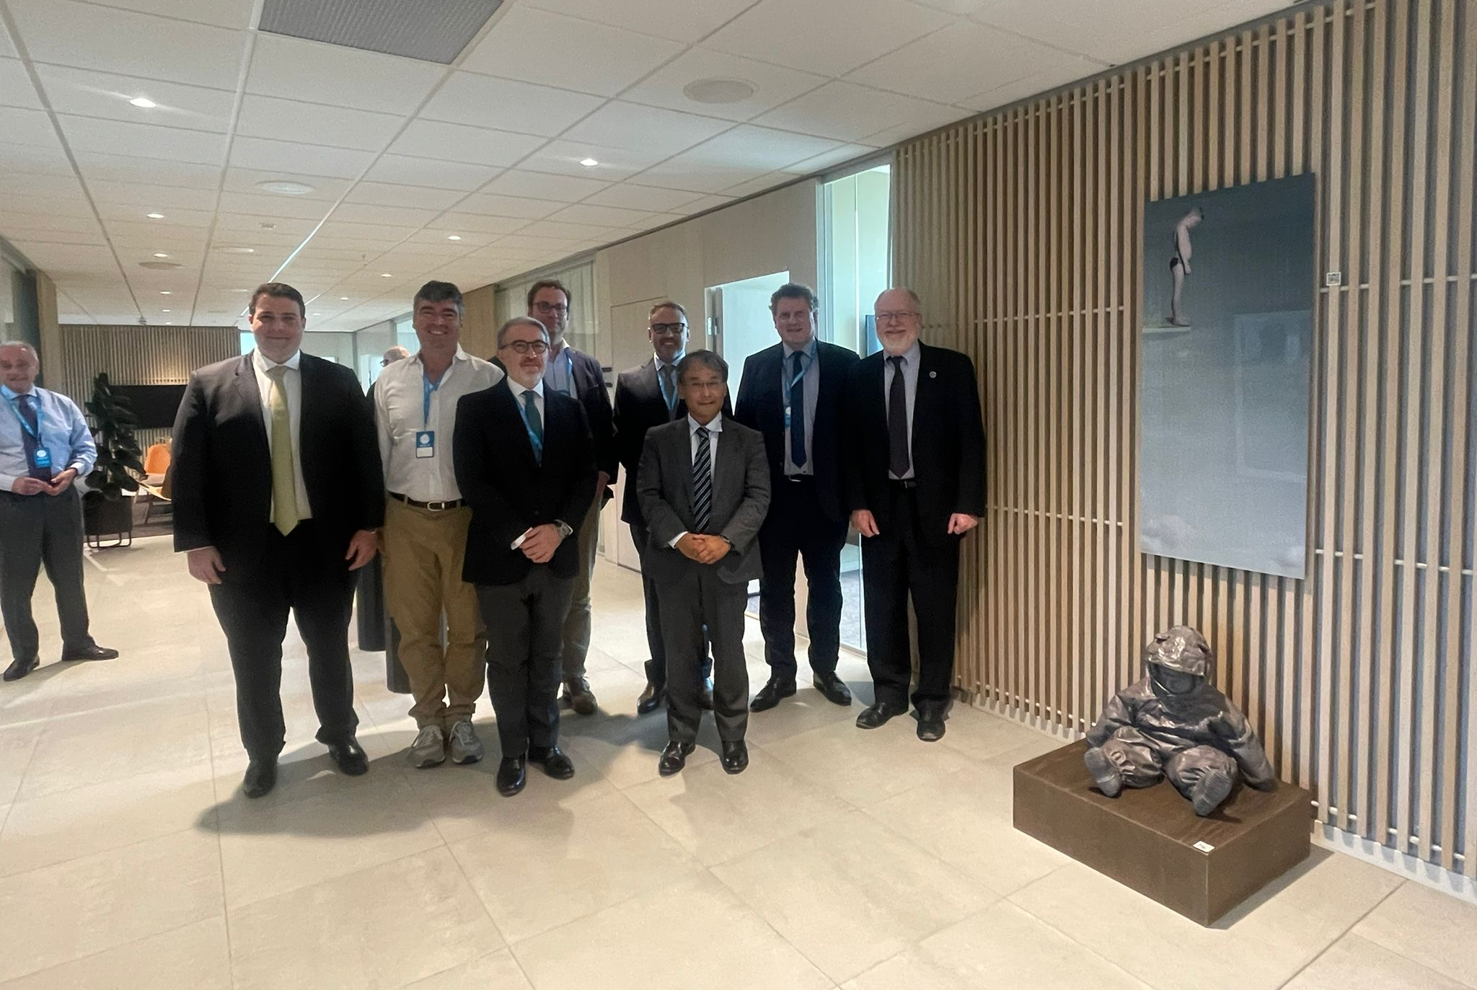
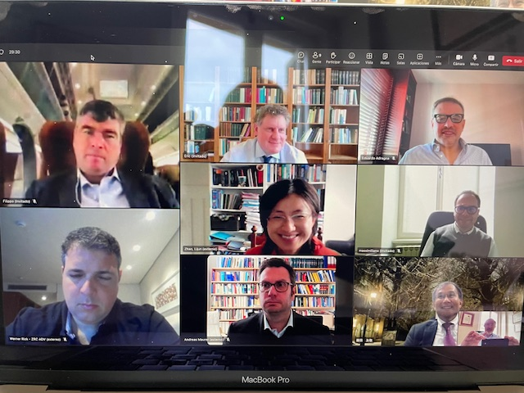
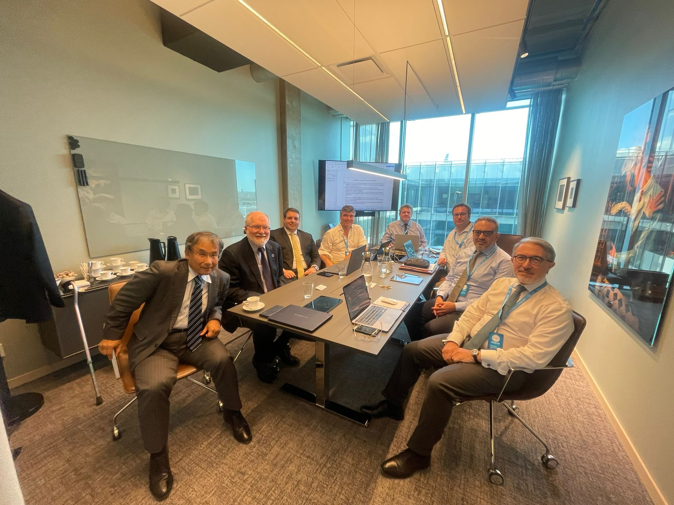

Slide 19
Final decision-making
The Gothenburg Draft published in the CMI YB 2024
Comments from numerous NMLAs
All comments, including those received in 2025, were processed
A new ‘Tokyo Draft’ was prepared, with track changes
CMI Tokyo Conference with 450 delegates
Meeting with CMI ExCo
Final IWG meeting
Presentation and discussion at public sessions
Adoption of the ‘Tokyo Principles’ by the CMI Assembly on 17 May 2025
Final editing process
Publication on the CMI website on 17 November 2025

Slide 20
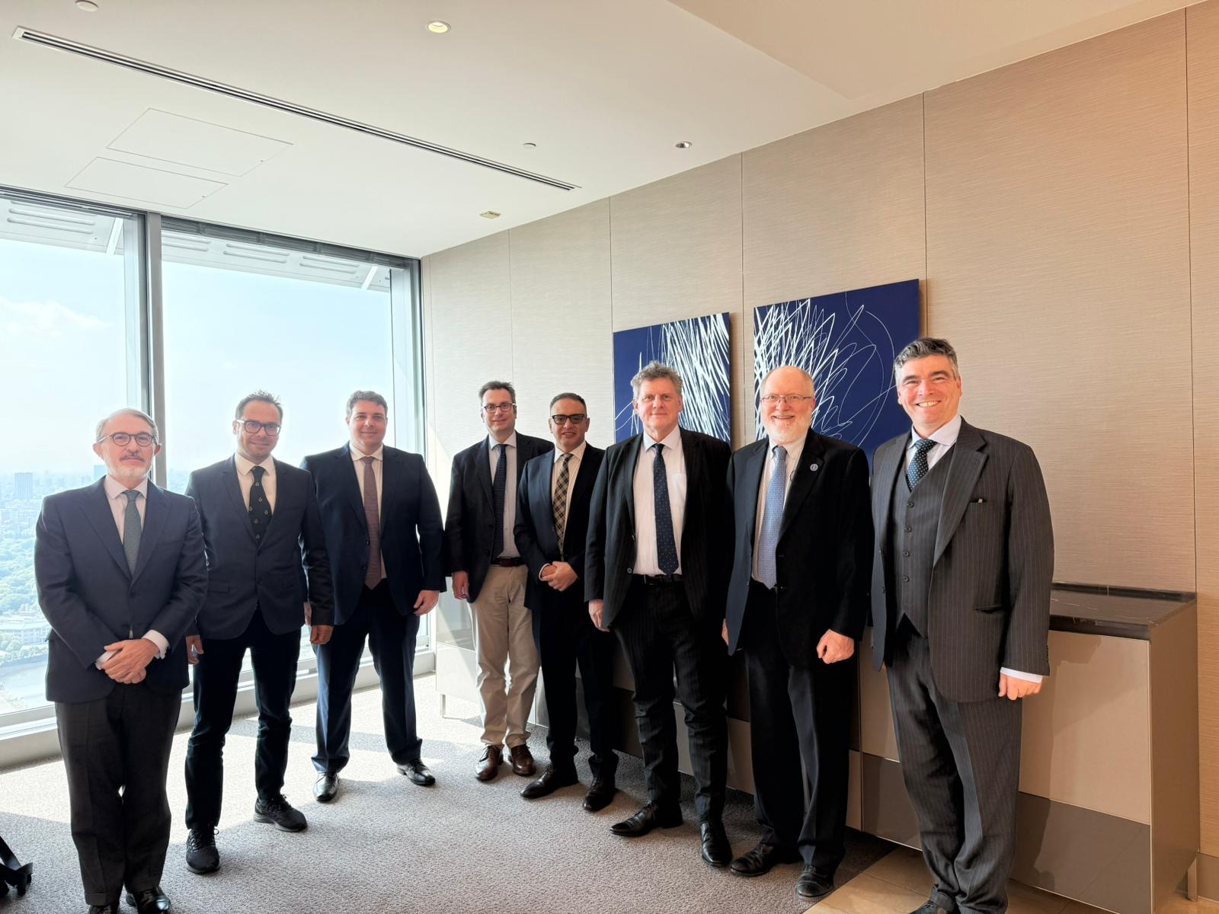


Slide 21
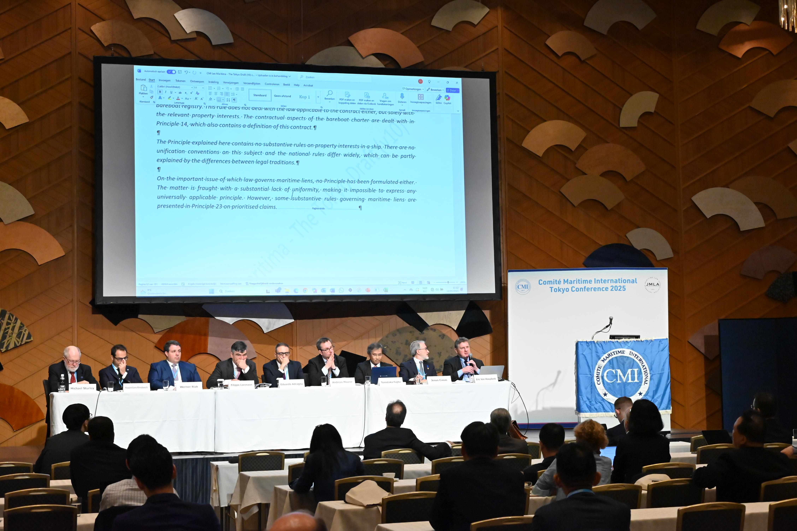

Slide 22
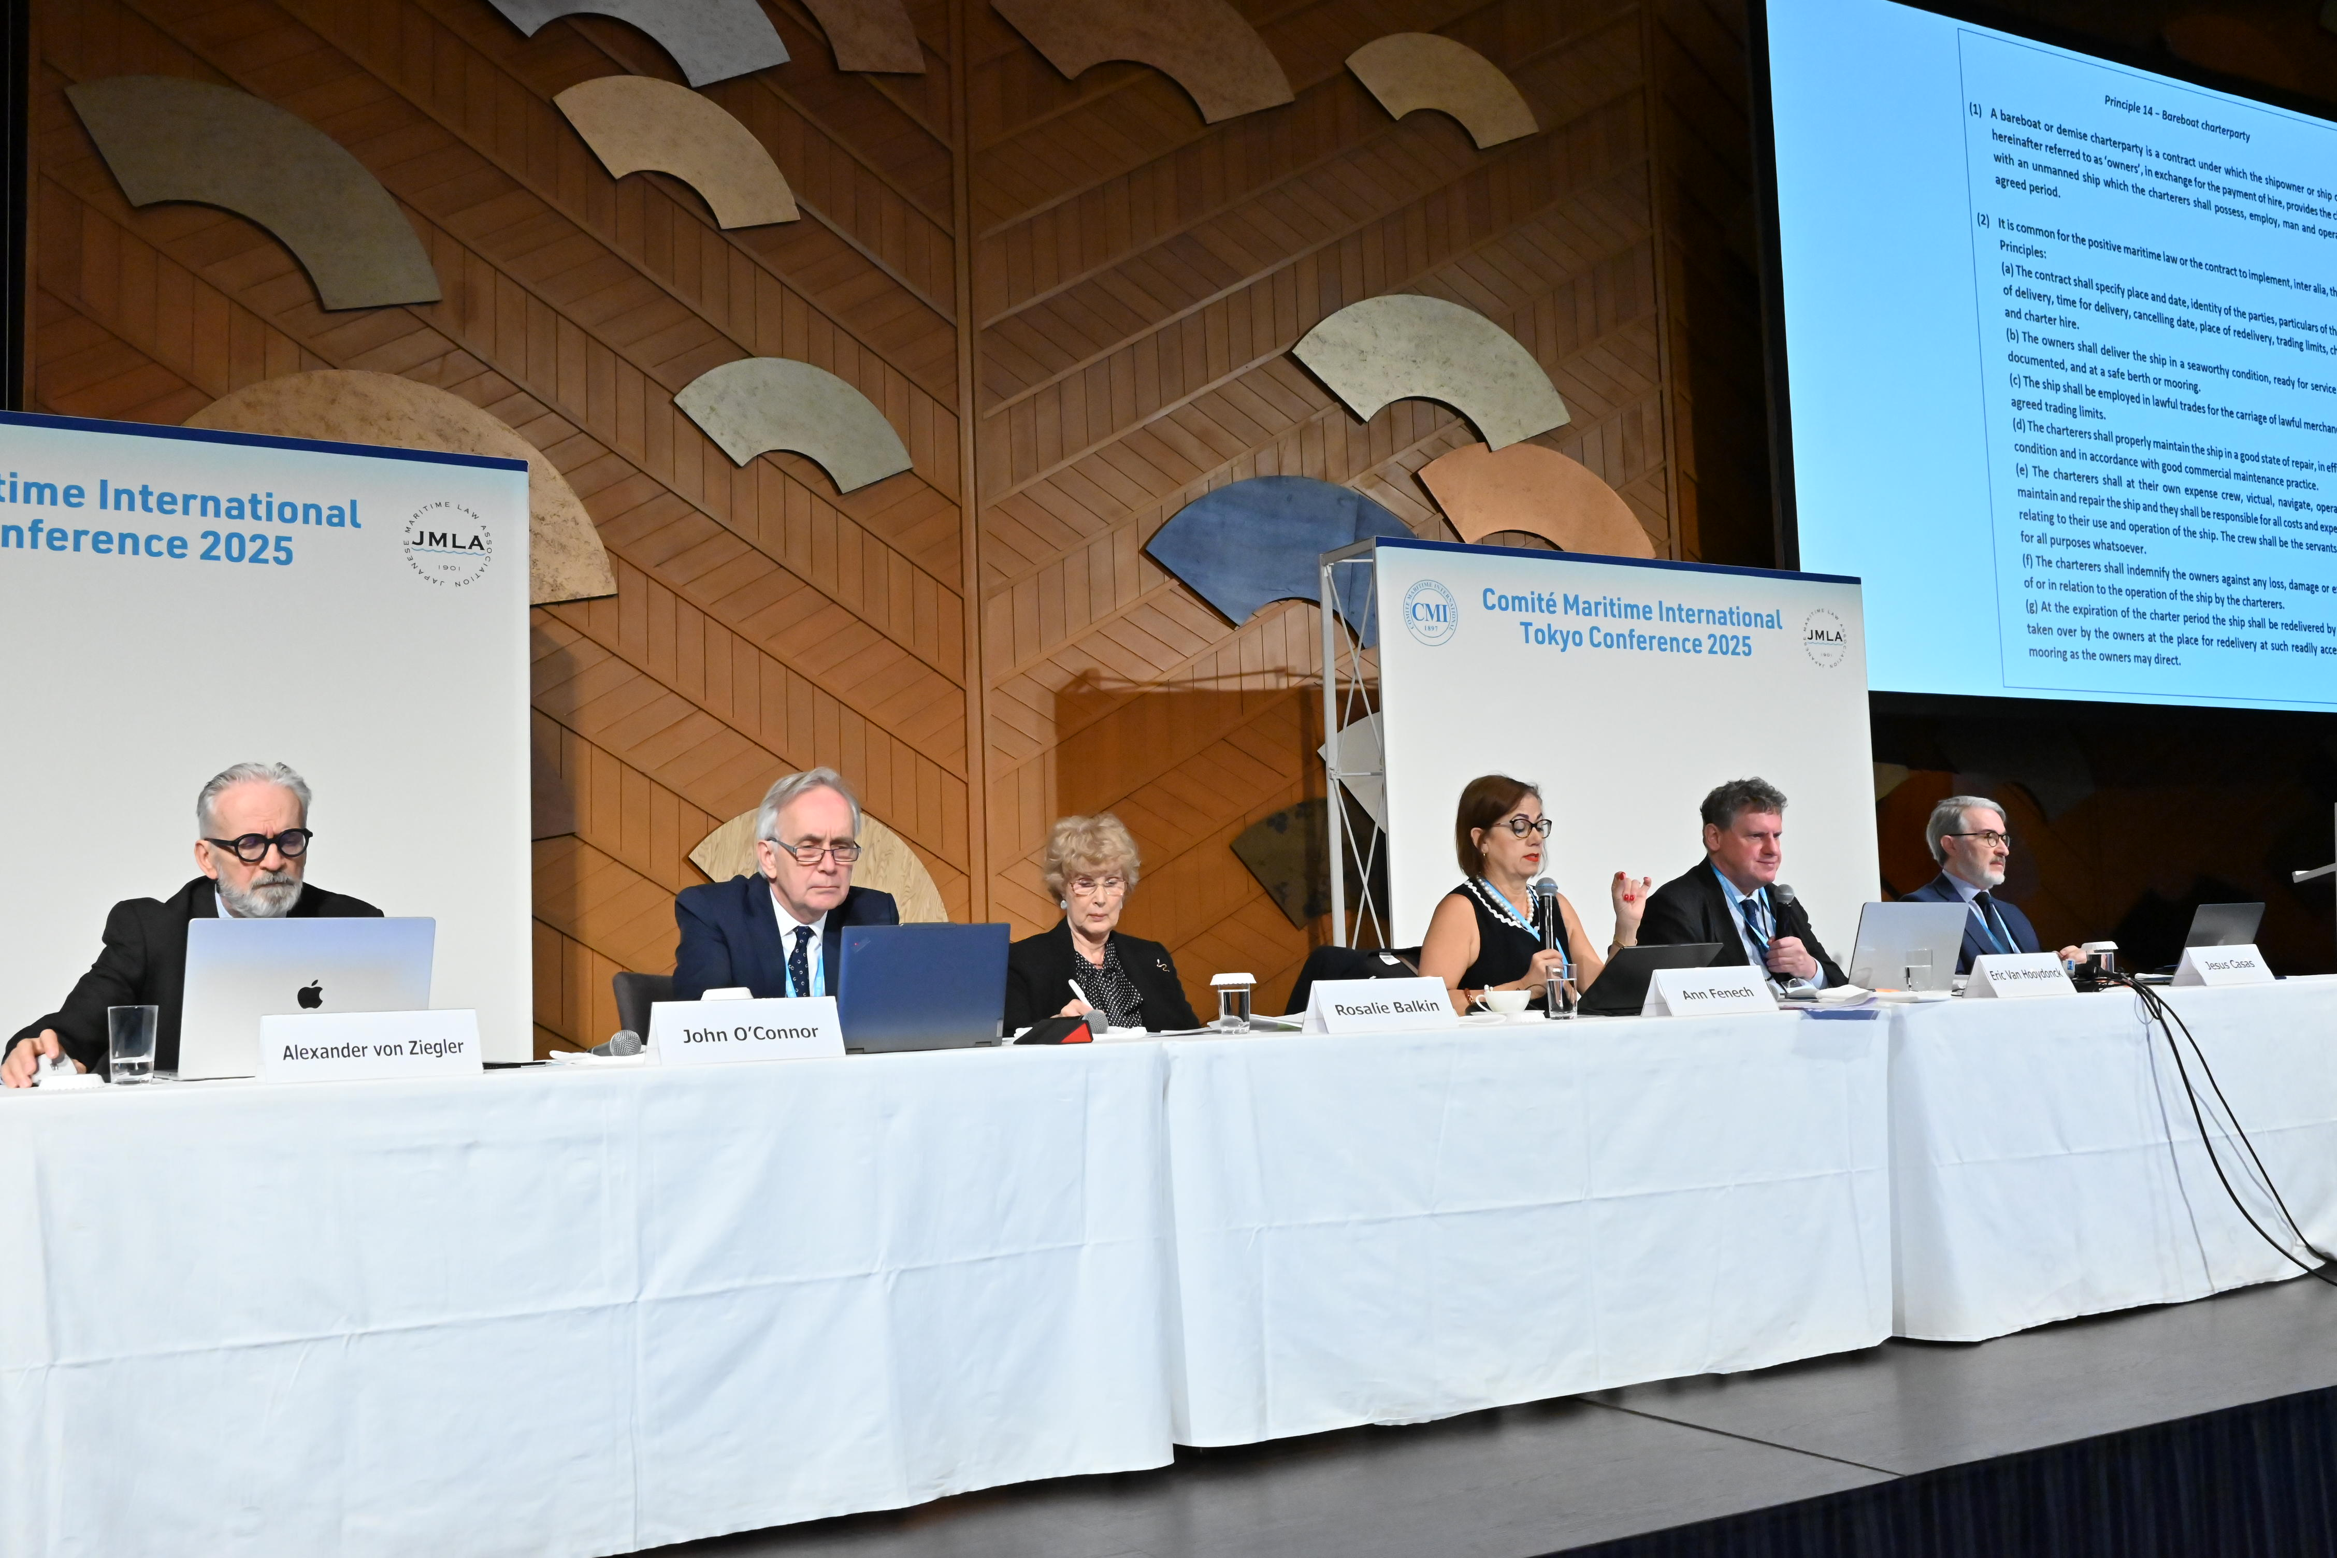

Slide 23
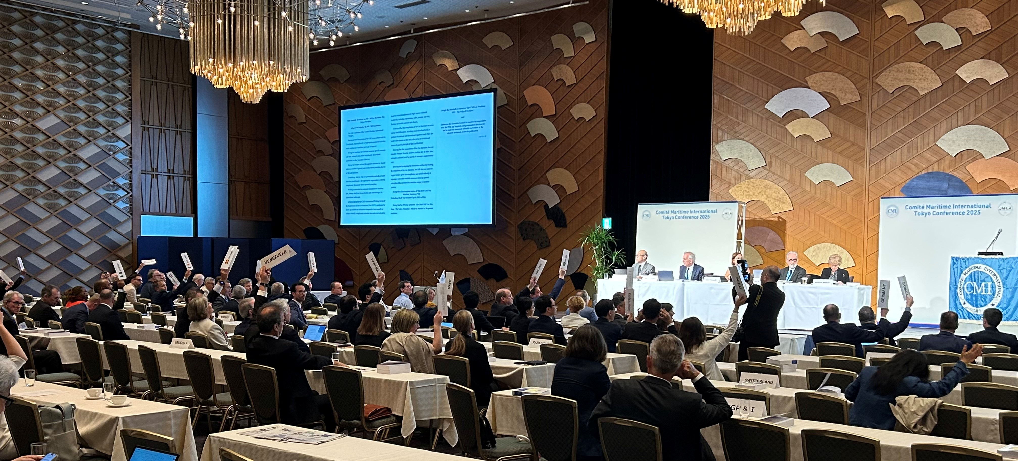

Slide 24
The CMI Lex Maritima 2025
The Tokyo Principles of Maritime Law
Where it can be found & Latest news

Slide 25
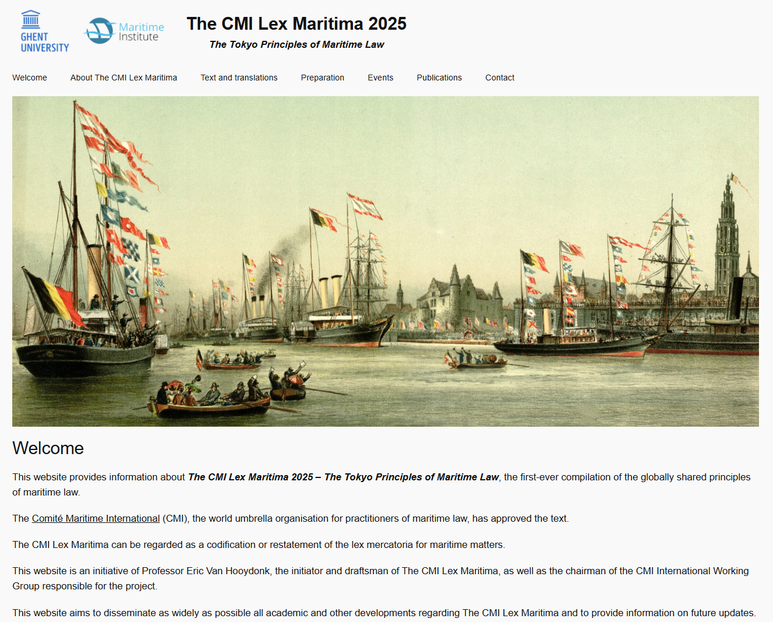
Websites
The official document: https://comitemaritime.org/work/lex-maritima/
Background, publications, translations, news: www.lexmaritima.world

Slide 26
Latest news
Further comments from MLAs
Translations
Legal doctrine
Events

Slide 27
The CMI Lex Maritima 2025
The Tokyo Principles of Maritime Law
The 5 Rules and the 25 Principles

Slide 28
The CMI Lex Maritima:
Its structure
General introduction
Part 1 − Preliminary rules
Part 2 − Sources of maritime law
Part 3 − Ships
Part 4 − Maritime responsibilities and liabilities
Part 5 − Maritime contracts
Part 6 − Maritime incidents
Part 7 − Maritime claims
Citations and abbreviations

Slide 29
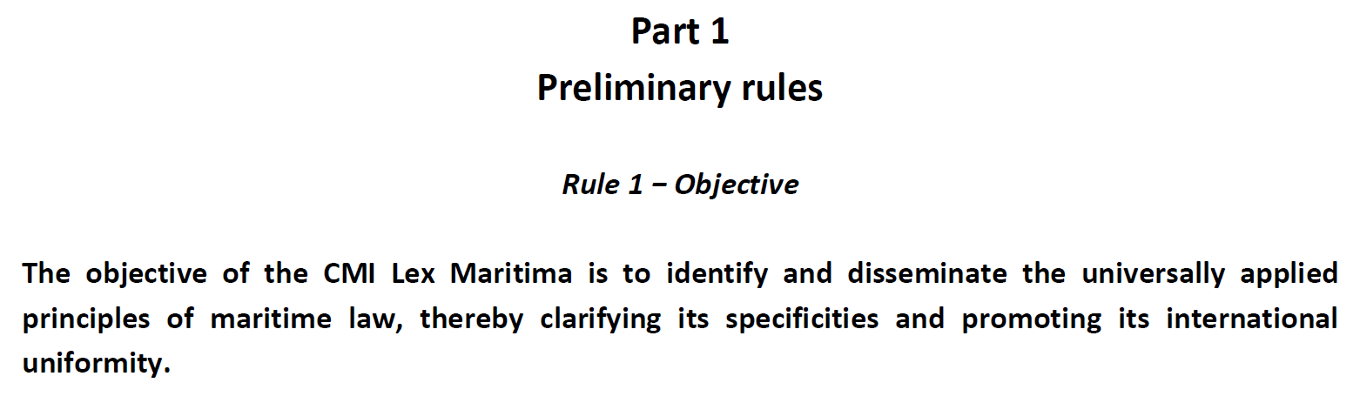

Slide 30
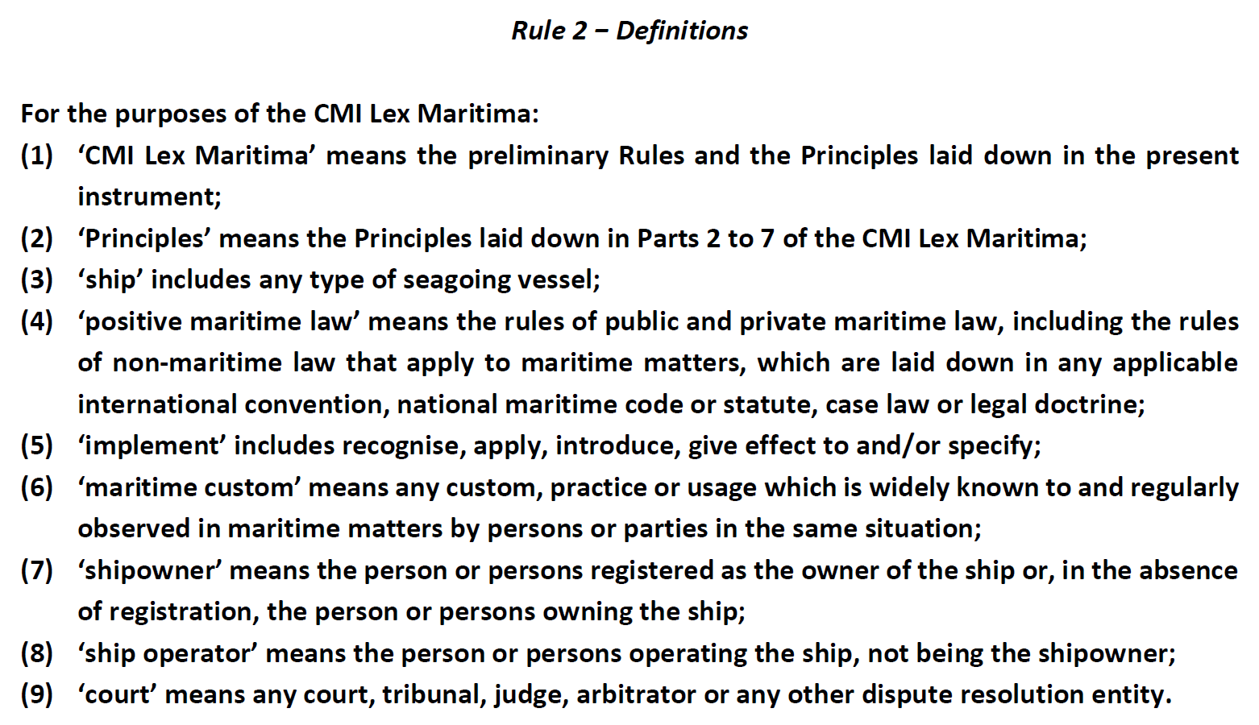

Slide 31
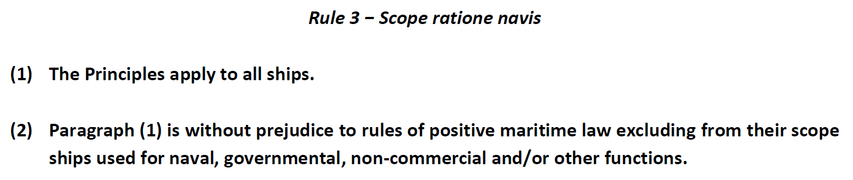

Slide 32
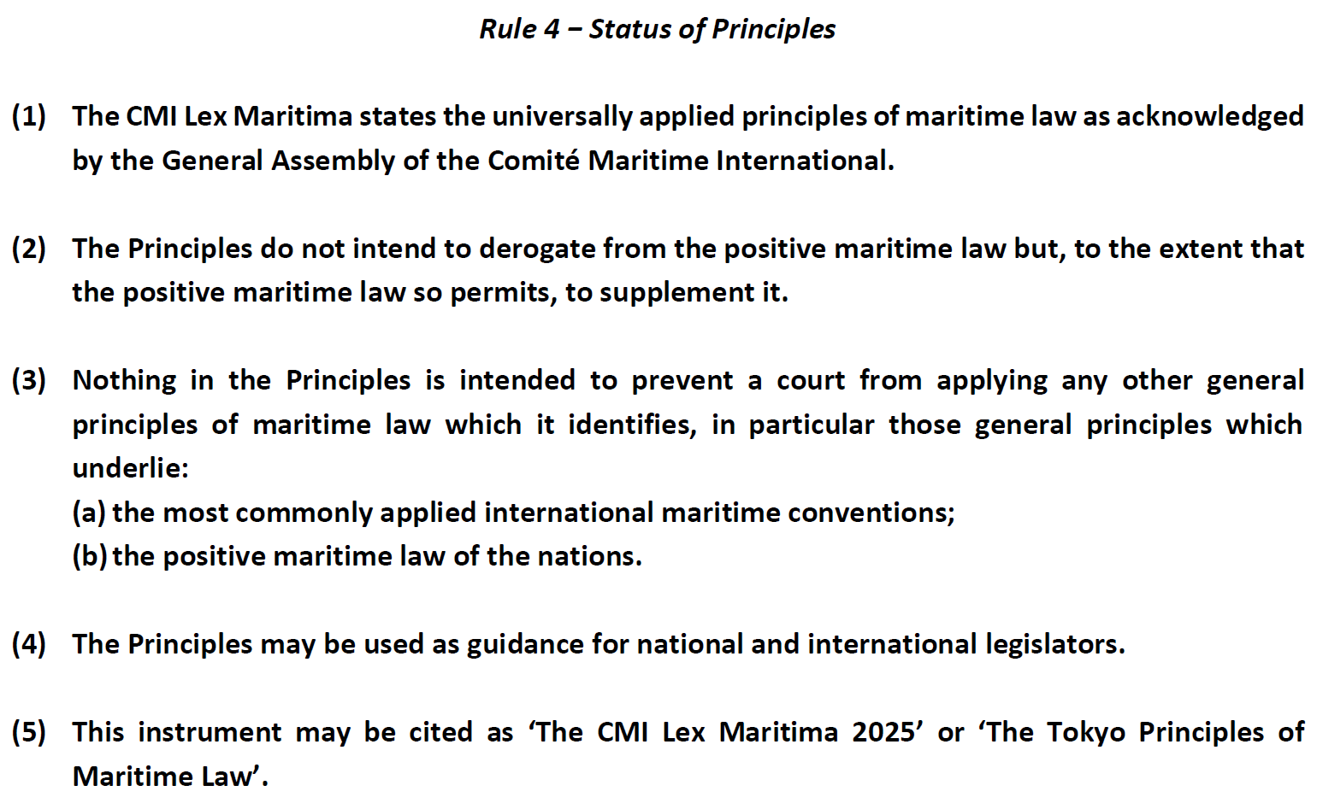

Slide 33
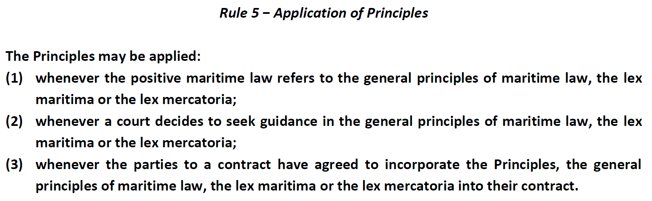

Slide 34
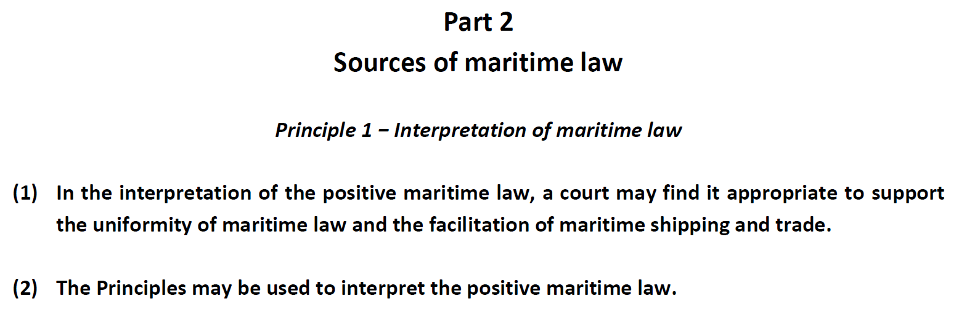

Slide 35
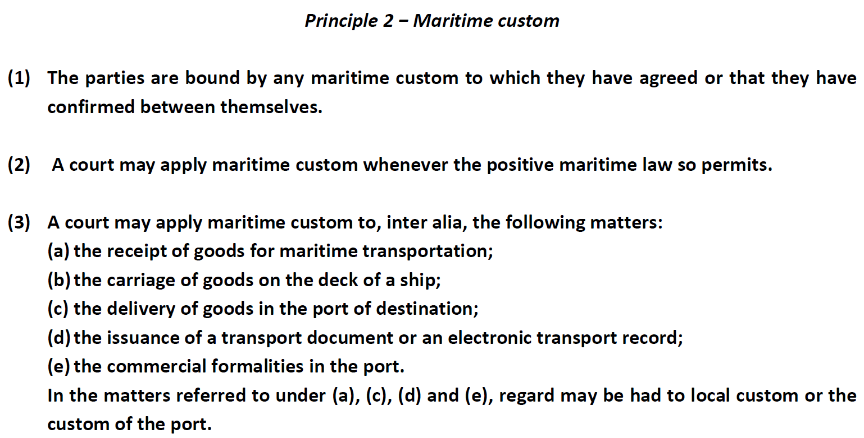

Slide 36
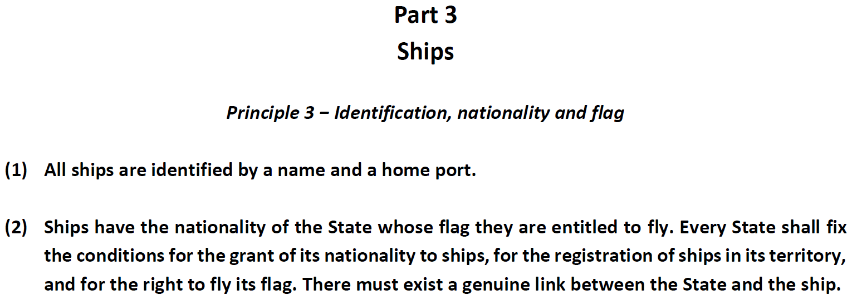

Slide 37
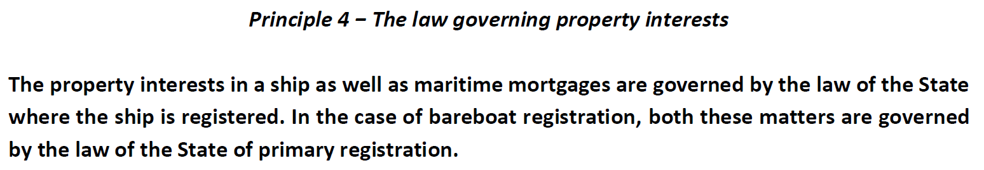

Slide 38
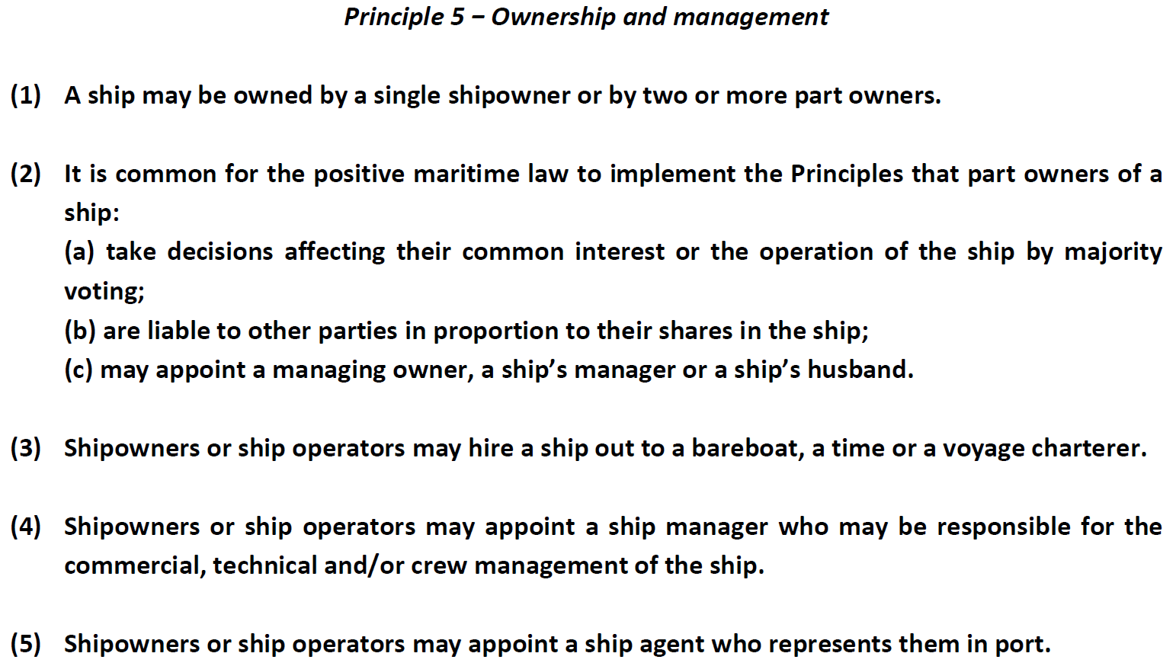

Slide 39
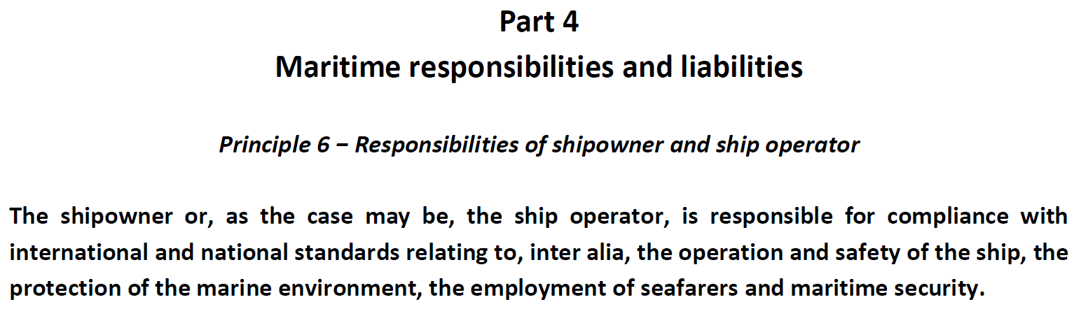

Slide 40
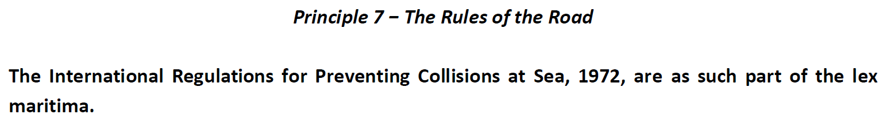

Slide 41
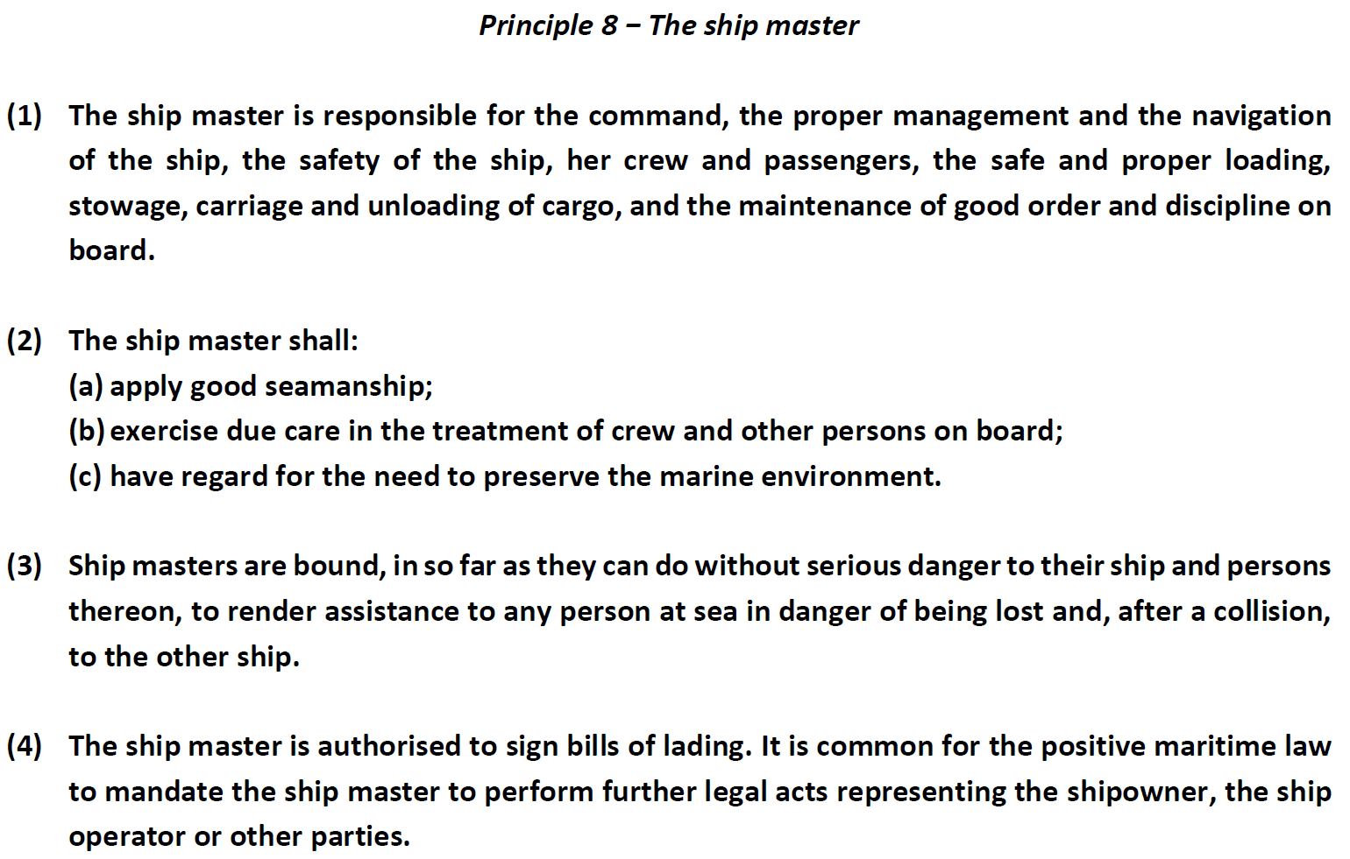

Slide 42
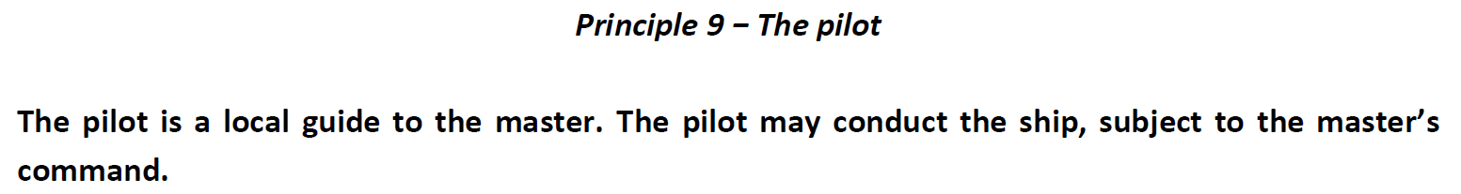

Slide 43
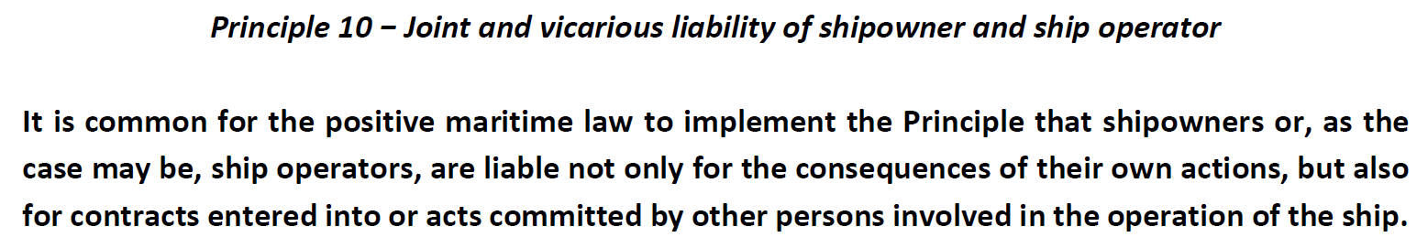

Slide 44
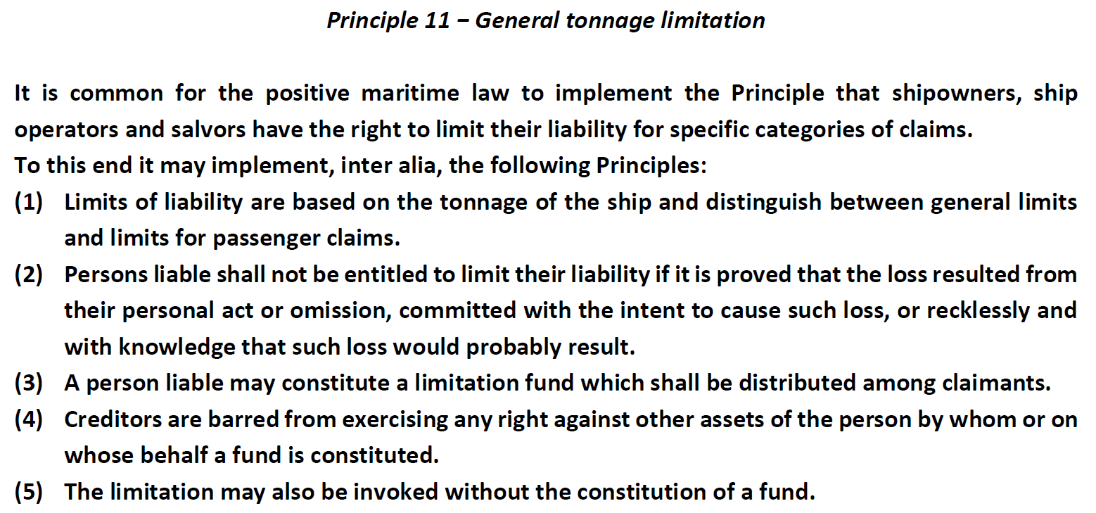

Slide 45
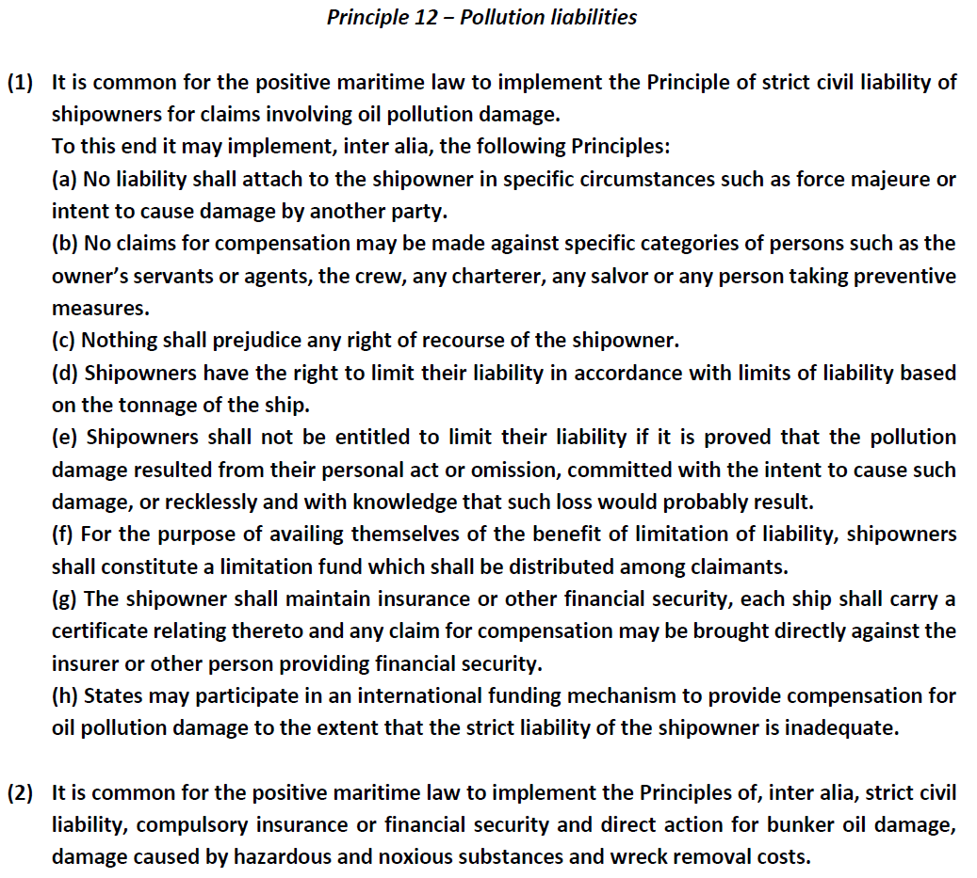

Slide 46
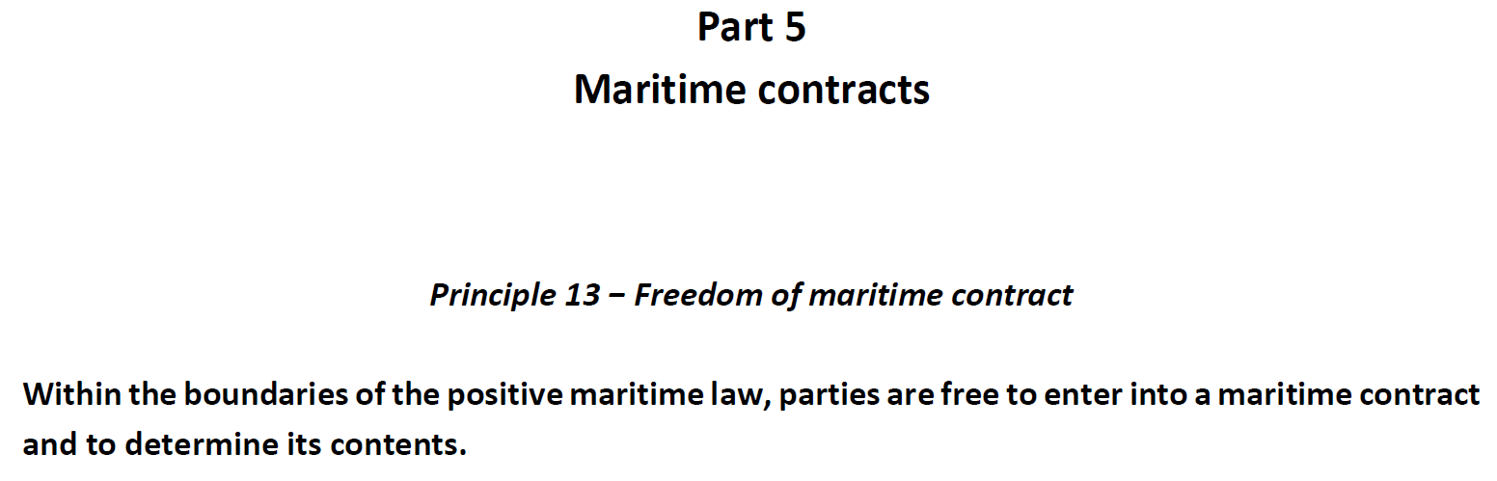

Slide 47
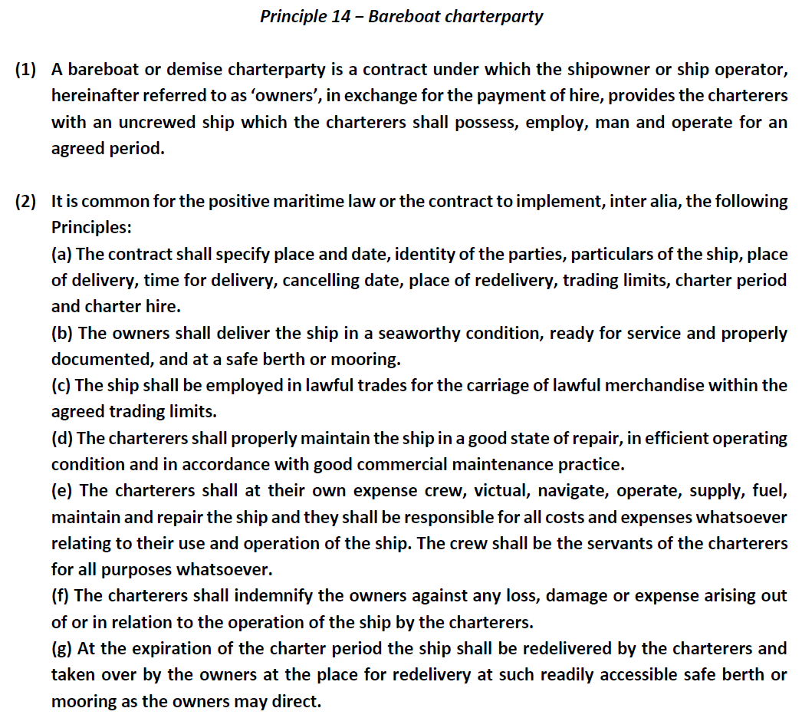

Slide 48
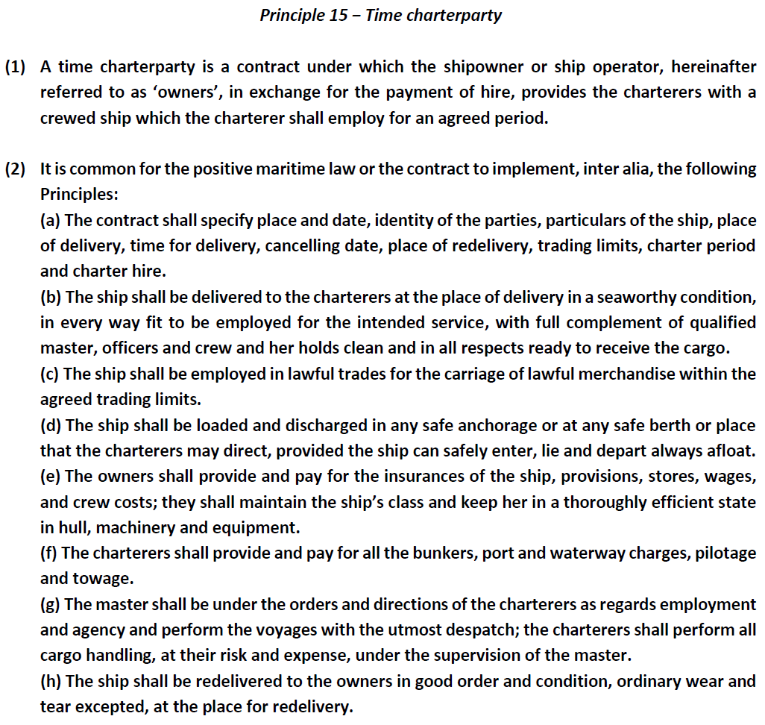

Slide 49
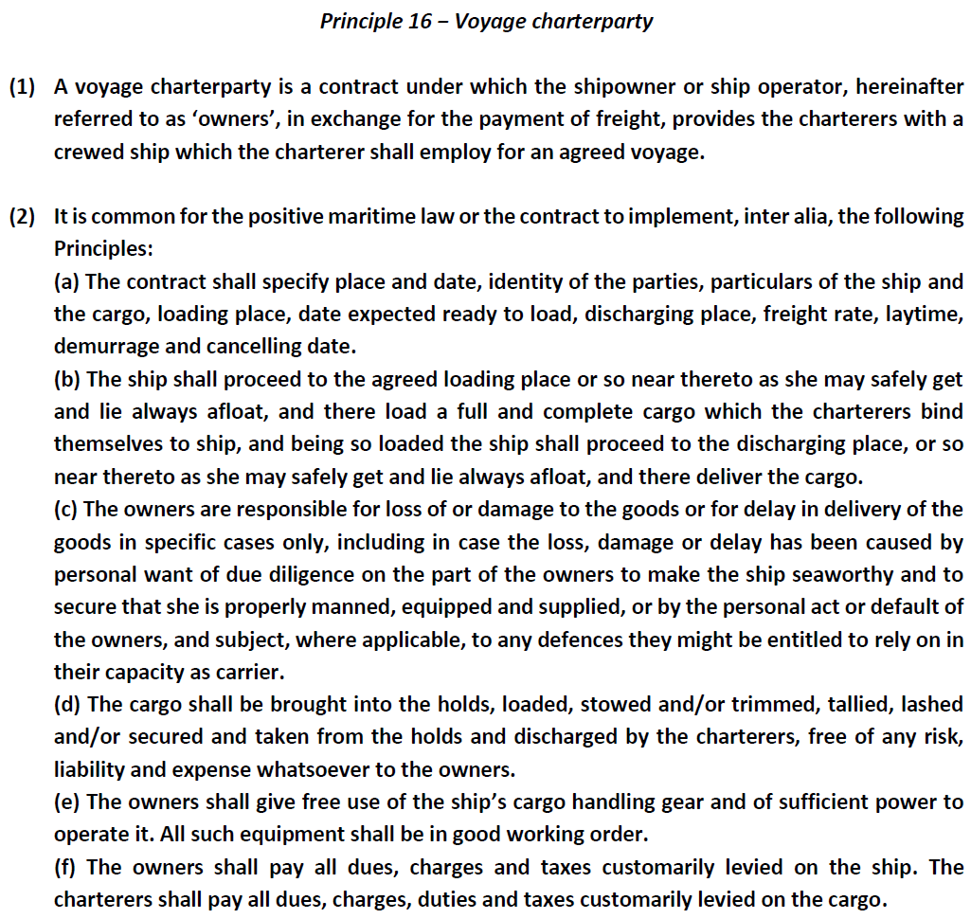

Slide 50
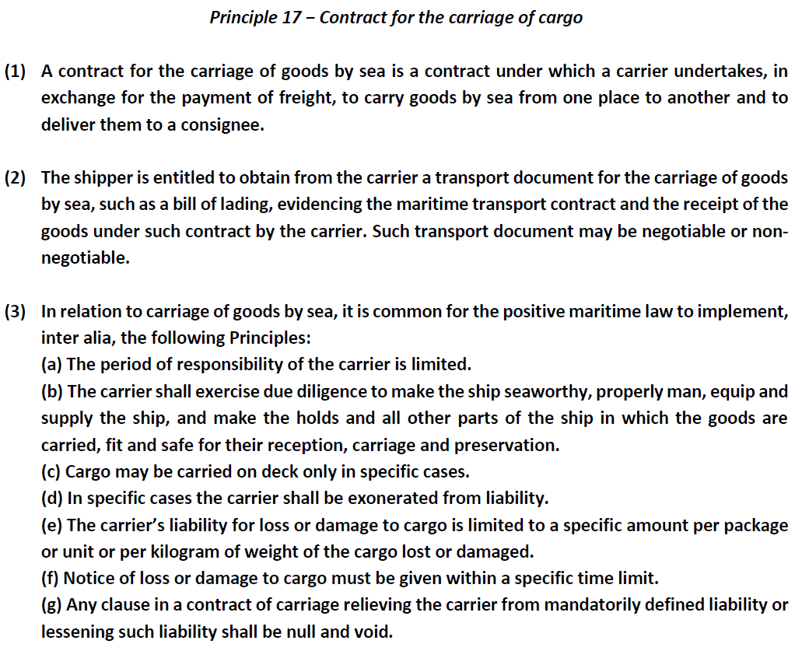

Slide 51
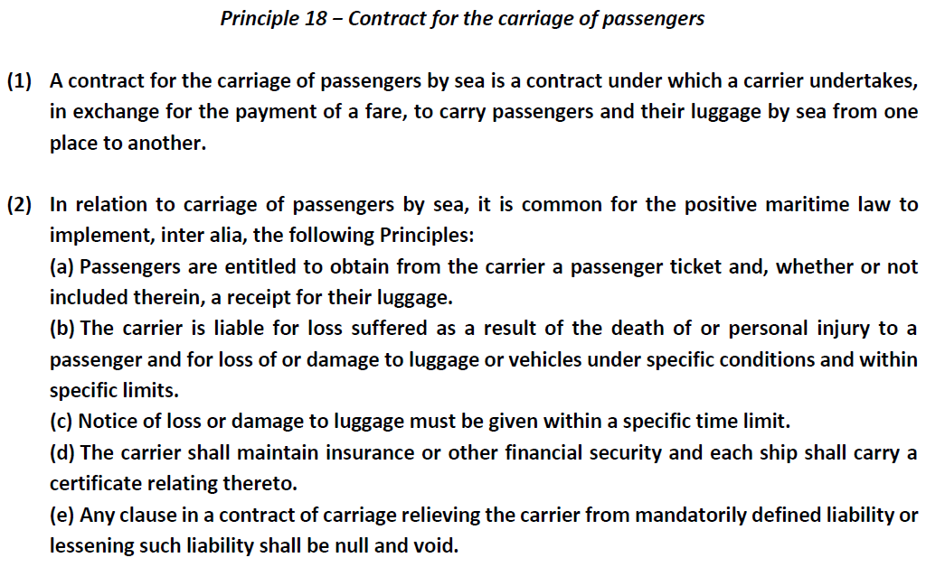

Slide 52
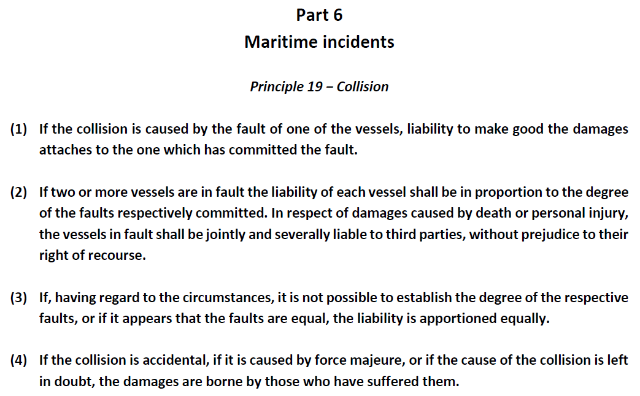

Slide 53
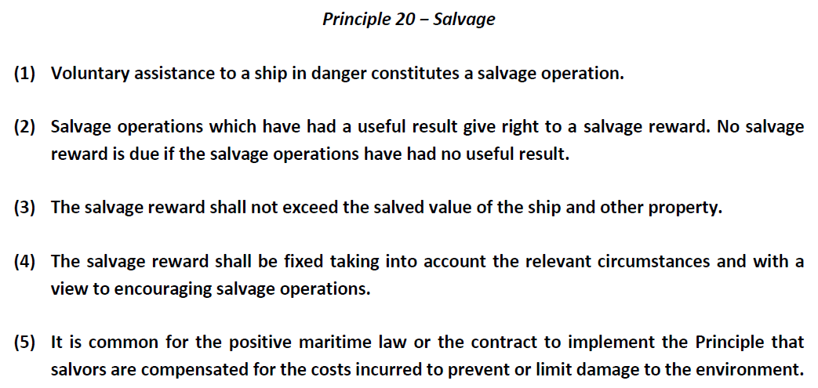

Slide 54
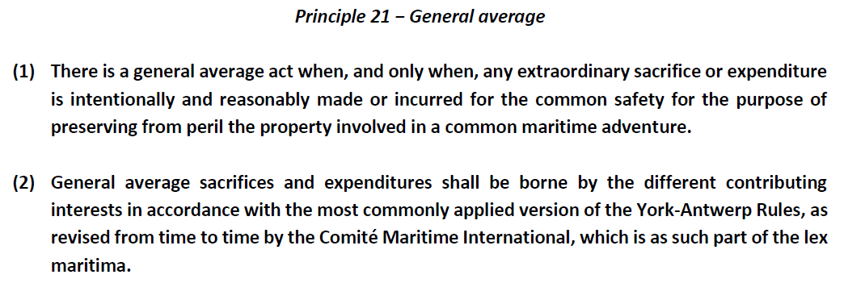

Slide 55
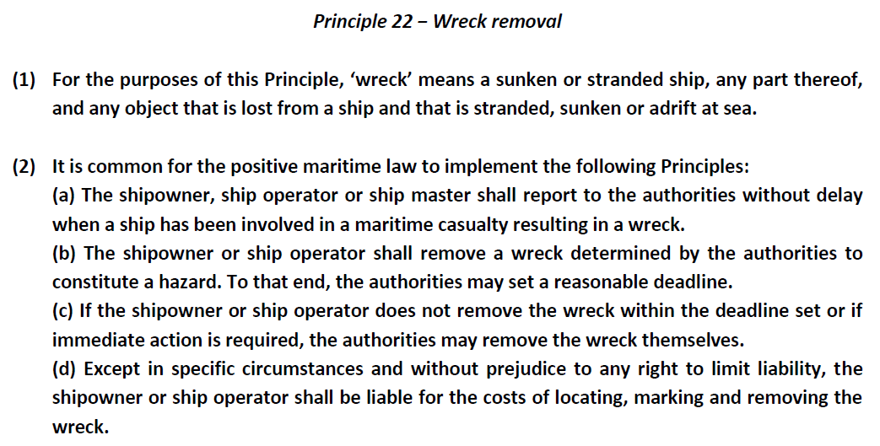

Slide 56
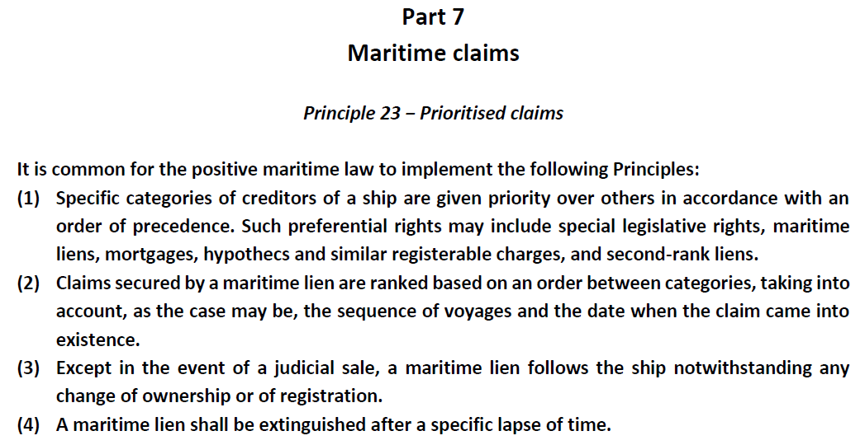

Slide 57
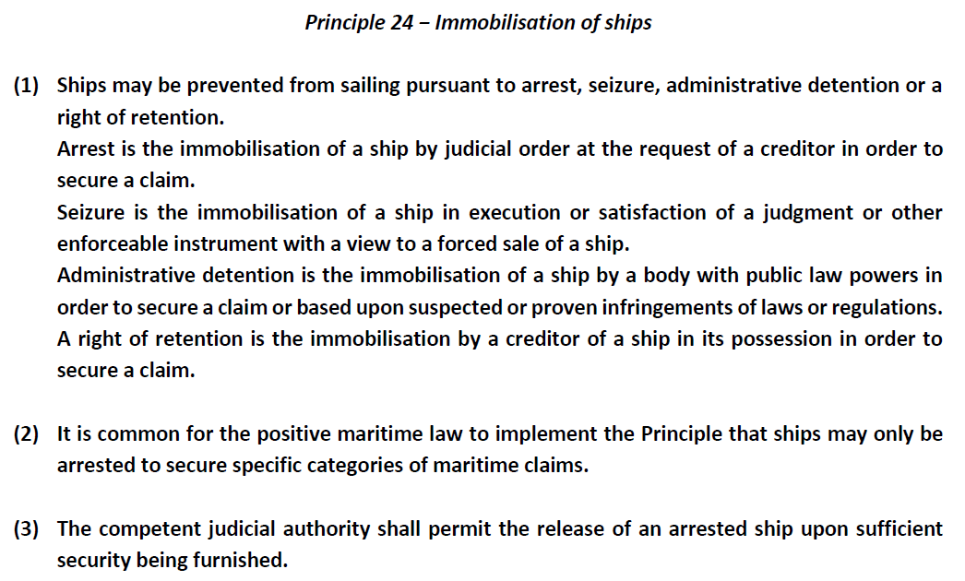

Slide 58
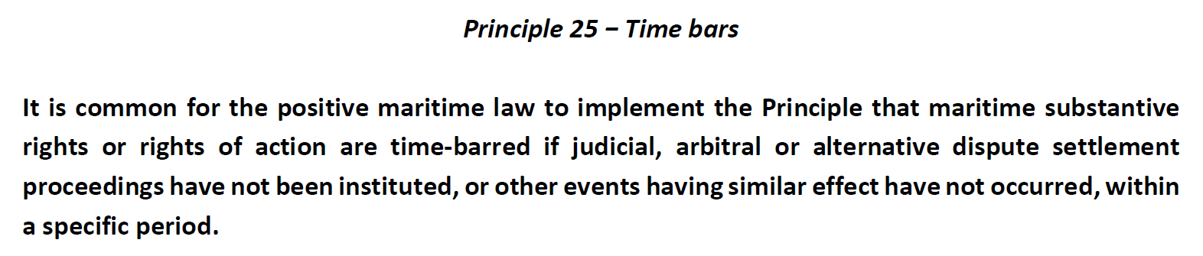

Slide 59
Thank you !

