Slide 1
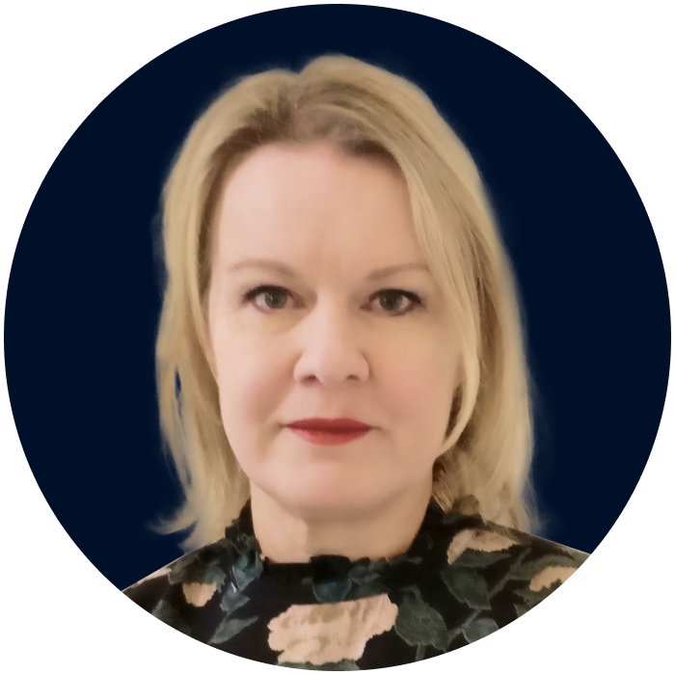
DIRE STRAITS
Comité International Maritime Colloquium
Rio de Janeiro, Brazil
May 13, 2026p
MICHELLE WIESE BOCKMANN
Senior Maritime Intelligence Analyst
Michelle.b@wnwd.com

Slide 2


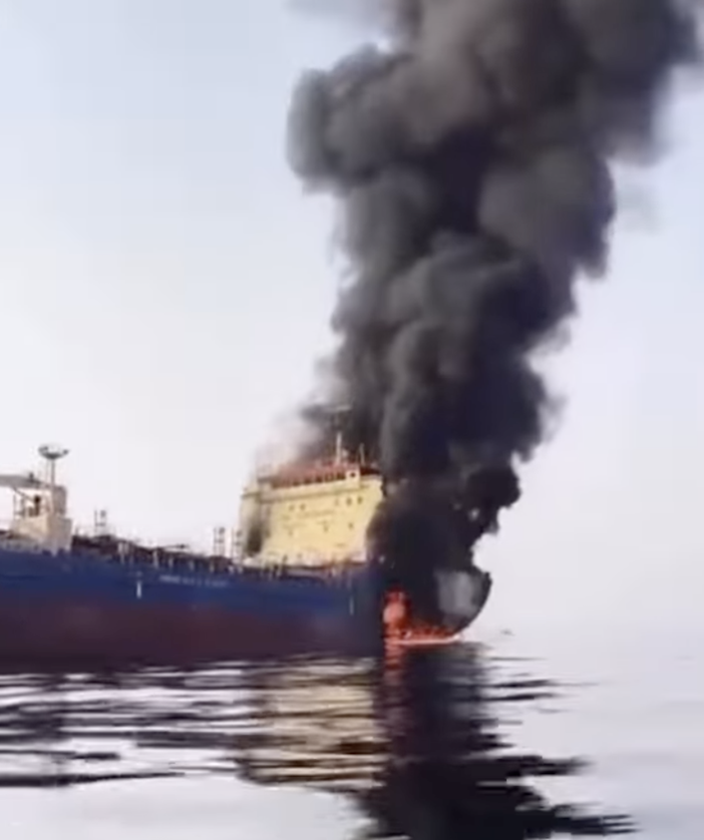


2026 … “UNPRECEDENTED”
War in the Arabian Gulf, Hormuz closed for a third month, maritime order upended, the dark fleet and shipping at center of geopolitics, greyzone aggression and military conflict.
A third US blockade on sanctioned oil shipments (Venezuela, Cuba, Iran)
Bifurcated global trade & parallel fleet ~21% crude tanker fleet sanctioned, with average age of 20 years.
Divisions between military and commercial
shipping blurring.
Deceptive shipping practices at all-time
highs.
Dark fleet business model broken in Venezuela; US and Iran Russia sanctions waivers give Dark Fleet new life
G7 Russia Oil Price Cap – dead in the water?
Notes:
Drone attacks reports of military personnel aboard vessels, spying equipment, cable-cutting

Slide 3
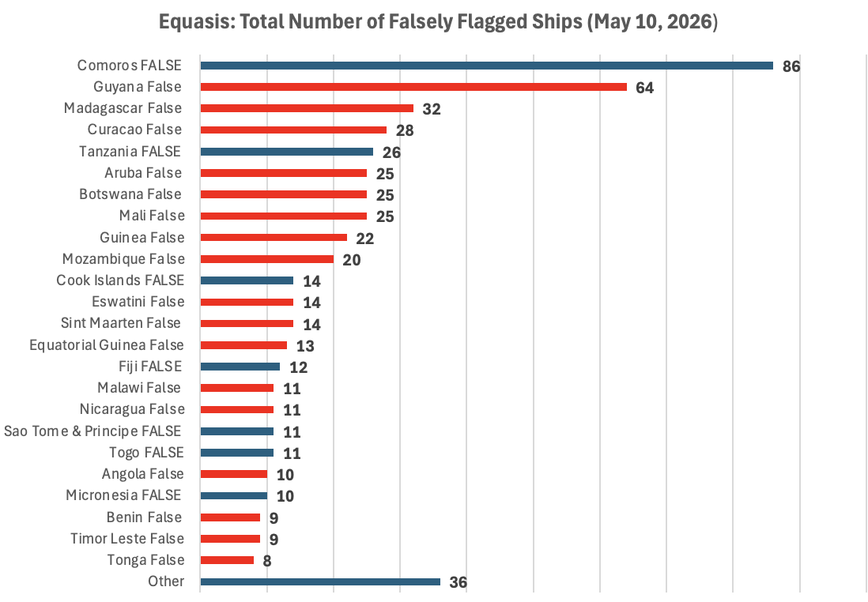
FALSE FLAGS & FRAUDULENT REGISTRIES
WHERE ARE WE NOW?
Falsely flagged ships are defined as those confirmed by a country’s maritime administration as not flying their flag.
Total number falsely flagged ships - 546 Equasis/565 GISIS (up from 470 4Q25). Average age: 26 years
63% of falsely flagged ships use fraudulent registries (by number) and 78% (by total GT)
2/3 of falsely flagged ships (by number) are tankers and 95% (by GT.)
75% of all falsely flagged ships (by GT) are tankers using fraudulent registries (275); number rose over 2025.
Databases lag real-time: ~290 internationally trading tankers were broadcasting via AIS flag of a fraudulent ship registry end Q126 (285 Q425)
5% of VLCC fleet (49 tankers) use fraudulent registries
88% of ships using fraudulent registries are Western-sanctioned

Slide 4
SANCTIONS + FLAG GOVERNANCE CRACKDOWN = FALSELY FLAGGED SHIPS
~21 fraudulent registries identified in Shadow Fleet (incl. Aruba, Angola, Benin, Botswana, Curaçao, Guinea, Guyana, Equatorial Guinea*, Mali, Malawi, Mozambique, Madagascar, Maldives, Nicaragua*, Timor Leste, St Maarten, Syria*, Tonga, Lesotho, Zimbabwe, Zambia)
Numbers 2x over 2025
Panama 3Q23 regulatory change +
Diplomatic outreach to countries of opportunistic flaggers of sanctioned tonnage (Barbados, Gabon, Cook Islands, San Marino, Guinea-Bissau, Comoros, Gambia, Palau ) =
Endemic flag-hopping: ~700 tankers changed flags 2-6x in 2025 &
Fewer ‘legitimate’ open registries now used by sanctioned ships: Oman, Vanuatu, Cameroon, Sierra Leone
BUT: Is the model breaking? Vulnerability to detention/seizure under Article 110 of UNCLOS over past 18 months slowed growth in fraudulent ship registrations since 4Q25
Notes:
Frontline of unprecedented foreign policy experiment, * 430 Equasis as of 13/11, of which gas tankers and oil and chemical tankers comprised 320, 448 in IMO as of 13/11, is sanctions stickiness, disproportionately misrepresented

Slide 5
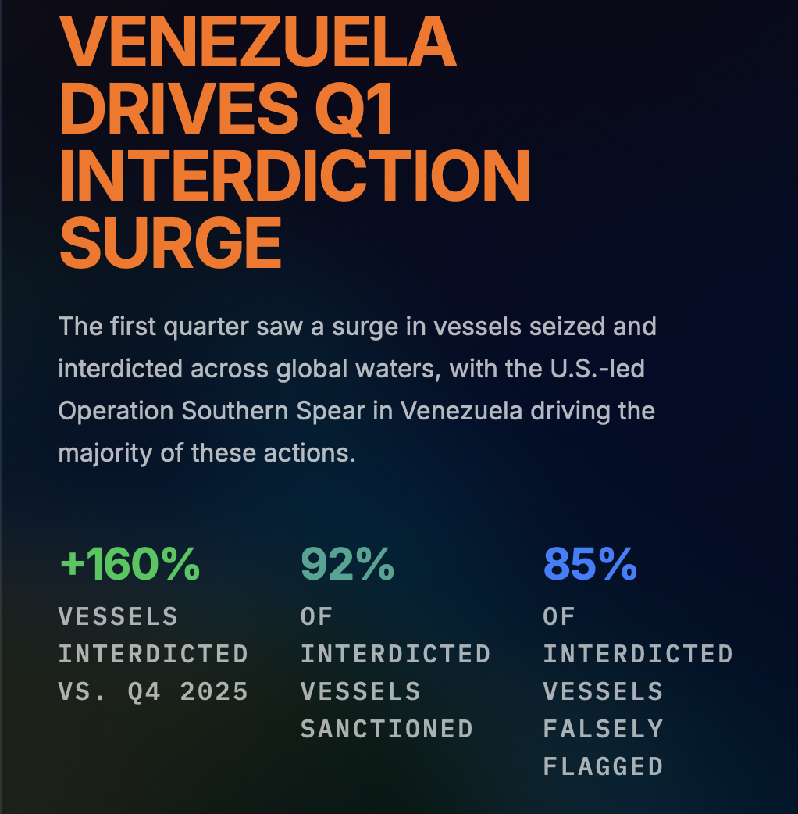
RUSSIA RECLAIMS ITS DARK FLEET
29 boardings, attempted boardings, detentions of Shadow fleet ships since Eagle S (24/12/24) by EU/UK/US navy or coast guard.
Tankers shifting to ‘legitimate’ registries to avoid ‘interdiction in EU and UK coastal waters (UNCLOS Article 110 allows authorities to board stateless vessels).
~70 sanctioned/false-flag tankers reflagged to Russia in 12 months; 48 since Dec.
Remainder have joined open registries of Sierra Leone and Cameroon.

Slide 6
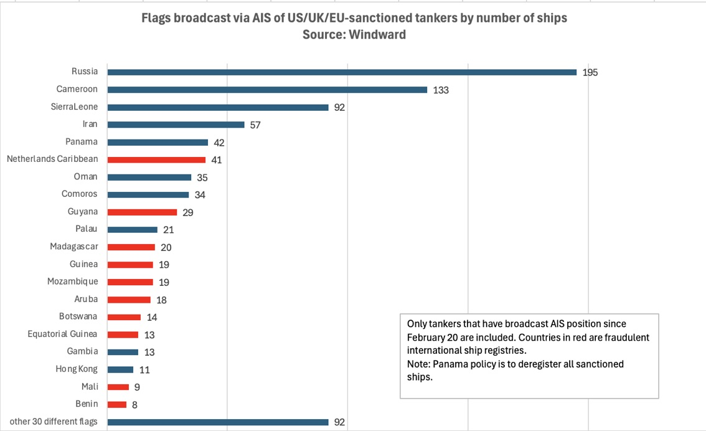
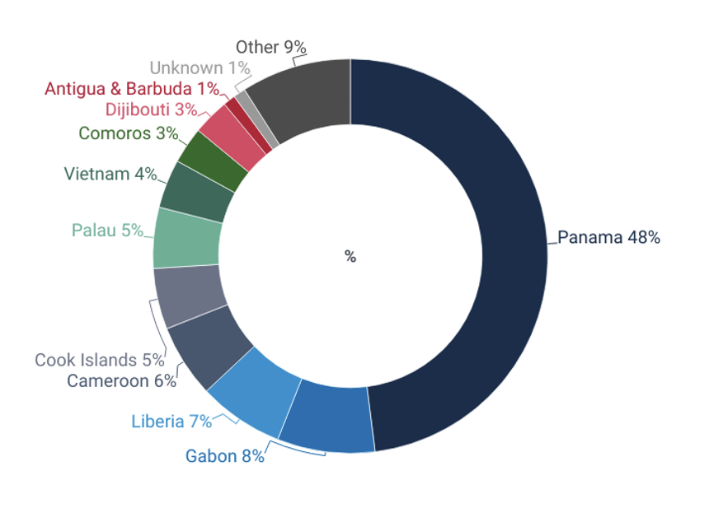
FLAG STATE: THEN AND NOW
The dark fleet by flag composition March 2024 (above) and May 2026 (left)
Notes:
Frontline of unprecedented foreign policy experiment, * 430 Equasis as of 13/11, of which gas tankers and oil and chemical tankers comprised 320, 448 in IMO as of 13/11, is sanctions stickiness, disproportionately misrepresented

Slide 7
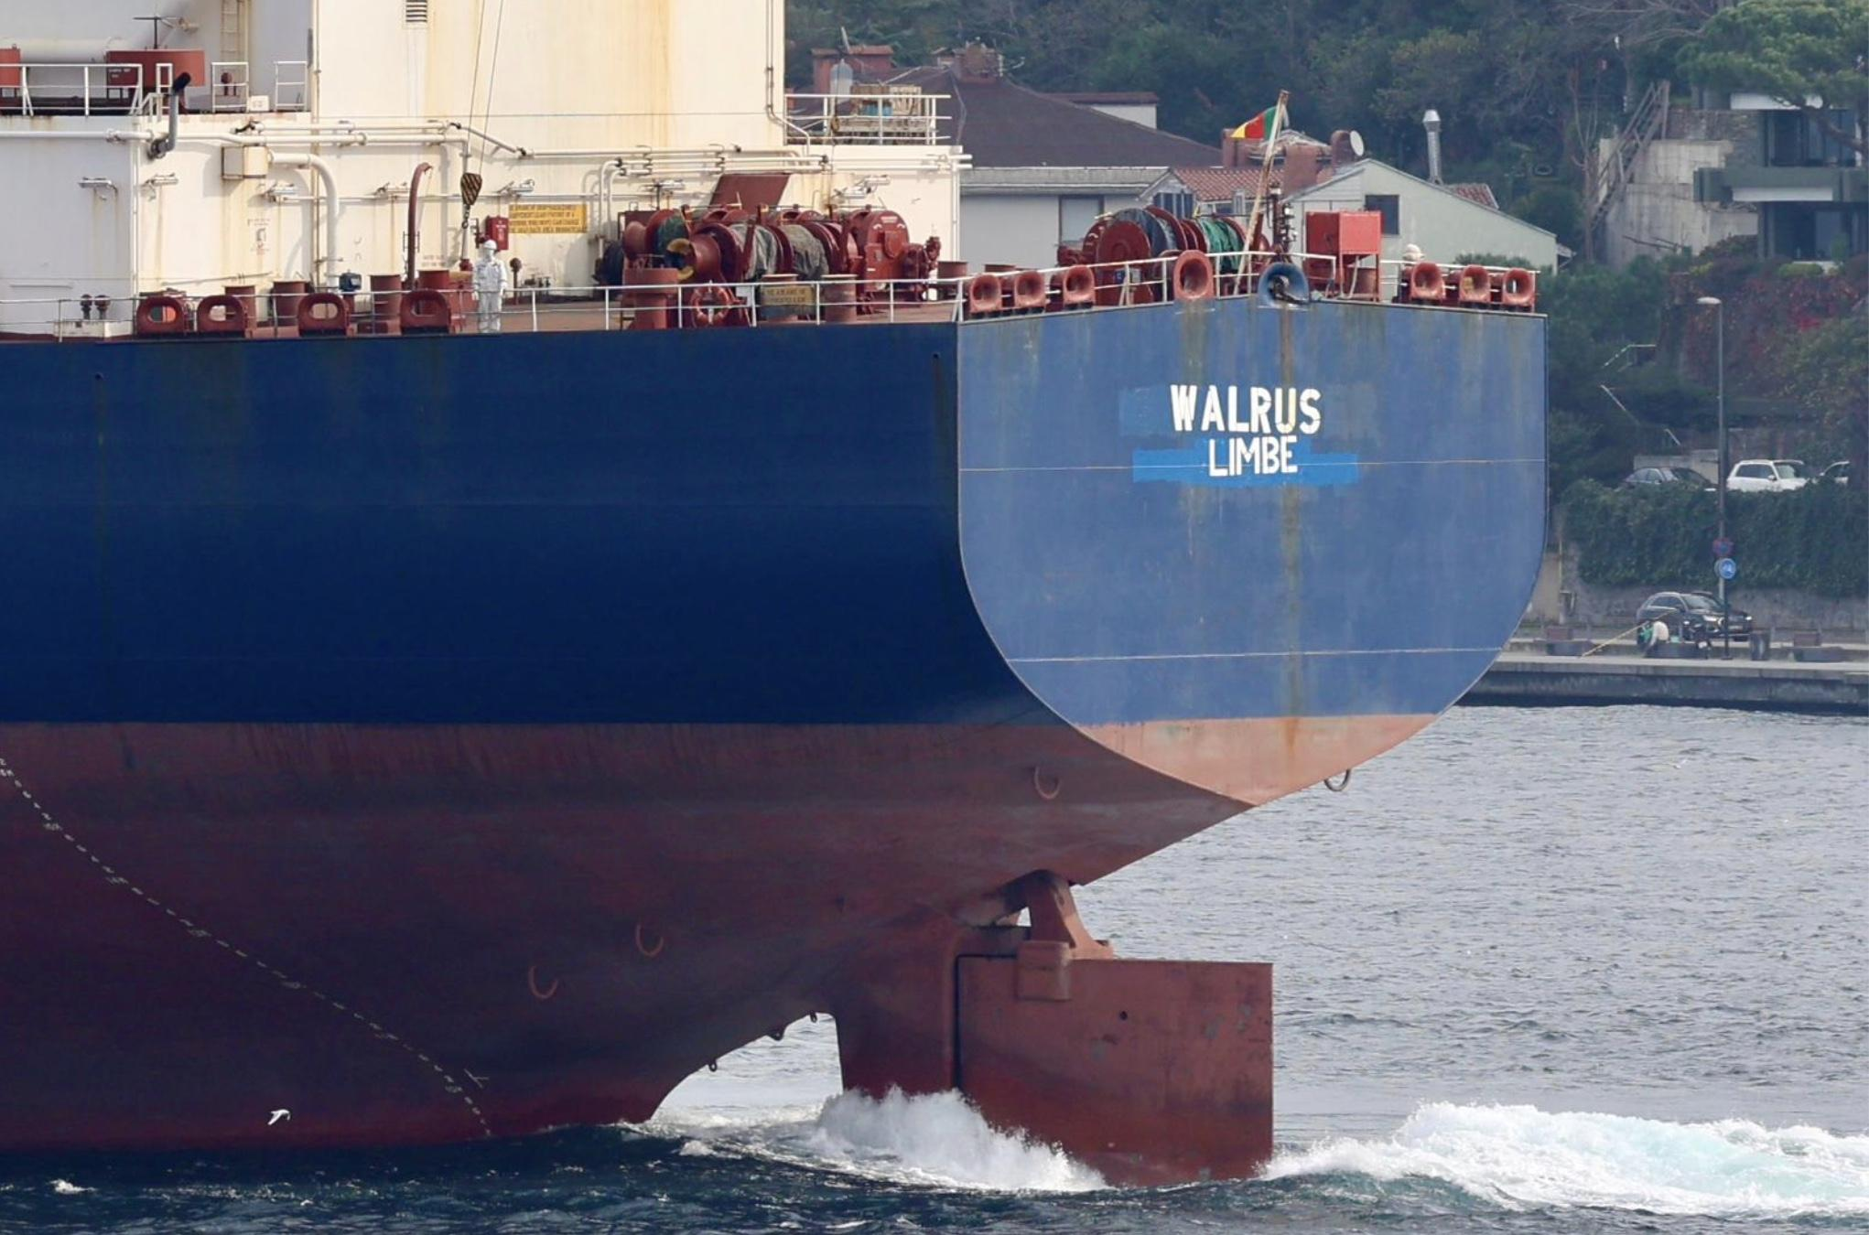
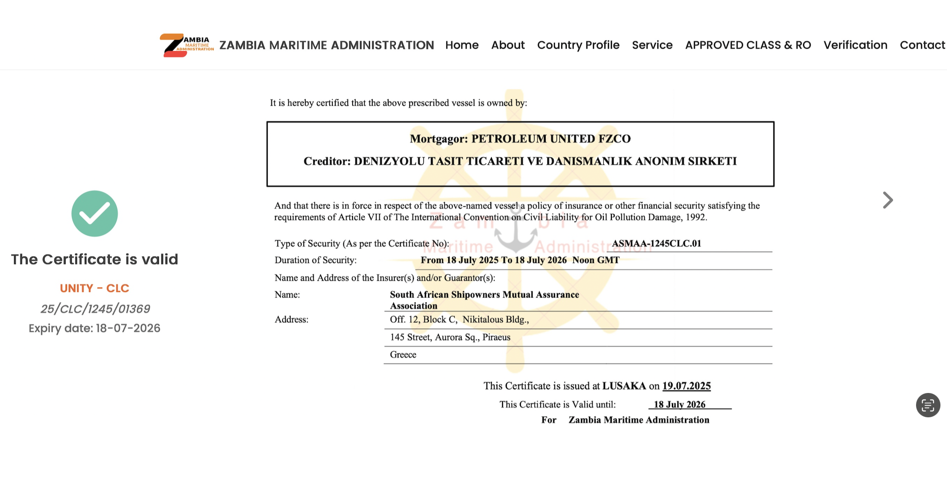
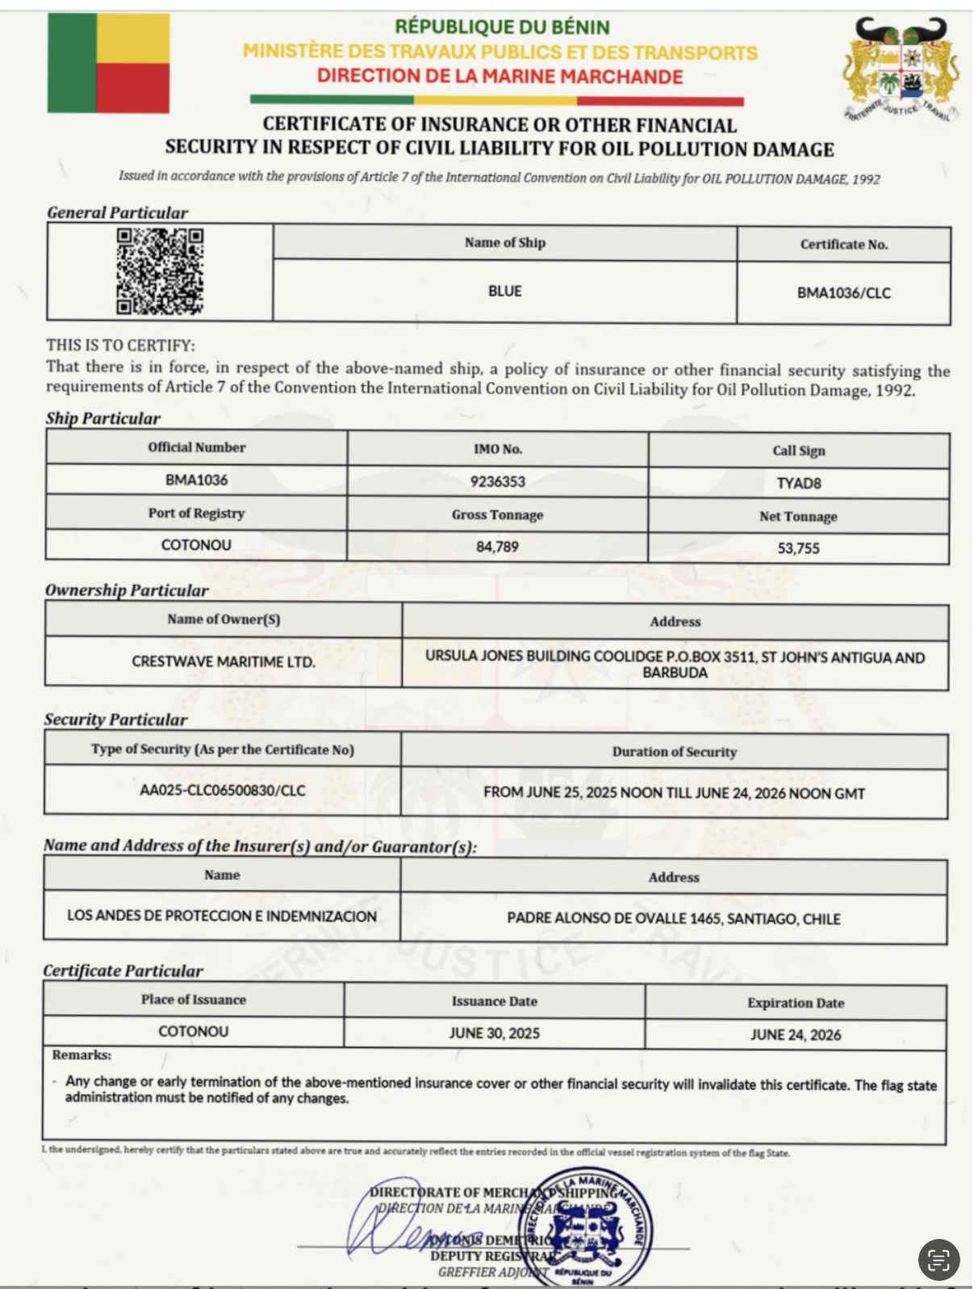
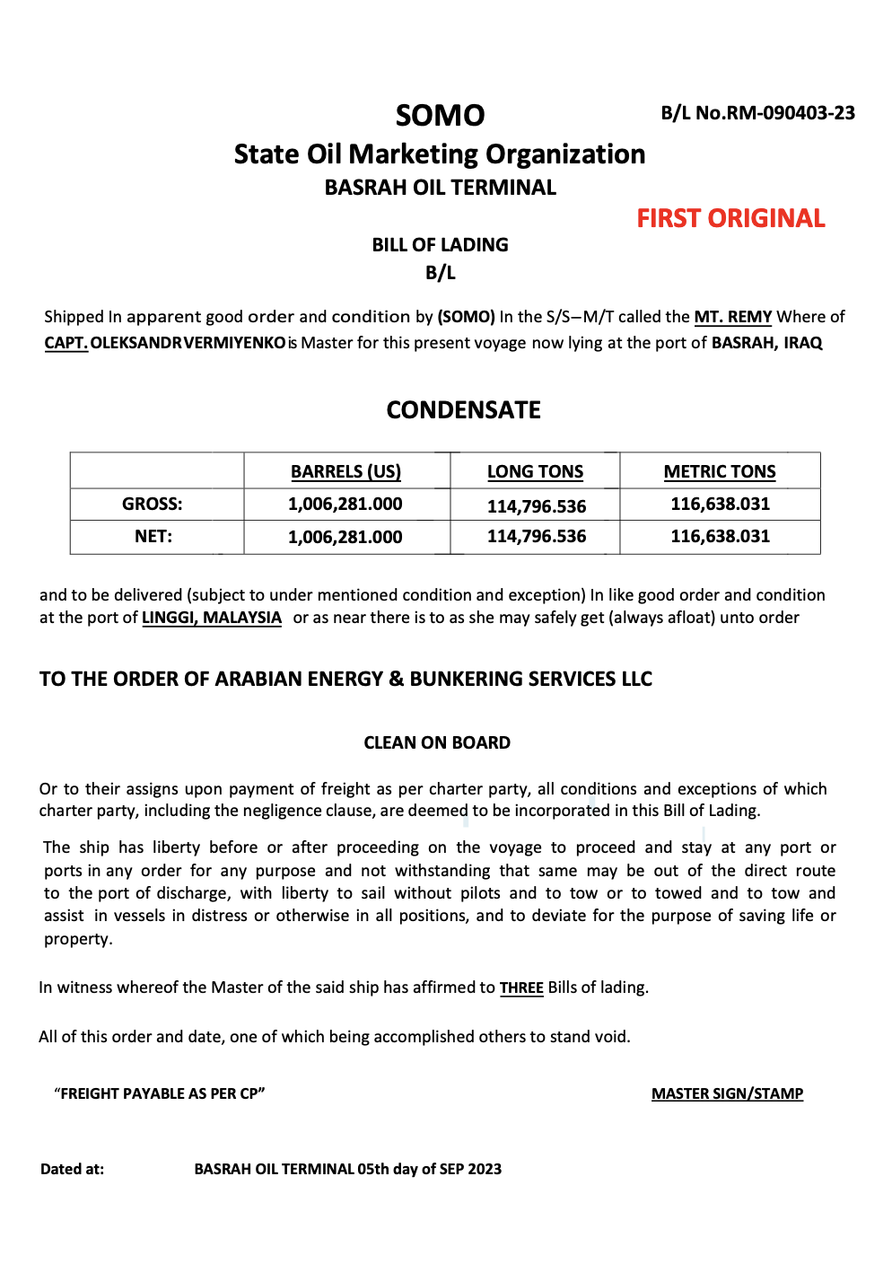
MIND THE GAP: DECEPTIVE SHIPPING PRACTICES AT RECORD
Illegitimate and fraudulent shipping practices threaten regulatory integrity of global trade and undermine international rules-based order
Flag-hopping
False flags/fraudulent registries
Spoofing (GNSS manipulation)
GPS jamming
Repeated vessel name/ownership changes
Zombie ships/Vessel identity fraud
Fake and fraudulent documents, BoL, widely used
Fake marine insurers/fake recognized organizations
STS in international waters
Notes:
definitions

Slide 8
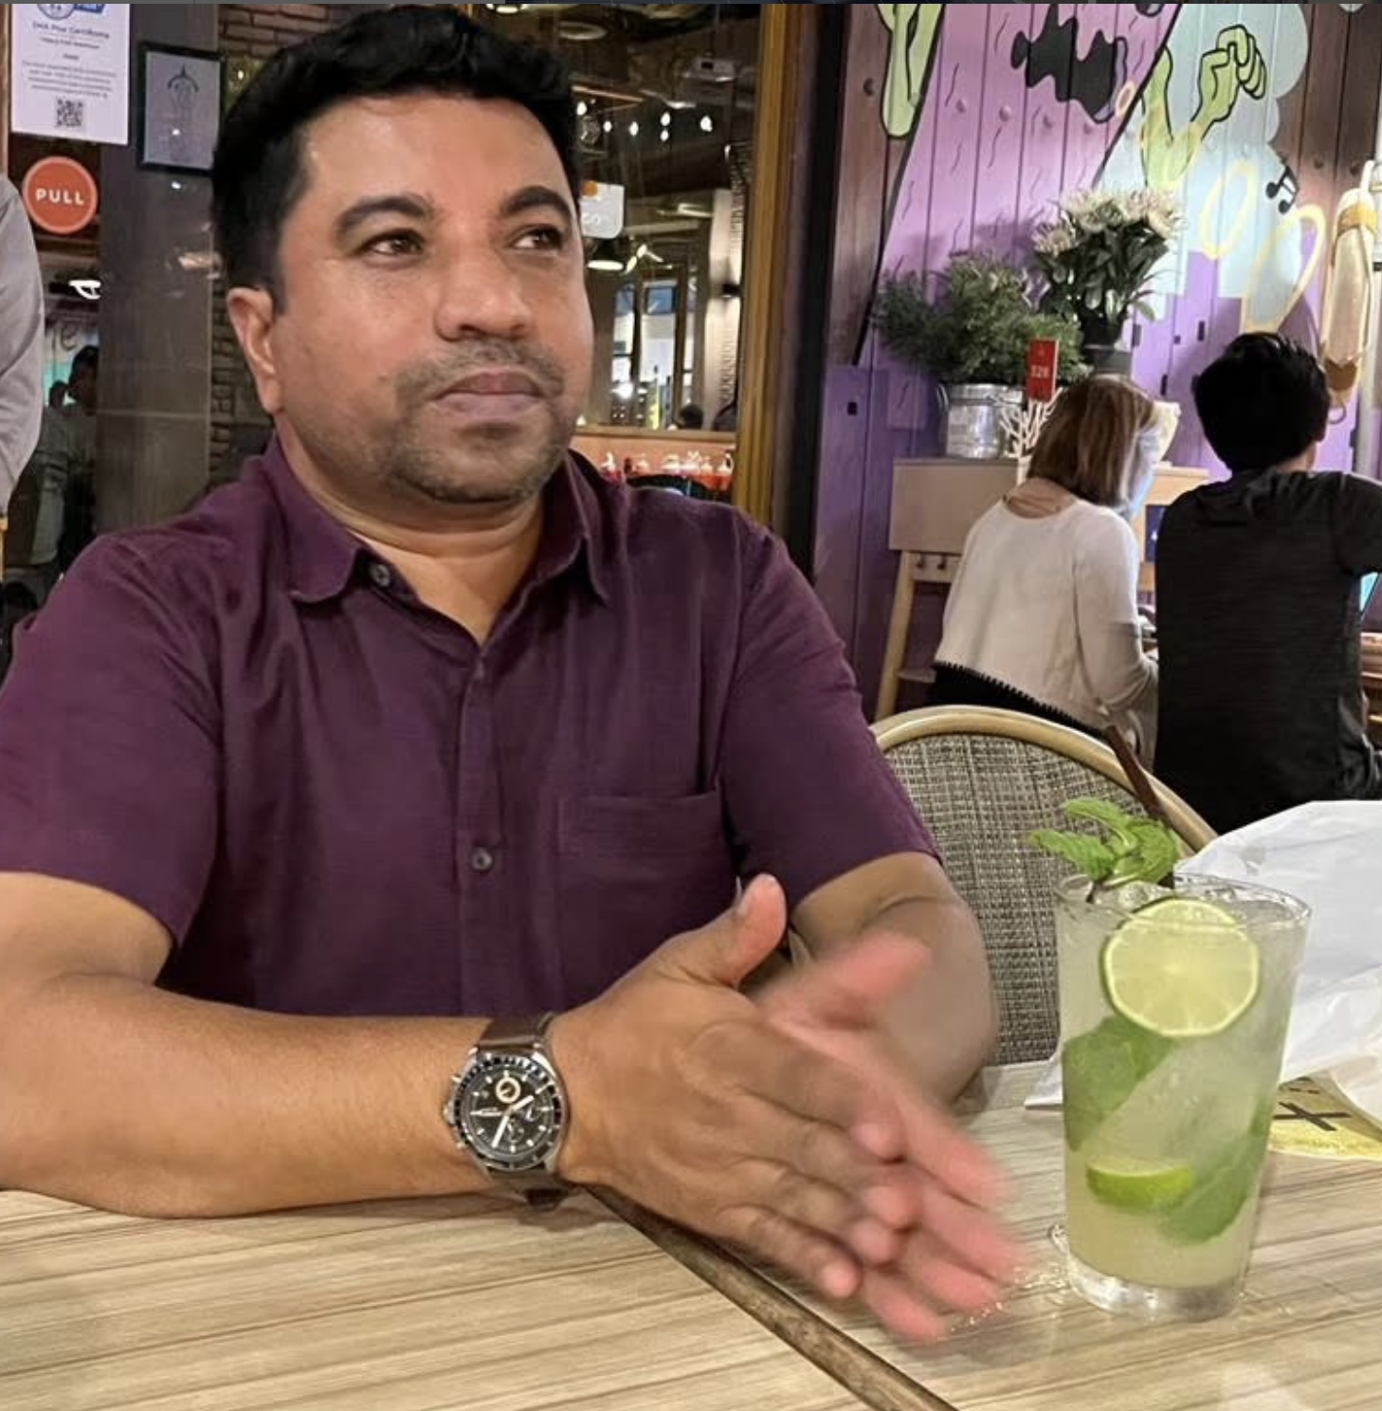
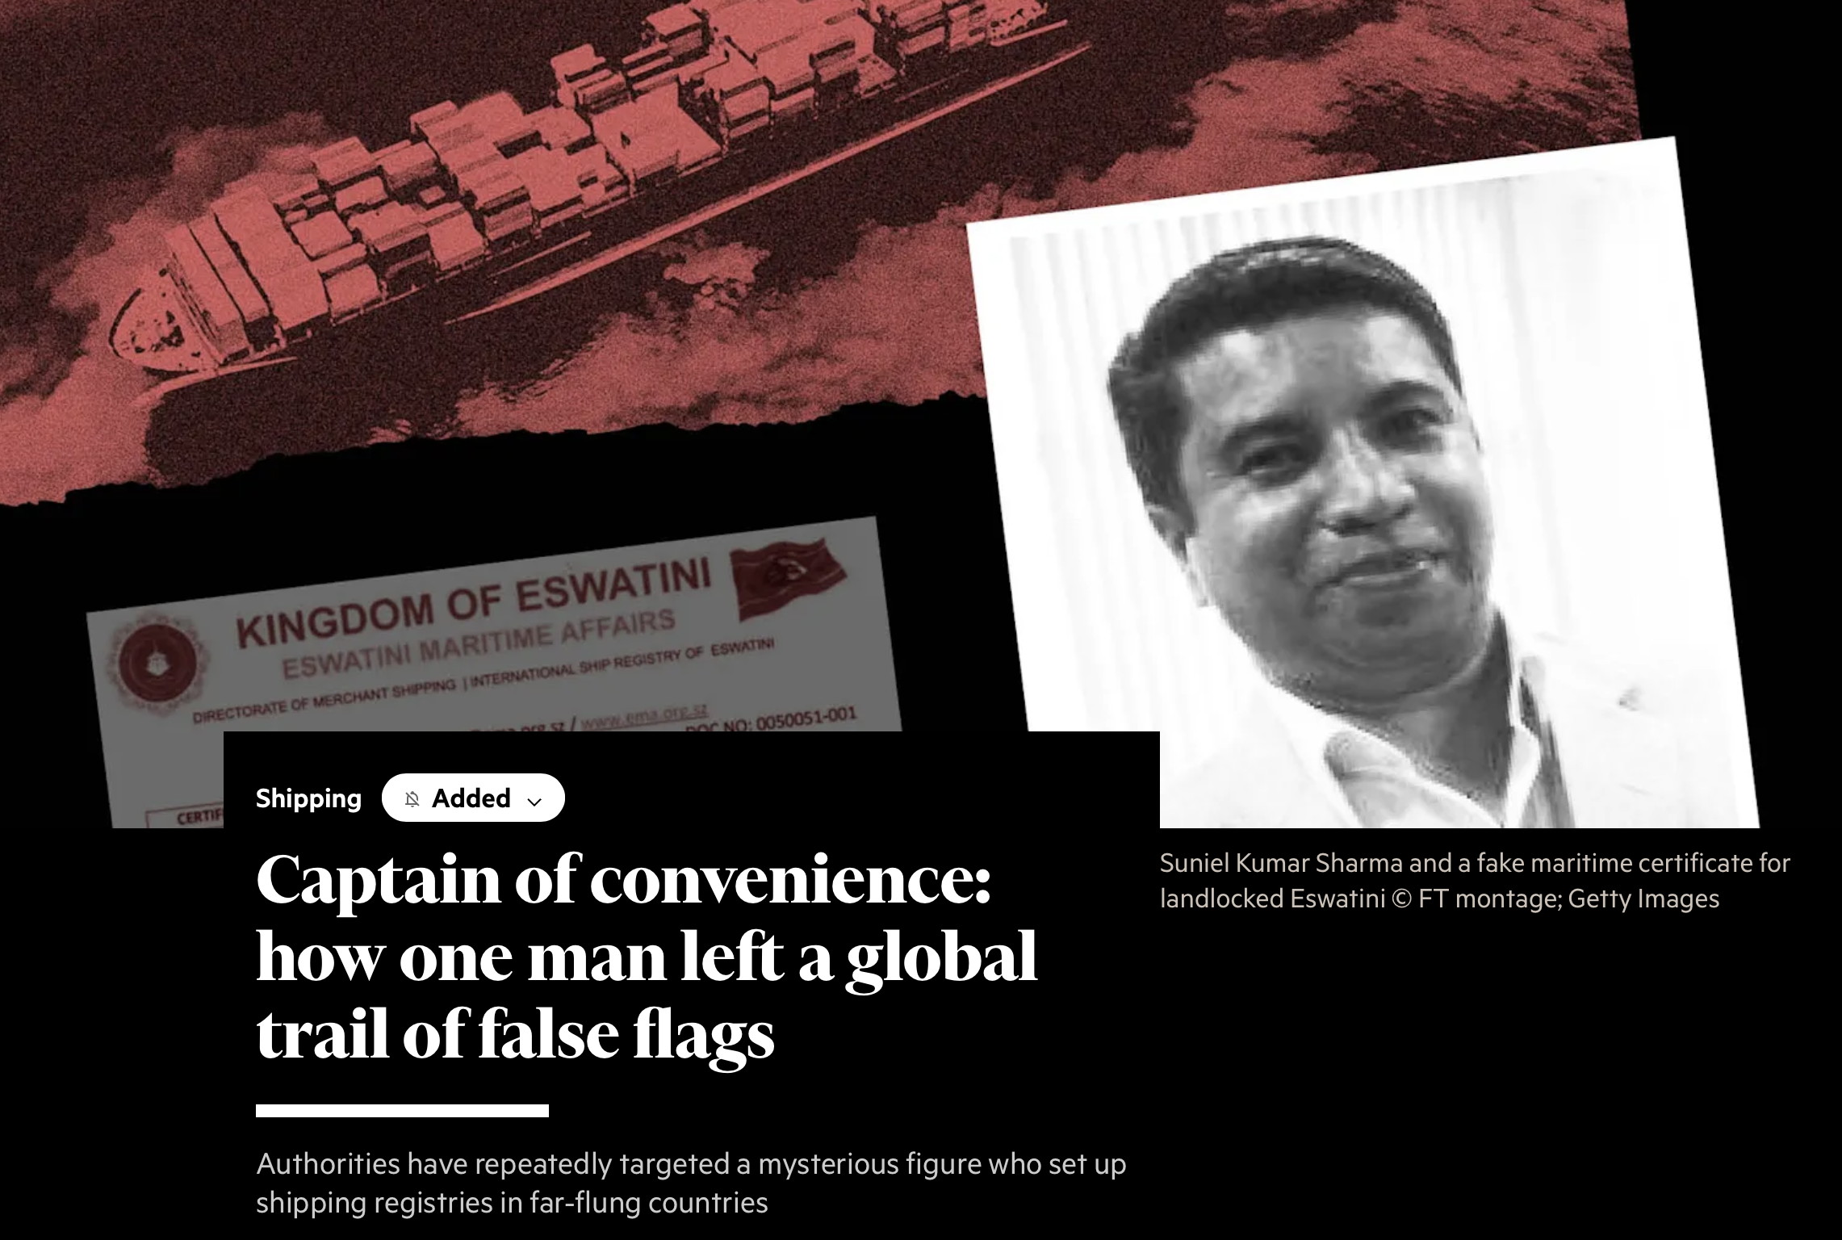
THE ‘CAPTAIN OF CONVENIENCE’
Suniel Kumar : “investor & developer” linked to Alexarya Corporation International, Chandigarh, India-based managing director of Oceaniek
Linked to Eswatini, Guyana (IMSAG still operating), Samoa, and at least 12 other fraudulent registries) latest flag is Nicaragua (February 2026)
Along with wife Jaspreet Kaur was censored by DG Shipping in 2019 for running fraudulent maritime training academies (new one just identified) ac
With registration ~$20,000 for aframax tanker, earnings in excess of ~$2m

Slide 9
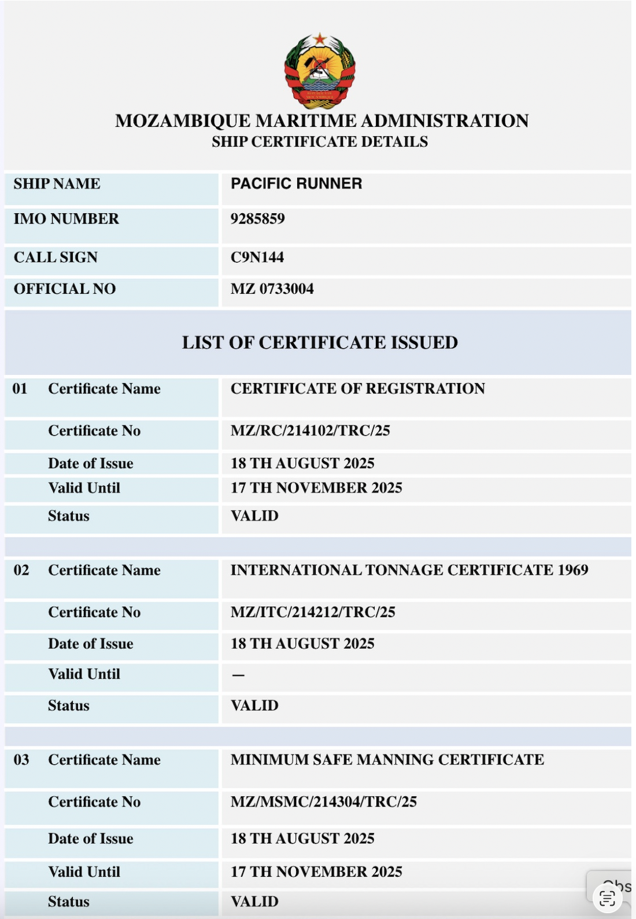
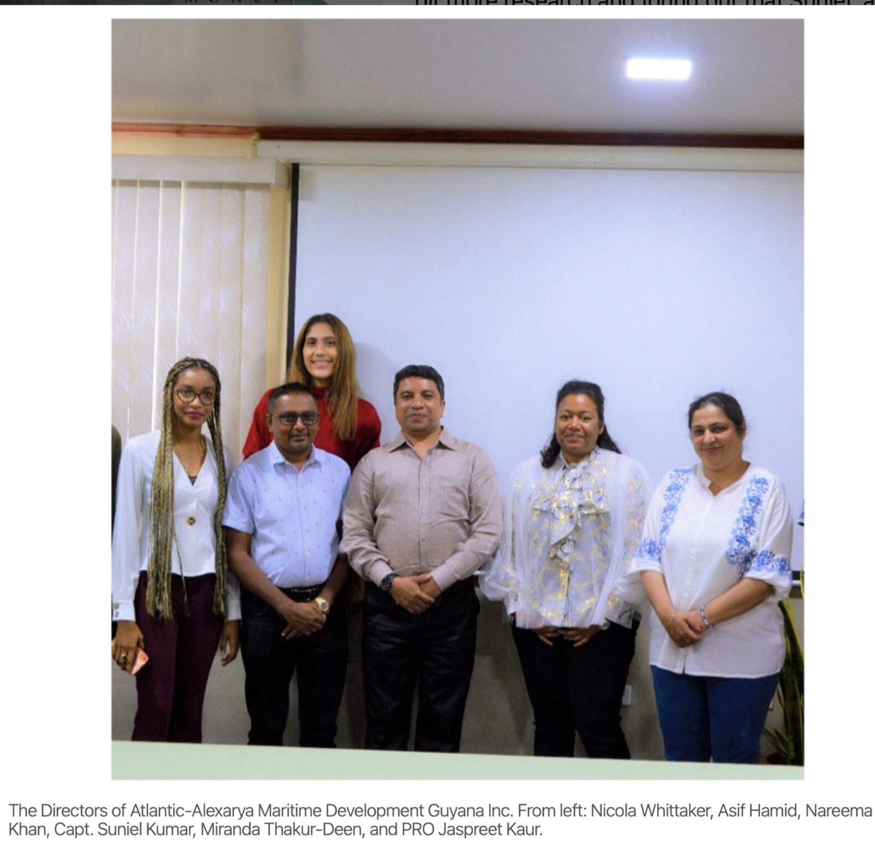
THE ‘CAPTAIN OF CONVENIENCE’

Slide 10
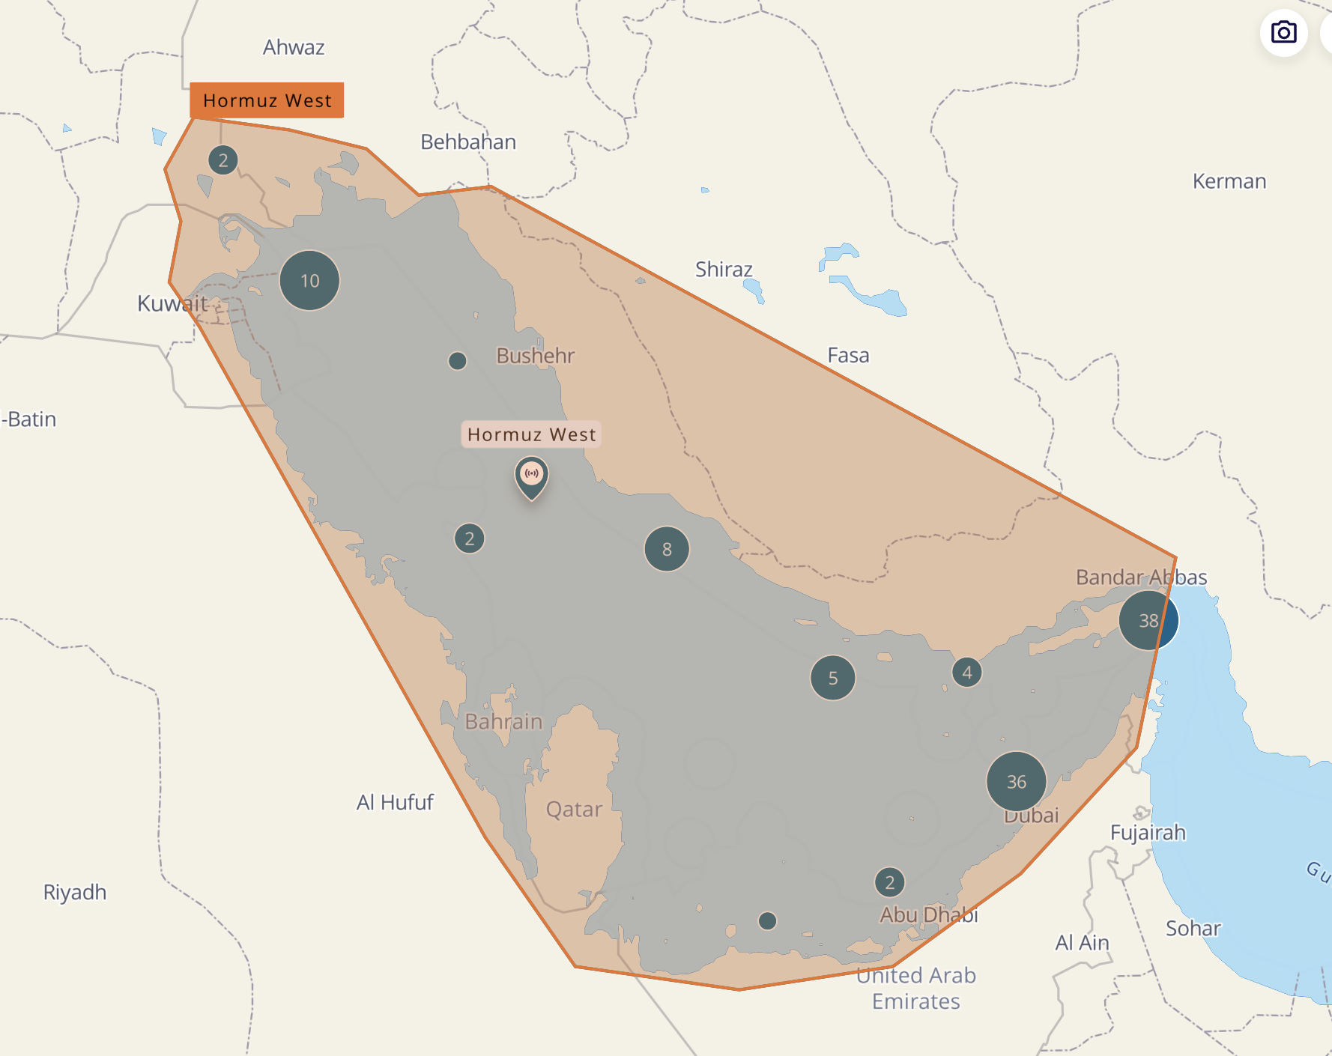
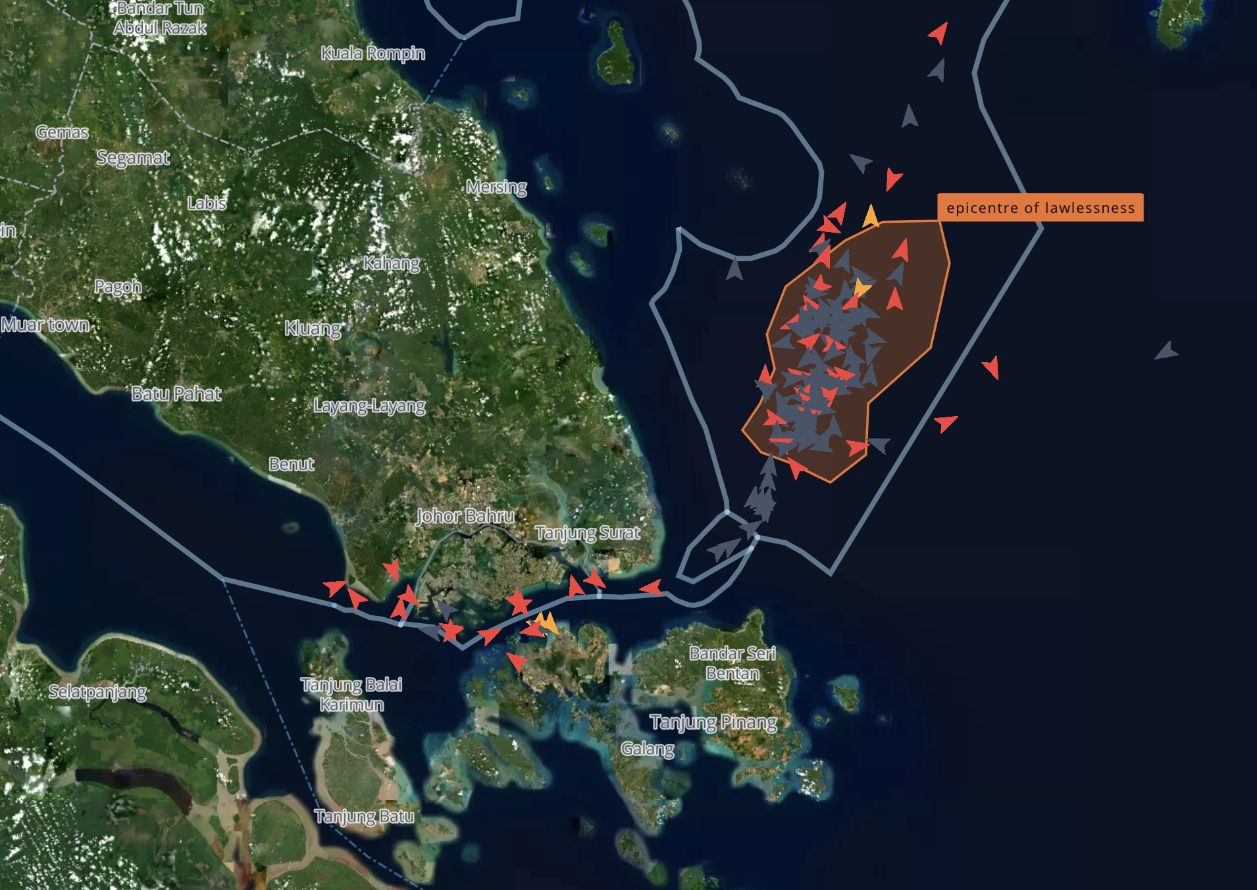
HOTSPOTS FOR FRAUDULENT FLAGS
107 ships with 21 fraudulent registries transmission in area – ‘epicenter of lawlessness’
109 ships with 21 fraudulent registries transmissions in area March 1-May 11 2026

Slide 11
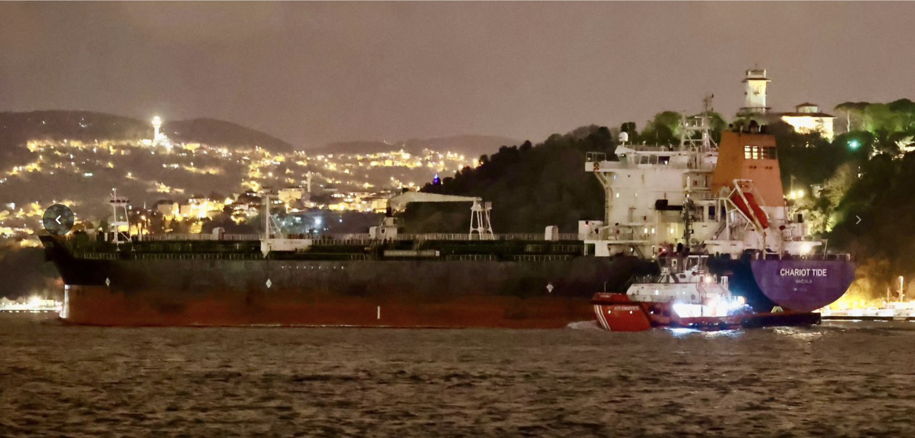
Chartio
FALSE FLAGS
FRAUDULENT REGISTRIES
Chariot Tide transits Bosporus May 2, 2026: photo Yoruk Isik

Slide 12
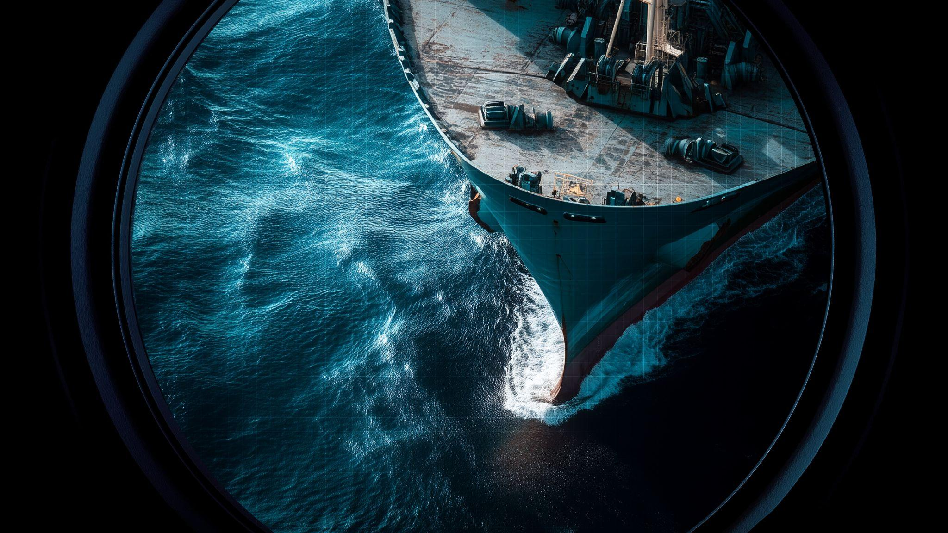
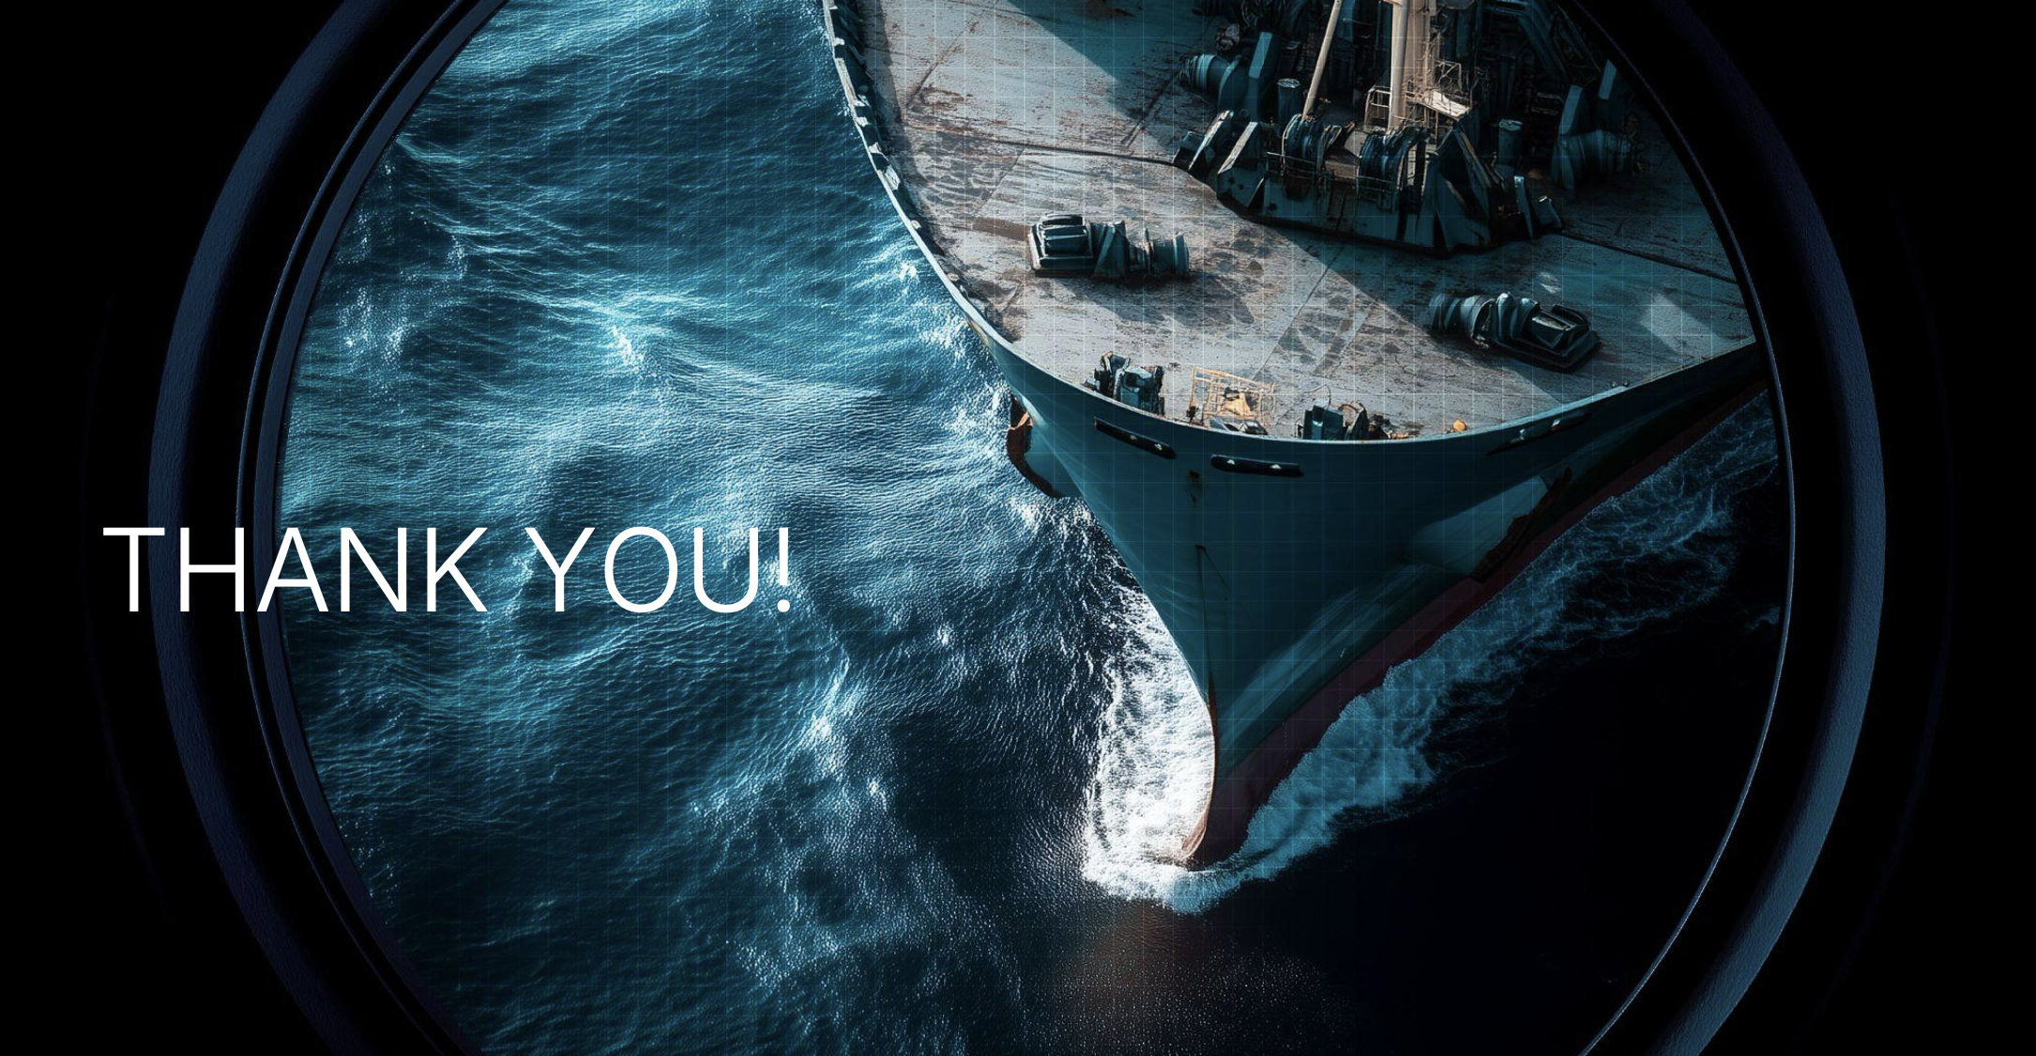
THANK YOU!

