Slide 1
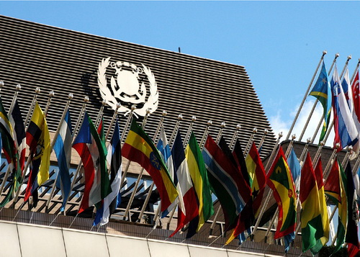
Fraudulent Registration and fraudulent registries of ships:
The IMO Experience / Initial Issues
Frederick Kenney, Director, Visiting Fellow, Swansea University

Slide 2
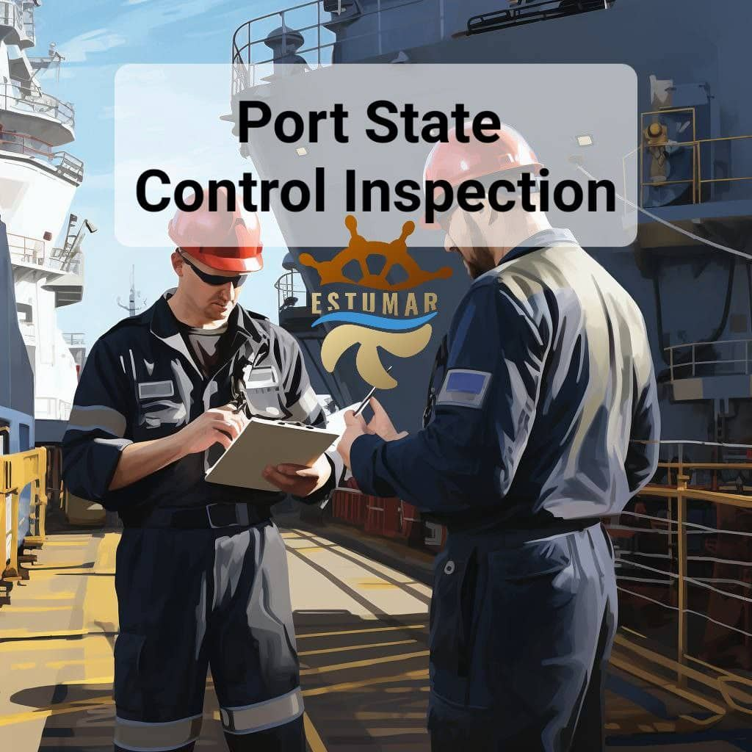
HOW THE SYSTEM WORKS
The Role of the Flag State
  Registration
  Issuance of Certificates
    MARPOL, SOLAS, STCW, “Blue Cards”
  Compliance Oversight
The Role of the Port State
  Port State Control
  “No more favorable treatment”
The threat – fraudulent registration & certificates
Verification Mechanisms

Slide 3
Overview of the Law
UNCLOS article 91(1):
  “Every State shall fix the conditions for the grant of its nationality to ships, for the registration of ships in its territory, and for the right to fly its flag. Ships have the nationality of the State whose flag they are entitled to fly. There must exist a genuine link between the State and the ship.”
UNCLOS article 94:
1. “Every State shall effectively exercise its jurisdiction and control in administrative, technical and social matters over ships flying its flag.
2. In particular every State shall: (a) maintain a register of ships containing the names and particulars of ships flying its flag, (…)”

Slide 4
Overview of the Law
1986 United Nations Convention on the Conditions for Registration of Ships
  Entry into force requirements: 40 Parties with combined tonnage of over 25% of the world tonnage
  Current status: 15 ratifications; 14 signatures
    Last ratification: Morocco, 19 Sept. 2012
  Article 6 Identification and accountability
  Article 8 Ownership of ships
  Article 11 Register of ships
International Convention on the Safety of Life at Sea (SOLAS), 1974
  IMO Numbering Scheme, Regulation XI-1/3 (most ships >100 GT & fishing vessels)
  Continuous Synopsis Record, Regulation XI-1/5 (all ships >500 GT)
  IMO Company Number, Regulation XI-I/3-1
Notes:
The Convention was adopted by a Conference of plenipotentiaries which met at Geneva from 20 January to 7 February 1986 under the auspices of UNCTAD.
The 1986 UN Convention on the Conditions for Registration of Ships establishes an international standard of the necessary elements for the registration of vessels in a national registry, including references to the genuine link, ownership, management, registration, accountability and the role of the flag State. However, the Convention has not yet entered into force. Thus, each country sets its own laws and regulations on the registration of ships.

Slide 5
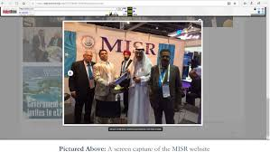
Scope of the Problem – Fraudulent registration/registries of ships
Entities purporting to be authorized to act on behalf of the Administration of a country, issuing fraudulent certificates of registration (Sierra Leone, United Republic of Tanzania)
Flying the flag of a State where no international registry has ever existed, through fraudulent registration/fraudulent registry (Democratic Republic of the Congo, Fiji, Federated States of Micronesia, Maldives, Nauru, Samoa)
Flying the flag of a State using fraudulently produced registration documents and certificates (Numerous major flag States)
Corrupt Government official providing fraudulent documentation (USA, India)
Defrauding IMO to get access to IMO web accounts (Federated States of Micronesia, Nauru)
Notes:
Sierra Leone: Sierra Leone International Ship Registry (SLISR) and Sierra Leone International Ship and Corporate Registry (SLISCR) both stated they were the entities appointed by the Government of Sierra Leone to handle the Sierra Leone Maritime Administration. The Government of Sierra Leone had problems terminating the contract with SLISCR.
Tanzania: Philtex, a company that had been the exclusive international shipping registration agent for the Tanzania Zanzibar Register of Shipping continued to illegally register ships and issue fake renewals of certificates on behalf of the Tanzanian flag although Tanzania had terminated all business relationships with it. It is often difficult for States which are victims of this kind of fraud to trace these companies. Worth noting that the Tanzania Zanzibar Register of Shipping was taken over and is now being managed by the Zanzibar Maritime Authority.
DRC, Fiji, Micronesia, Nauru and Samoa, though they did not authorize the use of their flag for international trade, were all victims of fraudulent registration companies claiming to be the respective States’ official registration offices.
Micronesia: IMO erroneously recognized a fraudulent registry as an official Micronesian entity after receiving communications on official-looking letterhead and stationery from an individual claiming to be the Director of the “Micronesia International Ship Registry” despite Micronesia not operating a ship registry.

Slide 6
Scope of the Problem: Threat posed by fraudulent registration/registries of ships
Illicit activities, including evading UN sanctions
Xin Yuan 18:
Fraudulently flying the Maldives flag to operate ship-to-ship transfer in violation of UNSCR
Xin Sheng Hai/Talent Ace:
One ship, two IMO numbers using false information on application, and involved in illicit transfer of coal
Migrant ghost ships
Ezadeen:
Registered under the Sierra Leone Flag, administered by the Sierra Leone International Ship and Corporate Register (SLISCR) - Discovered off the coast of Italy with no crew and ~450 migrants
Fraudulent certificates
Non compliance with safety and security regulations, endangering the vessels' crew and posing threat of damage to the marine environment
Notes:
Illicit activities: large shipments of narcotics found on board some vessels by INTERPOL. Fraudulently registered ships also makes the task of sanctions enforcement more difficult: Xin Yuan 18 was fraudulently flying the Maldives flag. Also, after Cambodian authorities decided in September 2016 to close their registry, which had been used by North Korean-controlled vessels looking to evade UN sanctions, some of those vessels continued—in violation of national law—to fly the Cambodian flag for a year.
Migrant ships: after this incident, Sierra Leone cancelled its contract with SLISCR
All certificates on board are invalid when a ship is fraudulently registered

Slide 7
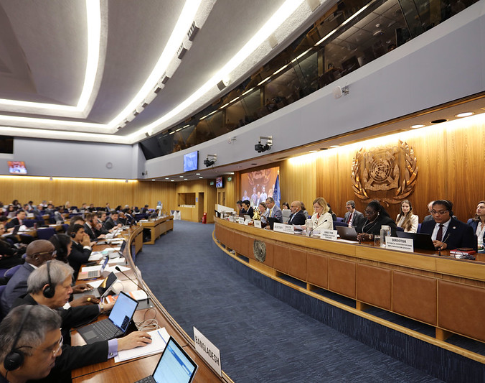
INITIAL IMO RESPONSE
RAISED BY DRC IN 2017
ADDED TO LEG WORK PROGRAMME IN 2018
ASSEMBLY RESOLUTION A.1142(31) – 2019 “REGISTER OF REGISTRIES”
GSIS UPDATED TO INCLUDE INFO ON FALSE REGISTRATION AND UN SANCTIONED VESSELS
WORK ON DEVELOPMENT OF BEST PRACTICES

