Slide 1

CMI · ECUADOR · 2026
Ecuador and the
Hamburg Rules
36
A transition laboratory.
Javier Cardoso
Comité Maritime International
Entry into force · 1 August 2026
the 36ᵗʰ State to accede

Slide 2
THESIS
Ecuador will not contribute new doctrine to this room.
It will contribute a transition.
A natural experiment in how uniform maritime law is absorbed when accession comes late and alone — half a century after adoption, in a mature export economy still wearing Hague-Visby paper.
Ecuador and the Hamburg Rules · CMI
2

Slide 3
01
Ecuador’s late entry into the regime
Why a maritime, export-driven country is only now
joining a Convention adopted half a century ago.
Ecuador and the Hamburg Rules · CMI
3

Slide 4
A FORTY-EIGHT YEAR GAP
From adoption to Ecuadorian entry into force
1978
1992
31 JUL 2025
1 AUG 2026
Hamburg Rules
adopted
International
entry into force
Ecuador deposits
instrument of accession
Entry into force
for Ecuador
48 years between adoption and accession — the gap, not the text of the Convention, is what makes the Ecuadorian case worth studying.
Ecuador and the Hamburg Rules · CMI
4

Slide 5
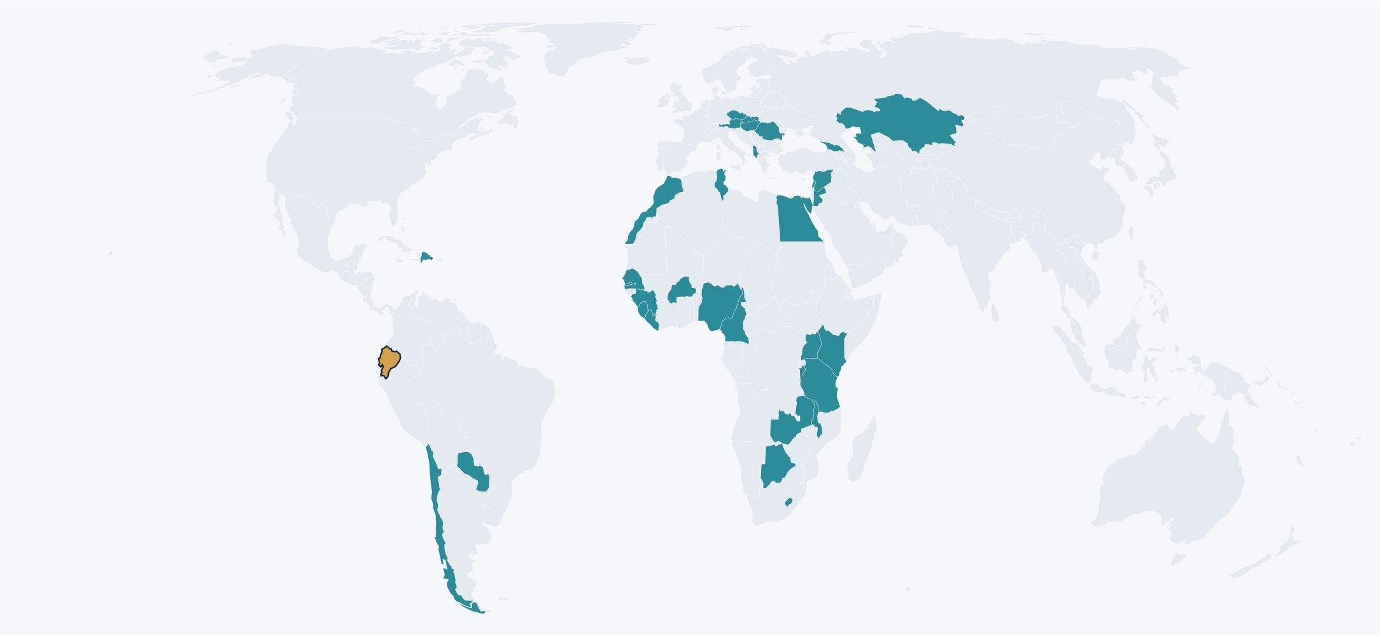
STATE OF THE CONVENTION
Thirty-six States. None of the major flag or trading powers.
19
6
6
5
0
AFRICA
AMERICAS
EUROPE
ASIA
OCEANIA
35 States · ratified
+ Ecuador
Ecuador · in force 1 Aug 2026
Ecuador and the Hamburg Rules · CMI
5

Slide 6

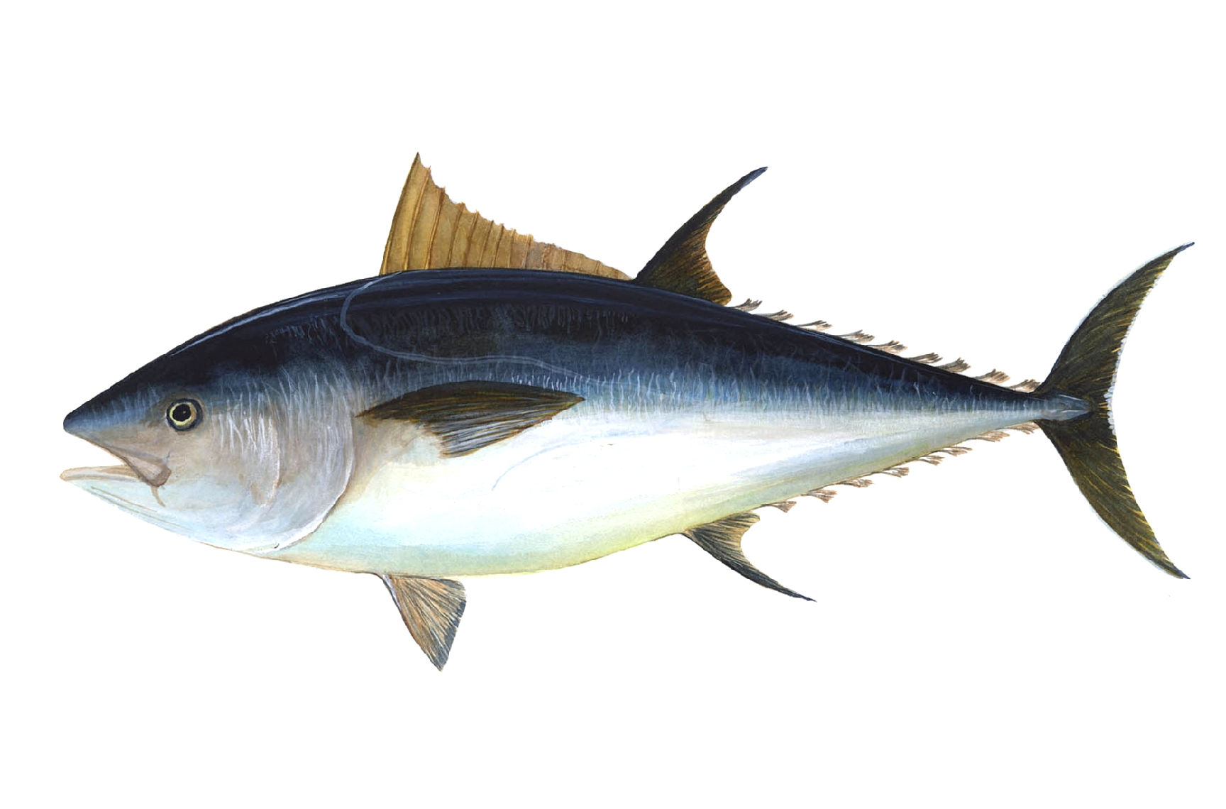

WHY THE CASE MATTERS
A cargo interest, kept for half a century
under a carrier-protective regime
7.47–8.4
378.41
3.93
USD billion
million boxes
USD billion
Shrimp exports
Banana exports
Tuna & fish exports
2025 · industry / Reuters
2025 · AEBE
2025 · Central Bank
Q4 2025 closed at a historic quarterly high for Ecuadorian non-petroleum exports.
Ecuador and the Hamburg Rules · CMI
6

Slide 7
THE ECUADORIAN PATH TO RATIFICATION
No reservations. No interpretive declarations.
No accompanying domestic reform.
1
2
3
4
8 May 2025
7 July 2025
31 July 2025
1 August 2026
Constitutional Court
Executive Decree 47
UNCITRAL deposit
Entry into force
Opinion 1-25-TI/25 declares
no legislative approval required.
Signed by President Noboa,
ratifying the Convention.
Instrument of accession
deposited with the Secretary-General.
Article 30 triggers entry into
force for Ecuador.
Ecuador and the Hamburg Rules · CMI
7

Slide 8
02
What changes on 1 August 2026
A normative shift on day one;
an operational adjustment in waves.
Ecuador and the Hamburg Rules · CMI
8

Slide 9
NORMATIVE SHIFT
What changes on day one
Hague-Visby (today)
Hamburg (from 1 August 2026)
Burden of proof
Cargo proves carrier fault
Carrier proves reasonable measures
Period of responsibility
Tackle-to-tackle
Receipt to delivery
Nautical fault defence
Available to the carrier
Eliminated
Delay
Not autonomously actionable
Actionable · cap 2.5× freight
Limits
666.67 SDR / 2 SDR per kg
835 SDR / 2.5 SDR per kg
Time bar
One year
Two years
Jurisdiction
Exclusive clauses prevail
Claimant’s menu (Art. 21)
Ecuador and the Hamburg Rules · CMI
9

Slide 10
03
First foreseeable
legal controversies
Four institutional fronts where the friction
will surface in the absence of local case law.
Ecuador and the Hamburg Rules · CMI
11

Slide 11

FOUR INSTITUTIONAL FRONTS
Where the first conflicts will appear
I
Jurisdiction & arbitration
Article 21 confronts pre-printed exclusive English or Swiss forum clauses. The first wave of objections — and possibly foreign anti-suit reactions — is coming.
Ecuador and the Hamburg Rules · CMI
12

Slide 12
A DEEPER LOOK · JURISDICTION & ARBITRATION
Forum as policy choice, not procedural technicality
Hamburg gives the claimant a menu of forums — and refuses to let an arbitration clause neutralise it.
ARTICLE 21
ARTICLE 22
Court jurisdiction
Arbitration
The claimant — at its option — may sue at any of:
The claimant — at its option — may arbitrate at any of:
1
Defendant’s principal place of business
1
Defendant’s principal place of business
or habitual residence
or habitual residence
2
Place where the contract was made
2
Place where the contract was made
if defendant has a branch or agency there
if defendant has a branch or agency there
3
Port of loading
3
Port of loading
connecting factor #1
mirrors Art. 21
4
Port of discharge
4
Port of discharge
connecting factor #2
mirrors Art. 21
5
Forum designated in the bill of lading
5
Seat designated in the arbitration clause
the carrier’s clause — non-exclusive
the carrier’s clause — non-exclusive
PRINCIPLE COMPETENCE COMPETENCE?
Ecuador and the Hamburg Rules · CMI
13

Slide 13

AFTER STURLEY · CARRIAGE OF GOODS BY SEA, CH. 6
“
Hamburg was not drafted in hostility to arbitration.
It was drafted to prevent the carrier’s arbitration clause from being used as a mechanism to evade the jurisdictional protections of Article 21.
MFS
MICHAEL F. STURLEY
Read in Ecuador: an exclusive forum clause that defeats the menu of Articles 21 and 22 is, by design, what the Convention came to neutralise.
Ecuador and the Hamburg Rules · CMI
11
14

Slide 14
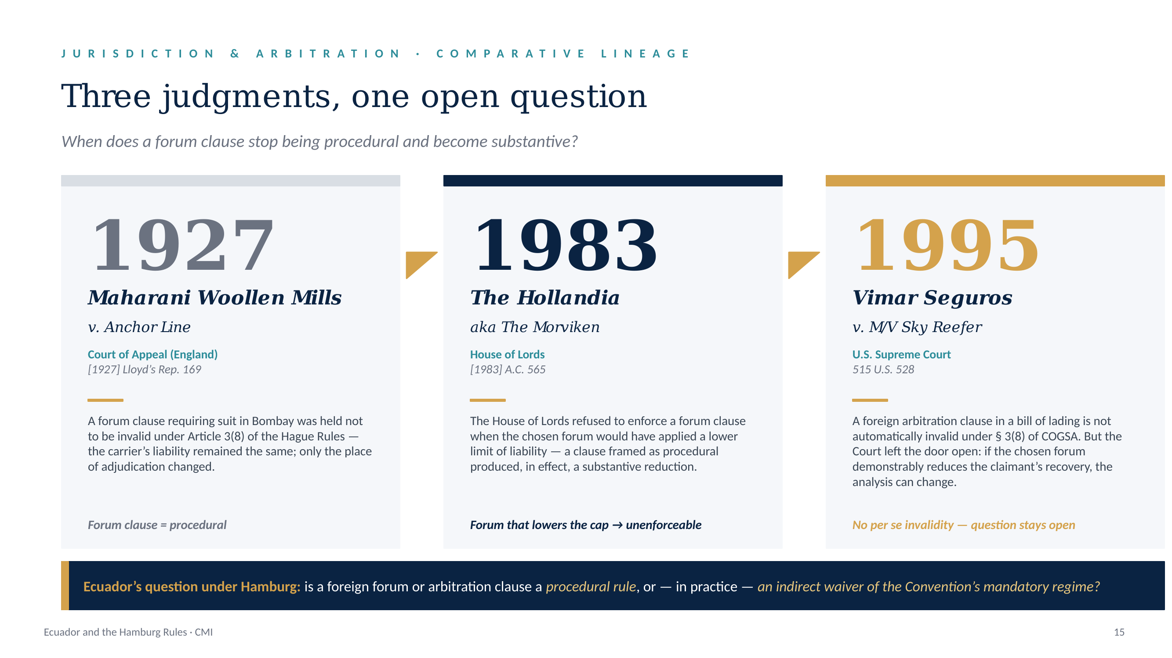

Slide 15
04
Early practical frictions
in an export-driven jurisdiction
DELAYS
Ecuador and the Hamburg Rules · CMI
13

Slide 16
OBSERVATION II
Delay matters — in a way Ecuador has not seen
Why cargo will press the recklessness doctrine
The structural inequality
Ecuadorian export trades:
  (shrimp, banana, tuna, flowers, cocoa)
Damage rarely manifests as physical loss.
Damage manifests as:
  Fall in commercial value through delay,
  Missed market windows,
  Breach of supply contracts with European retailers.
Consequential losses
in time-sensitive export trades
>
2.5 × freight cap
Article 6 limit on delay
Because those consequential losses will systematically exceed the 2.5× freight cap, cargo interests will reach for Article 8 (willful misconduct, or recklessness with knowledge of the probable result) far more often than in Hague jurisdictions.
That is where the recoverable money sits.
Outcome: pressure on Article 8.
Ecuador and the Hamburg Rules · CMI
15

Slide 17
OBSERVATION I
“
The first practical issue in Ecuador will not be doctrinal. It will be evidentiary.
The shift is from debating abstract liability rules to testing operational proof.
Vessel logs
Stowage plans
Temperature records
Port handling protocols
Surveyor reports
Ecuador and the Hamburg Rules · CMI
14

Slide 18
OBSERVATION III
“
The first implementation stage will be less about court decisions and more about contract paper catching up with the new mandatory regime.
Jurisdiction
Arbitration
Himalaya
Deck cargo
Ecuador and the Hamburg Rules · CMI
16

Slide 19
CLOSING
Ecuador will not offer this room new case law.
It will offer a transition laboratory.
Hamburg will make legally visible — in a mature export economy, half a century late, in an ecosystem still wearing Hague-Visby paper — a category of claims that until now were processed as commercial, logistical or insurance issues. Temperature excursions. Commercial degradation short of physical loss. Missed market windows. Short delivery without total loss. From 1 August, they will be litigated as breaches of an international uniform regime.
Worth watching for the next three years.
Ecuador and the Hamburg Rules · CMI
18

Slide 20
Thank you.
Questions, discussion, dissent — welcome.
Javier Cardoso
Comité Maritime International · 2026

