Slide 1

Wednesday, 13 May 2026
Parallel Session 2: United Nations Convention on Negotiable Cargo Documents
The NCD Convention-Background, Approach and Implications
José Angelo Estrella Faria

Slide 2
The NCD Convention-Background, Approach and Implications
  Introduction: Purpose of the NCD Convention
  The 2025 United Nations Convention on Negotiable Cargo Documents establishes a uniform legal framework governing the issuance and use of negotiable cargo documents (NCDs) — a new type of document of title, in paper or electronic form, that represents goods in transit, regardless of transport mode.
  The purpose of the Convention is to extend the benefits of negotiable documents beyond maritime transport.

Slide 3
The NCD Convention-Background, Approach and Implications
Background: Proposal by China
At the 52nd session of UNCITRAL in 2019, the Government of China presented a proposal on possible future work by UNCITRAL to develop a legal framework for railway consignment notes.
The proposal noted that:
  Unlike the ocean bill of lading, international railway consignment notes do not serve as a document of title and are not used for the settlement and financing of letters of credit.
  Although the UCP allows for the issuance of documentary credits against non-negotiable documents, many banks in various parts of the world still insisted on bills of lading, which hindered trade financing for land carriage.
5

Slide 4
The NCD Convention-Background, Approach and Implications
Background: Proposal by China
The proposal invited UNCITRAL to explore the possibility of “creating a rule on a bill of lading for one or more modes of transport, including railway, road and air, to achieve the goals of using a single bill, controlling the goods with the bill and taking delivery of goods with the bill, giving that new transport document the nature of a document of title in order to enable it to perform the financial settlement function.”
6

Slide 5
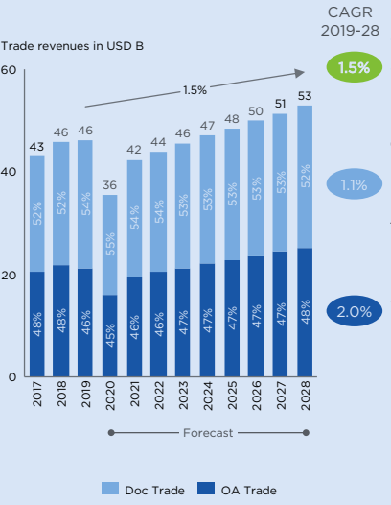
The NCD Convention-Background, Approach and Implications
Introduction: Structure of trade finance
Estimate share of documentary trade vs. open account (2011-2028)
Source: ICC Banking Commission, 2020 ICC Global Survey on Trade Finance
5

Slide 6
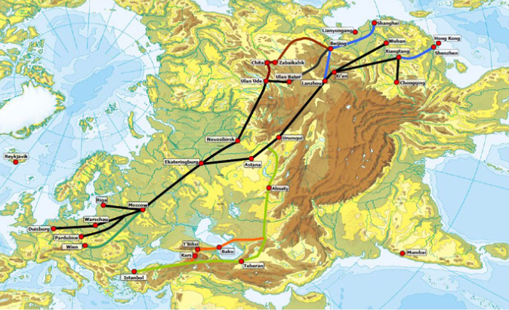
Introduction: Eurasian freights corridors between China and Europe
The NCD Convention-Background, Approach and Implications
Source: Global Railway Review (https://www.globalrailwayreview.com/article/80492/new-legal-regime-rail-freight/)
5

Slide 7
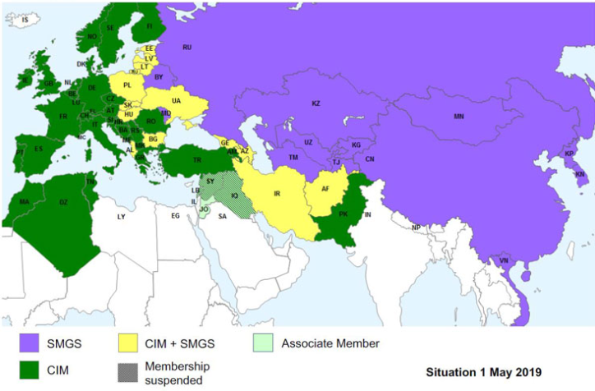
Introduction: International freight traffic regimes
The NCD Convention-Background, Approach and Implications
Source: Global Railway Review (https://www.globalrailwayreview.com/article/80492/new-legal-regime-rail-freight/)
5

Slide 8
The NCD Convention-Background, Approach and Implications
NCD Convention: Preparatory work
After informal consultations and preparatory work carried out by the secretariat, in 2022 UNCITRAL assigned the topic to Working Group VI.
The Working Group held seven sessions between December 2022 and December 2025.
Adopted by the UN General Assembly on 15 December 2025, the NCD convention will be opened for signature at a ceremony to be held in Accra in 2026.
The Convention will enter into force 180 days after the date of the deposit of the tenth instrument of ratification, acceptance, approval or accession.
7

Slide 9
The NCD Convention-Background, Approach and Implications
The “dual track” approach
From the outset there was agreement with the UNCITRAL secretariat proposal that
  “The document to be provided in the new instrument would not replace any of the transport documents that an actual carrier may be required to issue under the law (domestic or international) governing a specific segment of the international carriage in question.
  “… the new instrument would coexist and would not substantially affect the application of any international convention that governed the contract or contracts negotiated by the parties for the carriage in question or any part thereof, in particular the liability of the carrier for loss of or damage to the goods or for delay in their delivery.”
  (Note by the Secretariat, September 2022, A/CN.9/WG.VI/WP.96, para. 9)
5

Slide 10
The NCD Convention-Background, Approach and Implications
The “dual track” approach
There was further agreement that the “dual track” approach meant that the new Convention should only deal with the matters strictly necessary to enable the issuance and negotiation of NCDs:
  defining the nature of the document it covers;
  the minimum content of the document and how it is issued in both printed and electronic form;
  the evidentiary value of the document and its replacement (e.g., with an electronic record or vice-versa);
  the procedure for and effect of transfer of the document;
  the holder’s right of control of the goods, including the right to give or modify instructions with respect to the goods, to demand delivery of the goods upon presentation of the document or electronic record and to transfer title to the goods by transferring the document or transferring control of the electronic record.
  (Note by the Secretariat, September 2022, A/CN.9/WG.VI/WP.96, para.11)
5

Slide 11
The NCD Convention-Background, Approach and Implications
Structure of the NCD Convention
Chapter 1 – General provisions (Arts. 1–2)
Chapter 2 – Issuance/content/legal effect (Arts. 3–6)
Chapter 3 – Rights & liability of the holder (Arts. 7–11)
Chapter 4 – Special conditions for electronic NCDs (Arts. 12–18)
Chapter 5 – Final clauses (Arts. 19–27)
5

Slide 12
The NCD Convention-Background, Approach and Implications
Scope of application (Art. 1(1)): The NCD Convention applies to the issuance, transfer and legal effects of
  an NCD with a conspicuous reference to the Convention (“opt-in”) …
  … in connection with the international transport of goods by one or more than one mode of transport if
  If the NCD indicates that: (a) place of taking in charge (b) place of delivery; or (c) place of issuance is located in a State Party.
Excluded matters ((Art. 1(3)): The NCD Convention does not
  affect international/national rules on regulation and control of transport operations (Art. 1(2)); or
  modify rights and obligations of the transport operator, consignor or consignee or their liability under applicable international conventions or national law governing the transport contract, (except as otherwise provided).
5

Slide 13
The NCD Convention-Background, Approach and Implications
Definition of “Negotiable cargo document”:
Paper document or electronic record signed and issued by the transport operator indicating “to order/negotiable” (or equivalent) that goods have been taken in charge by the transport operator and consigned to the order of the holder (Art. 2 (5)).
Definition of “Transport operator”:
Person that concludes a transport contract with the consignor and that assumes responsibility for performance of the contract, irrespective of whether or not it performs the transport itself (Art. 2 (8)). This definition excludes freight forwarders acting as agents.
5
Notes:
Convention only governs “negotiable” cargo documents (i.e. NCD must state that it is “to order” or “negotiable” or contain an equivalent expression)

Slide 14
The NCD Convention-Background, Approach and Implications
Who will issue the NCD?
  Any transport operator acting as a contractual carrier (whether or not that person performs the carriage itself)
  This includes any rail/road/air carrier or freight forwarder who concludes a transport contract with the consignor and thus assumes responsibility for the performance of the contract.
How to issue an NCD (Art. 3(2))?
  Default rule - entering an annotation signed by the transport operator in each original of the transport document; or
  Fallback rule - as a separate document where no transport document has been issued or where a transport document has been issued and cancelled.
5
Notes:
Issuance of the NDC
Entirely based on party autonomy.
If agreed between the transport operator and the consignor, the transport operator shall issue an NCD, in the medium agreed upon, that contains a conspicuous reference to the Convention (Art. 3 (1)).
Definition of “Transport operator”:
Person that concludes a transport contract with the consignor and that assumes responsibility for performance of the contract, irrespective of whether or not it performs the transport itself (Art. 2 (8)). This definition excludes freight forwarders acting as agents.

Slide 15
The NCD Convention-Background, Approach and Implications
Content of the NCD
  Art. 4 contents requirement (similar to RR)
  Art. 5 (1): missing contents do not automatically invalidate the NCD, but missing contents may expose the transport operator to liability (Art. 5 (2)).
Evidentiary effect of NCDs
  Transport operator may qualify Art. 4(1)(c) information furnished by the consignor if it has actual knowledge/ reasonable grounds to believe that it is false/misleading, or no reasonable means of checking (Art. 6 (1)).
  Except to the extent qualified, NCD is prima facie evidence of the taking in charge of the goods by the transport operator as stated (Art. 6 (2)).
  If transferred to a third party acting in good faith in reliance on any of the information therein, proof to the contrary by the transport operator is not admissible against that third party (except to the extent qualified) (Art. 6 (3)).
5

Slide 16
The NCD Convention-Background, Approach and Implications
Negotiability of the NCD: Conditions and effect
  NCD may be made out to order or to the order of a named person. If the NCD fails to name the person, it is deemed to be made out to the order of the consignor (Art. 3 (6)).
  The rights provided for in the NCD can be exercised only by the holder, which shall include the right to demand delivery of the goods at destination (Art. 7(1)).
  A person other than the consignor that becomes a holder of the NCD acquires the right to bring a claim against the transport operator and, where applicable, the right of disposal under the transport contract, as well as those rights provided for in the law applicable to the transport contract, as if it were a party to that contract.
  The transport operator may not invoke against a holder that is not the consignor any terms of the transport contract that are inconsistent with the express terms of the negotiable cargo document (Art. 7(3)).
  The issuance and initial transfer of possession of the NCD, as well as any subsequent transfers, to the holder shall have the same effect, for the purpose of acquisition of rights to the goods, as the physical handing over of the goods (Arty. 7(4)).
5

Slide 17
The NCD Convention-Background, Approach and Implications
Negotiability of the NCD: Safeguards
  NCD can only be issued as a stand-alone document if no transport document has been issued or if it has been cancelled (no duplication of transport documents) (Art. 3 (2)(b)).
  The transport operator that issues a negotiable cargo document may not request the issuance of a negotiable transport document in respect of the goods to which the negotiable cargo document relates (Art. 3 (5).
  In order to exercise its rights, the holder must present the negotiable cargo document to the transport operator. If the negotiable cargo document states that more than one original has been issued, the holder shall present all originals to exercise the right of disposal (Art. 7(5)).
  Delivery of the goods may be demanded from the transport operator only against surrender of the NCD by the holder (Art. 10(1)).
5
Notes:
If more than one original of the negotiable cargo document has been issued, delivery
of the goods may be demanded against surrender of one original. If the negotiable cargo
document states that more than one original has been issued, the other originals will cease
to have any effect or validity after the surrender of one original.

Slide 18
The NCD Convention-Background, Approach and Implications
Interaction with existing liability regime
  The Convention focuses exclusively on the issuance and use of NCDs, rather than on the rights and obligations of the parties to the underlying transport contract.
  This approach helps ensure that the Convention does not interfere with existing legal regimes governing carrier liability under applicable transport law conventions or the domestic law governing the contract of carriage but instead complements and operates alongside these established frameworks.
Liability of NCD issuers
  Art. 1(3) provides that, except as otherwise provided for in the Convention, the Convention does not modify the rights and obligations of the transport operator, consignor or consignee or their liability under applicable international conventions and national laws governing transport contracts.
  Art. 5(2) clarifies that deficiencies in the NCD (missing mandatory particulars) may expose the NCD issuer to liability under applicable law, including applicable transport law convention or national law. Likewise, failure to comply with certain obligations (e.g., Art. 3(5) and Art. 8) may also expose the NCD issuer to liability under applicable law.
5

Slide 19
The NCD Convention-Background, Approach and Implications
Relationship to maritime carriage
Original proposal was to cover “all modes of transport in both unimodal and multimodal carriage of goods with or without a sea leg.”
(Note by the Secretariat, September 2022, A/CN.9/WG.VI/WP.96, para.12)
Working Group did not see a need to exclude international transport by sea “on the basis that multimodal transport might often include a sea leg even though not as the main leg” but noted that “the desirability of excluding international transport with a sea leg could be discussed at a later stage when discussing possible conflicts with other conventions.”
(WG, 43rd session (27 November–1 December 2023, A/CN.9/1164, para. 22 and 25)
5

Slide 20
The NCD Convention-Background, Approach and Implications
Relationship to maritime carriage
The Working Group revisited the issue in view of a specific proposal by the CMI to exclude maritime transport or negotiable transport documents recognized under applicable law
The Working Group maintained its view noting that:
  “Applying the convention to all modes of transport would provide freight forwarders, shippers and banks with the ability to opt for the solution to organize multimodal end-to-end or unimodal transportation as the circumstances required. The “opt in” nature of the convention was emphasized.
  “Furthermore, the difficulty in determining a “maritime” leg when negotiating the [Rotterdam Rules] was recalled. For banks, the convention provided a simple and straightforward regime to determine whether a document was a document of title. It was added that the negotiability of maritime bills of lading might be uncertain if issued in a jurisdiction which a bank was unfamiliar with.”
  (WG, 46th session (March 2025), A/CN.9/1205, para.13)
5
Notes:
CMI proposal (August 2024): exclude the application “in respect of any transport document issued pursuant to a transport contract that provides for carriage by sea, or to which any international convention on the carriage of goods wholly or partly by sea applies, and a negotiable cargo document shall not be issued in respect of goods so carried.” A/CN.9/WG.VI/WP.108 )

Slide 21
The NCD Convention-Background, Approach and Implications
Relationship to maritime carriage
UNCITRAL plenary session affirmed the Working Group’s decision when approving the draft NCD convention and noted that:
  “…the body of legal rules governing maritime bills of lading were not unified and that differences existed in the sources of rights under a maritime bill of lading among different jurisdictions”
  “… uncertainty existed as to the legal nature of maritime bills of lading, including with regard to the nature of “title” in the goods, and whether the holder had a direct right to sue the carrier to the exclusion of the consignor”;
  “…no concrete examples of conflict between the Hague Rules and the draft convention had been identified, which was a necessary precondition for entertaining a proposal to limit the convention’s scope”
  “… the legal characterization of transport documents issued for multimodal transport involving a maritime leg remained unclear under international conventions and national law.
  (UNCITRAL, 58th session (July 2025), A/80/17, paras.43 and 44)
5
Notes:
One suggestion was to exclude the maritime leg from the scope of application of the convention, given the longstanding practice of issuing negotiable bills of lading in respect of goods carried by sea, which were widely recognized as documents of title. It was emphasized that the well-established legal ecosystem for maritime bills of lading should not be disrupted by the convention. A concern was expressed that maritime carriers would receive less protection in case of the issuance of a negotiable cargo document (hereinafter “NCD”), rather than a maritime bill of lading.
Another suggestion was to limit the scope of application of the convention to documents that are not otherwise recognized by applicable law as negotiable transport documents. A concern was raised that annotating a maritime bill of lading to issue an NCD could cause confusion and ultimately jeopardize the legal status of the bill of lading as a document of title in a non-contracting State or invalidate the bill of lading.

Slide 22
The NCD Convention-Background, Approach and Implications
Relationship to maritime carriage: compromise solution
  A State may declare it will not apply the Convention to any negotiable transport document that evidences or contains a contract for the carriage of goods wholly by sea governed by an international convention to which it is a State Party (art. 24 (1)).
  Where a State Party makes a reservation, a document purporting to be an NCD may not produce the legal effects under the Convention in that State, but it may still have legal effect as a negotiable bill of lading under applicable law.
5

Slide 23
The NCD Convention-Background, Approach and Implications
Conclusions and outlook
The NCD Convention was primarily developed to extend the concept of “negotiable” documents of title beyond maritime transport to other modes of transport where negotiability did not exist.
It remains to be seen how the banking sector will react to the new convention and whether transport operators, including both freight forwarders and non-maritime carriers, will effectively use it.
The NCD Convention does not seem to conflict with the RR or existing maritime conventions or bill of lading statutes and assumes that, in principle, the issuance and transfer of NCD should not affect the rights and obligations of the transport operator, consignor and consignee under applicable international conventions or national law.
In particular, various references to the law governing the contract of transport make it clear that the nature and extend of the right of control, for instance, derives from the applicable convention or national law.
Given its limited scope, the NCD convention cannot replace either the RR or any of the existing unimodal conventions, but could supplement them, in particular the CMR or CIM-COTIF.

