Slide 1
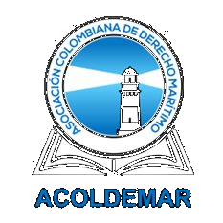

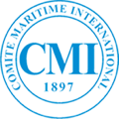

Colombia and
International Maritime Law:
Achievements and
the Road Ahead.
SPEAKER
EVENT
Elizabeth Salas Jiménez
CMI Colloquium
Founding Partner, Salas Law Group
Current Board Member and Past President (2017-2021; 2024-2026), Colombian Maritime Law Association (ACOLDEMAR)
Rio de Janeiro · 13 May 2026

Slide 2
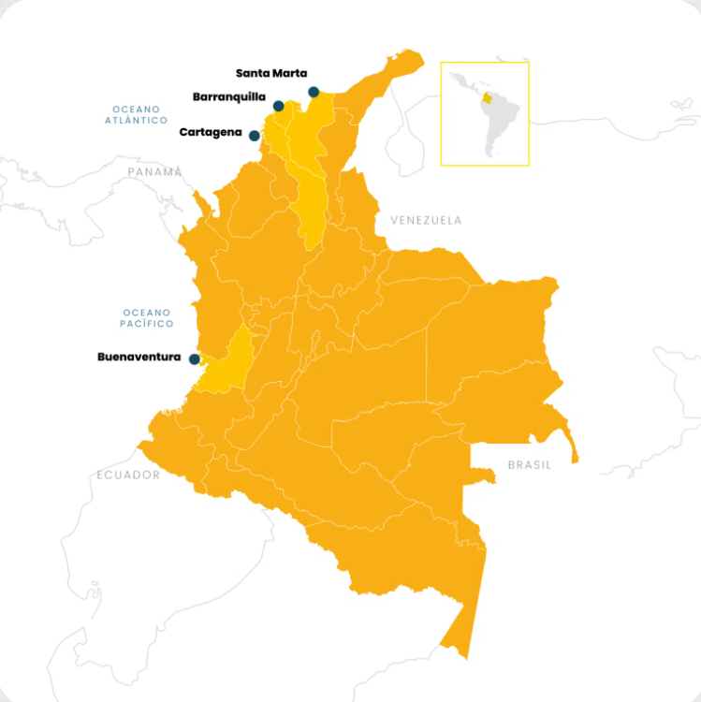
Colombia's geostrategic position
as a two-ocean coastal State
REGULATORY FRAMEWORK
Maritime safety
Protection of human life at sea, vessel certification, and operational integrity.
Port efficiency
Modern infrastructure and harmonized standards as enablers of competitive trade.
Protection of marine resources
Pollution prevention, biodiversity safeguards, and environmental responsibility.
2 / 6

Slide 3
Pillars of compliance
Strategic achievements in the Colombian maritime sector
01
02
03
Safety and human life at sea
Pollution prevention and control
The human element
SOLAS implementation
MARPOL and BWM compliance
STCW Convention
Law 2419 of 2024
Law 2362 of 2024
Continuous alignment
Adoption of the 1988 SOLAS/Load Lines Protocol, harmonizing survey and certification regimes to strengthen operational safety.
Adoption of the Ballast Water Management Convention, addressing the introduction of invasive species and protecting Colombia's marine biodiversity.
Reinforced implementation of the STCW framework, aligning Colombian seafarer training and certification with global competency standards.
3 / 6

Slide 4
Strategic benefits
The value of international alignment for Colombia
01
02
03
Legal certainty
Economic impact
Insurance and P&I coverage
A predictable, internationally aligned framework that reduces transactional risk for shipowners, operators, and Colombian counterparties.
Lower logistical costs, enhanced port competitiveness, and a stronger value proposition for Colombian exports across both oceans.
Greater alignment with international liability and limitation regimes provides clarity for underwriters and ensures more robust risk allocation.
04
05
Dispute resolution
A stronger global community
Convergence with global standards facilitates the use of arbitration and specialized maritime fora, reinforcing Colombia as a credible jurisdiction.
Active engagement allows Colombia to contribute regional perspective and experience to the development of international maritime law.
4 / 6

Slide 5
The road ahead
A proactive agenda for ratification and modernization
PENDING RATIFICATIONS
BEYOND RATIFICATIONS
Bunkers Convention
Colombian Maritime Code
International Convention on Civil Liability for Bunker Oil Pollution Damage, 2001
MARPOL Annex VI
Completion of the unified maritime code, modernizing a regulatory framework still rooted in pre-1991 legislation.
Regulations for the Prevention of Air Pollution from Ships
Nairobi Convention
Regional articulation
International Convention on the Removal of Wrecks, 2007
London Convention / Protocol
Stronger coordination across Latin America to harmonize positions and amplify regional voice in international fora.
Prevention of marine pollution by dumping of wastes, 1972 / 1996
HNS Convention
Balance between public and private international law
Liability for hazardous and noxious substances by sea, 2010 Protocol
The roadmap should transcend public international law by integrating private international law conventions.
5 / 6

Slide 6
Conclusion
Effective implementation of this agenda is a strategic investment for Colombia and a clear signal of legal certainty to the global market.
A nation that ratifies is a nation that competes.
We reduce logistical costs, attract top-tier investment, and ensure our ports operate as secure and efficient nodes in world trade.
Muito obrigada!

