Slide 1
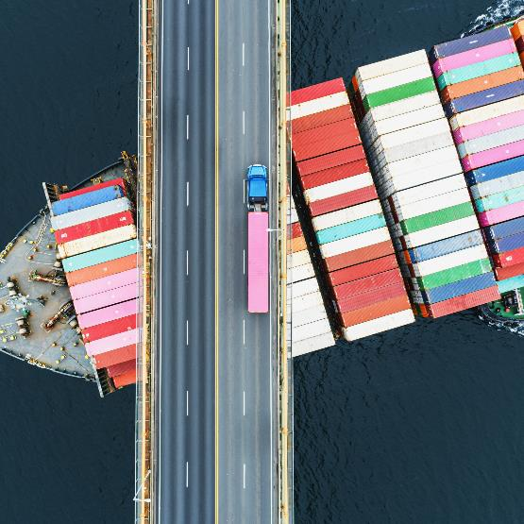
Overcoming the dichotomy of substantive and procedural aspects:
The jurisdiction rules under a new collision convention
Prof. Dr. Dieter Schwampe

Slide 2
The 1910 Collision Convention and its rules on Jurisdiction
International Convention for the Unification of Certain Rules of Law with respect to Collision between Vessels, Brussels, 23 September 1910
Rules on jurisdiction:
None

Slide 3
The 1910 Collision Convention, the 1952 Jurisdiction Convention and the rio draft 1977
International Convention for the Unification of Certain Rules of Law with respect to Collision between Vessels, Brussels, 23 September 1910
83 ratifications
International Convention on Certain Rules concerning Civil Jurisdiction in Matters of Collision, Brussels, 10 May 1952
35 ratifications
“Missing” states: Australia, Brazil, Canada, China, Denmark, Finland, India, Japan, Latvia, Malta, Mexico, Netherlands, New Zealand, Norway, Russia, Singapore, Sweden, Turkey, Uruguay
Rio Draft 1977

Slide 4
The Draft Protocol
Jurisdiction dealt with in Art. 9.3 Draft Protocol
Modelled after the Rio Draft
Provisions on
available jurisdictions
Conflicting proceedings

Slide 5
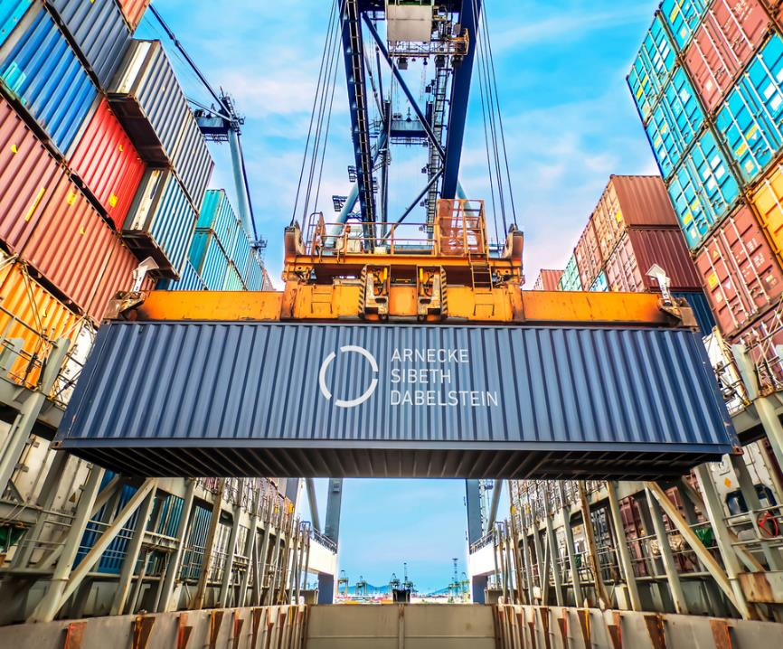
Available jurisdictions
Art. 9.3 as against the 1952 Convention and the Rio Draft

Slide 6
Art. 9.3 Draft Protocol and the 1952 Jurisdction convention
Protocol 1952 Jurisdiction convention
Unless the parties agree or have otherwise agreed,
actions on the merits of a collision shall be brought by a claimant in a court of a State Party to this convention
Art. 2:
The provision of Article 1 shall not in any way prejudice the right of the parties to bring an action in respect of a collision before a Court they have chosen by agreement or to refer it to arbitration.
Art. 1 (1)
An action for collision … can only be introduced

Slide 7
Art. 9.3 Draft Protocol and the 1952 Jurisdction convention
Protocol Rio draft 1977
Unless the parties agree or have otherwise agreed,
actions on the merits of a collision shall be brought by a claimant in a court of a State Party to this convention
Art. 2 (1):
Unless the parties otherwise agree,
the plaintiff may prosecute such an action only in a Court of a State Party to this Convention

Slide 8
Art. 9.3 Draft Protocol and the 1952 Jurisidction convention
Protocol 1952 Jurisdiction convention
where the defendant has his habitual residence or domicile, statutory seat, central administration or principal place of business;
Art. 1 (1) (a):
either before the Court where the defendant has his habitual residence or a place of business

Slide 9
Art. 9.3 Draft Protocol and the 1952 Jurisidction convention
Protocol Rio draft 1977
where the defendant has his habitual residence or domicile, statutory seat, central administration or principal place of business;
Art. 1 (1) (a):
where the defendant has his habitual residence or domicile, or principal place of business;

Slide 10
Art. 9.3 Draft Protocol and the 1952 Jurisidction convention
Protocol 1952 Jurisdiction convention
where the collision has occurred, provided that it occurred in the internal waters or territorial waters of that State
Art. 1 (1) (c)
or before the Court of the place of collision when the collision has occurred within the limits of a port or in inland waters.

Slide 11
Art. 9.3 Draft Protocol and the 1952 Jurisidction convention
Protocol Rio draft 1977
where the collision has occurred, provided that it occurred in the internal waters or territorial waters of that State
Art. 1 (1) (b):
in the internal waters or territorial sea of which the collision has occurred

Slide 12
Art. 9.3 Draft Protocol and the 1952 Jurisidction convention
Protocol Rio draft 1977
where a vessel involved in the collision or another vessel owned by the owner of the vessel has been arrested and the arrest has not been challenged or, if challenged, has been uphold, or where the arrest has been lifted by the provision of security
Art. 1 (1) (c):
where a vessel involved in the collision (other than the plaintiff's own vessel) or a vessel under the same ownership lawfully subject to arrest, has been arrested or security has been provided to avoid arrest on account of the collision

Slide 13
Art. 9.3 Draft Protocol and the 1952 Jurisidction convention
Protocol 1952 Jurisdiction convention
where a vessel involved in the collision or another vessel owned by the owner of the vessel has been arrested and the arrest has not been challenged or, if challenged, has been uphold, or where the arrest has been lifted by the provision of security;
Art. 1 (1) (b):
or before the Court of the place where arrest has been effected of the defendant ship or of any other ship belonging to the defendant which can be lawfully arrested, or where arrest could have been effected and bail or other security has been furnished

Slide 14
Art. 9.3 Draft Protocol and the 1952 Jurisidction convention
Protocol 1952 Jurisdiction convention
where a limitation fund has been properly constituted by the defendant in accordance with the law of that State on account of the collision.
xxx

Slide 15
Art. 9.3 Draft Protocol and the 1952 Jurisidction convention
Protocol Rio draft 1977
where a limitation fund has been properly constituted by the defendant in accordance with the law of that State on account of the collision.
Art. 2 (1) (e)
where a limitation fund has been properly constituted by the defendant in accordance with the law of that State on account of the collision.

Slide 16
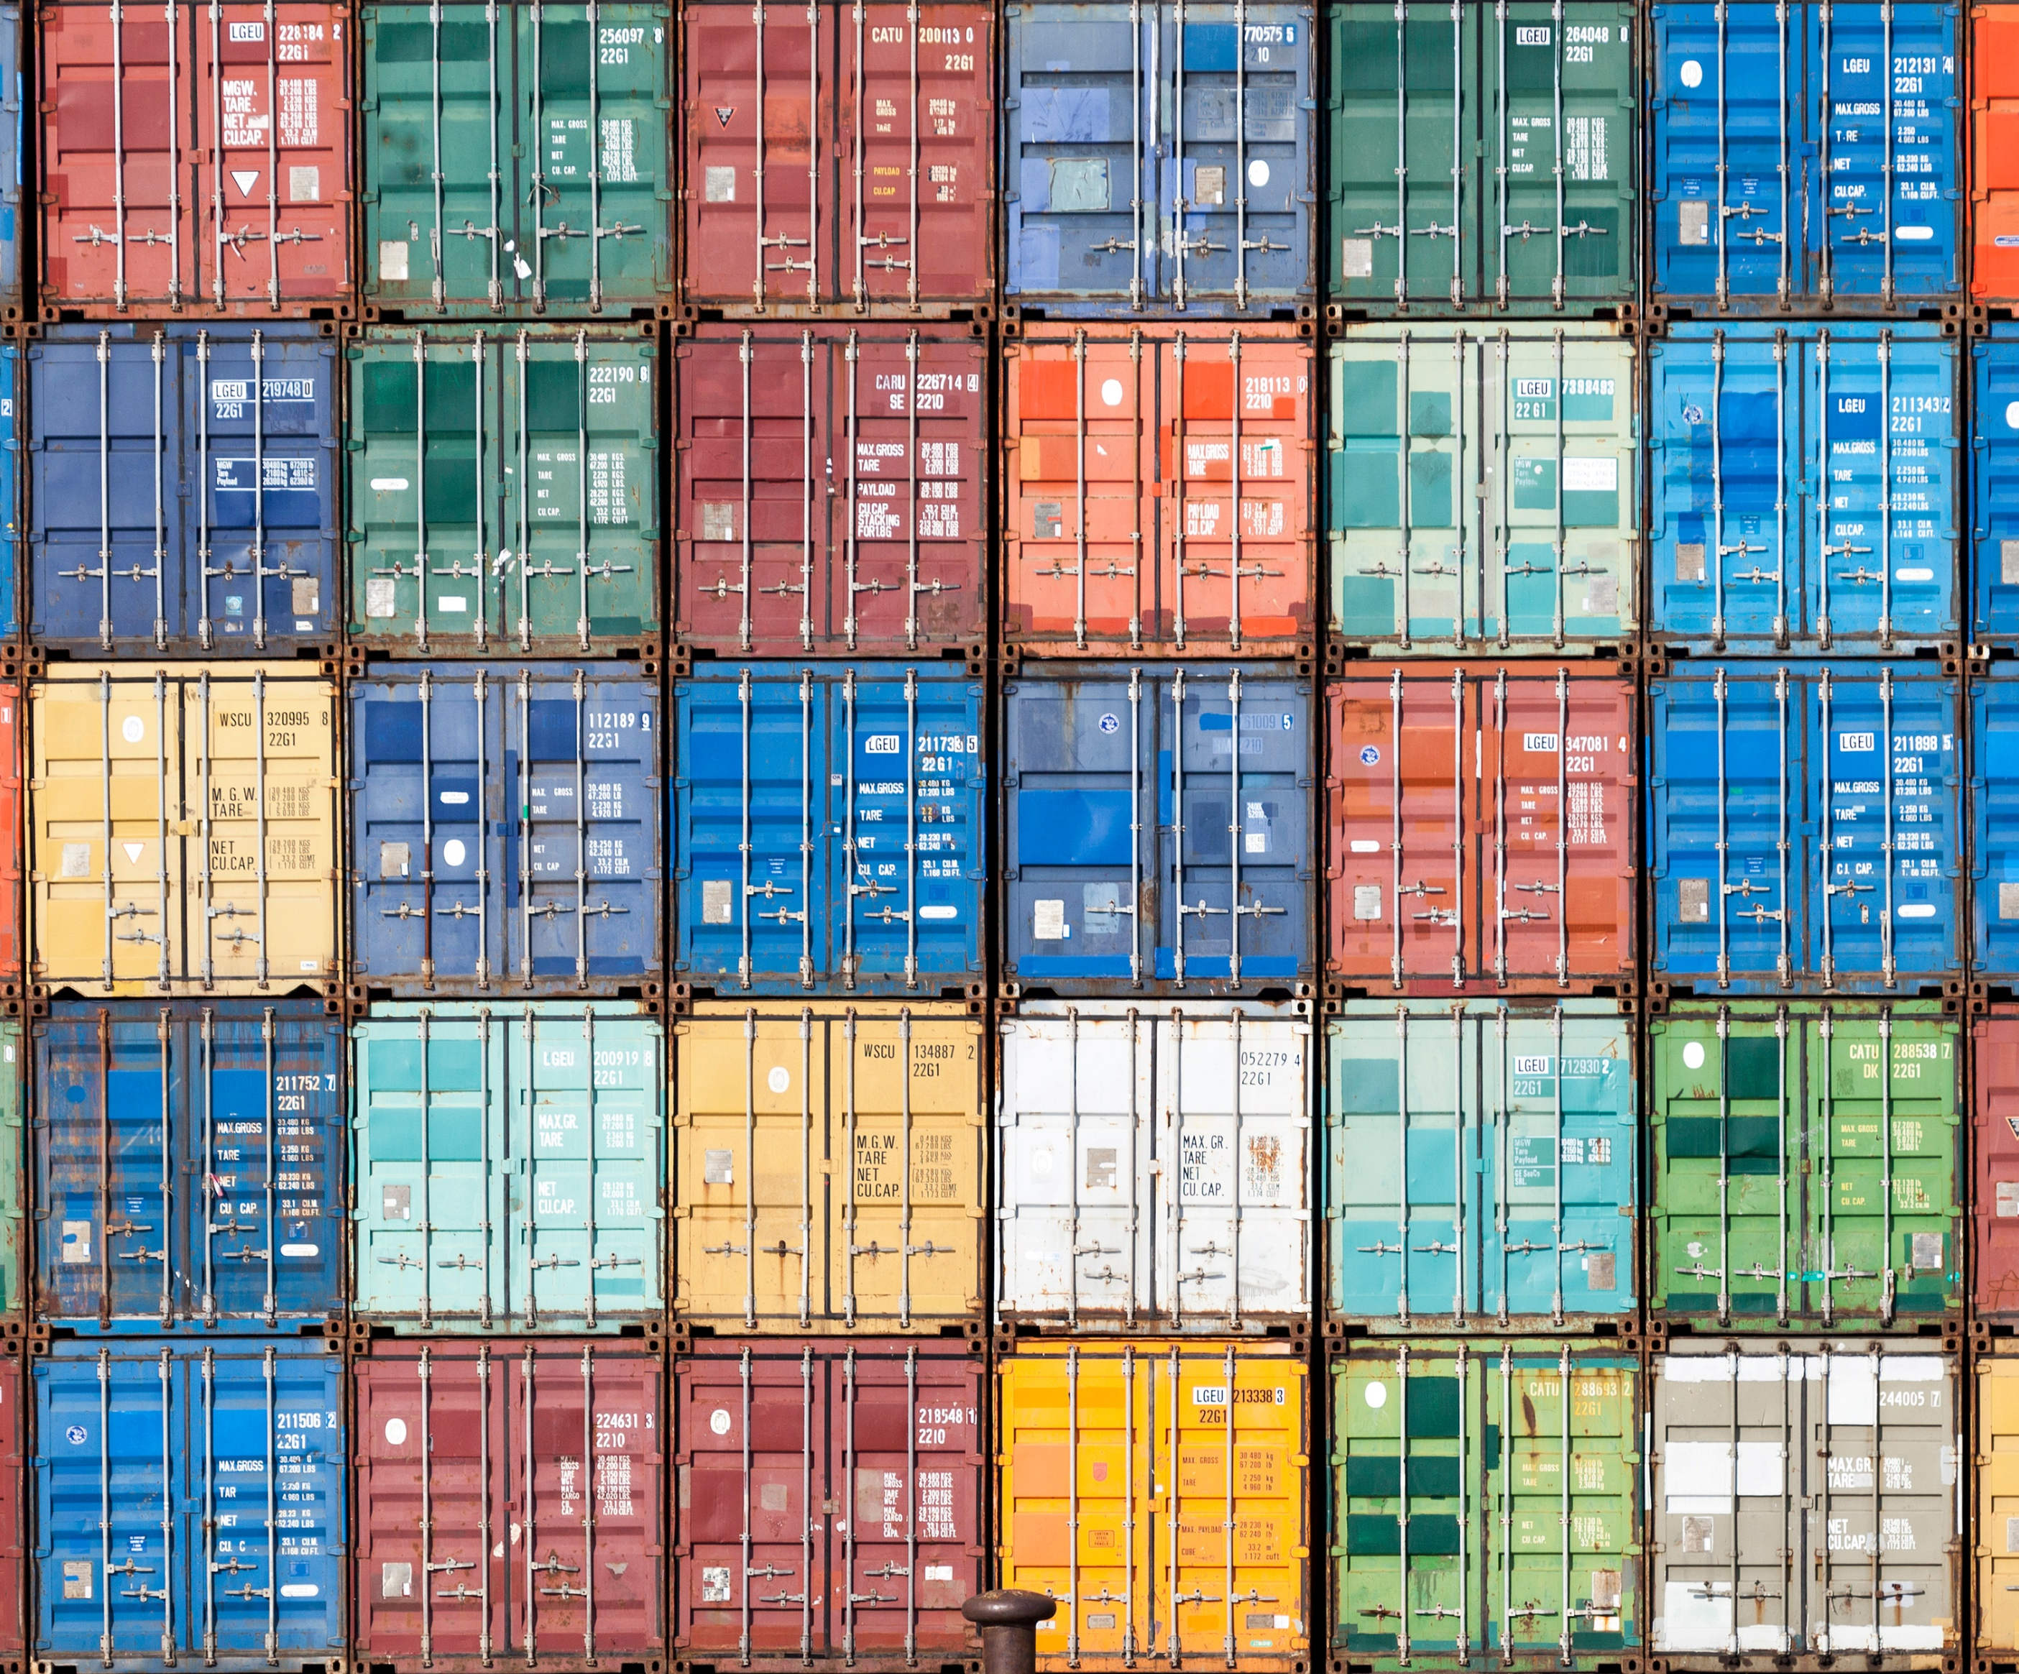
Conflicting proceedings

Slide 17
Art. 9.3 Draft Protocol and the 1952 Jurisidction convention
Protocol 1952 Jurisdiction convention
If an action on the merits of a collision is pending before a court of a State Party,
(a) any action, whether by counterclaim, subrogation, recourse or otherwise relating to damages caused by the collision, which could reasonably risk leading to contradictory judgments if heard separately, may be brought before that court
xxx

Slide 18
Art. 9.3 Draft Protocol and the 1952 Jurisidction convention
Protocol Rio draft 1977
If an action on the merits of a collision is pending before a court of a State Party,
(a) any action, whether by counterclaim, subrogation, recourse or otherwise relating to damages caused by the collision, which could reasonably risk leading to contradictory judgments if heard separately, may be brought before that court
Art. 3
In the event of there being more than one claim to which this Convention applies arising out of the same collision,
action on any such claim, whether by counterclaim or otherwise, may be brought against any party or parties to the proceedings before the Court seized of the original action

Slide 19
Art. 9.3 Draft Protocol and the 1952 Jurisidction convention
Protocol 1952 Jurisdiction convention
If an action on the merits of a collision is pending before a court of a State Party,
any further action brought in another State Party to recover the same damage shall be stayed unless and until the previous action has been discontinued, or, if the court so permits, stayed.
Art. 1 (3)
A claimant shall not be allowed to bring a further action against the same defendant on the same facts in another jurisdiction, without discontinuing an action already instituted

Slide 20
Art. 9.3 Draft Protocol and the 1952 Jurisidction convention
Protocol Rio draft 1977
If an action on the merits of a collision is pending before a court of a State Party,
any further action brought in another State Party to recover the same damage shall be stayed unless and until the previous action has been discontinued, or, if the court so permits, stayed.
Art. 1 (2)
If an action is pending in one State Party,
any further action brought in another State Party by the same plaintiff against the same defendant to recover for the same damage shall be stayed unless and until the previous action has been discontinued, or, if the Court so permits, stayed.

Slide 21

Art. 9.3 Draft Protocol and the 1952 Jurisidction convention

Slide 22

Dieter Schwampe
Große Elbstr. 36
22767 Hamburg
d.schwampe@asd-law.com

Slide 23

  FRANKFURT
  Güterplatz 1
  60327 Frankfurt am Main
  Germany
  HAMBURG
  Große Elbstraße 36
  22767 Hamburg
  Germany
  LEER
  Am alten Handelshafen 3A
  26789 Leer
  Germany
  BERLIN
  Kurfürstendamm 54/55
  10707 Berlin
  Germany
  MÜNCHEN
  Prinzregentenstraße 20
  80538 München
  Germany
  DRESDEN
  Am Brauhaus 1
  01099 Dresden
  Germany

