Slide 1
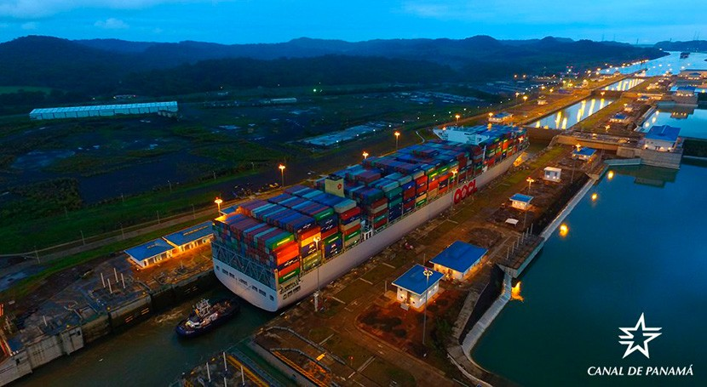
Panama’s ratification of the Convention on the International Effects of Judicial Sales of Ships
Joaquín de Obarrio
jdeobarrio@pmalawyers.com

Slide 2

Ratification Process
Panama ratified the United Nations Convention on the International Effects of Judicial Sales of Ships (Beijing Convention) on 19 March 2026.
Ratification followed Panama’s signature in early March 2025 and approval into Law 490 of 15 October 2025.
The instrument of ratification was deposited with the United Nations on 19 March 2026.
The Convention will enter into force for Panama on 15 September 2026.
Panama becomes the fourth State Party to the Convention.

Slide 3
Importance for Panama
Panama operates the largest ship registry in the World.
The Convention enhances legal certainty by ensuring that:
  Judicial sales conducted in Panama produce internationally recognized clean title.
  Vessels are sold free of prior liens and encumbrances.
Expected benefits include:
  Increased confidence among investors and lenders.
  Higher sale values in judicial sale proceedings.
Strengthening Panama’s position as a leading maritime jurisdiction.

Slide 4
Next Steps for Implementation
Alignment of domestic legislation and judicial practice with the Convention.
Development of procedures for:
  Issuance of certificates of judicial sale.
  Notice to affected parties in accordance with the Convention.
Operational coordination with the IMO GISIS repository as the international notice and certification platform.
Guidance and training for:
  Courts and Maritime authorities
  Maritime practitioners
Preparations to be completed ahead of the Convention’s entry into force.

