Slide 1


The Feasibility of an International Regime
for Security Interests in Shipping Containers
as distinguished from Security Interests in Ships
Panel Security Interests Containers – CMI Colloquium Rio 2026
Thursday, 14 May 2026
Dr. Warren de Waegh
Senior Lecturer
Shipping Law Unit
Commercial Law Department

Slide 2

Outline
Interface with security interests in ships
Uniform law on security interests in ships
Scope of protection
Characterisation and conflict of laws
Conclusion

Slide 3
1. Interface with security interests in ships
Mobile and elusive assets
High-value collateral for creditors
Impact of insolvency of ship operator
→ Special security interests
to extract high value from collateral despite mobile and elusive nature:
Maritime liens and mortgages on ships
vs
Lease and possessory liens on containers

Slide 4
2. Uniform law on security interests in ships
Consecutive CMI attempts to create a uniform framework on maritime liens and mortgages
  1926 MLM Convention: still in force in 22 countries
  1967 MLM Convention: never entered into force
  1993 MLM Convention: still in force in 21 countries
Also of relevance…
  1965 Geneva Convention on the registration of inland navigation vessels (Protocol 1)
  1986 UN Convention on Conditions for Registration of Ships
  2001 Cape Town Convention on International Interests in Mobile Equipment
→ Lack of international uniformity

Slide 5
3. Scope of protection: protected claims
International divergence on security interests in ships:
  Which claims receive maritime lien status?
    English law: minimal approach
    see Privy Council decision in The Bold Buccleugh (1851) 13 E.R. 884)
    vs.
    US law: generous approach including necessaries lien
    see 46 USC §31342(a) and §31301(4)
  Priority ranking?
  International consensus on
  ranking damage maritime lien over ship mortgages
  e.g. Art. 4, 1. (e) 1993 MLM Convention
  vs.
  Ranking damage maritime lien below ship mortgages under Dutch law
  Art. 8:217, 1. b) Dutch Civil Code

Slide 6
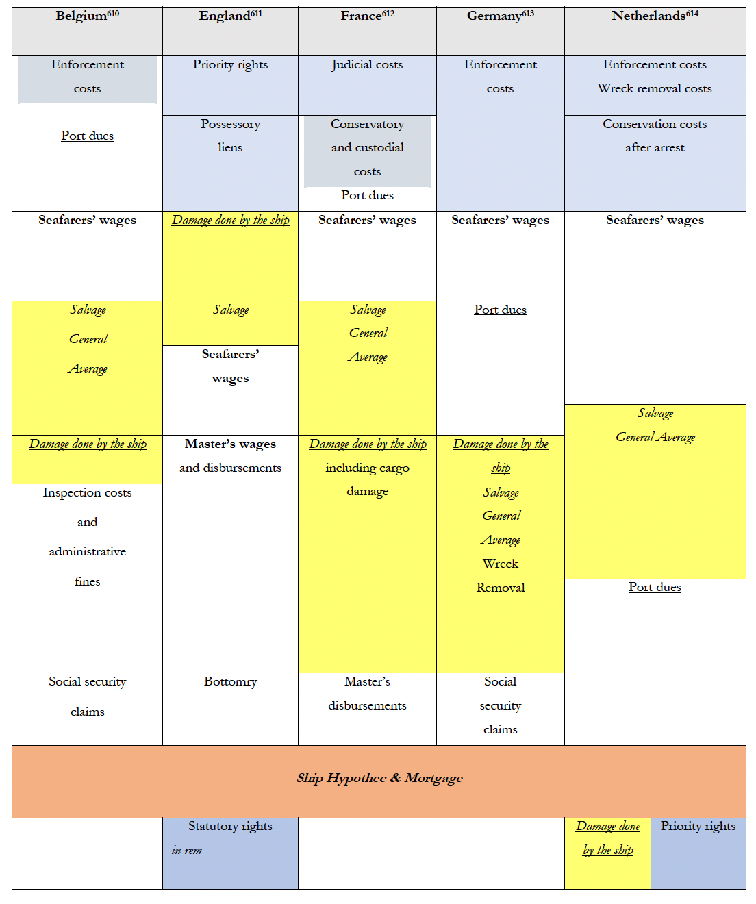

Slide 7
3. Scope of protection: protected claims
International divergence on security interests on ships:
  Which claims receive maritime lien status?
Lease and possessory lien on containers
widely recognised across legal systems
Exact scope of protection and formalities can vary
  Priority ranking?
De facto priority of possessory liens
Safeguards for abusive exercise of possessory lien?

Slide 8
3. Scope of protection: registration
No registration of maritime liens
  US Supreme Court in The Yankee Blade 60 US 82, 19 How 82 (1856):
  “But this privilege or lien, though adhering to the vessel, is a secret one ;- it may operate to the prejudice of general creditors and purchasers-without notice”
  Optional registration in some jurisdictions
  Art. 8:215, para 2 Dutch Civil Code
  US Code of Federal Regulations, Title 46, §67.217 (b) (3)
Tension between Cape Town regime built on
international registry
and secret maritime liens

Slide 9
3. Scope of protection: registration
Ship mortgages registered in national registries
  Following ship registry
  Often in offshore open registries
  Prompted by ship financiers
Cape Town regime built on international registry:
affects revenue stream for national (open) registries
and
limits available options for ship financiers and shipowners

Slide 10
3. Scope of protection: registration
No registration for maritime liens
Ship mortgages registered in national registries
Possessory lien not registered
→ Possession creates proprietary right
International diversity
on registration of title of lessors / retention of title
→ Feasibility of international registry because of:
  International consensus on key features
  Existence of BIC international registration of containers
  Exact role and function of international register?

Slide 11
4. Characterisation and conflict of laws
International differences in characterisation:
Civil law ship hypothec = limited proprietary right
vs.
  Common law ship mortgage = title to the ship
  Broader enforcement options for ship mortgages
Maritime liens = strong proprietary claims to the ship
but internationally diverging characterisation
Proprietary right, personal rights or procedural rights
Impact on enforcement in insolvency:
Only proprietary maritime liens protected

Slide 12
4. Characterisation and conflict of laws
International differences in conflict of laws:
  Ship hypothecs and mortgages: lex registrationis
    Reference to variety of domestic laws depending on registration
  Maritime liens = international variety of conflict rules
  → Following diverging characterisation
  → Following diverging policy objectives to recognize foreign liens
      Lex fori (e.g. Privy Council in The Halcyon Isle [1981] AC 221)
      Lex registrationis (e.g. Art. 2.2.5.1. §1 Belgian Shipping Code)
      Lex causae (e.g. Art. 45(2) German Introductory Act to Civil Code)
      Combined approach (see e.g. Art. 10:160 Dutch Civil Code)

Slide 13
4. Characterisation and conflict of laws
Relative international consensus on characterisation:
  Lessor retains ownership, while lessee is granted right of use
    Barring recharacterization
  Possessory lien = proprietary right to keep asset in possession for unpaid claims
  → Scope of protection / protection against abuse?
Relative international consensus on conflict of laws:
  For proprietary rights lex rei sitae is decisive
  Contractual dimension = lex causae / chosen law
  In case of international registry:
  → Uniform lex registrationis?
  → Reference to the applicable domestic system?

Slide 14
5. Conclusion
Legal certainty calls for uniform regime
Uniform regime security interests in containers more feasible than equivalent for ships
Potential for the Cape Town Convention: feasibility of international registry
Exact function of international registry?
Monitor developments in cross-border insolvency law:
  2027 revision of European Insolvency Regulation
  Draft UNCITRAL Model Law on Applicable Law in Insolvency

Slide 15
Thank you for your attention!
warren.dewaegh@uct.ac.za

