Slide 1

The Hidrovía Paraguay - Paraná

Slide 2
The Hidrovía: Final question
1
Is the Hidrovía a river?
2
Is the Hidrovía a waterway?
3
Is it important?
4
Is it a treaty?
5
Which countries are members of the treaty of the Hidrovía?
6
How is the treaty structured?
7
Is it a corporation?
8
Is it a legal system?
9
Are there problems with the waterway and also with the bidding process?

Slide 3
9. Are there problems with the waterway ?

Slide 4
9. Level Playing Field — Art. 7

Slide 5
9. Level Playing Field — Art. 7
“Countries party to the treaty should
create a level playing field, …..promote free market, cost reduction, and increased competitiveness.”
Real situation:
most vessels of the Hidrovía are registered in Paraguay
(lower labor, tax and social costs)

Slide 6
Fuente: C.P.T.C.P.
(Comisión Permanente de Transporte de la Cuenca del Plata)
NUMBER OF VESSELS FLYING PARAGUAYAN ARGENTINEAN BRAZILEAN AND BOLIVIAN FLAGS – YEARS: 2010-2011-2012
Tugs: 107
Tankers: 5
Bandera Cantidad
Brasil 2
Bolivia 5
Argentina 6
Paraguay 94
Bandera Cantidad
Argentina 1
Paraguay 1
Other: 30
Barges: 1780
Bandera Cantidad
Bolivia 1
Argentina 2
Paraguay 27
BanderaCantidad
Paraguay 1.397
Argentina 235
Bolivia 114
Brasil 22
Uruguay 12

Slide 7
9. Are there problems with the bidding process?
The National Port and Transport Agency of Argentina (ANPyN)
calls for a NATIONAL and INTERNATIONAL PUBLIC TENDER (No. 1/2025)
10 / 30

Slide 8
9.The bidding controversy
for the
  signaling and
  dredging
of the waterway
under concession regime
10 / 30

Slide 9
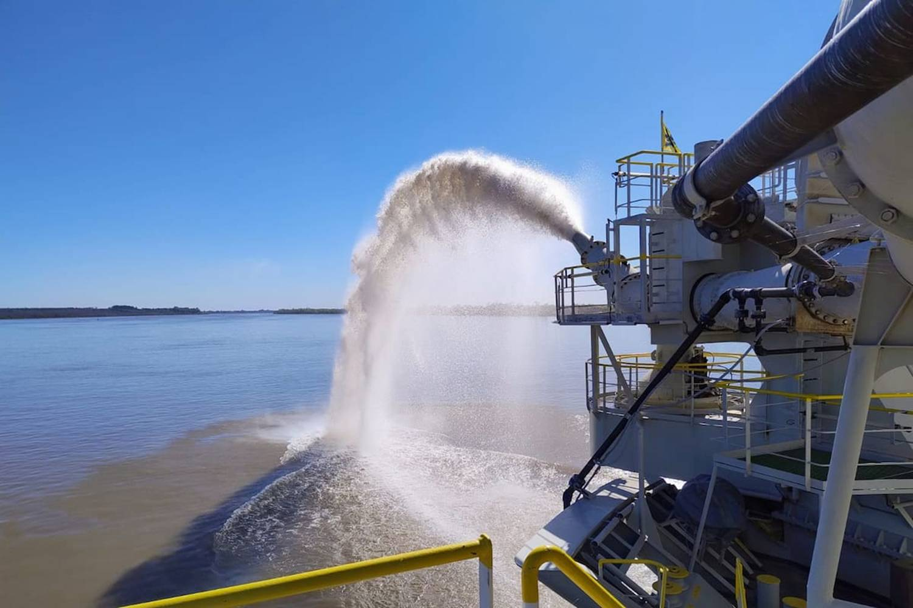
9. Dredge
10 / 30

Slide 10
9.Extension of the concession
Geographical extent
from
km 1238 of the Paraná River (Confluencia)
to km 239.1 of the Punta Indio Channel RIO DE LA PLATA
(includes Ingeniero Emilio Mitre Channel
Paraná de las Palmas, Bravo, Guazú)
Duration: 25 years

Slide 11
9.The bidding controversy
10 billion dollar business
in 25 years
10 / 30

Slide 12
9.The concession will increase the draft (toll per ton)
 | Depth | Minimum | Maximum
Stage 0 |  | USD 3,80 per t. | USD 4,20 per t.
Stage 1 | 36 feet | USD 4,65 per t. | USD 5,05 per t.
Stage 2 | 40 feet | USD 5,78 per t. | USD 6,18 per t.
Today |  | USD 4,30 per t.
10 / 30

Slide 13
9. Savings from greater draft for Panamax vessels
The savings from greater draft for
Panamax vessels to avoid top-off or intermediate stops
is about $54 billion (by 2035)
10 / 30

Slide 14
9.The bidding controversy
BID CONDITIONS | CRITICISM | OFFICIAL ANSWER
Bid restricted to bidders owning 6 dredgers built after 1994 | Limits the offer | Ensures solvency
Requires 15 million cubic meters dredged since 2016 with own equipment | Limits the offer | Ensures experience
State owned companies are excluded | Limits the offer | Prevents foreign countries control
Bid imposes a minimum and maximum rate to bidders | Does not lower costs | Prevents future insolvency
10 / 30

Slide 15
Summary
1
The Hidrovía is a waterway, a treaty, a corporation, and a legal system
2
Freedom of navigation (Art. 4) applies to all flags together with NATIONAL and REGIONAL CARGO RESERVATION
3
The 1910 Brussels Convention on collisions and the COLREG applies to the Hidrovía
4
The dredging concession controversy illustrates the tension between art. 7 (equal opportunity) and bidding requirements
5
Paraguay’s dominance in registered fleet (tugs, tankers and barges) makes it the key operational player — highlighting the need for common standards

Slide 16
“Ratification of International Conventions and Operation of Regional Navigation Agreements by Latin American Countries
Dr. Diego Esteban Chami
President of the Argentine MLA

