Slide 1
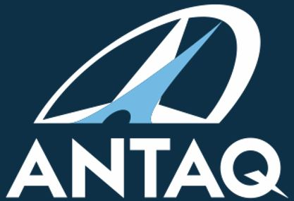
The Brazilian National Waterway Transportation Agency (ANTAQ) and the Energy Transition Framework
Uirá Cavalcante Oliveira
Superintendent of ESG and Innovation
CMI Rio Colloquium
12-15 May 2026
National Waterway Transportation Agency
ANTAQ.oficial
@antaq_oficial
CanalANTAQ
Linkedin.com/company/antaq
@ANTAQ_oficial

Slide 2




National Waterway Transportation Agency - ANTAQ
An Independent Authority of the Federal Administration
Supervise, inspect and regulate
Created by Federal Law 10,233/2001
Linked to the Ministry of Ports and Airports
Shipping Services
Port Infrastructure
Mission: Guarantee to the Brazilian society adequate provision of waterway transportation services and exploitation of ports and waterway infrastructures, ensuring competitive conditions and harmonizing public and private interests.
www.gov.br/antaq
Notes:
a navegação fluvial, lacustre, de travessia, de apoio marítimo, de apoio portuário, de cabotagem e de longo curso;

Slide 3
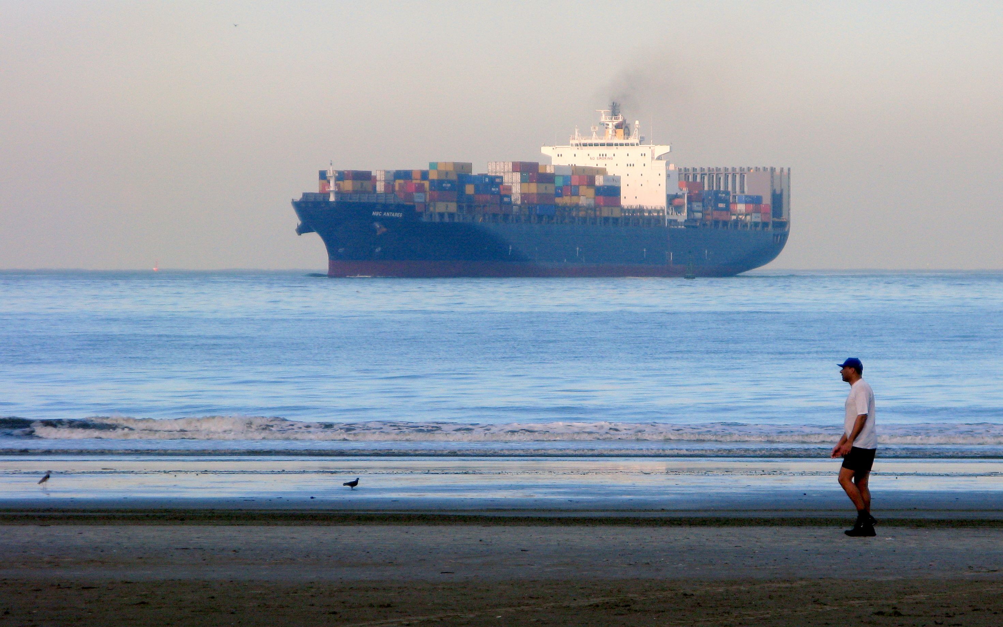
National Waterway Transportation Agency - ANTAQ
    Law nº 10.233/2001
    Art. 11: The management of infrastructure and the operation of waterway and land transportation shall be governed by the following general principles:
    V - making transport compatible with preserving the environment, reducing levels of noise pollution and contamination of the air, soil and water resources;
    Art. 12 - The general guidelines for managing the infrastructure and operation of waterway and land transportation are:
    V - promote the adoption of appropriate practices for the conservation and rational use of fuels and the preservation of the environment;
www.gov.br/antaq
Notes:
a navegação fluvial, lacustre, de travessia, de apoio marítimo, de apoio portuário, de cabotagem e de longo curso;

Slide 4

ANTAQ's Environmental and Safety Agenda
    Presents socio-environmental projects and actions prioritized by the Agency for the subsequent two-year period, with the aim of:
      Improve the development and sustainable use of the port areas;
      Increase adherence to good practices and compliance to environmental regulations applicable to the port and shipping sectors;
      Improve the evaluation and monitoring of the environmental performance of ports;
      Adopt indicators the Sustainable Development Goals (SDG) of the United Nations (UN) 2030 Agenda.
www.gov.br/antaq
Notes:
a navegação fluvial, lacustre, de travessia, de apoio marítimo, de apoio portuário, de cabotagem e de longo curso;

Slide 5
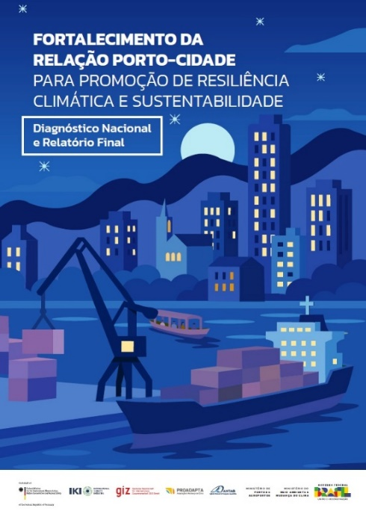
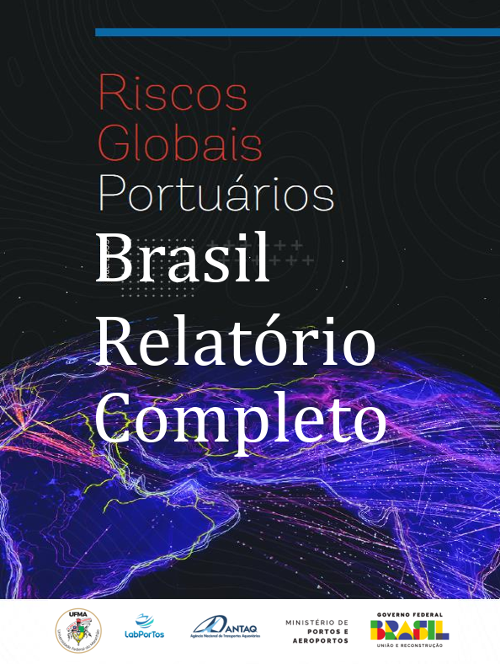
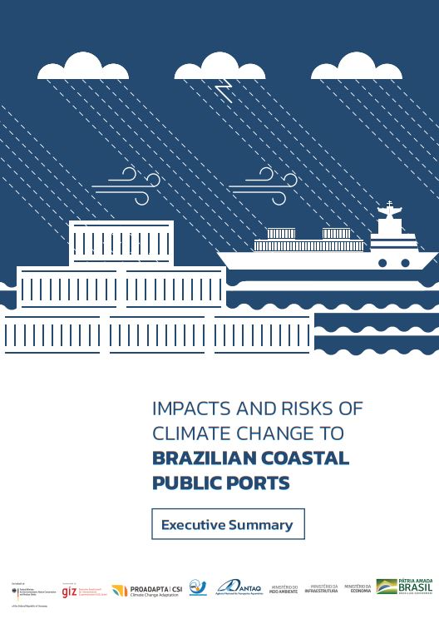
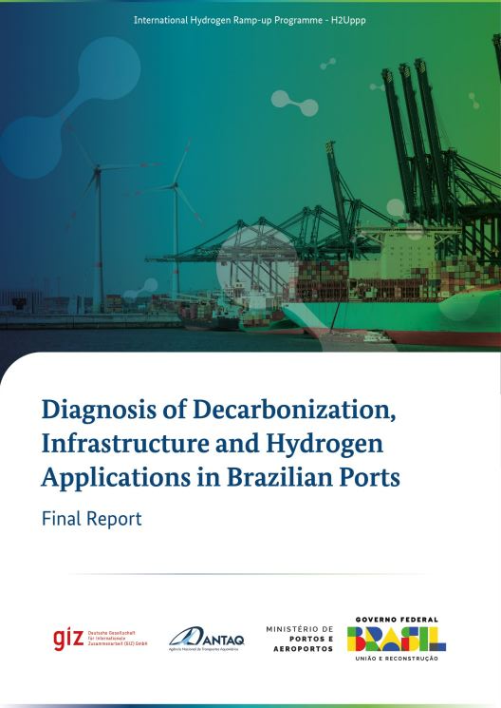
ANTAQ's Environmental and Safety Agenda
www.gov.br/antaq
Notes:
a navegação fluvial, lacustre, de travessia, de apoio marítimo, de apoio portuário, de cabotagem e de longo curso;

Slide 6


Energy Transition Framework
2015: 2030 Agenda for Sustainable Development
SDG 13 - Take urgent action to combat climate change and its impacts
SDG 13.2 13.2 Integrate climate change measures into national policies, strategies and planning
2023 IMO Strategy on Reduction of GHG Emissions from Ships
Levels of ambition:
.3 uptake of zero or near-zero GHG emission technologies, fuels and/or energy sources to increase
.4 GHG emissions from international shipping (...) to reach net-zero GHG emissions by or around, i.e. close to, 2050
www.gov.br/antaq
Notes:
a navegação fluvial, lacustre, de travessia, de apoio marítimo, de apoio portuário, de cabotagem e de longo curso;

Slide 7
Energy Transition Framework
2023: Diagnosis of Decarbonization, Infrastructure and Hydrogen Applications in Brazilian Ports
Possible actions for Ports and Terminals to advance in the emissions reduction strategy:
Prepare the GHG Emissions Inventory of port facilities;
Robust assessment of Scope 3 of existing GHG Emissions Inventories;
Auditing and publication of reports for greater reliability and transparency of GHG emissions inventories;
Mapping of opportunities for GHG emission reduction; and
Preparation of cost-benefit analysis of emission reduction measures.
Diagnosis and Planning: preparation of GHG emissions inventories (Scopes 1, 2 and 3), aligned with recognized methodologies such as the GHG Protocol and IPCC guidelines, and development of decarbonization plans.
www.gov.br/antaq
Notes:
a navegação fluvial, lacustre, de travessia, de apoio marítimo, de apoio portuário, de cabotagem e de longo curso;

Slide 8
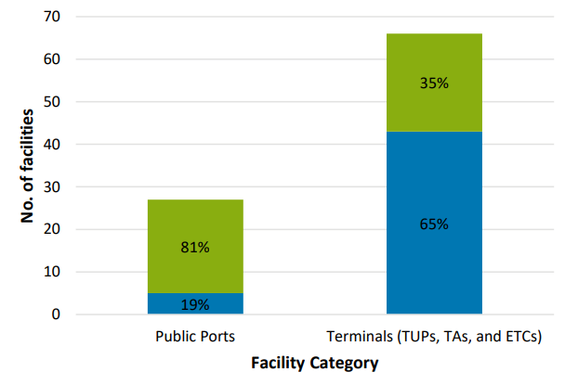
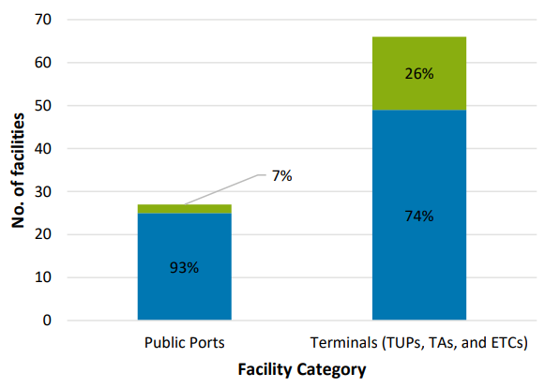



Energy Transition Framework
GHG Emissions Inventories
GHG emissions reduction target
www.gov.br/antaq
Notes:
a navegação fluvial, lacustre, de travessia, de apoio marítimo, de apoio portuário, de cabotagem e de longo curso;

Slide 9
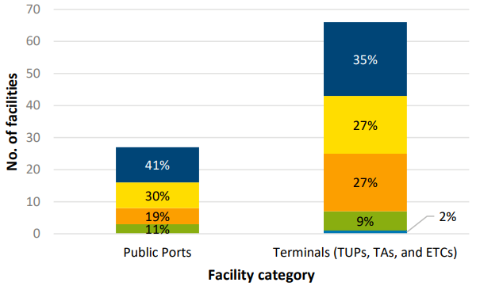
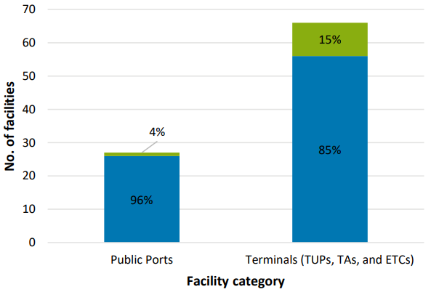


Energy Transition Framework
Fuel currently most used by vessels
Registry of ships operating on low-carbon fuel
www.gov.br/antaq
Notes:
a navegação fluvial, lacustre, de travessia, de apoio marítimo, de apoio portuário, de cabotagem e de longo curso;

Slide 10

Energy Transition Framework
2024: Interministerial Sustainability Guidelines of the Ministry of Transport (MT) and the Ministry of Ports and Airports (MPor)
"Climate change mitigation measures, such as reducing greenhouse gas emissions, are essential to minimize the transport sector's contribution to global warming.“
Planned lines of action:
Adopt measures to promote decarbonization.
Consider socio-environmental and climate parameters in contracts, concessions and leases.
www.gov.br/antaq
Notes:
a navegação fluvial, lacustre, de travessia, de apoio marítimo, de apoio portuário, de cabotagem e de longo curso;

Slide 11
Energy Transition Framework
2025: Sustainability Policy of the Ministry of Ports and Airports (Ordinance No. 58, of January 24, 2025)
Key actions that integrate the Environment and Climate Change pillar:
Promote the decarbonization of the port, waterway, air and airport transport sector; and
Adopt measures to promote mitigation and adaptation actions to climate change in the sector.
www.gov.br/antaq
Notes:
a navegação fluvial, lacustre, de travessia, de apoio marítimo, de apoio portuário, de cabotagem e de longo curso;

Slide 12
Energy Transition Framework
2025: Institutional Strategic Plan (PEI 2025-2028) of Antaq
Strategic Objective 1: Promote the transition to a more sustainable and resilient waterway sector
Key Strategic Results (KR) of note:
KR 1.1. By 2028, implement the annual collection of carbon inventory data for the port sector.
KR 1.3. From 2028 onwards, include sustainability and resilience clauses in 100% of new waterway lease and concession contracts.
www.gov.br/antaq
Notes:
a navegação fluvial, lacustre, de travessia, de apoio marítimo, de apoio portuário, de cabotagem e de longo curso;

Slide 13
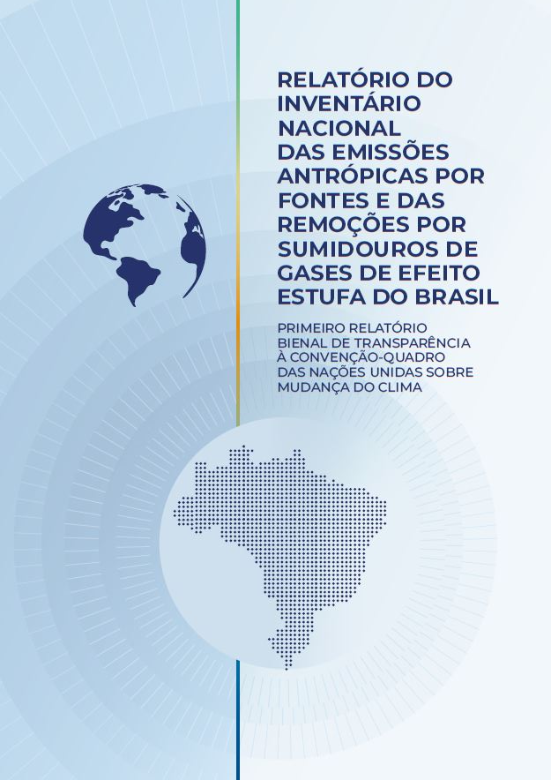
Energy Transition Framework
National Inventory Report | 1990-2022
Ministry of Science, Technology and Innovation
The Transportation category was responsible for the largest share of GHG emissions (54.9%). Within the Transportation Category:
trucks and buses 57%
automobiles 34%
air transport 4%
Cabotage and inland navigation 1.6%
rail transport contributed 1.5%
Coastal shipping and inland navigation have become more energy efficient, partly justifying the continuous decrease in GHG emissions from these modes (port traffic data vs. fuel oil consumption in waterborne transport).
www.gov.br/antaq
Notes:
a navegação fluvial, lacustre, de travessia, de apoio marítimo, de apoio portuário, de cabotagem e de longo curso;

Slide 14

Energy Transition Framework
National Climate Change Plan (Climate Plan)
Articulates federal climate action and guides the country towards the commitment to achieve net-zero greenhouse gas emissions by 2050.
2026 - Climate Mitigation Plan - Transportation Sectoral Plan
Priority Levers:
Use of low-carbon sustainable fuels
Improvement of the quality of Transport Infrastructure
Increase operational efficiency
Balancing the cargo and passenger transport matrix
Electrification
www.gov.br/antaq
Notes:
a navegação fluvial, lacustre, de travessia, de apoio marítimo, de apoio portuário, de cabotagem e de longo curso;

Slide 15
Energy Transition Framework
2026 - Climate Mitigation Plan - Transportation Sectoral Plan
Structural Actions (establish the fundamental conditions for the execution and implementation of mitigation measures):
Financial and fiscal incentives
Use of renewable energy in ports
Use of low-carbon sustainable fuels
GHG emission reduction targets for domestic shipping
Expanding access to the carbon market
Innovation in the transport sector
Regulatory limits on air pollutant emissions from vessels
Sustainable vessels in cabotage under the BR do Mar Program rule
Promotion of inland navigation
Concessions for waterway infrastructure
www.gov.br/antaq
Notes:
a navegação fluvial, lacustre, de travessia, de apoio marítimo, de apoio portuário, de cabotagem e de longo curso;

Slide 16
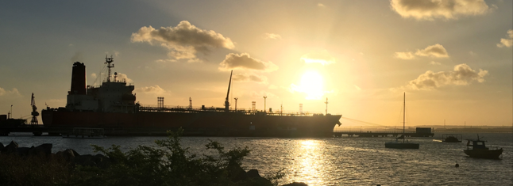
Energy Transition Framework
2026 - Climate Mitigation Plan - Transportation Sectoral Plan
Impactful actions (with a direct impact on reducing emissions or removing/capturing GHGs):
Increase the use of biofuels
Increase the use of low-carbon fuels
Increase the share of waterway transport in the cargo transport matrix
Increase the use of green diesel (Hydrotreated Vegetable Oil - HVO)
www.gov.br/antaq
Notes:
a navegação fluvial, lacustre, de travessia, de apoio marítimo, de apoio portuário, de cabotagem e de longo curso;

Slide 17





THANK YOU!
Superintendence of ESG and Innovation (SESGI)
sesgi@antaq.gov.br
+55 (61) 2029-6660
ANTAQ.oficial
@antaq_oficial
CanalANTAQ
Linkedin.com/company/antaq
@ANTAQ_oficial

